Slide 1
Shifting power to children and communities for locally owned and led child protection
#AM2025 #CPHA
Notes:
Additional hashtags to add in relation to your session: #ArmedViolence #ClimateShocks #Displacement #Escalation

Slide 2
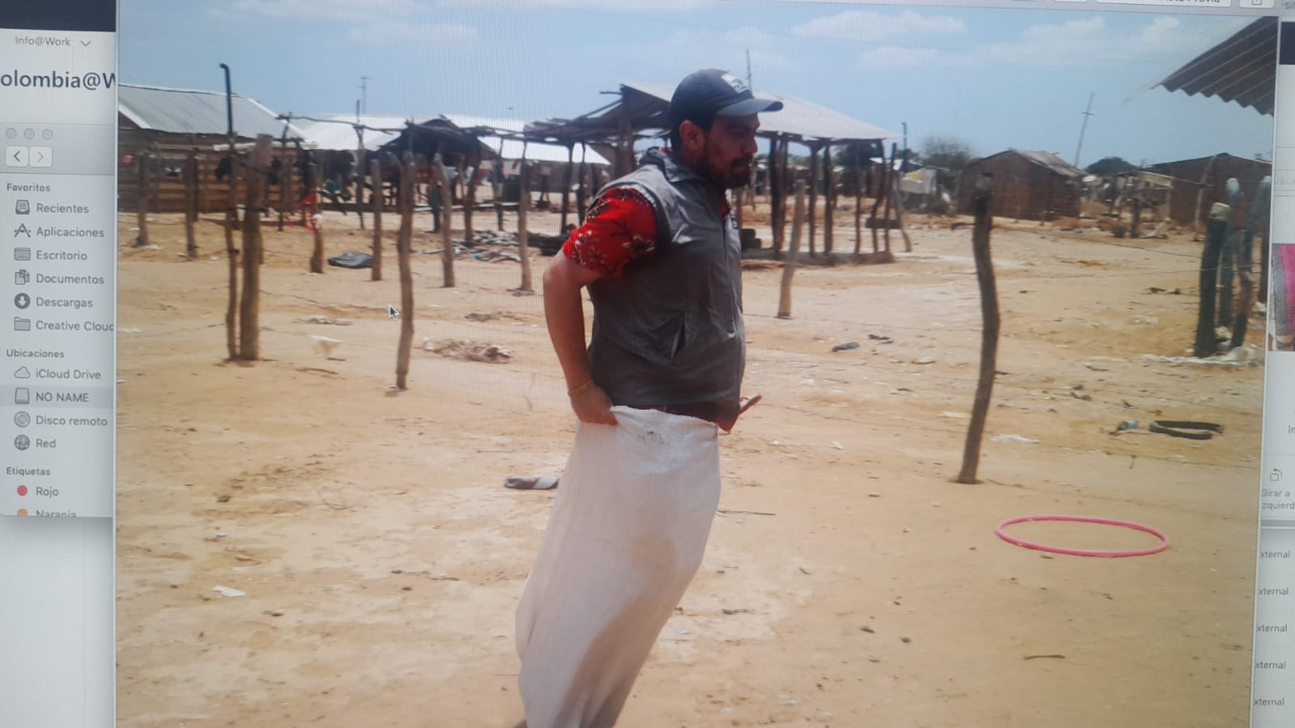
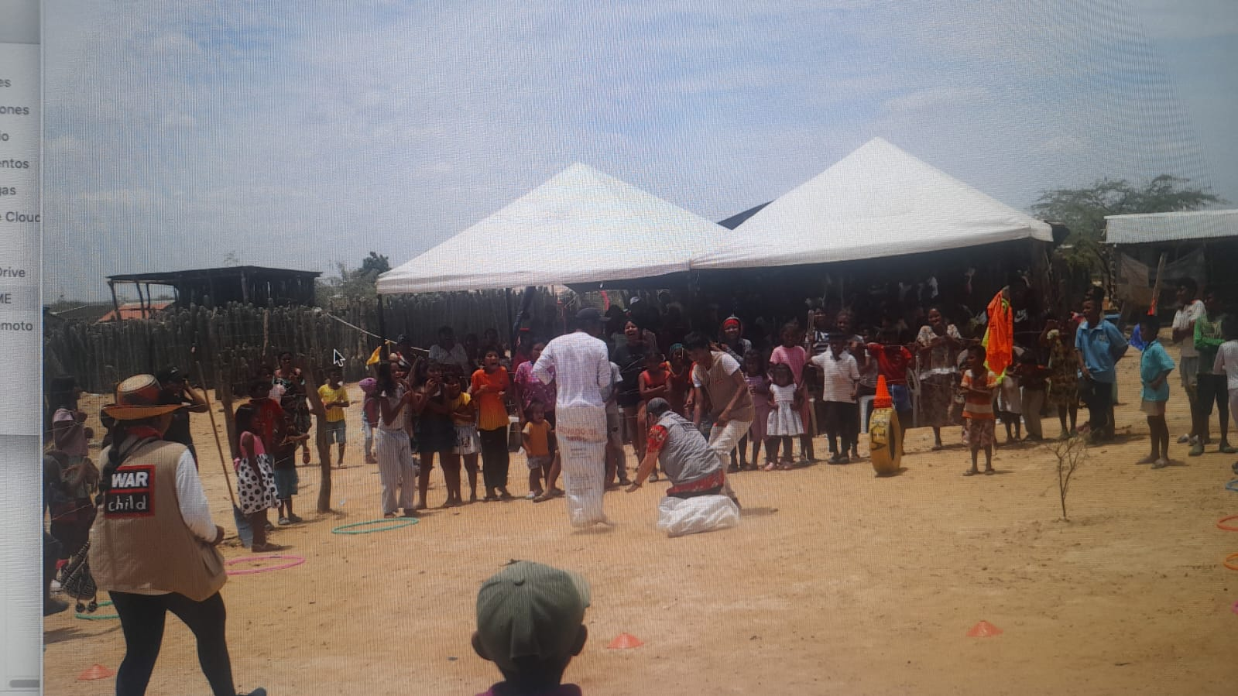
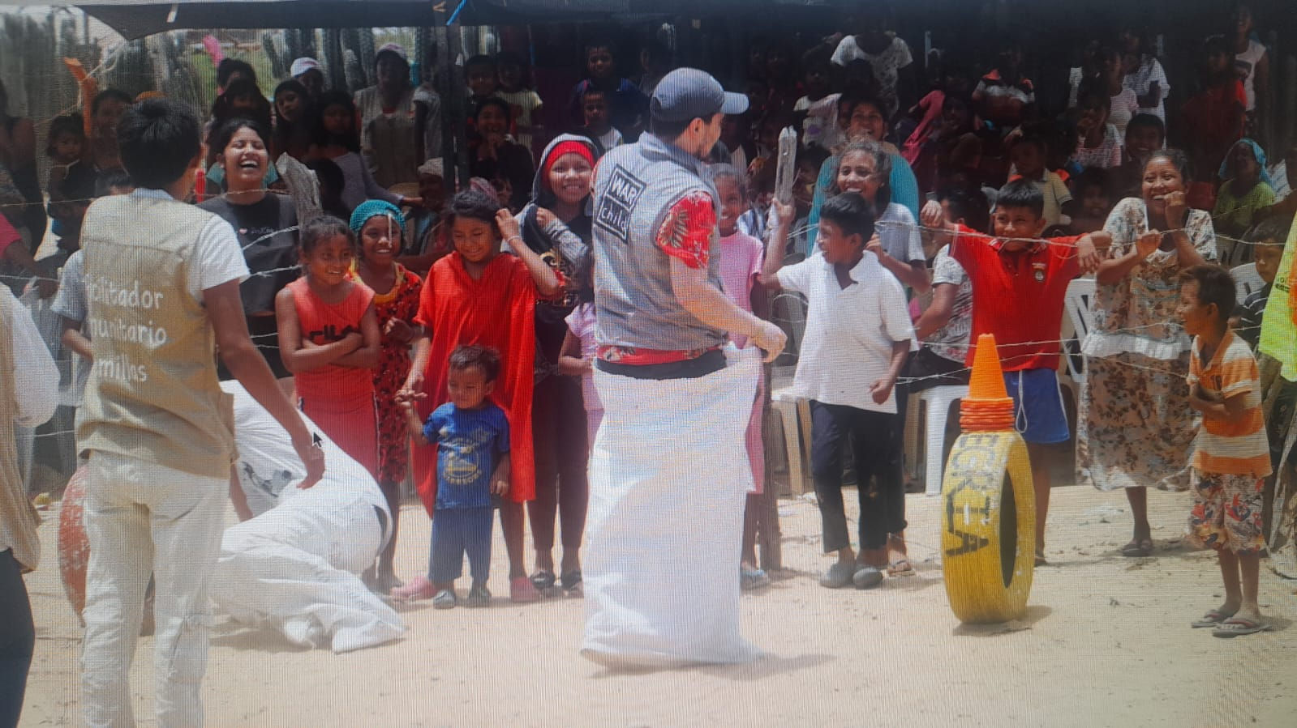
A quick introduction
Myself (situated knowledge):
Our vision of localization at War Child:
A world where affected communities, local/national actors have the autonomy, access to the necessary networks, resources and decision-making power to identify, design, collaborate and implement strategies that yield meaningful, sustainable outcomes for and with children and youth affected by conflict.
Juan José Castellanos,
Colombian,
Regional CP Advisor Africa + Colombia
War Child
juan.castellanos@warchild.net

Slide 3
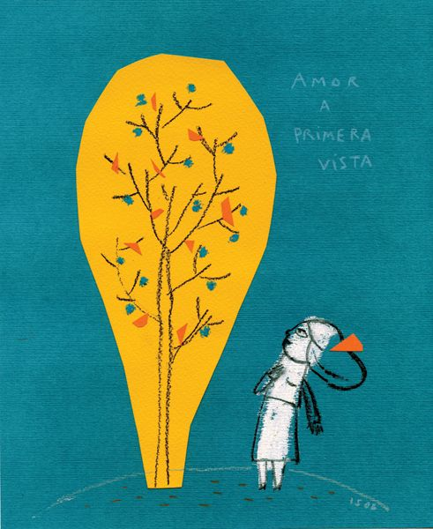
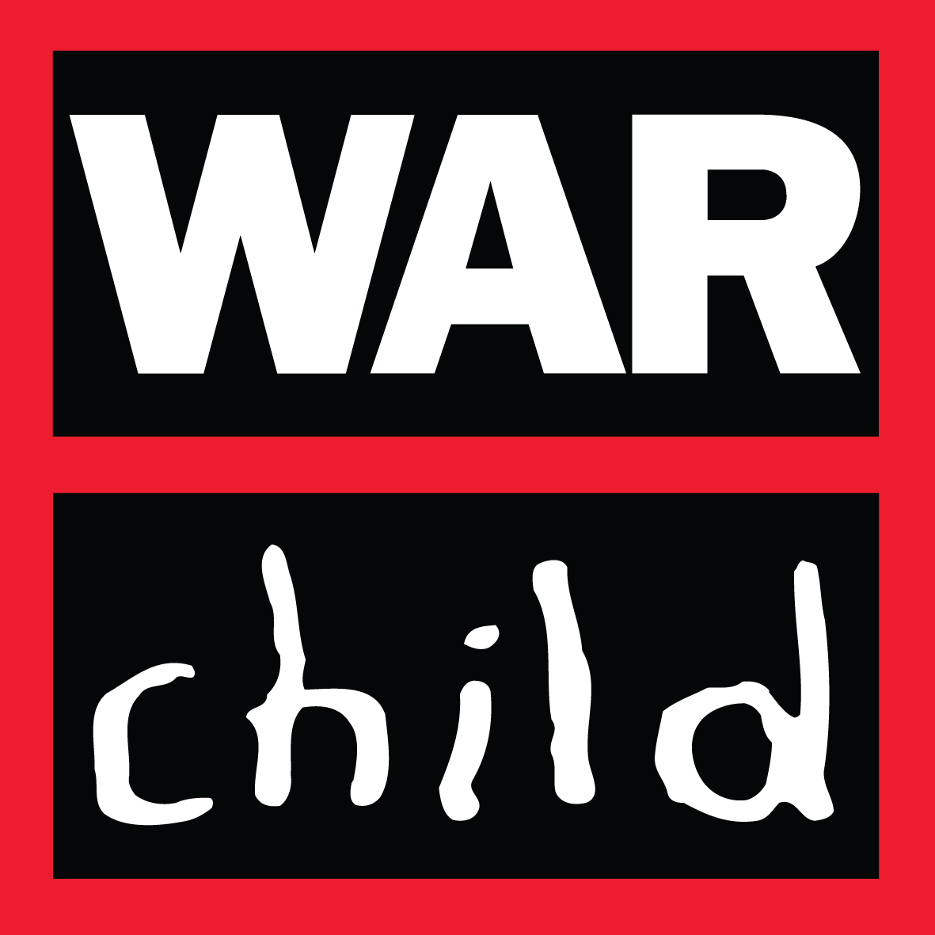
Community of practice on Community-Led Child Protection
Together we practice constant collective reflection around practice.
#AM2024 #ChildrenInCrises #CPHA

Slide 4
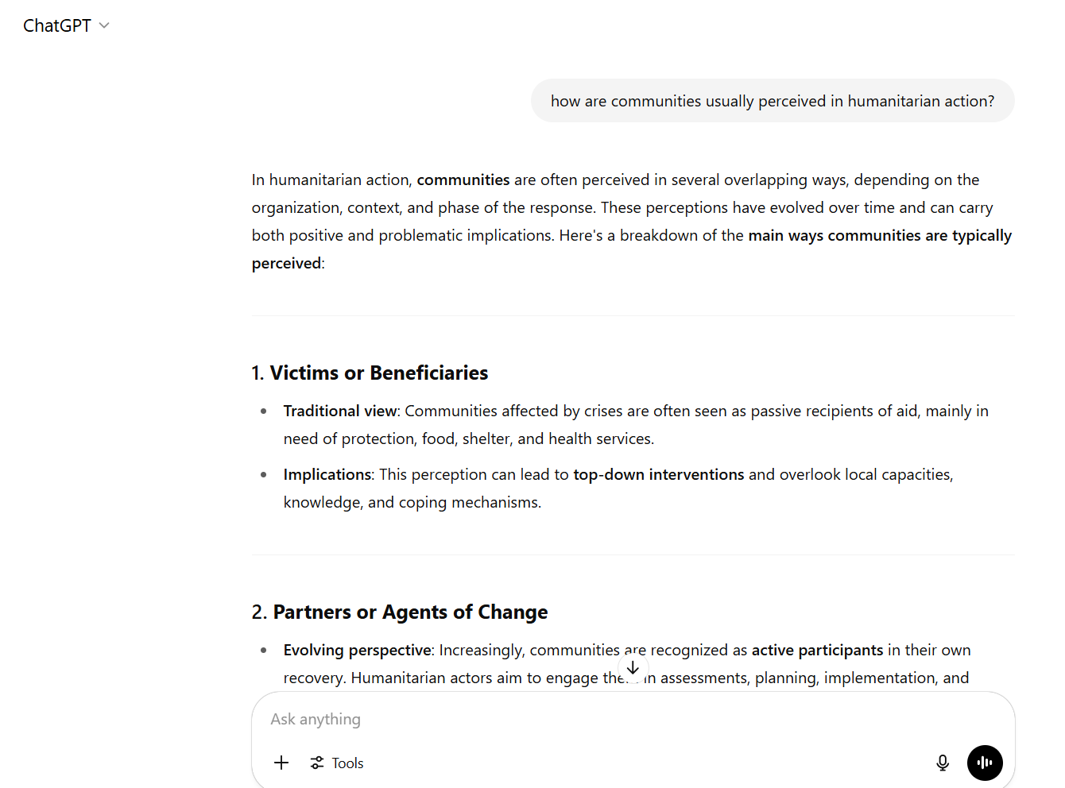
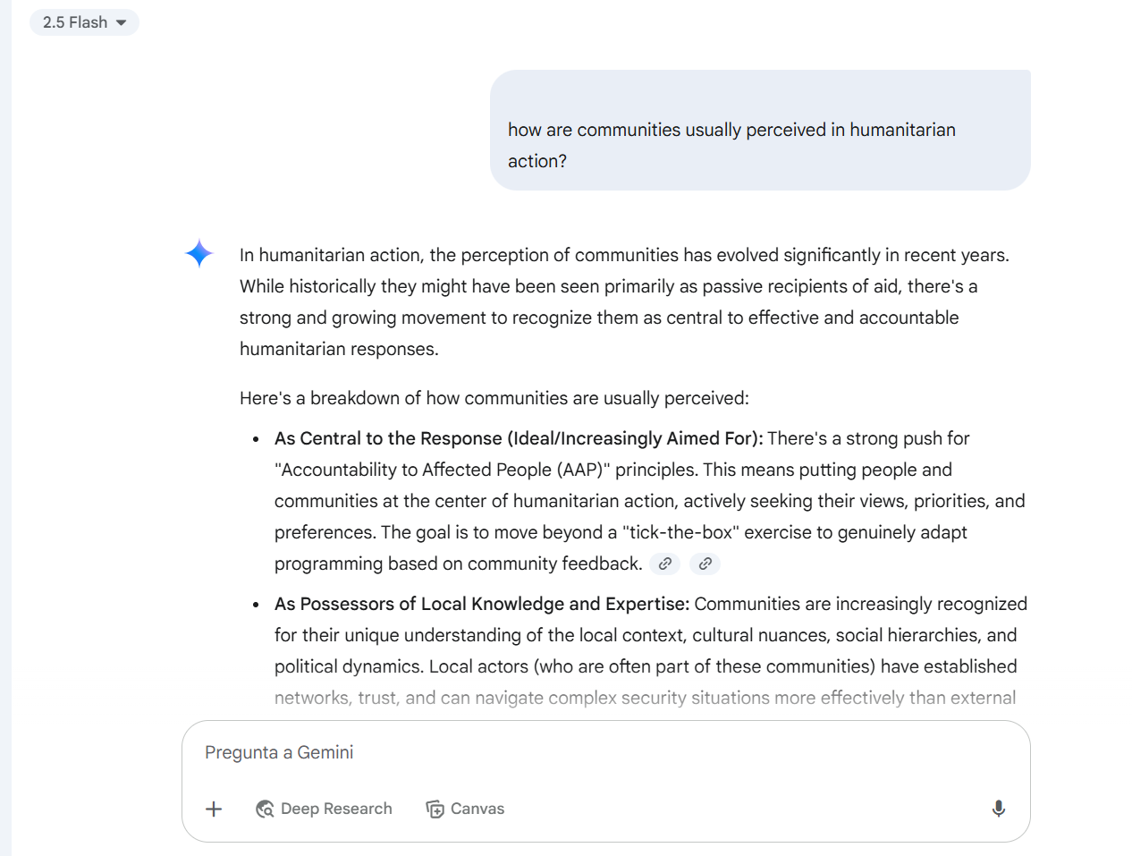
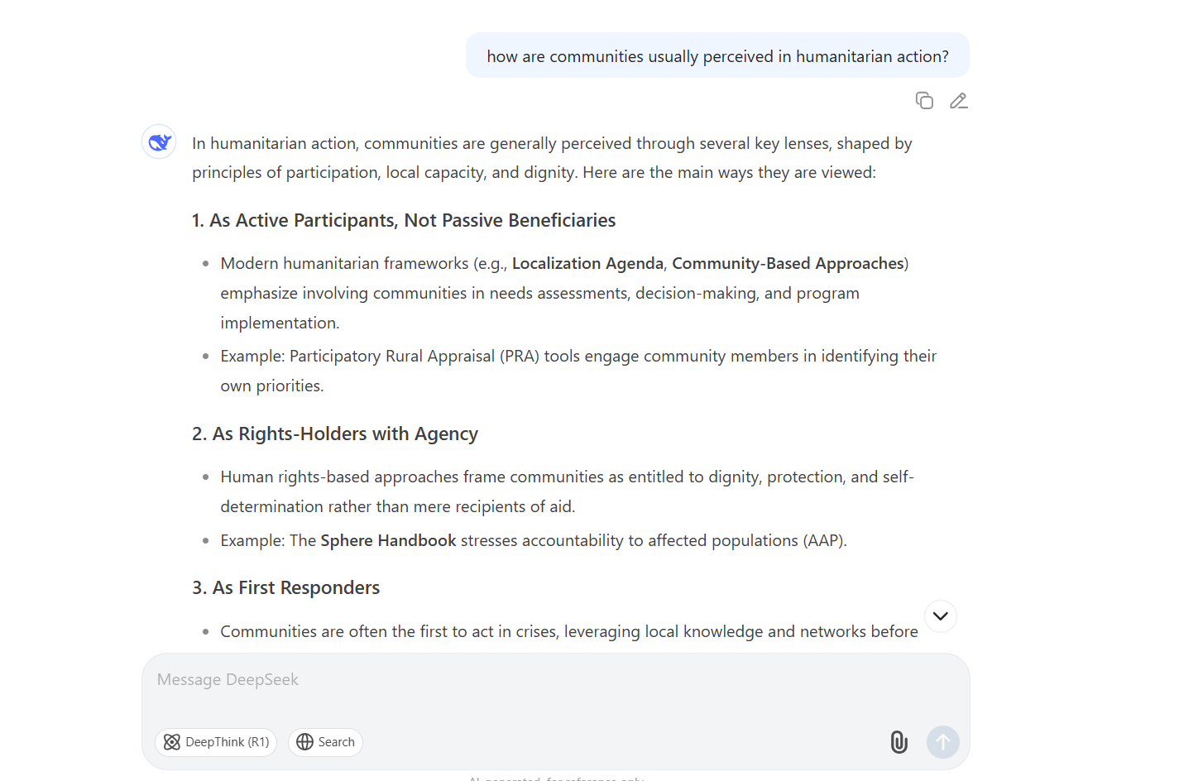
A brief reflection
#AM2024 #ChildrenInCrises #CPHA

Slide 5
What happens when we think and act on communities as passive actors?
If we think of communities as "occupiers of a passive soil" we will not acknowledge or recognize their capacity to initiate action, their historical cultural value and their possibilities to achieve change and create new possible worlds (Escobar, 2022).
Evidence reviews show that the commonly used approaches have limitations: self-silencing, backlash, weak sustainability and community ownership (Wessells, 2015).
We miss a great opportunity to shift power, to reflect and to collectively work towards achieving prevention of VACS and social and institutional change from the ground up.
Photo: Seeds participant in Cali Colombia
#AM2024 #ChildrenInCrises #CPHA

Slide 6
Understanding communities as active actors: promoting community ownership
“the extent to which communities have strong concerns about issues that affect children, see work to support vulnerable children as their own responsibility, and engage in self-motivated action to improve children’s lives”
#AM2024 #ChildrenInCrises #CPHA

Slide 7
Key messages:
Communities are key local actors too with agency to drive change.
Communities are already protecting children and have walked a path to develop self organized actions to promote child protection.
Photo: Seeds Community Dialogue in Cauca, Colombia
#AM2024 #ChildrenInCrises #CPHA

Slide 8
Key messages:
Shift decision-making power to communities for collective action.
Trust communities to lead in protecting children.
Take a strengths-based rather than a deficit-based approach.
Strengthen institutional learning and change mindsets to remove barriers that limit the promotion community ownership.
Shift from an expert-led approach to a facilitation approach
Photo: Seeds Community Dialogue in Cauca, Colombia
#AM2024 #ChildrenInCrises #CPHA

Slide 9
Constant individual and collective reflection as a pathway for learning.
Our collective pathway:
True change begins within. To shift child protection programming in a meaningful way, we must first reflect honestly on our own assumptions, roles, and ways of working.
Individual and Collective reflection
Research and Development
Learning from Practice
#AM2024 #ChildrenInCrises #CPHA

Slide 10
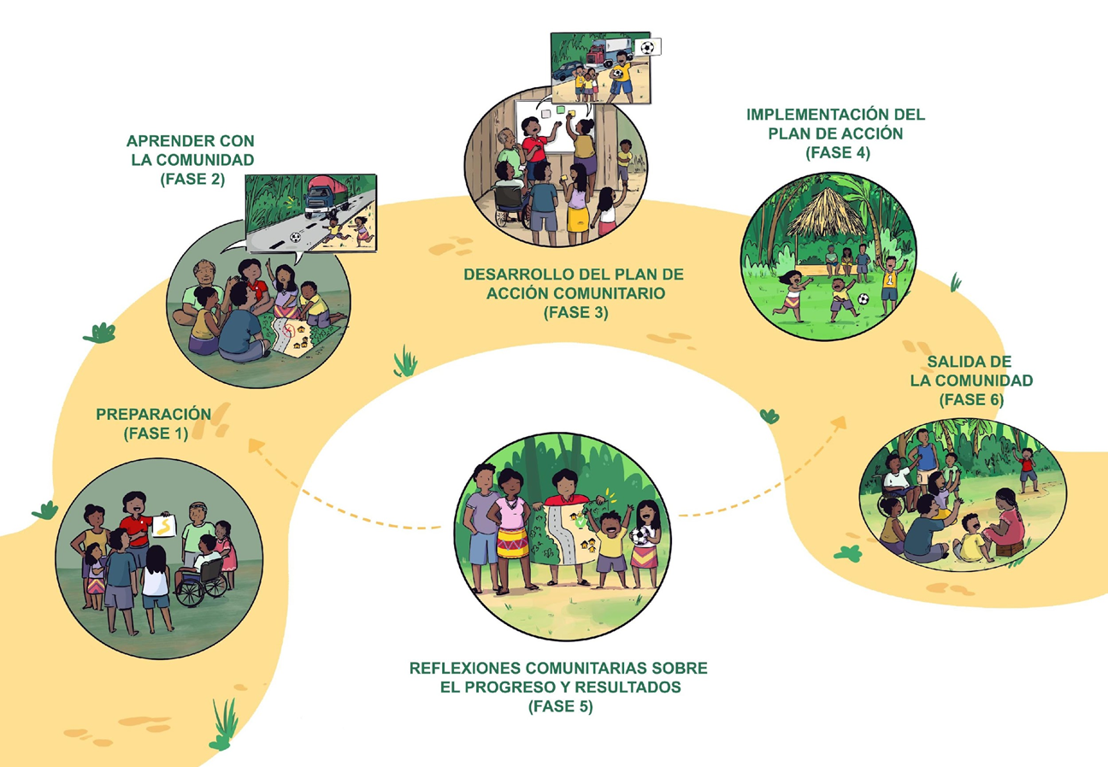
Community Led Child Protection: Facilitating community ownership of CP.
Our experience from practice and research:
#AM2024 #ChildrenInCrises #CPHA

Slide 11
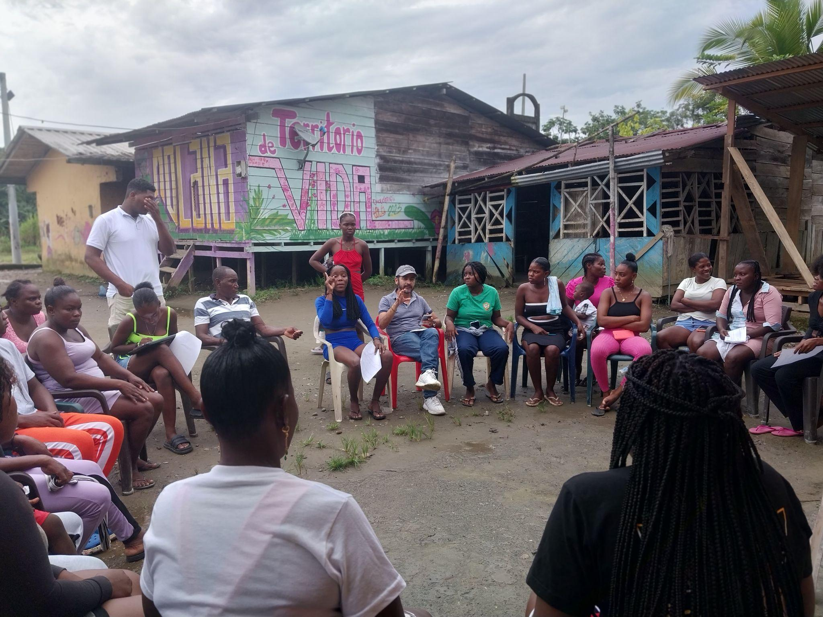
Added value in the times of a humanitarian reset:
Shifting power to communities
Re-imagining the sector based on good practices and evidence:
“We must both regroup and renew at the same time. I propose we do so on the foundation of three strategic priorities: the best possible crisis response with the resources we have; urgent work to reform and reimagine how we work; and shift power to our humanitarian leaders in country, and the people we serve.” (Tom Fletcher, 2025)
Central question: who holds the power to take decisions? “if it doesn’t come from a community it isn’t a community led approach
Sustainability + cost effectiveness. Evidence of impact.
Collective effort and mutual support:
Connection of systems for sustainability:
Communities as agents that drive change.
communities on the driver’s seat
Photo: Seeds Community Dialogue in Chocó,, Colombia
#AM2024 #ChildrenInCrises #CPHA

Slide 12
A message from the communities:
“Now there is greater interest in community issues. Before, they (the community members) didn't give their opinion, now they propose things and say what they think [...] Among the mothers, they are exchanging to teach something to the children and teenagers per week."
Photo: Seeds youth participants, Cali, Colombia
#AM2024 #ChildrenInCrises #CPHA

Slide 13
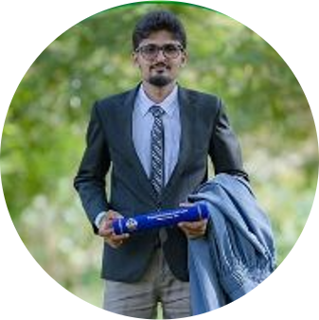
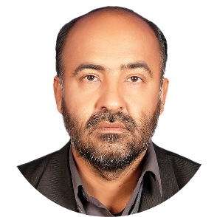
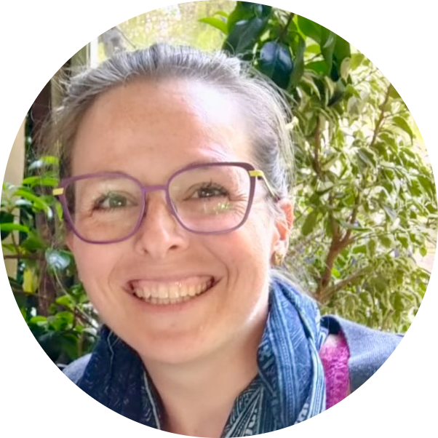
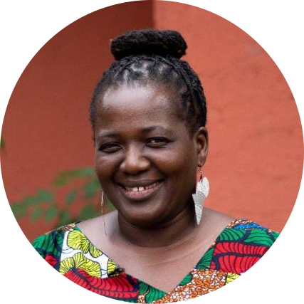
Our Speakers:
Rannulu Keshan Hirantha Dheerasingue De Zoysa
Youth Leader Sri Lanka
Atta ul Haq Khaderzai
Founder and Technical advisor of the Youth Association for Development (YAD) Pakistan
Connolly Butterfield
Senior Program Manager-Protection at InterAction
Amé Atsu David
Africa Regional Co Director Global Fund For Children Liberia

