Slide 1
Primary Prevention in the Programme Management Cycle

Slide 2
What are the Programme Management Cycle Steps?

Slide 3
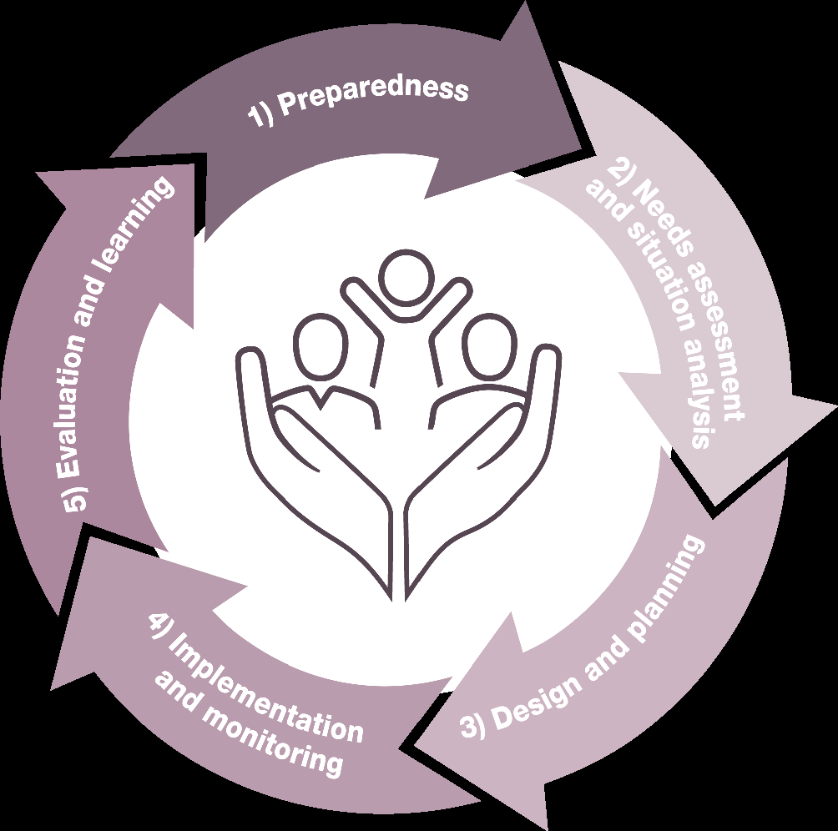
What are the Programme Management Cycle Steps?

Slide 4
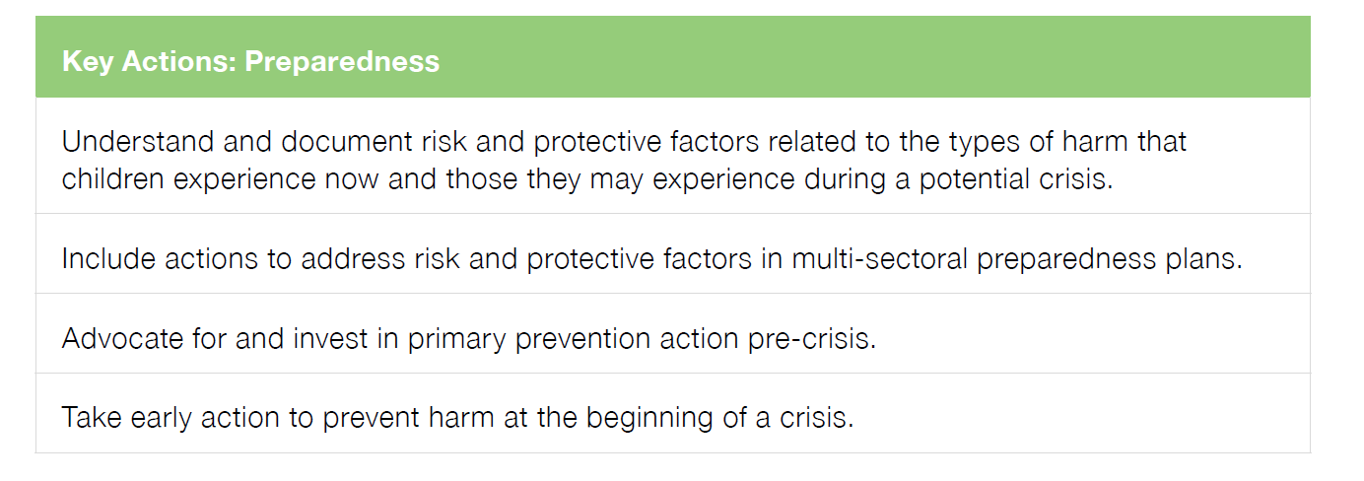
Step 1
Preparedness
Notes:
Emergency preparedness is the activities and measures taken before a crisis to ensure a rapid and
effective response.

Slide 5
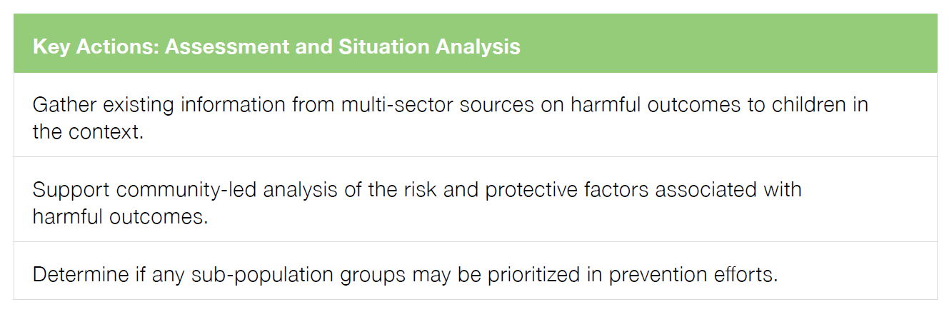
Step 2
Assessment and Situation Analysis
Notes:
A primary prevention approach is based on a comprehensive analysis of the risk and protective
factors that impact whether children experience harmful outcomes. It goes beyond the question
of “What are the harmful outcomes to children occurring in this context?” (e.g., child marriage,
violence in schools, recruitment in armed forces, family separation). Prevention programming also
needs to know:
• “What are the risk factors leading to harmful outcomes for children?” and
• “What are the protective factors that can prevent children from experiencing harmful outcomes?”17

Slide 6
Step 3
Design and Planning

Slide 7
Step 4
Implementation and Monitoring

Slide 8
Step 5
Evaluation and Learning

Slide 9
Next Steps

Slide 10
Setting: 1 | Setting: 2 | Setting:3

