Slide 1
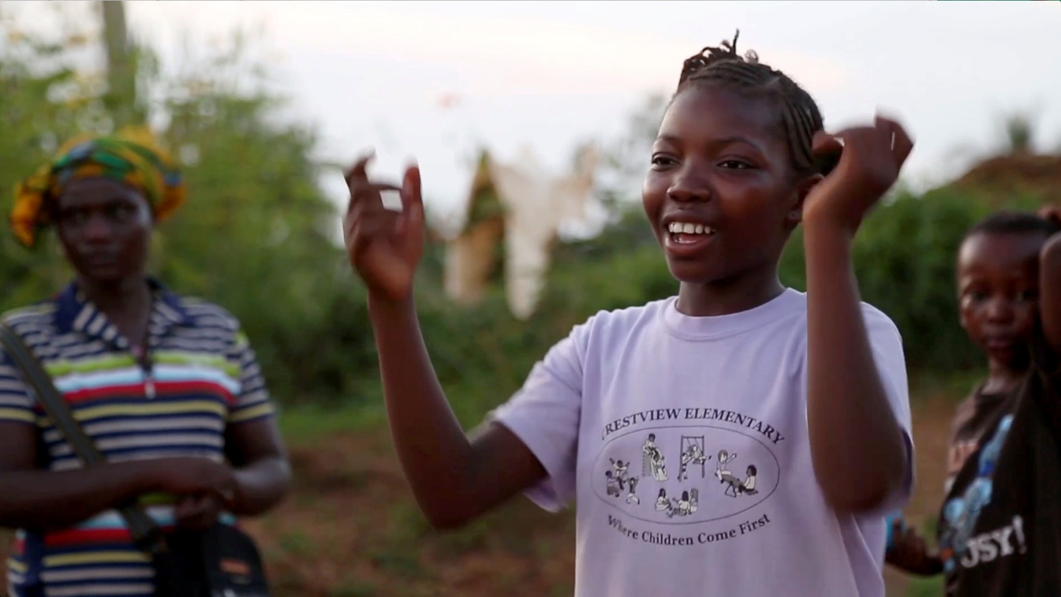
The Basics of Psychological First Aid (PFA)

Slide 2
Learning Outcomes
Understand the basics of PFA
How to apply PFA to the work with OICCs

Slide 3
What is Psychological First Aid?
“A description of a humane, supportive response to a
fellow human being who is
suffering and who may need support.”
From WHO, War Trauma Foundation and World Vision International (2011),
based on Sphere (2011) & IASC MHPSS Guidelines (2007)

Slide 4
PFA involves…
Giving practical care and support that does not intrude
Assessing needs and concerns
Helping people access basic needs (e.g. food and water)
Comforting people and helping them to feel calm
Helping people connect to information, services and social supports
Protecting people from further harm
Notes:
It is not counselling or clinical in nature

Slide 5
PFA is not...
Something only professionals can give
Professional counselling
A clinical or psychiatric intervention (although it can be part of good clinical care)
Psychological debriefing
Asking someone to analyse what happened to them or to put time and events in order
Pressing people to tell you their story
Asking people details about how they feel or what happened

Slide 6
Common reactions of all age groups
Signs of fear that the event will take place again
Worry that their loved ones or they themselves will be hurt or separated
Reactions to seeing their community destroyed
Reactions to separation from parents and siblings
Sleep disturbances
Crying

Slide 7
What experiences do you think impact how children react?
Loss of one or more family members or friends
Seeing seriously injured or dead bodies
Family members who remain missing after the event, including when their body has not been recovered, but they are presumed dead
Becoming hurt or sick because of the disaster or other event
Being unable to evacuate quickly
in a life-threatening situation
Trapped, delayed evacuation
Loss of home, school, belongings
Loss of pets
Previous experiences with loss, stressful events and other difficulties

Slide 8
Children at high risk of strong reactions are children who...
Are separated from their family or care-givers
Have watched loved ones or others being hurt or killed
Have been physically hurt
Feel threatened
Are worried and concerned because their parents or care-givers are grieving or concerned too
Feel guilty about surviving when others died

Slide 9
Children with obvious signs of distress...
Have physical symptoms of not feeling well, such as shaking, headaches, loss of appetite, aches and pains
Cry a lot
Are hysterical and panicking
Are aggressive and try to hurt others (hit, kick, bite, etc.)
Cling continuously to their care-givers
Seem confused or disorientated
Appear withdrawn or very quiet with little or no movements
Hide or shy away from other people
Do not respond to others, do not speak at all
Are very scared
Notes:
Again these can be all normal reactions.

Slide 10
Children with obvious signs of distress...
Under 6: Change in sleep habits; nightmares; sleep terrors; inability to sleep through out the night; inability to sleep without someone's presence or light; Crying in various forms – more than usual (previously)
Regressive behaviour: some behaviour may reappear - thumb sucking; bed wetting; loss of bowel/bladder control; fear of darkness or animals; fear of being left alone or crowds/strangers; inability to dress or eat without help; excessive clinginess
6 to 12: bedwetting, sleep terrors, sleep problems, weather fears, irritability, disobedience, depression, headaches, excessive clinginess, nausea, eating problems, problems in school (refusal to go to school, poor performance, fighting, lack of interest, inability to concentrate, distractibility, peer problems)
12 to 17: Withdrawal and isolation, physical complaints, depression and sadness, antisocial behaviour, school problems, sleep issues, confusion.

Slide 11
Culturally specific behaviour?

Slide 12
What are the obvious signs of distress in parents and care-givers?
May have the same reactions as children
More?
May not be able to care for themselves or their children
Cultural reactions?
What would that look like?

Slide 13
Action principles for PFA for children
Look
Listen
Link

Slide 14
Look…
Check for safety
Look for children with obvious urgent basic needs
Look for children, parents and care-givers with serious distress reactions

Slide 15
Listen…
Approach children and parents or case-givers who may need support
Ask about children and parents’ or care-givers’ needs and concerns
Listen to children and their parents or care-givers, and help them feel calm

Slide 16
Link…
Help children and their families to address basic needs and access services
Help children and their families cope with problems
Provide information
Connect children and their families with each other, and with social support

