Slide 1
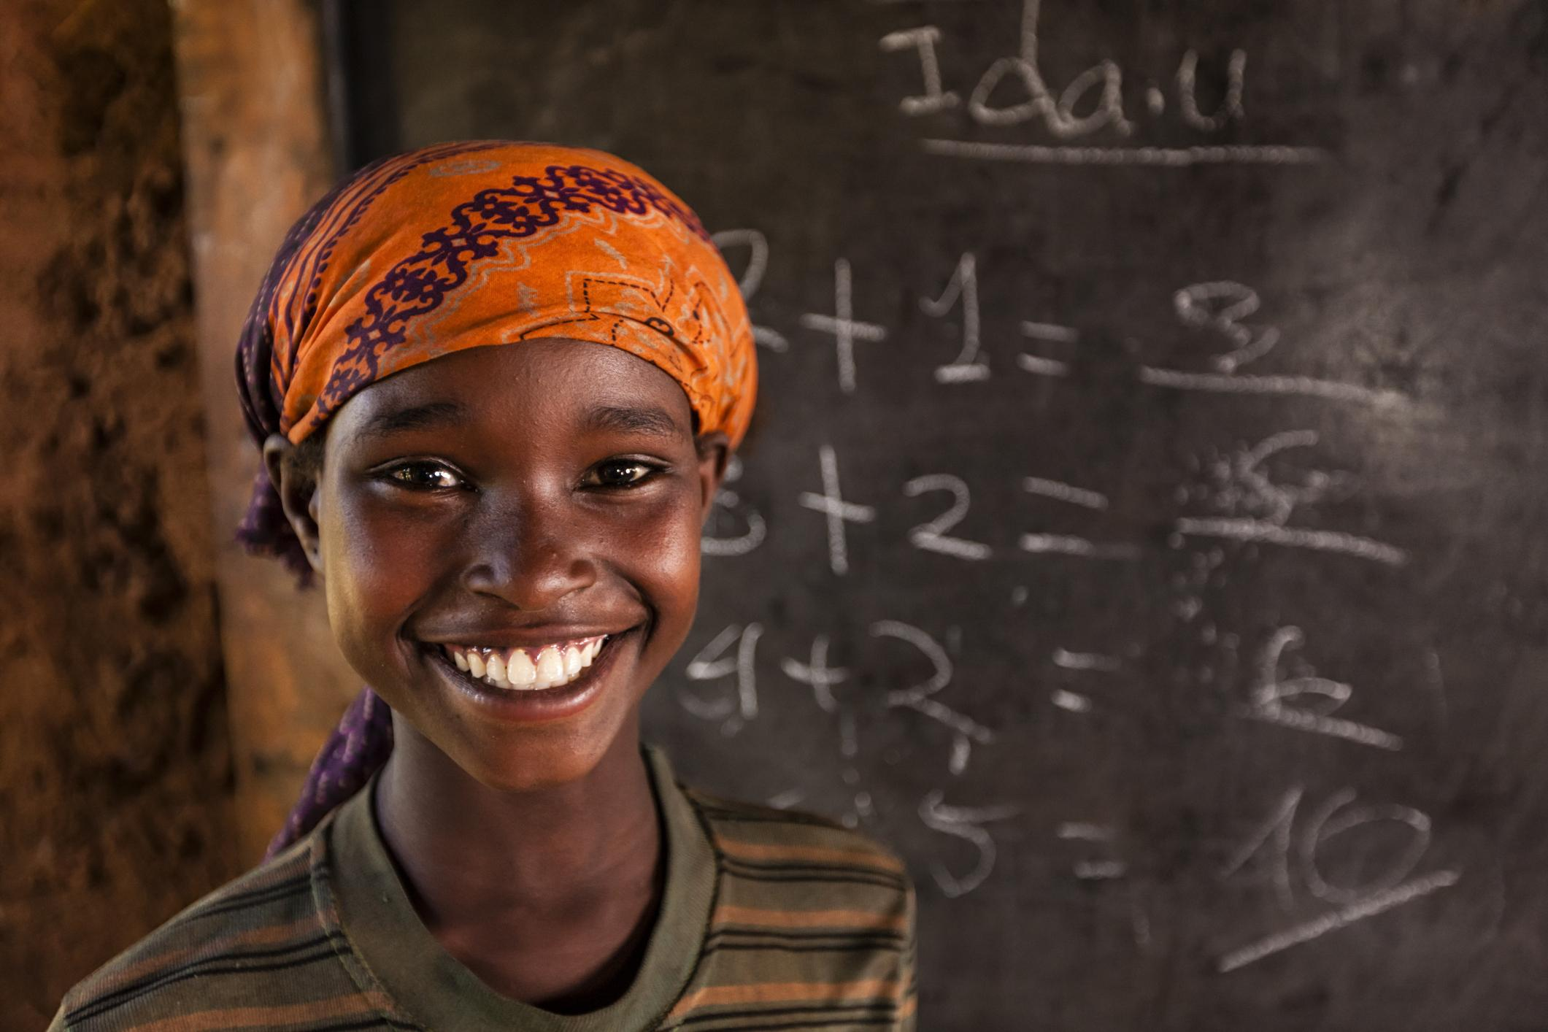
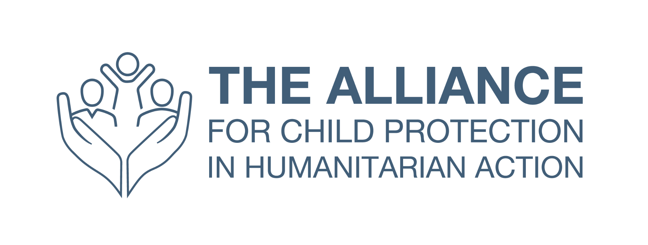
PRIMARY PREVENTION IN CHPA: ORIENTATION SESSION
Notes:
Instructions for use:
This orientation session targets the following audiences:
Coordination groups (inter-agency working groups, clusters etc.)
Internal stakeholders (NGOs country management teams) and
External stakeholders (other NGO actors and government actors)
It is not meant to be used with child protection actors, as they will be assumed to have a different baseline of knowledge. This orientation session is designed to be delivered in as little as 20-30 minutes (for example, during a national-level cluster meeting) and up to an hour (for a more targeted orientation). This orientation is meant to be used as a guide and can be tailored as necessary for the intended audience.

Slide 2
Agenda
Introduction to primary prevention in humanitarian settings
Overview of the three levels of prevention
Defining key terms: harmful outcomes, risk factors, protective factors
The role of CP actors in primary prevention
Your role in primary prevention

Slide 3
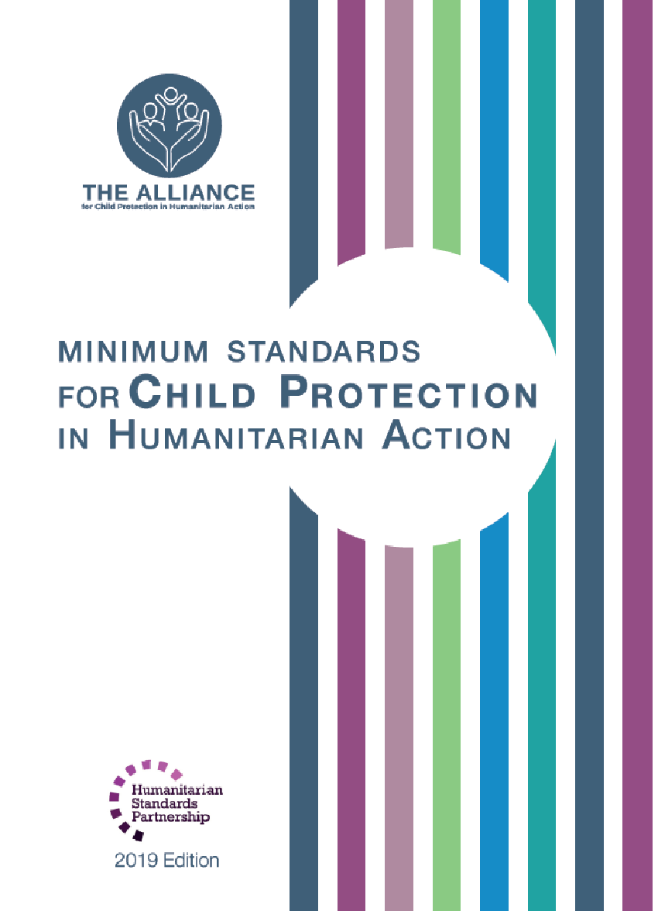
What is Child Protection in Humanitarian Action?
Child protection is the “prevention of and response to abuse, neglect, exploitation, and violence against children”.

Slide 4
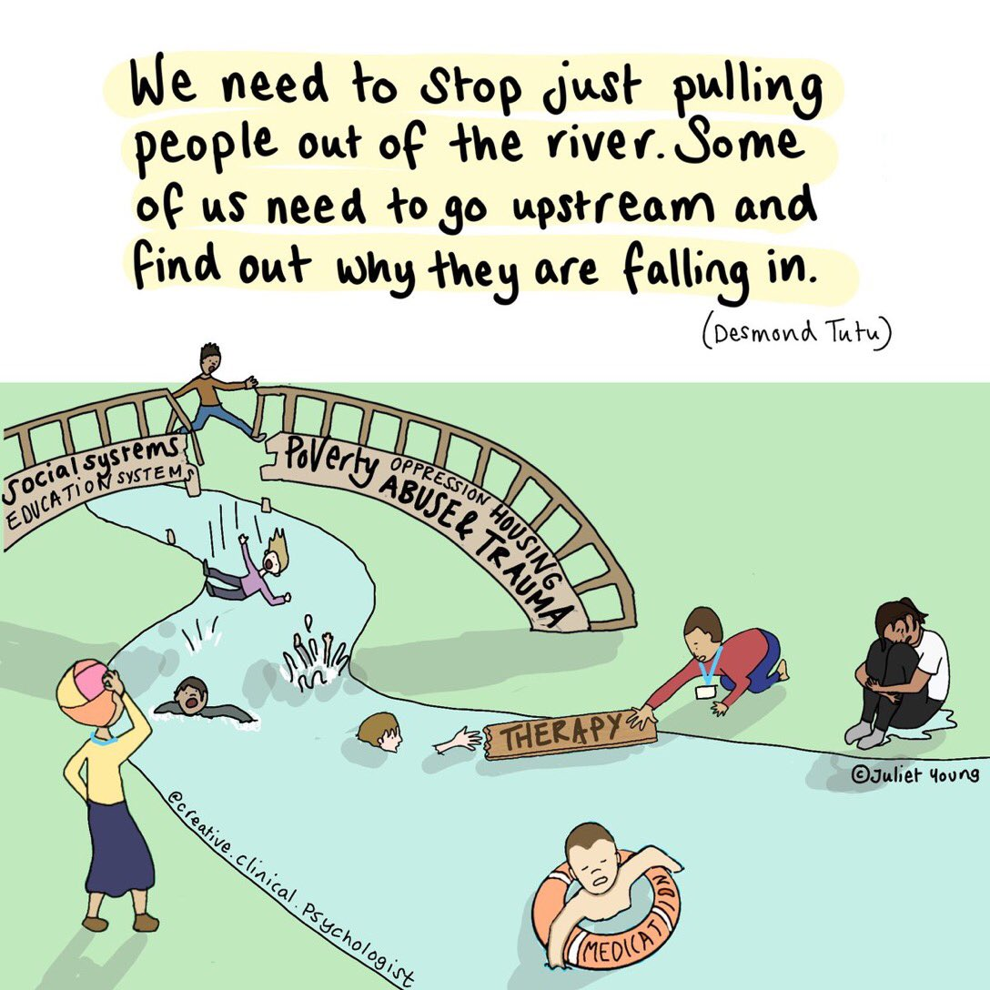
Prevention
Taking action to stop harm (to children) before it occurs
Notes:
For a simple summary video, go here: https://www.youtube.com/watch?v=vpJ4h8sxOJg
Prevention seeks to avoid harm happening before it can occur by addressing the root causes within a population or community.
All sectors working in humanitarian settings share a common responsibility under the Centrality of Protection principle to place protection, including children, at the centre of humanitarian action.
All humanitarian actors have a common ethical responsibility to prevent harm to children before it occurs. An integrated approach to primary prevention also improves the sustainability and long-term impact of humanitarian responses and increases the cost-effectiveness of programming.

Slide 5
What is Primary Prevention?
Primary Prevention: seeks to avert harm before it occurs by addressing the root causes of harmful outcomes to children within a population or community.
It does this by:
Reducing risk factors which are threats and vulnerabilities that increase the probability of a harmful outcome happening, and
Increasing protective factors which are capacities to mitigate specific threats in a child’s environment.
Notes:
facilitator notes:
both risks and protective factors can be found at different levels of the socio-ecological model, for example:
Protective factors:
Individual level: ability to form meaningful relations at least with one person / a sense of self-esteem /hope, faith and optimism
Family level: caregiving in early life by at least one consistent and responsible caregiver/opportunities to develop problem-solving/trust and support by peers
Community level: opportunities to acquire skills and knowledge/access to effective formal and non-formal education/age-appropriate opportunities to contribute to community well-being
Society: access to formal and non-formal education/access to quality basic services (health, shelter, water and sanitation)
Risk Factors:
Individual level: premature birth, low birth weight/disability or psicosocial disorder/harmful use of alcohol or drug abuse
Family level: Lack of responsible and consistent caregiving in early life/family separation temporary or permanent/exposure to interpersonal violence including genrder or sexual violence/harmful social or gender norms/unmet basic needs or neglect/child marriage
Community level: lack of or loss access to formal and non-formal education/unmet basic needs/exposure to estructural, social or interpersonal violence/loss of community connections/high community crime rates
Society level: lack of loss of access to basic services/lack of or loss of access to formal and non-formal education/lack of social protection systems

Slide 6
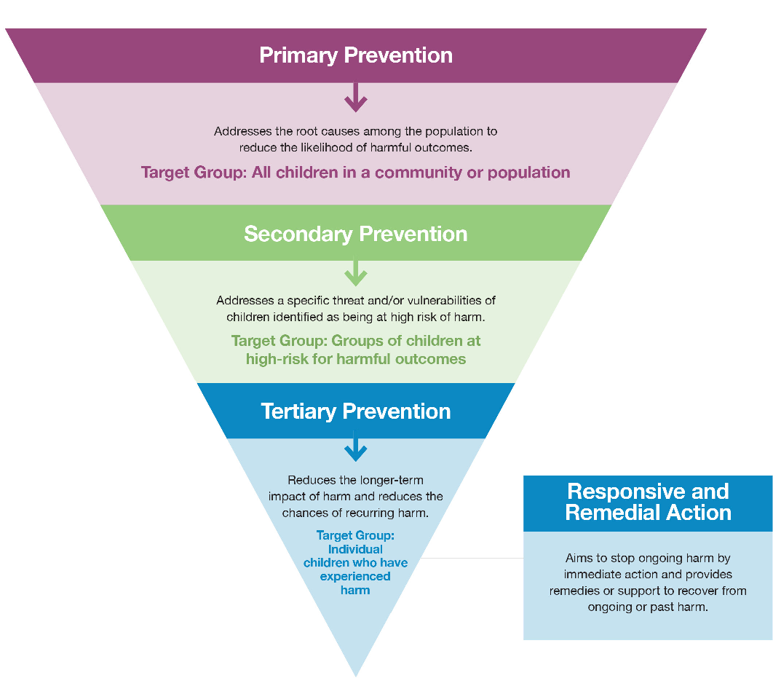
The Three Levels of Prevention
Notes:
According to the Minimum Standards for Child Protection in Humanitarian Action (CPMS) there are three levels of prevention. While a comprehensive approach including the three layers is needed, this brief explains why shifting to invest in and commit to primary prevention to address root causes of harm to children is paramount.
Primary Prevention: seeks to prevent harm before it can occur by addressing the root causes of harm to children within a population or community. Target: All children.
Secondary Prevention: addresses a specific threat and/or vulnerability of children who have been identified as being at high risks of harm. Target: children already identified at risk.
Tertiary Prevention: is directed to children who have already experienced harm to reduce the negative effects and minimise the chances of recurring harm. Target: children who had already experienced harm.

Slide 7
Population Approach
Primary prevention aims to reduce the risk of harm for all children within a population or a subgroup of the population.
A population can refers to a whole society or community. For example, the entire population of a refugee camp or all of the people living in a village. This would be inclusive of all the children in this refugee camp or village.
A subgroup or subpopulation refers to a specific demographic or group within that population. For example, all children under five living in the refugee camp or all adolescent girls living in the village.
Notes:
Facilitator notes:
when explaining the concepts of population and subpopulation the facilitator can refer to page 10 of the PPF for further insights.
In order to help participants to better understand the concept of “population approach”, the following example of a common CPHA intervention touching upon the 3 levels of prevention can be given to participants:
Dignity Kit Support: Dignity kits are a common tool to respond to and prevent GBV in humanitarian settings. Under CPHA programming, dignity kits can be a key tool to keep girls in school and to support girls experiencing a harmful outcome
Dignity kits as a primary prevention intervention (population level): Dignity kits are distributed to all adolescent girls in a refugee camp to support school attendance and mitigate the risk of school drop out.
Dignity kits as a secondary prevention intervention (girls at risk of harm): Targeted dignity kits are distributed to adolescent girls that meet a specific eligibility vulnerability criteria and are therefore at greater risk of dropping out of school.
Dignity kits as a tertiary prevention intervention (children who have already experience harm): An adolescent girl survivor of SGBV supported through case management receives a dignity kit as part of her case plan.
Below are two concrete examples of common CPHA interventions at a primary (population or sub-population), secondary (at-risk of harm), and tertiary (children who have experienced harm) prevention level.

Slide 8
Notes:
facilitators notes:
the use of the video is option and will depend on the time you have available. If the time allows, you can foster participants discussion on what they have learned from the video

Slide 9
Primary Prevention Principles
Notes:
Facilitators notes: this are the 9 key principles that should be taken into account and be applied in each step of the process. You can find further information in page 12 of the revised PPF. Of special relevance since this is orientation session is addressing non child protection actos is number 3 “ use a holistic, multi sectoral approach”. The key main actions under thai principle are the following.
Compile and analyze existing data on child well-being and harmful outcomes in all multi-sector assessments and monitoring systems.
Conduct multi-sectoral analysis of risk and protective factors to develop joint theories of change on preventing harmful outcomes to children as well as joint program outcomes and indicators.
Determine which sectors should be involved in prevention efforts based on the major risk and protective factors identified in context.
Jointly design integrated primary prevention programs with other sectors

Slide 10
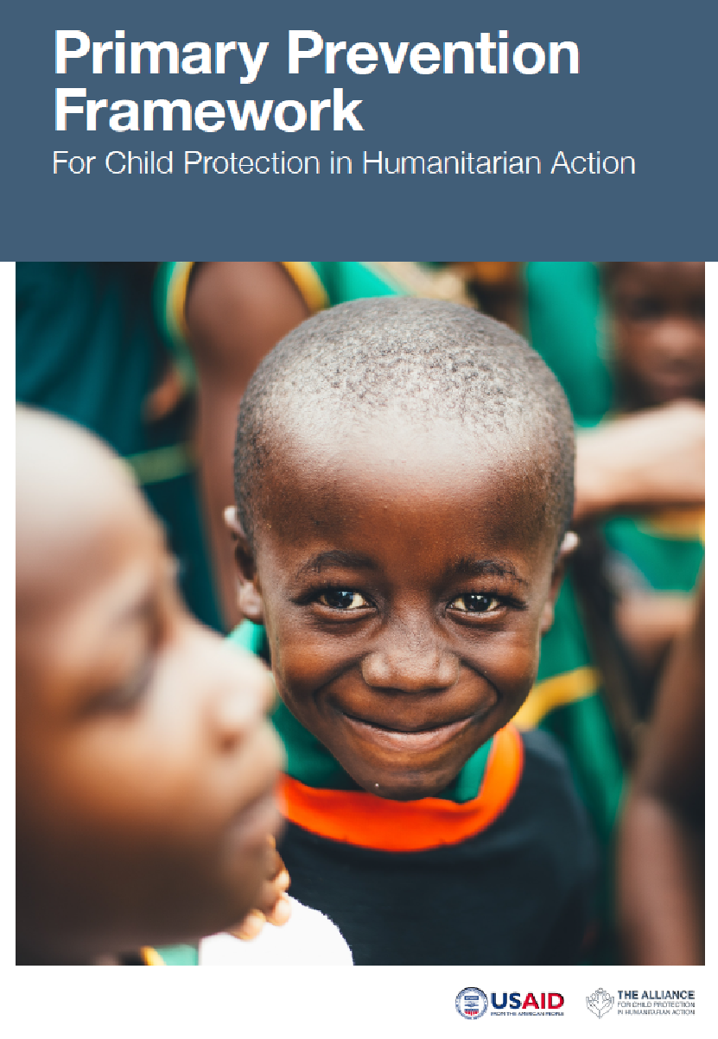
The Primary Prevention Framework
The Primary Prevention Framework was developed by the Prevention Initiative of the Alliance for Child Protection in Humanitarian Action in 2022
The Prevention Initiative revised the Framework in 2024 following field testing in two humanitarian contexts
The Framework outlines the nine principles for primary preventive approaches and provides key steps and considerations for primary preventive approaches across the program cycle.
Notes:
The Framework is based on a desk review of evidence-based prevention approaches within the child protection sector as well as other humanitarian sectors such as education, gender-based violence (GBV) and health.
The desk review highlights the importance of understanding the root causes of CP risks (risk factors) at each level of the socio-ecological model.
In addition, the desk review indicates that protective factors –what can reduce the impact of risk factors and decrease vulnerability – are key to preventing harm to children.
All material produced under the Prevention Initiative can be found on the Alliance’s webpage at: Prevention Initiative | The Alliance for Child Protection in Humanitarian Action (alliancecpha.org)
This is the tool we will be focusing on through the course of this training; and the whole prevention pilot

Slide 11
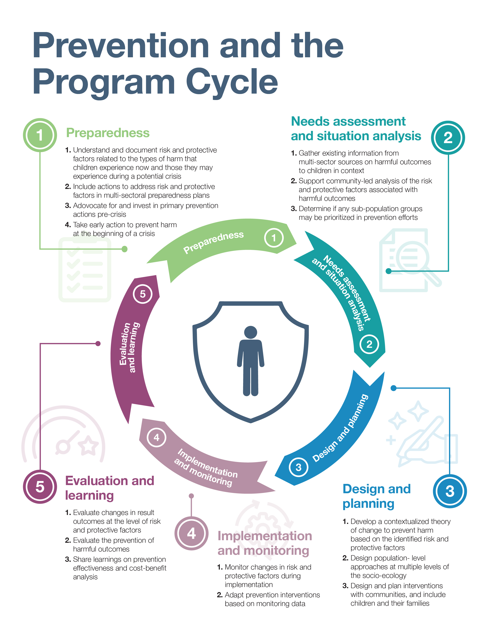
KEY STEPS FOR PRIMARY PREVENTION IN THE PROGRAM MANAGEMENT CYCLE
Notes:
These are the 5 steps for primary prevention that are outlined in the Prevention Framework

Slide 12
What is my role in primary prevention?
Notes:
Facilitator note:
facilitators should select and keep the slide that is most relevant to the audience they are delivering the orientation to and tailor its content to the specific audience.

Slide 13
The role of non-CP humanitarian actors
Understand the key considerations on Primary Prevention
Work together in coordination with Child Protection teams, to prevent harmful outcomes for children, through the phases of the program cycle: preparedness, assessment, design and planning, implementation & monitoring and evaluation & learning.
Involvement will depend on the context, setting and what harmful outcome is to be prevented. For example:
If in a refugee camp access to quality education is identified by communities as a protective factor to prevent child marriage, then universal access to quality education for all children in the camp will be an appropriate intervention. The planning and designing of this intervention should be done jointly by the Education and Child Protection actors.
Notes:
Facilitator notes:
Facilitators will have to adapt this slide to the concrete audience they are presenting to. For example, if we are delivering this orientation session to colleagues from health in country or operation X. we should be able to find an example related to a harmful outcome with a root cause related to health and high prevalence, so that the audience can better relate to it.
Technical notes:
Each humanitarian sector has its priorities, strategies and protocols to follow. However, all sectors share a common responsibility under the Centrality of Protection principle to place protection including children at the centre of humanitarian action

Slide 14
The role of NGO Senior Management
Understand the key considerations on Primary Prevention and why it is important to adopt and advocate for primary preventive approaches
Advocate for Primary Prevention approaches in inter-agency forums
Support and encourage various teams/departments to work together in Primary Prevention: Child protection, Education, Livelihood and FSL, Gender, M&E, and Business and Proposal Development teams.
Notes:
Facilitator notes:
Facilitators will have to adapt this slide to the concrete audience they are presenting to within the organization. I.e: senior management, finance department, business development etc.

Slide 15
The role of CP Inter-agency Coordination Groups and Clusters
Promote the understanding of the key considerations on Primary Prevention among CP actors and other sectors
Include Primary Prevention in their strategies, work plans, and during HNO and HRP development
Collaborate with coordination group from other sectors towards a mutual understanding of the multi-sectoral nature of prevention, and the role of their respective sectors in protecting children from harm (i.e. addressing root causes of harm).
Encourage members to collaborate across agencies towards more comprehensive prevention programs.
Facilitate/coordinate the analysis of risk and protective factors in an inter-agency fashion.
Notes:
Facilitator notes:
Facilitators will have to tailor this slide to their specific audience.

Slide 16
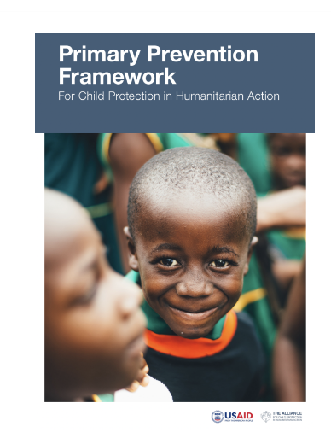
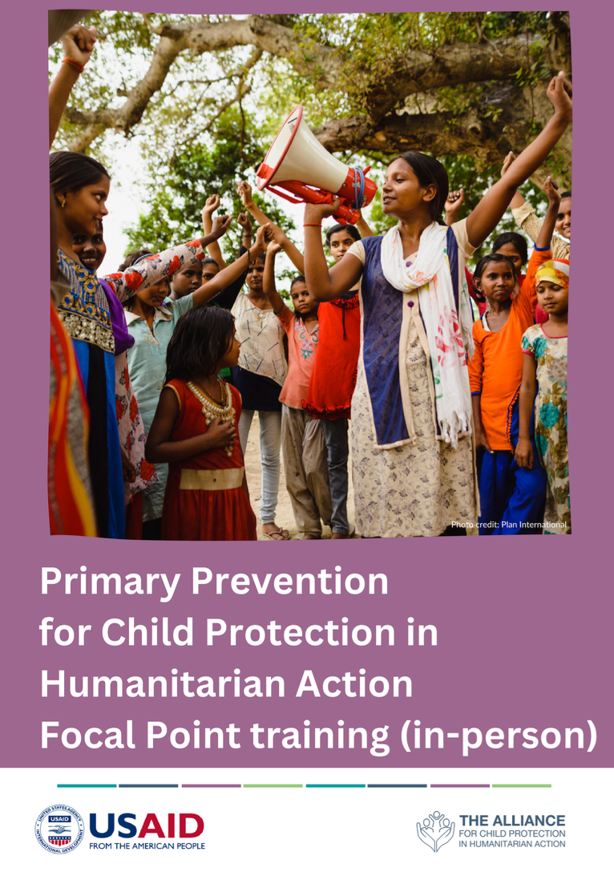
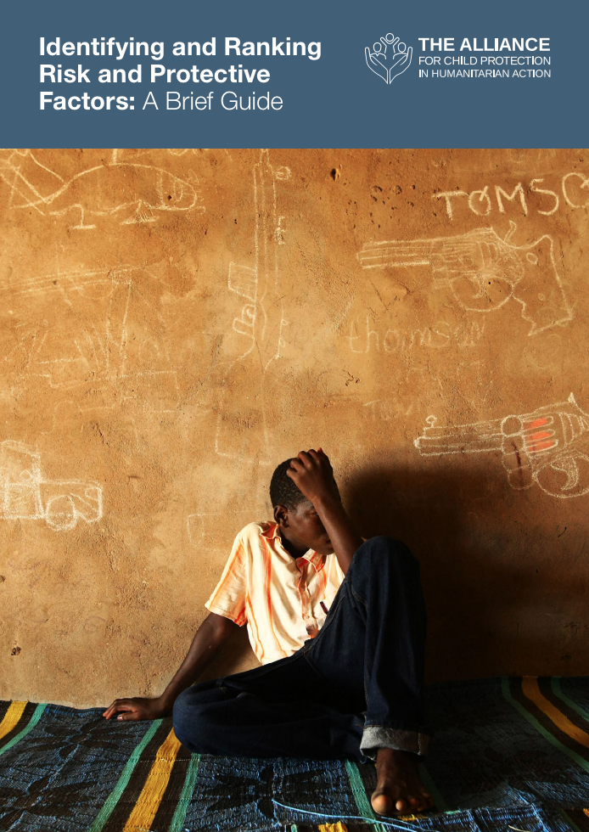
Useful resources
https://alliancecpha.org/en/series-of-child-protection-materials/prevention-initiative
https://alliancecpha.org/en/primary-prevention-framework
Primary Prevention for Child Protection in Humanitarian Action Focal Point Training

