Slide 1
The Minimum Standards for Child Protection in Humanitarian Action
CPMS
SLIDE DECK
Notes:
Facilitators:
This briefing is for any potential user of the CPMS. It is geared primarily toward child protection staff, so consider broadening some questions or providing more detail, if colleagues from other sectors join you.
It is assumed that the group is about 20 people and that everyone in the room knows each other (perhaps colleagues from your agency or the CP coordination group). if not, add 5 minutes for quick introductions.
PREPARE: a flipchart with the objectives of the session
By the end of the session, participants will be able to:
Describe the structure and content of the CPMS, especially Pillar 4
Demonstrate how & why to use the handbook
NOTE: if you have already done a Session on other CPMS Pillar(s), skip slide 2 & 9
TIP: Slides are animated -> for each click, some words, a title or an image will appear on the slide.
Read the corresponding info from the facilitators notes before showing the next point, so participants have time to process what you say, and read each point.

Slide 2
Aim of the Standards
Benchmark for CPHA.
Collaborative, inter-agency tool
Links with Core Humanitarian Standard
Contextualisation for local ownership
Purpose:
quality and accountability
impact for children’s protection and well-being
Notes:
Donors, local governments, colleagues in other sectors and our beneficiaries themselves want to know what we are doing and why. The CPMS is our benchmark. They are the key way to operationalise or make real children's rights in the practice of humanitarian response.
The CPMS are a collaborative, inter-agency tool, that links with other initiatives, such as the Core Humanitarian Standard and the Humanitarian Inclusion Standards
Wherever relevant, the CPMS align with INSPIRE’s 7 strategies to end violence against children – initiative’s icons are actually scattered through the text. In addition, the Core Humanitarian Standard on Quality and Accountability is highlighted in the Introduction and resonates throughout the handbook.
Contextualisation is encouraged and can create ownership of the standards at every level. It can build a deeper understanding of child protection in the specific context for a wide range of actors. National coordination groups are therefore encouraged to adapt the CPMS. Please raise it with colleagues locally and then seek the guidance of the global CPMS team. You may also be interested in a short video about contextualisation which is on the Alliance’s YouTube channel.
BOX: The CPMS aim at improving the quality and accountability of our programing, as well as increase impacts for children’s protection and well-being in humanitarian action (all contexts), by establishing common principles, evidence, prevention and goals to achieve. They provide a synthesis of good practice and learning to date.

Slide 3
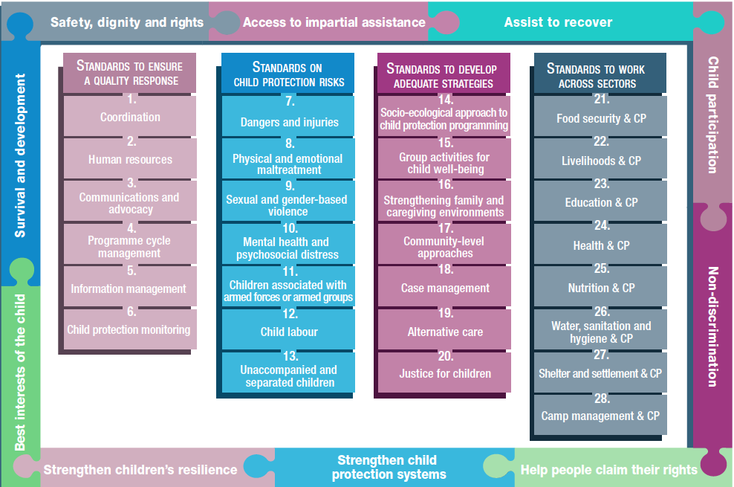
Overview
Notes:
This is an overview of the CPMS structure: there are 28 Standards across 4 pillars and 10 CPHA principles threaded throughout.
You can find this overview on the back of the CPMS handbook or in the online handbook; it’s a practical way of locating quickly a specific topic.
This presentation focuses on the 10 Principles that underlie all our work in Child Protection in Humanitarian Action.

Slide 4
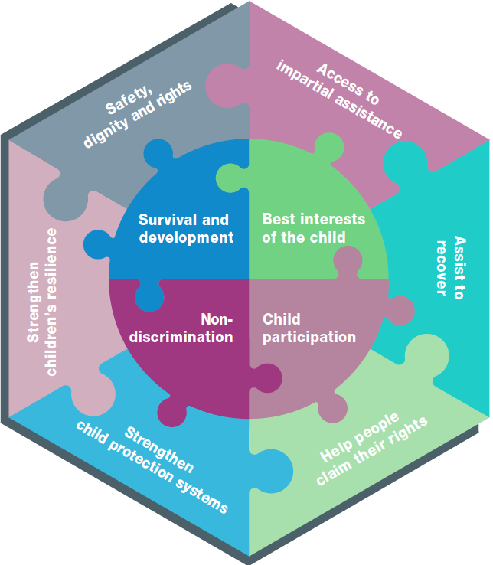
10 Principles…
… grouped together as equals
Presented in a separated section, but also
Woven into each standard as a reminder
Take the e-modules
Notes:
The 10 Principles that we use to guide CPHA have not changed throughout the years. All 10 have been grouped in one section with equal weight.
And they are also highlighted under each standard and hyperlinked so you can easily go back and check on them in the online version and app.
Principles 1-4 are the key principles set out by the Convention on the Rights of the Child (CRC) which is by definition applicable to all humanitarian action.
Principles 5-8 are the protection principles from the Sphere Handbook, restated here with specific references for the protection of children.
Principles 9-10 are specific to the Minimum Standards for Child Protection in Humanitarian Action.
Discussion prompt: (Wait before clicking for the 4th time) Can anyone name all or some of the 10 Principles that guide our work?
Answer:
Survival and Development (UNCRC)
Non-discrimination and inclusion (UNCRC)
Children’s Participation (UNCRC)
The Best Interests of the Child (UNCRC)
Enhance people’s safety, dignity and rights, and avoid exposing them to further harm (Sphere)
Ensure people’s access to impartial assistance according to need and without discrimination (Sphere)
Assist people to recover from the physical and psychological effects of violence, coercion or deliberate deprivation (Sphere)
Help people to reclaim their rights (Sphere)
Strengthen child protection systems (created for the CPMS)
Strengthen children’s resilience in humanitarian action (created for the CPMS)
THEN click and make the visual appear, as a summary
Encourage participants to take the relevant CPMS e-modules available on the Alliance website. There is an overview module and some that are for specific Principles. Each is 30-45 mins long

Slide 5
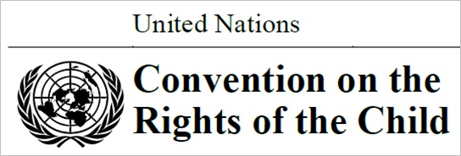
Principle 1 - Survival And Development
Article 6
“All children have the right to survival, development and full potential – which are all the responsibility of the State to accomplish to the maximum extent possible”
Stimulation and attachment in a nurturing environment
Effects of the crisis and humanitarian response
Support children to:
reinforce their strengths and resilience
maximise their opportunities
Notes:
This is a key principle applicable to all humanitarian action.
It is set out by the Convention on the Rights of the Child (CRC)
The stimulation and attachment that occur in predictable, nurturing relationships are crucial to all aspects of a baby’s and young child’s development: physical, psychological, emotional, social and spiritual development
Humanitarian actors must consider the effects of both the crisis and the response on (a) the fulfilment of children’s right to life and (b) children’s development.
Children must be supported to use their own strengths and resilience to maximise their opportunities for survival and development in humanitarian crises.

Slide 6
Principle 2 – Non discrimination & Inclusion
Equal opportunities for all
Dignity and acceptance
Diversity criteria
Values, beliefs and unconscious biases about childhood and family roles
Discrimination/power patterns
Existing cycles of exclusion
New layers of exclusion
Article 2
“States Parties shall take all appropriate measures to ensure that the child is protected against all forms of discrimination”
Notes:
This is a 2nd key principle applicable to all humanitarian action.
This principle includes prohibiting all forms of discrimination in the enjoyment of rights and requiring proactive measures to ensure equal opportunities for all children to enjoy their rights. This includes respect for the inherent dignity and acceptance of all children.
Diversity: Children shall not be discriminated against on ANY basis (gender, sexual orientation, age, disabilities, nationality, immigration status, activities, expressed opinions, or beliefs of the child's parents, legal guardians, or family member).
Humanitarian workers must be aware of their own values, beliefs and unconscious biases about childhood and the roles of the child and the family. This will help us to avoid imposing our beliefs and unconscious biases on children in ways that deny children their rights.
Discrimination also increases children’s risks of all forms of abuse, neglect, exploitation and violence.
Humanitarian crises and responses can increase discrimination, worsen existing cycles of exclusion and create new layers of exclusion.
Note: Children who are refugees, internally displaced, migrants or stateless have the same rights as all other children, and States have obligations to protect them regardless of their status. Legal, policy and practical barriers as well as discrimination can result in these children (a) being denied access to essential services or (b) facing immigration, detention, lack of freedom of movement, xenophobia or exclusion.

Slide 7
Principle 3 – Children’s participation
Meaningful participation in decisions that affect them
Adapted
Impact:
Hope
Responsibilisation
Sense of belonging
Justice
Accountability
Requirements for effective and ethical children’s participation :
Transparent and informative
Voluntary
Respectful
Relevant
Child-friendly
Inclusive
Supported by training
Safe and sensitive to risks
Accountable
Article 12
Notes:
This is 3rd key principle applicable to all humanitarian action.
It is set out by the Convention on the Rights of the Child (CRC), in Article 12, stating: “States Parties shall assure to the child who is capable of forming his or her own views the right to express those views freely in all matters affecting the child, the views of the child being given due weight in accordance with the age and maturity of the child.”
Humanitarian workers must provide children with the time and space to meaningfully participate in all decisions that affect children, including during emergency preparedness and response.
Participation is a right, and should be adapted to gender, age, communication method, level of maturity, context, safety, security, etc
Participation nurtures hope, which enables children to think about the possibility of positive change. Children can work for positive change by engaging in decision-making processes according to their evolving abilities and independence. Taking responsibility and making decisions helps children develop a sense of belonging and justice. Participation strengthens accountability.
The basic requirements for effective and ethical children’s participation should be applied to any process involving children. They are: (click to make each appear). If needed: https://resourcecentre.savethechildren.net/library/nine-basic-requirements-meaningful-and-ethical-childrens-participation
There is a distinction between asking children for information that humanitarian actors need and supporting children’s right to participate in processes or decisions that affect their lives.

Slide 8
Principle 4 – Best interest of the child
Primary consideration in all actions and decisions
Applies to all children
Guiding principle for programming
3 aspects:
Basic Right
Legal principle
Rule of procedure
Article 3
“In all actions concerning children, the best interests of the child shall be a primary consideration”
Notes:
This is the final principle drawn from the Convention on the Rights of the Child (CRC)
DEF: The term ‘best interests of the child’ broadly describes the well-being of a child.
Children have the right to have their best interests assessed and taken into account as a primary consideration in all actions or decisions that concern them, both in the public and private spheres (social welfare institutions, courts of law, administrative authorities or legislative bodies).
It applies to all children without discrimination, whether they are nationals, asylum-seekers, refugees, internally displaced, migrants or stateless.
The best interests principle guides the design, implementation, monitoring and adjustment of all humanitarian programmes and interventions and should be routinely reassessed.
There are three aspects to the best interests concept. They are:
A child’s basic right: children have a right to have their best interests assessed and taken as a primary consideration;
A legal principle: if a legal provision is open to more than one interpretation, the interpretation which most effectively serves the child’s best interests should be chosen;
A rule of procedure: whenever a decision will affect a child, a group of children or children in general, the decision-making process must (a) evaluate the possible impact of the decision on the child(ren) concerned and (b) show that the right of children to have their best interests assessed and taken as a primary consideration has been explicitly taken into account.
When humanitarian actors make decisions for individual children, agreed-upon procedural safeguards should be implemented to support this principle (-> safeguarding icon)
Understandably, there is often a lot of discussion around this Principle. Be careful to manage the time and feel free to point people to resources / resource people including the CPMS e-module.

Slide 9
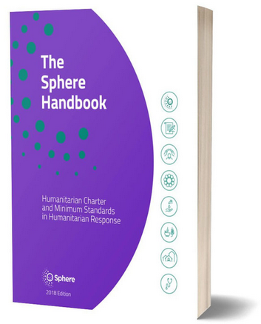
Principle 5 - People’s safety, dignity and rights and Do no Harm
Reduce the risks
Meet needs w/ dignity
Safeguarding protocols
Children’s expertise & participation
Community expertise & experience
“Humanitarian actors take steps to reduce overall risks to and vulnerability of people, including potentially negative effects of humanitarian programmes.”
Notes:
Humanitarian assistance must be provided in ways that reduce the risks that people may face and meet their needs with dignity.
Assistance needs to be provided in an environment that does not further expose people to physical hazards, violence or abuse: hence the existence of (child) safeguarding protocols
We need to overlay this with children’s perspectives and needs. For example, a key step to support people’s capacity to protect themselves is to promote meaningful and safe children’s participation. Programme design is improved by including children’s own expertise.
We also need to reflect on how the relevant issues were previously addressed by children, families, communities and authorities and how the crisis has affected these strategies and behaviours.

Slide 10
Principle 6 - Access to impartial assistance
Based on needs
Without discrimination
Monitor access
Address barriers
Relevant Information
Proactive outreach to excluded children
“Humanitarian actors identify obstacles to accessing assistance and take steps to ensure it is provided in proportion to need and without discrimination”
Notes:
Non-discrimination is of such importance that it is a separate principle (Principle 2) in the CPMS
Actions should be taken to ensure children and their families are not deprived of their basic needs:
- Monitor children’s and their families’ access to services and decision-making processes;
Identify and address barriers (including for LQBTQ children and for refugees, internally displaced, migrants and stateless by providing translations or cultural mediators, removing or reducing costs, etc)
Provide all stakeholders with relevant information (making children aware of what services are available and where)
Adjust interventions to provide all members of the affected population with access to assistance (where patterns of discrimination or exclusion exists).
[Facilitators – if you have a few minutes, try to inject some fun into the session! It helps the participants feel more comfortable with the handbook itself. You may not have time for all of the activities suggested into this presentation]
→ Discuss contextualized examples of excluded children, and forms of reaching them.

Slide 11
Principle 7 – Assistance to recover from violence, coercion or deliberate deprivation
Reduce exposure to further violence, coercion or deprivation
Support children’s & families’ efforts to stay safe
Responses to make children more secure
“Humanitarian actors provide immediate and sustained support to those harmed by violations, including referral to additional services as appropriate”
Notes:
This principle includes
taking all reasonable steps to ensure that the affected population (in our case, children) is not subject to further violence, coercion or deprivation
supporting children’s own efforts to recover their safety, dignity and rights within their communities.
All child protection responses (and we as actors) should seek to make children more secure, facilitate their and their families’ own efforts to stay safe and reduce children’s exposure to risks

Slide 12
Principle 8 – Assistance to claim rights
Providing information
Assisting with documentation
Assisting in identifying solutions
Supporting ability to protect
Supporting their engagement as informed citizens
Advocacy duty
“Humanitarian actors help affected communities claim their rights through information and documentation, and support efforts to strengthen respect for rights”
Notes:
Children are rights holders, and need to be supported to assert their legal rights (i.e inheritance, restitution, asylum) and access remedies/solutions (i.e legal actions at local, national or international levels) by:
- Providing information;
- Assisting with documentation (such as promoting birth registration, supporting families to replace lost documents, etc.); and
Assisting in identifying solutions
Influencing their ability to protect themselves
Supporting them to become informed and engaged citizens
We as humanitarian actors have a duty to advocate for the full respect of children’s rights and the compliance with international law that support a stronger protective environment.

Slide 13
Principle 9 – Strengthen child protection systems
Quality and availability of services
Innovations
Formal and informal system components
systemic approach to mitigating risks & responding to needs
sustainable and long-term impact
Notes:
This principle is set out specifically by the CPMS
Systems strengthening is a dominant paradigm for child protection actors
DEF: Child protection systems consist of components, connected around a common goal to protect children, set in a specific context (Systems are unique to the context in which they exist). They operate at different levels –from the child to the State and international actors. They may be more or less formal in nature. The interactions between components define how systems operate.
The response phase can provide an opportunity to build on and strengthen the many levels and parts of systems (people, processes, laws, institutions, capacities and behaviours) that normally protect children and may have become weak or ineffective. This requires a systemic approach to mitigating risks and responding to urgent needs as opposed to risk- or issue-specific interventions.
By strengthening systems, we ensure approaches are sustainable and will have a long-term impact, allowing all children to be protected, no matter what issues they face.
Humanitarian settings can provide opportunities to strengthen child protection systems, by:
improving the quality and availability of services
introducing innovations into systems to improve protection outcomes for children.
Linkages across the range of formal and informal aspects of systems should be facilitated (i.e: police, social workers, health workers, child welfare services, education services, sexual and reproductive health actors, the juvenile justice system, mental health services, armed force or group)

Slide 14
Principle 10 – Strengthen children’s resilience
Components of resilience:
Strengths and abilities
Peer and support network
Problem-solving skills
Participation
Positive relations
Build children’s strengths
Eliminate or reduce risk factors
Strengthen protective factors
= Addressing, coping & overcoming
Notes:
This principle is set out specifically by the CPMS and differs from other sectors’ understanding of the term “resilience”.
DEF: Resilience arises when a child has enough protective factors, both individual and environmental, to overcome the distress caused by the risk factors.
One of the goals of humanitarian actors is to build children’s own strengths by eliminating or reducing risk factors and by strengthening the protective factors that support and encourage resilience.
= Children’s success in addressing and coping with their situation depends on the patterns of risk and protective factors in their social environments and on their own strengths and abilities.
Children with strengths - such as good problem-solving skills, peer support, having good skills for seeking help - are often able to handle the crisis environment relatively well and to make decisions that support the well-being of themselves, their families and their peers. Participation & positive relations between children, families and communities are also key to building resilience

Slide 15
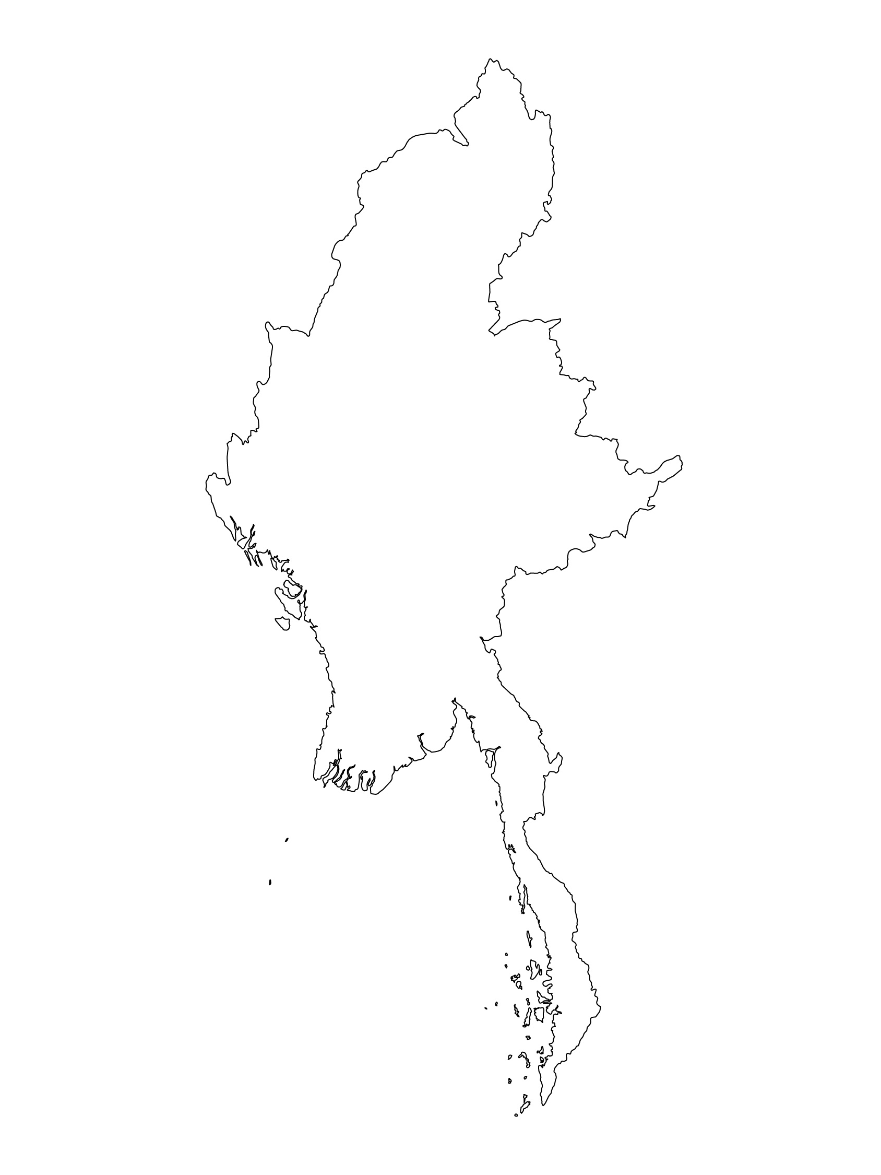
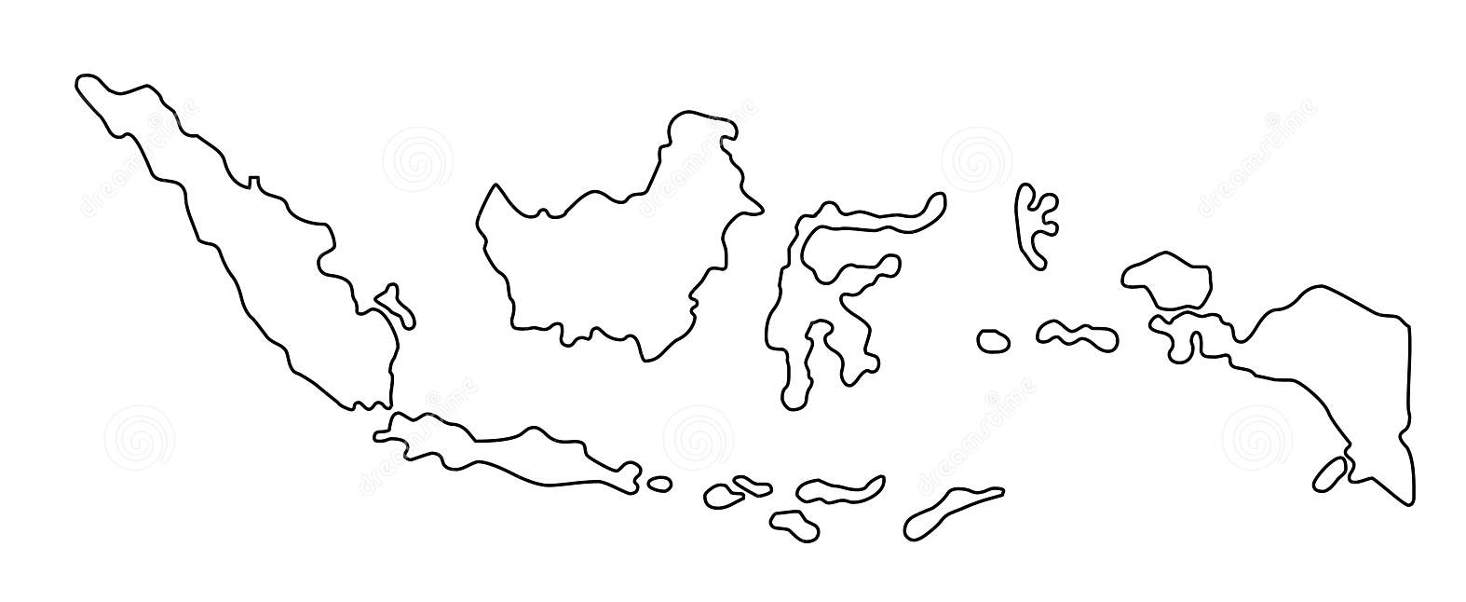
Examples from the Region
[COUNTRY NAME]
Add key presentation sentence about a specific program/project using Pillar 2
Add name of organisations
Add key message / numbers
[ COUNTRY NAME]
Add key presentation sentence about a specific program/project using Pillar 2
Add name of organisations
Add key message / numbers
[ COUNTRY NAME]
Add key presentation sentence about a specific program/project using Pillar 2
Add name of organisations
Add key message / numbers
Notes:
Depending on the time you have for facilitation, consider adding here examples from the Region/ Country/ Response, of programming that meets the standards.
This could be a draft slide that you could update or remove if necessary.
For each example, you could add:
A short, concise, key presentation sentence about the specific program/project using Pillar 3
Add the name of organisations and partners involved
Add practical lessons learnt, key actions, message or numbers, that will attract interest of your audience
Another option, if you have longer (and also depending on the audience you have), this slide can be completed in an interactive way during the session.
In that case, you could:
split into 2 or 3 smaller groups,
allow 15 – 20 min for them to prepare a short presentation of an example from the Region/ Country/ Response, of programming that meets the standard
in plenary, have the groups present their examples, and discuss /compare lessons learnt out of them.
If you will be sending this presentation to the participants after the training, you can fill up this slide, to keep records of the presentations.
TIP: you can use https://thenounproject.com/ to get map outlines like those.

Slide 16
Need more than the hard copy?
On the Alliance website
PDF version
Briefing & Implementation Pack
25-page Summary
E-course
YouTube videos
A gallery of illustrated Standards
👉 www.AllianceCPHA.org
On the Humanitarian Standards Partnership website
Online, interactive version
HSP App for mobile phones and tablets
👉 www.HumanitarianStandardsPartnership.org
Notes:
[Facilitators - if you can project from the internet, then we suggest you navigate people there and show them]
Alliance website.
The PDF & all materials available can be downloaded if people want to print just portions of the CPMS, on the Alliance site
The “Introduction to CPMS” Briefing Pack contains this PPT and facilitation notes, plus the 2 page Introduction handout.
A Summary: At just 32 pages, it means that it is very topline but can be used to introduce the idea of minimum standards or start child protection discussions with government colleagues or other humanitarians without overwhelming them with the huge handbook.
Discover our free CPMS e-course with a range of modules
Videos on the Alliance Youtube channel
A gallery of illustrated Standards
HSP:
1. Online handbook
2. The Humanitarian Standards Partnership App
– It is the 2nd most popular app on that site after Sphere
ASK: What should our next steps as a team/agency/individual be?
(i.e. you might schedule a longer meeting to digest the changes and create a plan; or ask colleagues to present certain new/revised standards and their implications for the programme; or set up a training or ask Senior Management for a meeting to discuss accountability to children, etc)
[Facilitators - Printed copies – there is a small stockpile of the Handbook and Summary that the global Alliance has in Geneva; however, countries and regions are encouraged to print & manage their own copies locally. Usually, this would be done through the inter-agency Coordination structure. On request, the Alliance can share a print-ready PDF.]
Thank you so much for coming together and starting to explore the CPMS. I will follow up on the next steps we discussed. And that’s the key – the CPMS is a gift that just keeps on giving every time you open it!

