Slide 1
The Minimum Standards for Child Protection in Humanitarian Action
CPMS
SLIDE DECK
Notes:
Facilitators:
This briefing is for any potential user of the CPMS. It is geared primarily toward child protection staff, so consider broadening some questions or providing more detail, if colleagues from other sectors join you.
It is assumed that the group is about 20 people and that everyone in the room knows each other (perhaps colleagues from your agency or the CP coordination group). if not, add 5 minutes for quick introductions.
PREPARE: a flipchart with the objectives of the session
By the end of the session, participants will be able to:
Describe the content of Standard 14
Explain & Share its key messages
Demonstrate how & why to use the handbook
NOTE: if you have already done a Session on Pillar(s), Principles or other Standard(s), skip slide 2 & 8
TIP: Slides are animated -> for each click you’ll make, some few words, a title or an image will appear on the slide.
Read the corresponding notes from the facilitators notes, before showing the following content, so participants have time to process what you say, and read each point.

Slide 2
Aim of the Standards
Benchmark for CPHA.
Collaborative, inter-agency tool
Links with Core Humanitarian Standard
Contextualisation for local ownership
Purpose:
quality and accountability
impact for children’s protection and well-being
Notes:
Donors, local governments, colleagues in other sectors and our beneficiaries themselves want to know what we are doing and why. The CPMS are our benchmark. CPMS are the key way to operationalise or make real children's rights in the practice of humanitarian response.
They are a collaborative, inter-agency tool, that links with other initiatives, such as the Core Humanitarian Standard, INSPIRE and the Humanitarian Inclusion Standards
Wherever relevant, the CPMS align with INSPIRE’s 7 strategies to end violence against children – initiative’s icons are actually scattered through the text. In addition, the Core Humanitarian Standard on Quality and Accountability is highlighted in the Introduction and resonates throughout the handbook.
Contextualisation is encouraged and can create ownership of the standards at every level. It builds a deeper understanding of child protection in the specific context for a wide range of actors. For more information, watch the short contextualization video on the Alliance’s youtube channel.National coordination groups are encouraged to adapt the CPMS. Please raise it with colleagues locally and then seek the guidance of the global CPMS team.
BOX: The CPMS aim at improving the quality and accountability of our programing and increasing impact for children’s protection and well-being in humanitarian action (internal displacement and refugee contexts), by establishing common principles, evidence, prevention and goals to achieve. They provide a synthesis of good practice and learning to date.

Slide 3
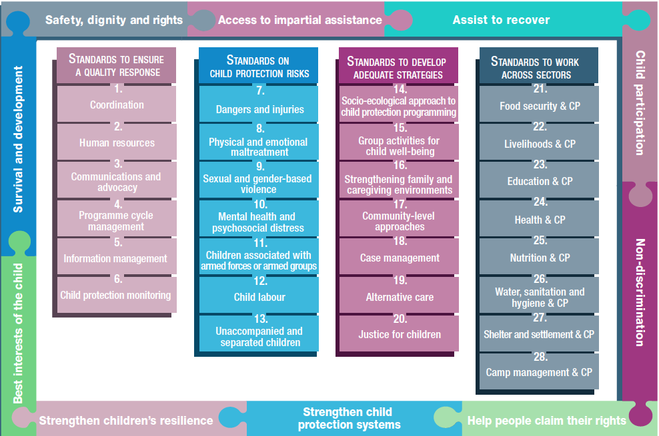
Overview
Notes:
This is an overview of the CPMS structure: there are 28 Standards across 4 pillars and 10 CPHA principles threaded throughout.
You can find this overview on the back of the CPMS handbook or in the online handbook; it’s a practical way of locating quickly a specific topic.
This presentation focuses on Standard 14: Socio-ecological approach to child protection programming

Slide 4
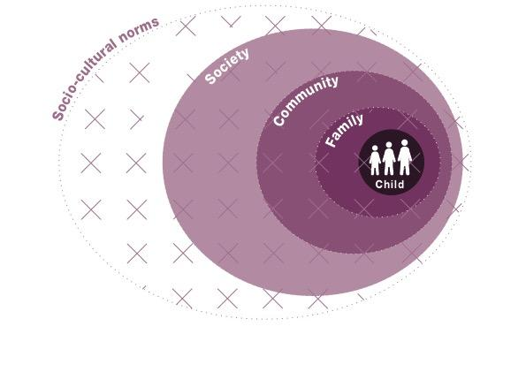
General introduction to Standard 14
Key strategies, approaches and interventions
Prevention and response to child protection risks
Flexible programming
Incorporate a systems approach
Address all levels of the socio-ecological model
Contextualization
Evolution over time
Notes:
This Standard is part of the third Pillar related to developing adequate strategies, approaches and interventions for preventing and responding to the child protection risks outlined in Pillar 2. It is structured around the socio-ecological model and also links with the INSPIRE package, where appropriate, and builds on their evidence-based strategies for preventing violence against children. Hence the ICON in the corner. The INSPIRE package has a similar goal: evidence-based strategies for preventing violence against children. More info about INSPIRE strategies on: http://inspire-strategies.org/
This Standard promotes flexible programming that integrates new learning and adapts accordingly throughout implementation. Its point is to integrate approaches that work in partnership with the child, their family, community, and society, as well as with socio-cultural norms.
It provides a concrete framework that supports systems thinking for child protection programming. It looks at an entire situation to (a) identify all the different elements and factors and (b) understand how they relate to and interact with each other. It considers the full range of problems facing the child, their root causes and the solutions available at all levels (rather than looking at a single protection issue or specific service in its own).
Is complementary to child protection systems thinking & seek to achieve the same goal: a holistic, integrated approach to protecting children.
It is important to note that CP systems differ by context and change, adapt, evolve over time: a thorough analysis of CP risks and protective factors, as well as a regular mapping of formal and informal system elements, are needed, to develop a plan to strengthen, scale up, adapt the system
*Icon: increased emphasis on Prevention of child protection risks
*Links with ALL INSPIRE strategies and overall approach of systems strengthening

Slide 5
“Children, families, communities and societies are supported to protect and care for children.”
Levels…
Children
Families
Communities
Social, political and cultural environments, including cultural norms
What are the 7 INSPIRE strategies?
What, in your country, would be part of each level?
Notes:
Standard 14 states: “Children, families, communities and societies are supported to protect and care for children.”
It links with ALL 7 INSPIRE strategies and overall approach of systems strengthening
Discussion Prompt 1: What are the 7 INSPIRE strategies?
-> Implementation and enforcement of laws
Norms and values
Safe environments
Parent and caregiver support
Income and economic strengthening
Response and support services
Education and life skills
Facilitators: We suggest that after presenting the 4 levels, you discuss with the group:
1) Discussion Prompt 2: What, in your country, would be part of each level?
-> within your specific country/context, discuss contextualized parts of each level
2) the contextualized and local strengths and vulnerabilities of each level. You can complement their answers with the following generic ideas:
Children’s specific strengths and vulnerabilities include the following:
Younger children depend on their primary caregivers for basic needs and have difficulty understanding disruptions caused by a crisis.
Older children and adolescents can address some of their own basic needs but face a greater likelihood of being separated from their families, becoming associated with armed forces or groups, being forced into labour, exploited, etc.
Children who are refugees or stateless, or undocumented, that are excluded from national child rights and child protection laws, standards and services [→ the displacement icon]
Families, other close relations and peers are the closest protective layer around a child, are sources of resilience and support for children. However, they may experience stress caused by:
Economic hardship;
Social isolation, abandonment;
Lack of registration and documentation;
Changes in family composition and roles due to death, divorce or forced separation;
Changing family structures, parental stress, substance abuse and
The loss of protective community mechanisms.
Communities have the potential to support children and families, but this is often reduced during crises.
If community members do not consider the best interests of all children, particular groups of children may face increased risks related to discrimination or exclusion.
Risks: Poverty, poor housing, social norms and displacement
The broader social, political and cultural environments in which children live and grow play significant roles in preventing and responding to risks.
Priority should be given to changing policies that exclude particular groups of children – such as children who are refugees or stateless – from national child rights and child protection laws, standards and services.
Risks: wide-spread conflict, famine, infectious disease outbreaks, weak legal frameworks, and poor law enforcement.
3) We encourage you to discuss further: how contextualized vulnerabilities in each of the 4 levels increase directly CP risks?

Slide 6
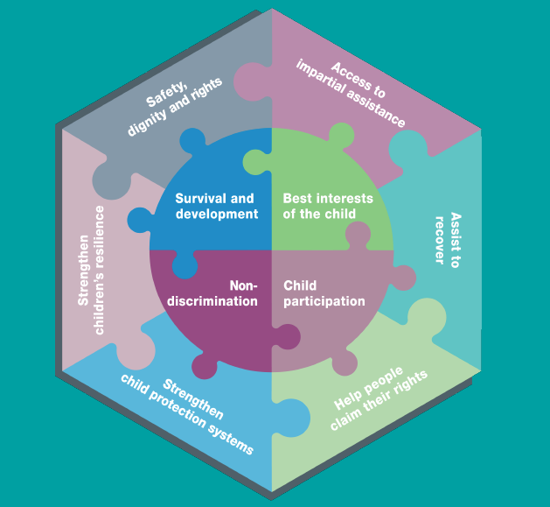
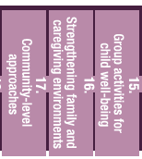
‘Socio-ecological’ approach
What does it mean?
-> designing integrated approaches
-> partnership with children, families, communities and societies
-> actions that address all 4 levels
What does it mean to use this approach when apply St 15, 16 & 17, and the Principles?
Notes:
Applying a ‘socio-ecological’ approach to child protection involves designing integrated approaches that work in partnership with children, families, communities and societies. This standard outlines actions that:
Address all four levels of the socio-ecological model; and/or
Take place at the society level and are not covered in other standards. This includes strengthening laws and policies, funding for child protection, social welfare and birth registration services.
The following should be read with this standard:
Principles;
Standard 15: Group activities for child well-being;
Standard 16: Strengthening family and caregiving environments;
Standard 17: Community-level approaches.
If you have time, Discussion Prompt 3: What does it mean to use this approach when apply St 15, 16 & 17, and the Principles?
Why are we saying that standards need to be ‘read together with other standards’.

Slide 7
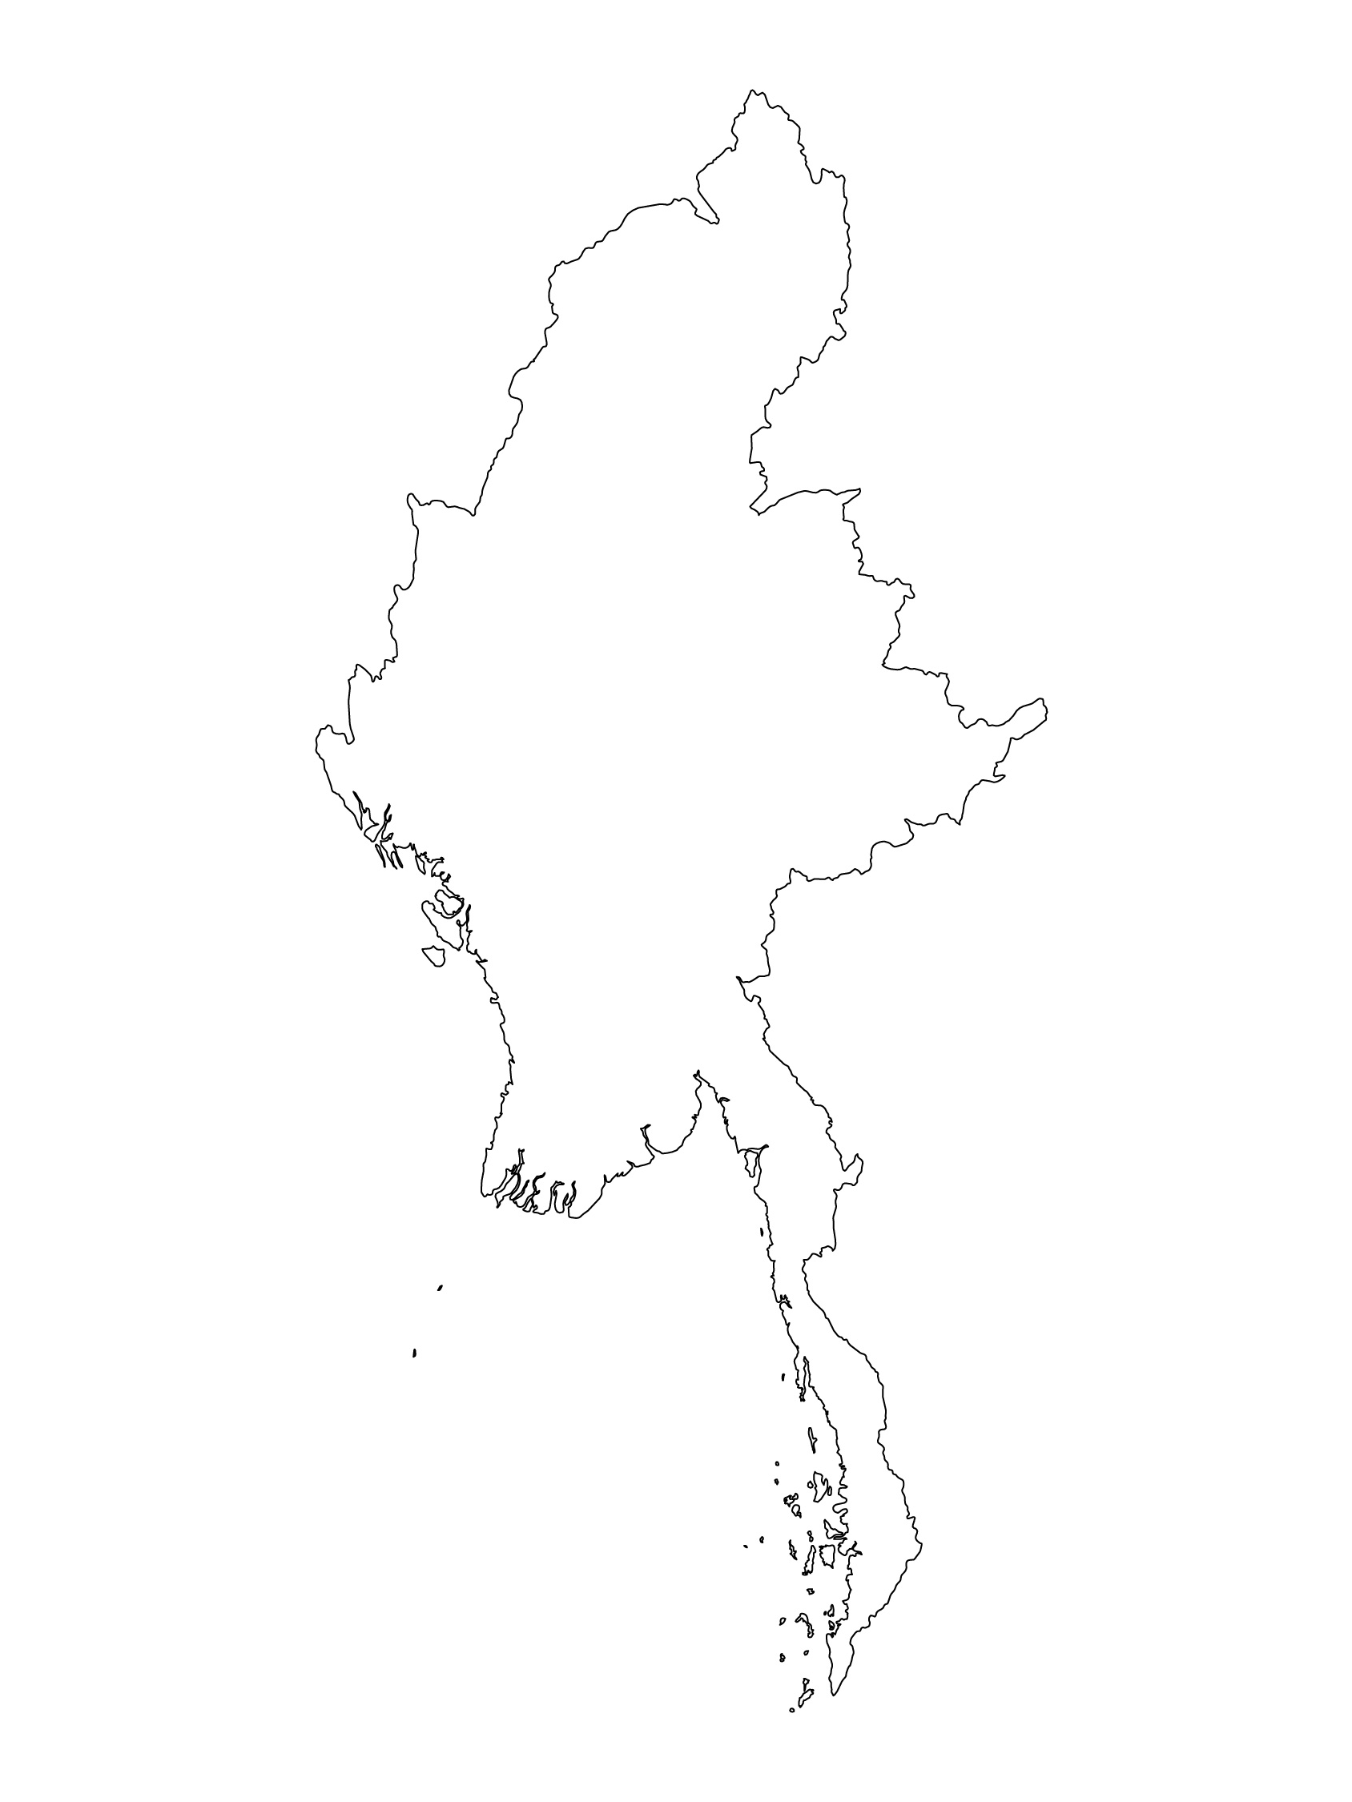
Examples from the Region
[COUNTRY NAME]
Add key presentation sentence about a specific program/project using Standard 14
Add name of organisations
Add key message / numbers
[ COUNTRY NAME]
Add key presentation sentence about a specific program/project using Standard 14
Add name of organisations
Add key message / numbers
[ COUNTRY NAME]
Add key presentation sentence about a specific program/project using Standard 14
Add name of organisations
Add key message / numbers
Notes:
Depending on the time you have for facilitation, consider adding here examples from the Region/ Country/ Response, of programming that meets the standards.
This could be a draft slide that you could update or remove if necessary.
For each example, you could add:
A short, concise, key presentation sentence about the specific program/project using Standard 14
Add the name of organisations and partners involved
Add practical lessons learnt, key actions, message or numbers, that will attract interest of your audience
Another option, if you have longer (and also depending on the audience you have), this slide can be completed in an interactive way during the session.
In that case, you could:
split the groups into 2 or 3 smaller groups,
allow 15 – 20 min for them to prepare a short presentation of an example from the Region/ Country/ Response, of programming that meets the standard
in plenary, have the groups present their examples, and discuss /compare lessons learnt out of them.
If you will be sending this presentation to the participants after the training, you can fill up this slide, to keep records of the presentations.
TIP: you can use https://thenounproject.com/ to get map outlines like those.

Slide 8
Need more than the hard copy?
On the Alliance website
PDF version
Briefing & Implementation Pack
25-page Summary
E-course
YouTube videos
A gallery of illustrated Standards
👉 www.AllianceCPHA.org
On the Humanitarian Standards Partnership website
Online, interactive version
HSP App for mobile phones and tablets
👉 www.HumanitarianStandardsPartnership.org
Notes:
[Facilitators - if you can project from the internet, then we suggest you navigate people there and show them]
HSP:
1. Online handbook
2. The Humanitarian Standards Partnership App
– It is the 2nd most popular app on that site after Sphere
CPMS page:
1. Interactive handbook – our greatest resource
2. A Summary: At just 32 pages, it means that it I CPHA topline but can be used to introduce the idea of minimum standards or start child protection discussions with government colleagues or other humanitarians without overwhelming them with the huge handbook.
Alliance website:
The PDF & all materials available can be downloaded if people want to print just portions of the CPMS, on the Alliance site
The “Introduction to CPMS” Briefing Pack contains this PPT and facilitation notes, plus the 2 page Introduction handout.
A gallery of illustrated Standards
Discover our free CPMS e-course with a range of modules
Videos on the Alliance Youtube channel
ASK: What should our next steps as a team/agency/individual be?
(i.e. you might schedule a longer meeting to digest the changes and create a plan; or ask colleagues to present certain new/revised standards and their implications for the programme; or set up a training or ask Senior Management for a meeting to discuss accountability to children, etc)
[Facilitators - Printed copies – there is a small stockpile of the Handbook and Summary that the global Alliance has in Geneva; however, countries and regions are encouraged to print & manage their own copies locally. Usually, this would be done through the inter-agency Coordination structure. On request, the Alliance can share a print-ready PDF.]
Thank you so much for coming together and starting to explore the CPMS. I will follow up on the next steps we discussed. And that’s the key – the CPMS is a gift that just keeps on giving every time you open it!

