Slide 1
The Minimum Standards for Child Protection in Humanitarian Action
CPMS
SLIDE DECK
Notes:
Facilitators:
This briefing is for any potential user of the CPMS. It is geared primarily toward child protection staff, so consider broadening some questions or providing more detail, if colleagues from other sectors join you.
It is assumed that the group is about 20 people and that everyone in the room knows each other (perhaps colleagues from your agency or the CP coordination group). if not, add 5 minutes for quick introductions.
PREPARE: a flipchart with the objectives of the session
By the end of the session, participants will be able to:
Describe the content of Standard 16
Explain & Share its key messages
Demonstrate how & why to use the handbook
NOTE: if you have already done a Session on Pillar(s), Principles or other Standard(s), skip slide 2 & 7
TIP: Slides are animated -> for each click you’ll make, some few words, a title or an image will appear on the slide.
Read the corresponding notes from the facilitators notes, before showing the following content, so participants have time to process what you say, and read each point.

Slide 2
Aim of the Standards
Benchmark for CPHA.
Collaborative, inter-agency tool
Links with Core Humanitarian Standard
Contextualisation for local ownership
Purpose:
Quality and accountability
Impact for children’s protection and well-being
Notes:
Donors, local governments, colleagues in other sectors and our beneficiaries themselves want to know what we are doing and why. The CPMS is our benchmark. They are the key way to operationalise or make real children's rights in the practice of humanitarian response.
They are a collaborative, inter-agency tool, that links with other initiatives, such as the Core Humanitarian Standard and the Humanitarian Inclusion Standards.
Wherever relevant, the CPMS align with INSPIRE’s 7 strategies to end violence against children – initiative’s icons are actually scattered through the text. In addition, the Core Humanitarian Standard on Quality and Accountability is highlighted in the Introduction and resonates throughout the handbook.
Contextualisation is encouraged and can create ownership of the standards at every level. It builds a deeper understanding of child protection in the specific context for a wide range of actors. National coordination groups are therefore encouraged to adapt the CPMS. Please raise it with colleagues locally and then seek the guidance of the global CPMS team. For more information, watch the short contextualization video on the Alliance’s youtube channel.
BOX: The CPMS aim at improving the quality and accountability of our programing and increasing impact for children’s protection and well-being in humanitarian action (internal displacement and refugee contexts), by establishing common principles, evidence, prevention and goals to achieve. They provide a synthesis of good practice and learning to date.

Slide 3
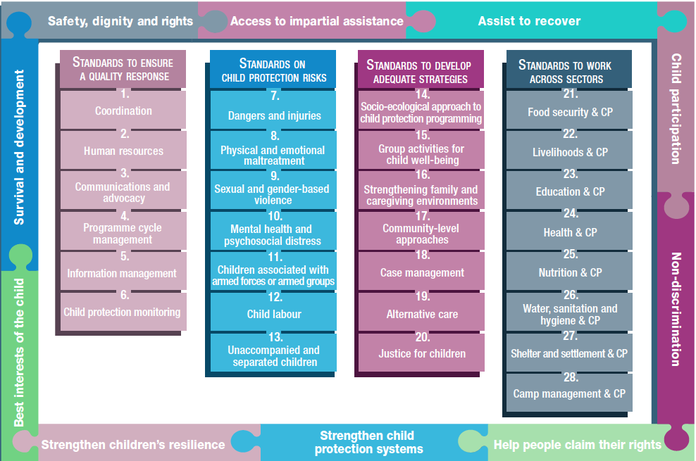
Overview
Notes:
This is an overview of the CPMS structure: there are 28 Standards across 4 pillars and 10 CPHA principles threaded throughout.
You can find this overview on the back of the CPMS handbook or in the online handbook; it’s a practical way of locating quickly a specific topic.
This presentation focuses on Standard 16: Strengthening family and caregiving environments

Slide 4
General intro to Standard 16
Key strategies, approaches and interventions
Prevention and response to child protection risks
Caring and protective environments
Responsive and supportive caregivers
Healthy caregiver-child relationships
Holistic support to families -> improved care
resilience
What is an immediate caregiver ? Give examples
Notes:
This Standard is part of the third Pillar of Standards related to developing adequate strategies, approaches and interventions for preventing and responding to the child protection risks outlined in Pillar 2. It is structured around the socio-ecological model and also links with the INSPIRE package, where appropriate, and builds on their evidence-based strategies for preventing violence against children. Hence the ICON in the corner. The INSPIRE package has a similar goal: evidence-based strategies for preventing violence against children. More info about INSPIRE strategies on: http://inspire-strategies.org/
DEF: A ‘caregiving environment’ is the child’s unique, direct physical and human living arrangement. Caregiving includes both formal, legal arrangements and informal arrangements in which the caregiver does not have legal responsibility. Caring and protective environments; responsive and supportive caregivers; and healthy caregiver-child relationships are protective factors that are key to build resilience and give children the ability to thrive and grow in difficult environments.
Whole standard is essential prevention and response work as the focus is on holistic support to families to improve the care they provide to children
Emphasizes importance of contextualizing evidence-based approaches like those found in INSPIRE. This standard links with Inspire strategies on Parent & Caregiver support + Income and economic strengthening
Discussion Prompt: What is an immediate caregiver ? Give examples
-> An immediate caregiver is a person with whom the child lives and who provides daily care to the child. An immediate caregiver can be the mother, father, another family member or even a non-relative. Immediate caregivers are responsible for:
Meeting the child’s physical, emotional, social, cognitive and spiritual needs;
Developing a consistent and caring relationship with the child; and
Protecting the child from harm.

Slide 5
“Family and caregiving environments are strengthened to promote children’s healthy development and to protect them from maltreatment and other negative effects of adversity.”
Support access to services before, during & after crisis
Family strengthening prevention and response programme
Positive parenting practices, improving relationships and self-care
REMINDER
Why is it important to support caregiving capacity?
Notes:
Standard 16 states the following: “Family and caregiving environments are strengthened to promote children’s healthy development and to protect them from maltreatment and other negative effects of adversity.”
Discussion Prompt: Why is it important to support caregiving capacity?
Immediate caregivers are responsible for:
Meeting the child’s physical, emotional, social, cognitive and spiritual needs;
Developing a consistent and caring relationship with the child; and
Protecting the child from harm.
Caregiving capacity can be limited by caregiver’s own experiences of distress and adversity during conflict, disaster and displacement. Stress that affects caregivers’ well-being can be increased by economic hardship; pre-existing mental illness; social isolation; changes in family composition and roles due to death, divorce and forced separation; and the loss of protective community mechanisms.
Holistic support to families examples of interventions:
Improving access to services (livelihood and food security support, education and adequate health care)
FS prevention & response programme (awareness & prevention of negative coping mechanisms; social networks, groups, peer-to-peer and self-help groups support; intimate partner violence (IPV) prevention and response …) [🡪 the prevention icon]
positive parenting programming (caregiver-child relationships support, appropriate self-care, home visiting programmes…)
male caregivers’ involvement/engagement: Research demonstrates the positive impact of male caregivers’ engagement on children’s social, educational, behavioural and psychological outcomes.
economic interventions (economic empowerment of women, cash and voucher assistance and other forms of economic support, like direct financial support)
mental health, psychosocial well-being
REMINDER: We have to keep in mind, when planning for Family Strengthening interventions: to include child-headed households, and households that meet locally defined risk criteria, all family members and other family members (beyond primary caregivers), and foster families, and adapt our interventions accordingly …

Slide 6
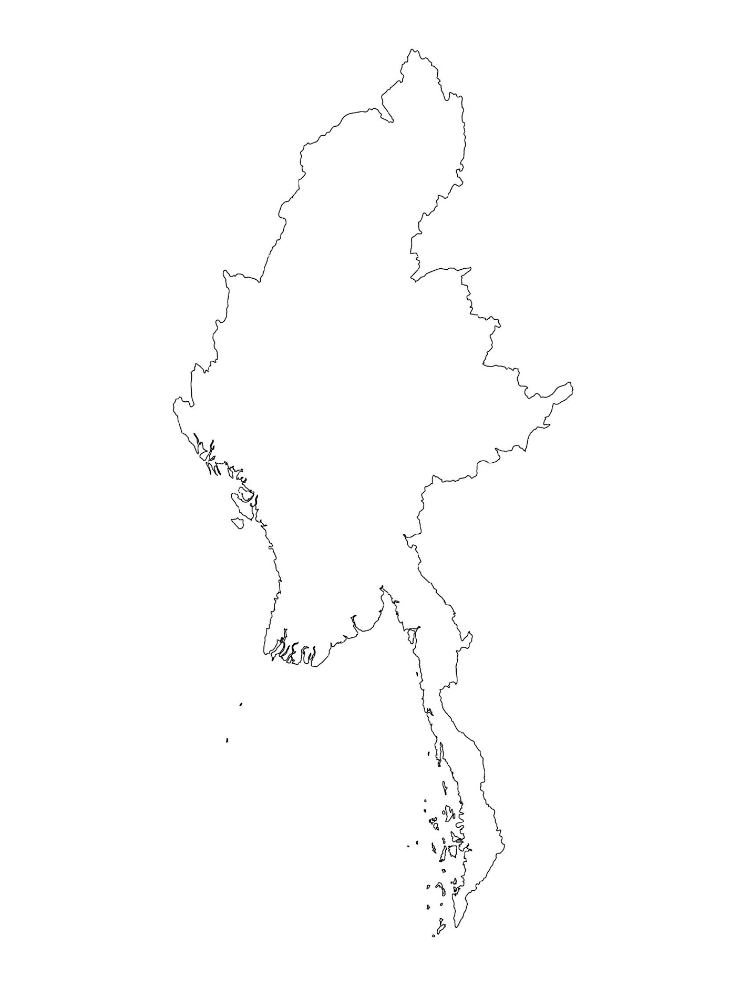
Examples from the Region
[COUNTRY NAME]
Add key presentation sentence about a specific program/project using Standard 16
Add name of organisations
Add key message / numbers
[ COUNTRY NAME]
Add key presentation sentence about a specific program/project using Standard 16
Add name of organisations
Add key message / numbers
[ COUNTRY NAME]
Add key presentation sentence about a specific program/project using Standard 16
Add name of organisations
Add key message / numbers
Notes:
Depending on the time you have for facilitation, consider adding here examples from the Region/ Country/ Response, of programming that meets the standards.
This could be a draft slide that you could update or remove if necessary.
For each example, you could add:
A short, concise, key presentation sentence about the specific program/project using Standard 16
Add the name of organisations and partners involved
Add practical lessons learnt, key actions, message or numbers, that will attract interest of your audience
Another option, if you have a longer facilitation span (and also depending on the audience you have), this slide can be completed in an interactive way during the session.
In that case, you could:
split the groups into 2 or 3 smaller groups,
allow 15 – 20 min for them to prepare a short presentation of an example from the Region/ Country/ Response, of programming that meets the standard
in plenary, have the groups present their examples, and discuss /compare lessons learnt out of them.
If you will be sending this presentation to the participants after the training, you can fill up this slide, to keep records of the presentations.
TIP: you can use https://thenounproject.com/ to get map outlines like those.

Slide 7
Need more than the hard copy?
On the Alliance website
PDF version
Briefing & Implementation Pack
25-page Summary
E-course
YouTube videos
A gallery of illustrated Standards
👉 www.AllianceCPHA.org
On the Humanitarian Standards Partnership website
Online, interactive version
HSP App for mobile phones and tablets
👉 www.HumanitarianStandardsPartnership.org
Notes:
[Facilitators - if you can project from the internet, then we suggest you navigate people there and show them]
HSP:
1. Online handbook
2. The Humanitarian Standards Partnership App
– It is the 2nd most popular app on that site after Sphere
CPMS page:
1. Interactive handbook – our greatest resource
2. A Summary: At just 32 pages, it means that it is very topline but can be used to introduce the idea of minimum standards or start child protection discussions with government colleagues or other humanitarians without overwhelming them with the huge handbook.
Alliance website:
The PDF & all materials available can be downloaded if people want to print just portions of the CPMS, on the Alliance site
The “Introduction to CPMS” Briefing Pack contains this PPT and facilitation notes, plus the 2 page Introduction handout.
A gallery of illustrated Standards
Discover our free CPMS e-course with a range of modules.
Videos on the Alliance Youtube channel
ASK: What should our next steps as a team/agency/individual be?
(i.e. you might schedule a longer meeting to digest the changes and create a plan; or ask colleagues to present certain new/revised standards and their implications for the programme; or set up a training or ask Senior Management for a meeting to discuss accountability to children, etc)
[Facilitators - Printed copies – there is a small stockpile of the Handbook and Summary that the global Alliance has in Geneva; however, countries and regions are encouraged to print & manage their own copies locally. Usually, this would be done through the inter-agency Coordination structure. On request, the Alliance can share a print-ready PDF.]
Thank you so much for coming together and starting to explore the CPMS. I will follow up on the next steps we discussed. And that’s the key – the CPMS is a gift that just keeps on giving every time you open it!

