Slide 1
The Minimum Standards for Child Protection in Humanitarian Action
CPMS
SLIDE DECK
Notes:
Facilitators:
This briefing is for any potential user of the CPMS. It is geared primarily toward child protection staff, so consider broadening some questions or providing more detail, if colleagues from other sectors join you.
It is assumed that the group is about 20 people and that everyone in the room knows each other (perhaps colleagues from your agency or the CP coordination group). if not, add 5 minutes for quick introductions.
PREPARE: a flipchart with the objectives of the session
By the end of the session, participants will be able to:
Describe the content of Standard 17
Explain & Share its key messages
Demonstrate how & why to use the handbook
NOTE: if you have already done a Session on Pillar(s), Principles or other Standard(s), skip slide 2 & 8
TIP: Slides are animated -> for each click you’ll make, some few words, a title or an image will appear on the slide.
Read the corresponding notes from the facilitators notes, before showing the following content, so participants have time to process what you say, and read each point.

Slide 2
Aim of the Standards
Benchmark for CPHA.
Collaborative, inter-agency tool
Links with Core Humanitarian Standard
Contextualisation for local ownership
Purpose:
quality and accountability
impact for children’s protection and well-being
Notes:
Donors, local governments, colleagues in other sectors and our beneficiaries themselves want to know what we are doing and why. The CPMS is our benchmark. They are the key way to operationalise or make real children's rights in the practice of humanitarian response.
They are a collaborative, inter-agency tool, that links with other initiatives, such as the Core Humanitarian Standard and the Humanitarian Inclusion Standards.
Wherever relevant, the CPMS align with INSPIRE’s 7 strategies to end violence against children – initiative’s icons are actually scattered through the text. In addition, the Core Humanitarian Standard on Quality and Accountability is highlighted in the Introduction and resonates throughout the handbook.
Contextualisation is encouraged and can create ownership of the standards at every level. It builds a deeper understanding of child protection in the specific context for a wide range of actors. National coordination groups are therefore encouraged to adapt the CPMS. Please raise it with colleagues locally and then seek the guidance of the global CPMS team. For more information, watch the short contextualization video on the Alliance’s youtube channel.
BOX: The CPMS aim at improving the quality and accountability of our programing and increasing impact for children’s protection and well-being in humanitarian action (internal displacement and refugee contexts), by establishing common principles, evidence, prevention and goals to achieve. They provide a synthesis of good practice and learning to date.

Slide 3
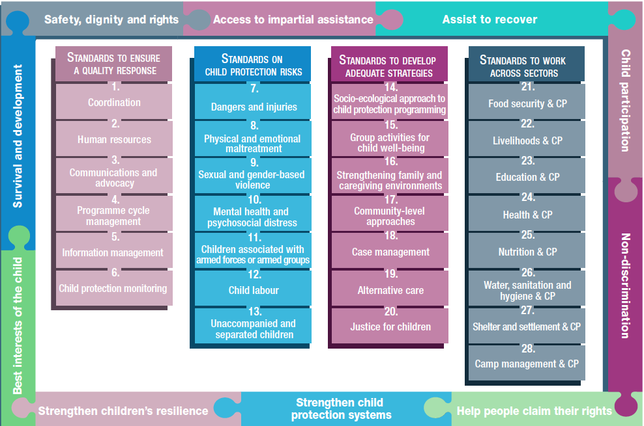
Overview
Notes:
This is an overview of the CPMS structure: there are 28 Standards across 4 pillars and 10 CPHA principles threaded throughout.
You can find this overview on the back of the CPMS handbook or in the online handbook; it’s a practical way of locating quickly a specific topic.
This presentation focuses on Standard 17: Community-led approaches

Slide 4
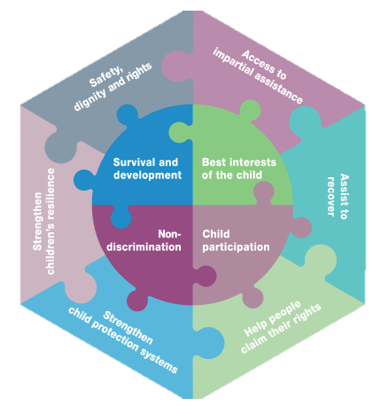
General introduction to Standard 17
Key strategies, approaches and interventions
Prevention and response to child protection risks
Initiatives, structures, processes and networks by community members, including children
Support children’s rights, safety, development, well-being and participation.
In-depth context analysis and mapping of community capacities and risk factors
Strengthen supportive practices
Influence change in practices that pose a risk
Notes:
This Standard is part of the third Pillar of Standards related to developing adequate strategies, approaches and interventions for preventing and responding to the child protection risks outlined in Pillar 2. It is structured around the socio-ecological model and also links with the INSPIRE package, where appropriate, and builds on their evidence-based strategies for preventing violence against children. Hence the ICON in the corner. The INSPIRE package has a similar goal: evidence-based strategies for preventing violence against children. More info about INSPIRE strategies on: http://inspire-strategies.org/
DEF: Community-level approaches support community members to protect children and ensure their right to healthy development. Humanitarian actors should seek to understand existing community capacities that promote children’s rights, safety, development, well-being and participation. These include initiatives, structures, processes and networks that are led and organised by community members, including children. Community-level approaches require:
A thorough understanding of the context;
An understanding and prioritisation of the needs; and
An understanding of existing practices.
-> Humanitarian actors therefore often rely on top-down approaches that are implemented in the community but do not come from the community.
Communities play a significant role in preventing and responding to risks faced by children in humanitarian settings. Communities organize themselves in a variety of ways to protect children, but these may be disrupted in humanitarian crises, particularly during displacement. We have to avoid a one-sized fits all approach and rather base community approaches on an in-depth context analysis and mapping.
Aim to strengthen and support practices that support children’s protection and influence change in practices that pose a risk
Icons: Link with INSPIRE Strategies: Safe Environments and Norms and Values.
The following should be read with this standard: Principles and Standard 14: Applying a socio-ecological approach to child protection programming.

Slide 5
“Children live in communities that promote their well-being and prevent abuse, neglect, exploitation and violence against children before, during and after humanitarian crises.”
Child protection capacities, interventions and risk factors
Build collaborative relationships
Community-led processes and ownership
Strengthen links with formal system
What does « community » mean to you ?
Notes:
Standard 17 states: “Family and caregiving environments are strengthened to promote children’s healthy development and to protect them from maltreatment and other negative effects of adversity.”
Discussion Prompt: What does « community » mean to you ?
Discuss locally and contextualized conceptions and understanding of community. If needed, complement answers with the following
-> The Alliance has a resource providing a list of common Community Based Child Protection (CBCP) - related terms and their definitions -, intending to show the evolving definitions around CBCP. Terms include
community-based
community-based child protection
community driven
formal child protection system
informal child protection system
family and kinship structures
child welfare workforce
In that resource, we can read that Community is defined geographically, emphasising a group of interacting people living in proximity in a particular location such as a village or urban neighbourhood. Frequently consists of multiple sub-groups that differ according to religion, socio-economic status, and ethnicity, and some groups may wield much more power and influence than others do
Wanna see more: https://alliancecpha.org/en/system/tdf/library/attachments/terminology_and_definitions_reference_list_lowres_0.pdf?file=1&type=node&id=33504
We have to take into account social norms and attitudes that support or weaken child protection, as well as existing child protection capacities, interventions and risk factors, to develop strategies to minimise any identified risks and address (a) negative social, power and gender norms and (b) community practices that are harmful to children
Build collaborative relationships (local civil society organisations, religious and traditional leaders and other influential community members) to monitor and support children and families who are at risk.
External agencies should avoid bringing in unfamiliar processes, concepts, structures or groups that can weaken existing resources and introduce unsustainable, culturally insensitive approaches, but rather build on communities’ resources for and commitment to children. Community-level approaches are most effective and sustainable when communities see them as meeting their collective responsibility to children.
Where appropriate, support community connections to formal child protection systems (police, social workers, health workers, child-welfare services, education services, sexual and reproductive health services, the juvenile justice system, mental health services, etc).

Slide 6
Community engagement
Prioritise their concerns
Propose solutions
Mobilise resources
Promote culturally sensitive approaches
Representation and inclusion
Financial or material resources
Capacity building
Notes:
Agencies should work with diverse members of the community and take time to allow the community to:
Prioritise their concerns;
Propose solutions; and
Mobilise resources.
We should promote culturally sensitive approaches that align with international legal and human rights standards.
Representation and inclusion:
External agencies must understand the local dynamics around children’s participation in community processes to prevent potential risks and facilitate children’s safe, voluntary and meaningful participation. Participation must include and be sensitive to the rights of all children who are at risk of discrimination.
Ensure that no harm is done to any person or group, especially those most at risk of discrimination
Consider how to accommodate refugees, internally displaced persons, stateless persons or other non-nationals & refer children who are at risk to case management [🡪 the refugee & case management icon]
However, evidence shows that introducing large sums of financial or material resources (including payments to individuals for their participation in activities) can weaken community ownership and limit sustainability. Exceptions may be made for small supports (such as phone credit, notebooks, refreshments or uniforms) that are given in exchange for performing agreed-upon responsibilities. It may be worth considering financial support to whole-community initiatives as opposed to resourcing individuals.
Capacity building should be inclusive, accessible and culturally, developmentally, age- and gender-appropriate. We should use participatory methods to build on local understandings of child protection concepts and to ensure genuine inclusiveness. We also have to include diverse representatives, not just the most powerful or influential community members.

Slide 7
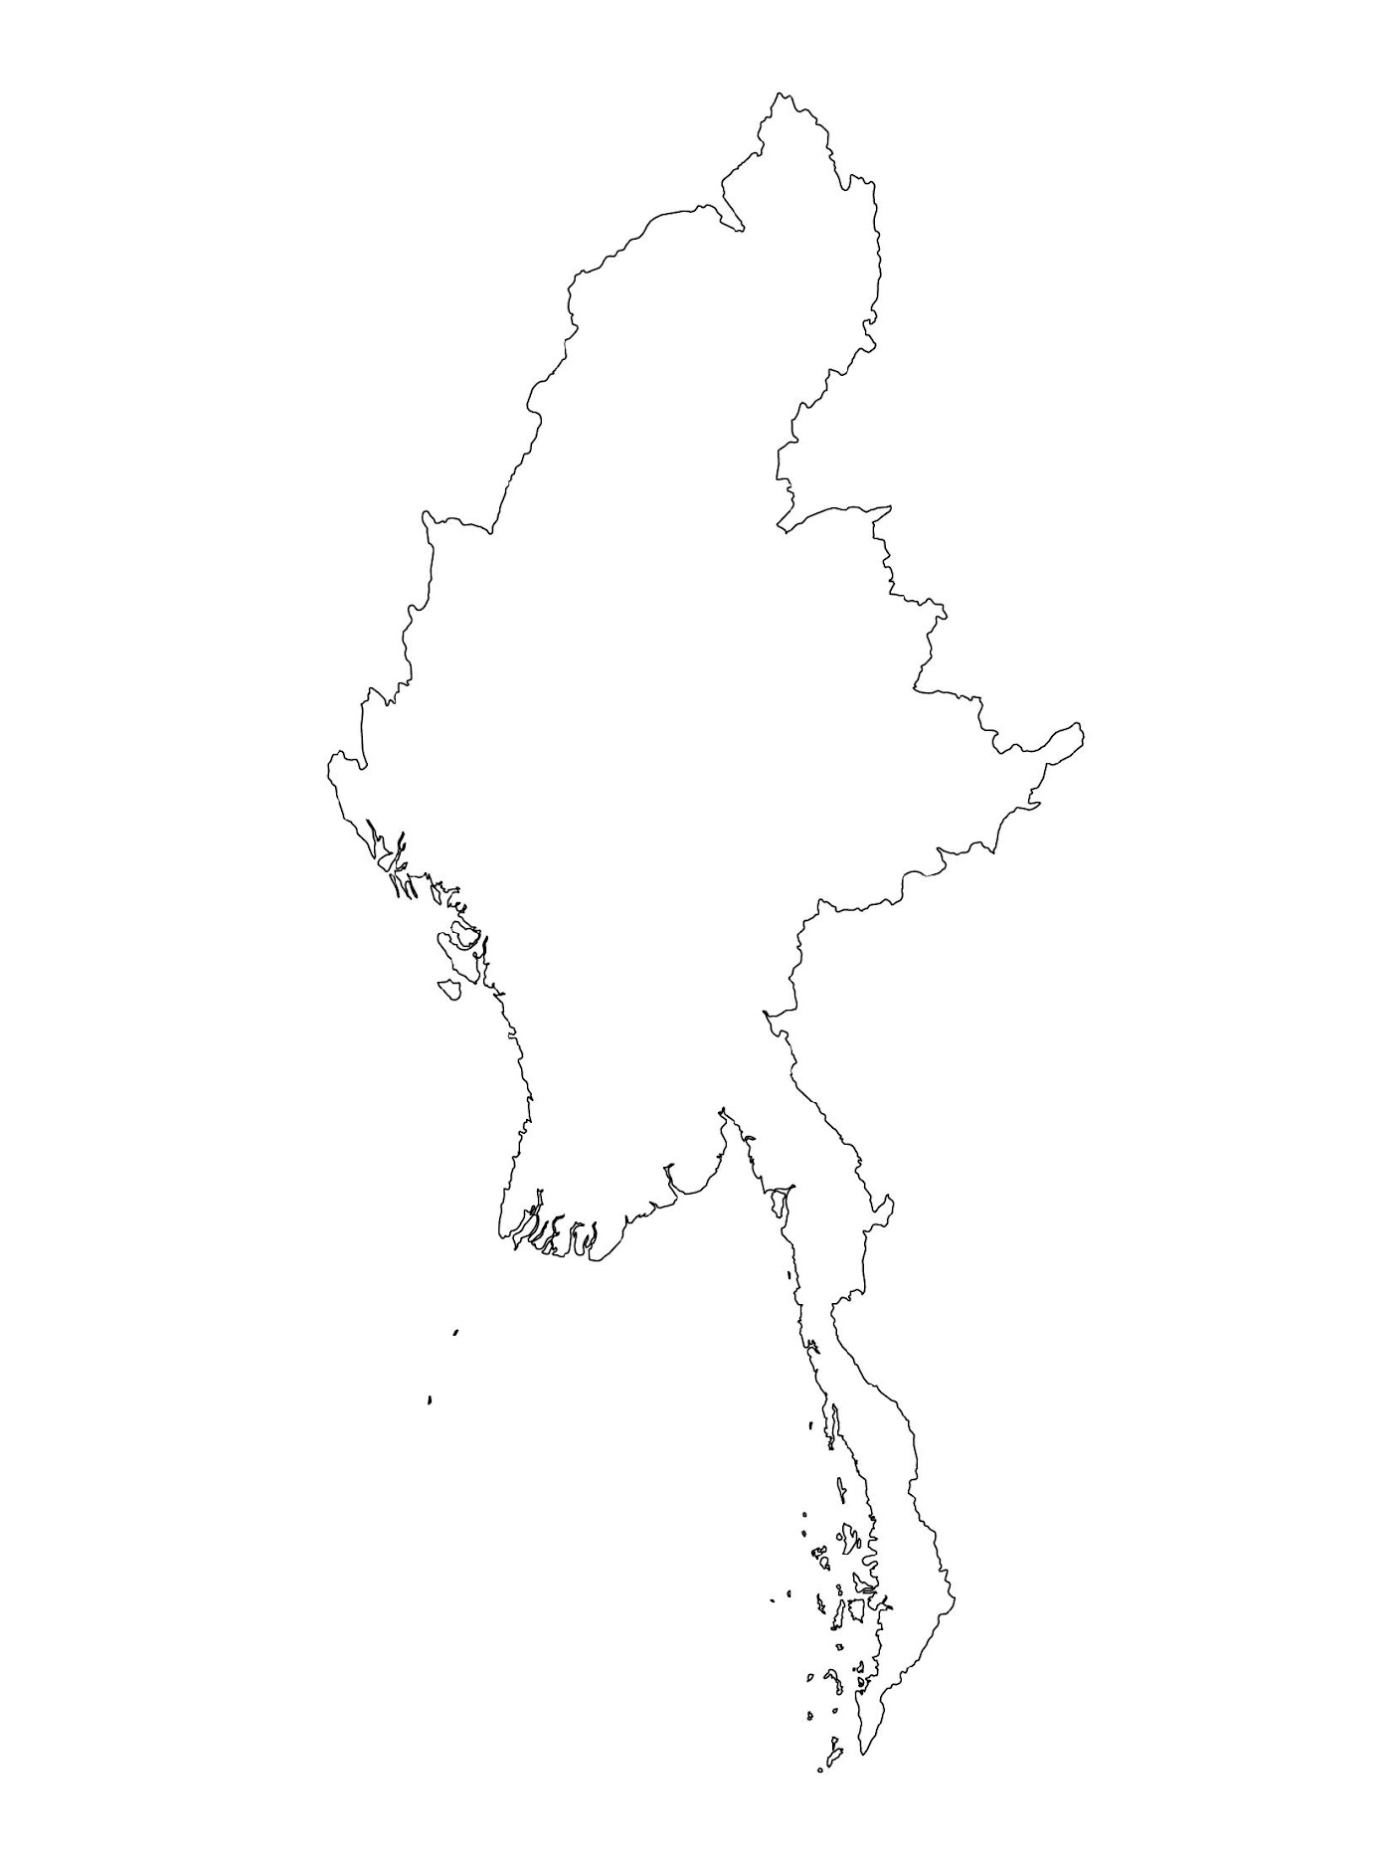
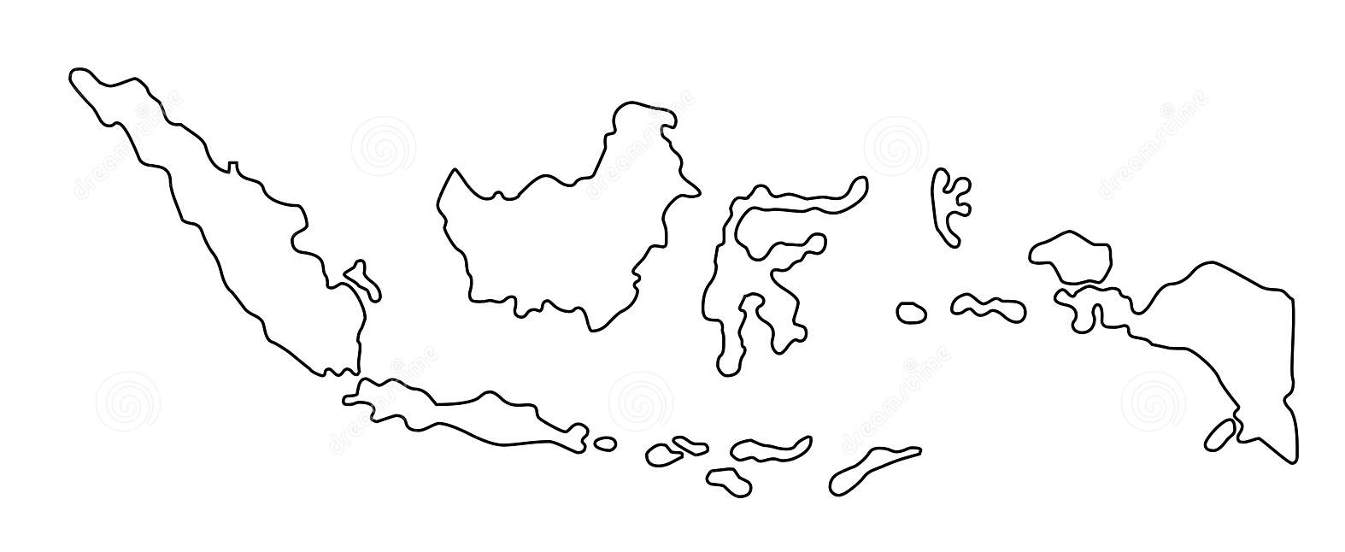
Examples from the Region
[COUNTRY NAME]
Add key presentation sentence about a specific program/project using Standard 17
Add name of organisations
Add key message / numbers
[ COUNTRY NAME]
Add key presentation sentence about a specific program/project using Standard 17
Add name of organisations
Add key message / numbers
[ COUNTRY NAME]
Add key presentation sentence about a specific program/project using Standard 17
Add name of organisations
Add key message / numbers
Notes:
Depending on the time you have for facilitation, consider adding here examples from the Region/ Country/ Response, of programming that meets the standards.
This could be a draft slide that you could update or remove if necessary.
For each example, you could add:
A short, concise, key presentation sentence about the specific program/project using Standard 17
Add the name of organisations and partners involved
Add practical lessons learnt, key actions, message or numbers, that will attract interest of your audience
Another option, if you have a longer facilitation span (and also depending on the audience you have), this slide can be completed in an interactive way during the session.
In that case, you could:
split the groups into 2 or 3 smaller groups,
allow 15 – 20 min for them to prepare a short presentation of an example from the Region/ Country/ Response, of programming that meets the standard
in plenary, have the groups present their examples, and discuss /compare lessons learnt out of them.
If you will be sending this presentation to the participants after the training, you can fill up this slide, to keep records of the presentations.
TIP: you can use https://thenounproject.com/ to get map outlines like those.

Slide 8
Need more than the hard copy?
On the Alliance website
PDF version
Briefing & Implementation Pack
25-page Summary
E-course
YouTube videos
A gallery of illustrated Standards
👉 www.AllianceCPHA.org
On the Humanitarian Standards Partnership website
Online, interactive version
HSP App for mobile phones and tablets
👉 www.HumanitarianStandardsPartnership.org
Notes:
[Facilitators - if you can project from the internet, then we suggest you navigate people there and show them]
HSP:
1. Online handbook
2. The Humanitarian Standards Partnership App
– It is the 2nd most popular app on that site after Sphere
CPMS page:
1. Interactive handbook – our greatest resource
2. A Summary: At just 32 pages, it means that it is very topline but can be used to introduce the idea of minimum standards or start child protection discussions with government colleagues or other humanitarians without overwhelming them with the huge handbook.
Alliance website:
The PDF & all materials available can be downloaded if people want to print just portions of the CPMS, on the Alliance site
The “Introduction to CPMS” Briefing Pack contains this PPT and facilitation notes, plus the 2 page Introduction handout.
A gallery of illustrated Standards
Discover our free CPMS e-course with a range of modules.
Videos on the Alliance Youtube channel
ASK: What should our next steps as a team/agency/individual be?
(i.e. you might schedule a longer meeting to digest the changes and create a plan; or ask colleagues to present certain new/revised standards and their implications for the programme; or set up a training or ask Senior Management for a meeting to discuss accountability to children, etc)
[Facilitators - Printed copies – there is a small stockpile of the Handbook and Summary that the global Alliance has in Geneva; however, countries and regions are encouraged to print & manage their own copies locally. Usually, this would be done through the inter-agency Coordination structure. On request, the Alliance can share a print-ready PDF.]
Thank you so much for coming together and starting to explore the CPMS. I will follow up on the next steps we discussed. And that’s the key – the CPMS is a gift that just keeps on giving every time you open it!

