Slide 1
The Minimum Standards for Child Protection in Humanitarian Action
CPMS
SLIDE DECK
Notes:
Facilitators:
This briefing is for any potential user of the CPMS. It is geared primarily toward child protection staff, so consider broadening some questions or providing more detail, if colleagues from other sectors join you.
It is assumed that the group is about 20 people and that everyone in the room knows each other (perhaps colleagues from your agency or the CP coordination group). if not, add 5 minutes for quick introductions.
PREPARE: a flipchart with the objectives of the session
By the end of the session, participants will be able to:
Describe the content of Standard 18
Explain & Share its key messages
Demonstrate how & why to use the handbook
NOTE: if you have already done a Session on Pillar(s), Principles or other Standard(s), skip slide 2 & 9
TIP: Slides are animated -> for each click you’ll make, some few words, a title or an image will appear on the slide.
Read the corresponding notes from the facilitators notes, before showing the following content, so participants have time to process what you say, and read each point.

Slide 2
Aim of the Standards
Benchmark for CPHA.
Collaborative, inter-agency tool
Links with Core Humanitarian Standard
Contextualisation for local ownership
Purpose:
quality and accountability
impact for children’s protection and well-being
Notes:
Donors, local governments, colleagues in other sectors and our beneficiaries themselves want to know what we are doing and why. The CPMS is our benchmark. They are the key way to operationalise or make real children's rights in the practice of humanitarian response.
They are a collaborative, inter-agency tool, that links with other initiatives, such as the Core Humanitarian Standard and the Humanitarian Inclusion Standards
Wherever relevant, the CPMS align with INSPIRE’s 7 strategies to end violence against children – initiative’s icons are actually scattered through the text. In addition, the Core Humanitarian Standard on Quality and Accountability is highlighted in the Introduction and resonates throughout the handbook.
Contextualisation is encouraged and can create ownership of the standards at every level. It builds a deeper understanding of child protection in the specific context for a wide range of actors. National coordination groups are therefore encouraged to adapt the CPMS. Please raise it with colleagues locally and then seek the guidance of the global CPMS team. For more information, watch the short contextualization video on the Alliance’s youtube channel.
BOX: The CPMS aim at improving the quality and accountability of our programing and increasing impact for children’s protection and well-being in humanitarian action (internal displacement and refugee contexts), by establishing common principles, evidence, prevention and goals to achieve. They provide a synthesis of good practice and learning to date.

Slide 3
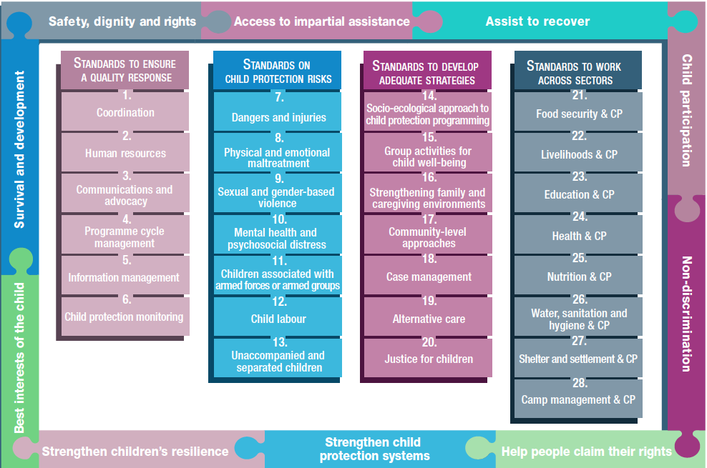
Overview
Notes:
This is an overview of the CPMS structure: there are 28 Standards across 4 pillars and 10 CPHA principles threaded throughout.
You can find this overview on the back of the CPMS handbook or in the online handbook; it’s a practical way of locating quickly a specific topic.
This presentation focuses on Standard 18: Case Management

Slide 4
Introduction to Standard 18
Key strategies, approaches and interventions
Prevention and response to child protection risks
Direct one-on-one, individualized, coordinated, holistic, multisectoral support + link to relevant service providers
Address 3 levels of the SE Model
Preparedness is key!
What principles are especially KEY to CM process?
Notes:
This Standard is part of the third Pillar of Standards related to developing adequate strategies, approaches and interventions for preventing and responding to the child protection risks outlined in Pillar 2. It is structured around the socio-ecological model and also links with the INSPIRE package, where appropriate, and builds on their evidence-based strategies for preventing violence against children. Hence the ICON in the corner. The INSPIRE package has a similar goal: evidence-based strategies for preventing violence against children. More info about INSPIRE strategies on: http://inspire-strategies.org/
DEF: Case management (CM) is an approach for addressing the needs of an individual child who is at risk of harm or has been harmed. The child and their family are supported by a caseworker in a systematic and timely manner through direct support and referrals. CM provides individualised, coordinated, holistic, multisectoral support for complex and often connected child protection concerns.
Address needs through individualized case management process, either through direct one-on-one support and/or connections to relevant service providers.
CM systems are an essential part of the child protection response. CM is implemented at three levels of the social ecological model: child, family/caregivers and community.
However, before starting CM services, preparedness is a major component. Before focusing on CM steps & forms, it is crucial to:
determine if CM is a current gap and is contextually appropriate and what approach is more suitable;
to adapt globally endorsed case management processes and tools (including SOPs, case management forms, referral pathways, information-sharing and data protection policies) to the context
to implement a phased capacity-building plan (on job descriptions, roles and responsibilities; knowledge and skills on communicating with children and families, the case management process, data protection, confidentiality, privacy and safe identification and referrals)
to coach and supervise on technical competence and practice
Icons: Link with Inspire strategies on Response and support services
Discussion Prompt:. What principles are key to CM process?
-> The views and decisions of the child and their family should direct the CM process.
-> The best interests of the child is a primary consideration.
-> CM requires adequate procedural safeguards

Slide 5
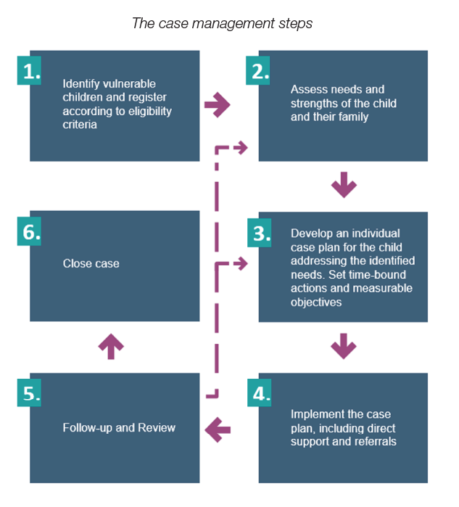
Case management steps
Not a linear process
Interconnected steps
Repetition until closure
Notes:
There are a number of core steps in the case management process as shown in the diagram. Here a detailed description of each step, If needed, but we rather advice to discuss each of them with the group:
IDENTIFICATION & REGISTRATION – A child who is in need of case management services can be identified through a variety of pathways. Staff members in child protection and other sector programmes might identify a child in the course of their regular activities, or an agency or community member might refer the child to receive case management services. In some cases, the child or their family might present themselves directly. Every programme involving case management services should outline specific vulnerability criteria to help guide this identification process and raise awareness on these within a community. Registration occurs when the child meets the vulnerability or risk criteria and both the child and their family give informed consent/assent to accept services. Registration includes the initial collection of data on the child (intake).
ASSESSMENT – The systematic evaluation of the situation of the child. This should consider the vulnerabilities, risks and harm factors, and also the protective influences and strengths and resilience of a child and their family. In emergencies, this may be a relatively quick and straightforward process concentrating on basic needs (for example food and shelter). Where there is an immediate risk to the child (for example the child is living with the perpetrator of abuse or violence), immediate intervention will be prioritized before a comprehensive assessment and case plan is developed. In a second phase, a subsequent in-depth (comprehensive) assessment is conducted to gain a holistic understanding of the child’s situation. The holistic needs of a child are always considered even if an agency is not able to address every concern directly. In such a case, the case would be referred to another agency/service provider able to address specific concern. (See later sections on referrals).
CASE PLANNING– A case plan lists the needs identified in the assessment and sets a strategy for addressing them through direct service provision, referrals and/or community-based programmes. In complex cases, a multi-disciplinary, inter-agency case conference may be called to develop a case plan. Specific, measurable, time-bound case objectives are set at this time and should ideally be reached prior to case closure. Case plans are fluid documents that can be revised at any time if a child’s situation or needs change.
IMPLEMENTING THE CASE PLAN – The actions taken in order to realise the plan including direct support and services and referral to other agencies/service providers, as appropriate. A caseworker or manager is responsible for coordinating all of these services, documenting progress, and ensuring case objectives are being met.
FOLLOW UP AND REVIEW – Follow up involves checking that a child and his/her family are receiving appropriate services and support. Follow-up also involves monitoring the child’s situation and identifying any changes in a child or family’s circumstances. Follow-up takes place throughout the case management process. Review is a reflection on how the implementation of the plan is progressing, whether the objectives outlined in the case plan are being met, whether the plan remains relevant, and how to make adjustments to the plan if necessary. Child protection working group Inter agency guidelines
CASE CLOSURE – The point at which work with the child ends. This can be for a variety of reasons – for example because the situation is resolved, (i.e. the case plan has been completed and the child no longer requires support). In some cases an organisation would close a case and transfer the child to another organisation – for example if the child moves to a different location or, in emergency situations, if the organisation is no longer working in the area, The case will also be closed where the child becomes 18 years old (unless there are good reasons to remain involved, such as additional vulnerabilities) or if the child dies
Child protection CM is not a linear process.
The steps are interconnected, and each one may require a return to an earlier stage in the process.
Steps may be repeated several times before a case is closed.
Icon: Developing and implementing accessible, responsive and confidential feedback and reporting mechanisms for children and families ensure quality CM and adequate safeguarding.

Slide 6
“Children and families who face child protection concerns in humanitarian settings are identified and have their needs addressed through an individualised case management process, including direct one-on-one support and connections to relevant service providers.”
Existing and emerging formal and informal systems and structures -> sustainability, effective transition
Based on SoPs
Quality
Best Interest Procedures
Notes:
Standard 18 states: “Children and families who face child protection concerns in humanitarian settings are identified and have their needs addressed through an individualised case management process, including direct one-on-one support and connections to relevant service providers.”
It is essential to understand and build on existing and emerging formal and informal systems and service structures that already protect children (traditional caregiving and parenting practices and any existing case management systems). Harmonising and integrating the activities of humanitarian actors with those of long-term, in-country social service workforce avoids duplication or parallel CM systems; ensures sustainability; and promotes effective transition and exit strategies.
Standard operating procedures guide CM in humanitarian settings, allowing service providers across agencies and sectors to harmonise and standardise services and approaches. Standard operating procedures should be developed in a timely manner, should be reviewed regularly as part of the humanitarian response, and developed in cooperation with all child protection case management actors.
We have to keep in mind the quality, accessibility, continuity and child-friendliness of services. Constant monitoring and evaluation allows to review, assess and adjust the process and delivery methods according to lessons learned (use of appropriate indicators, regular programme evaluation, child and family feedback interviews, accessible feedback and reporting mechanisms, supervision and coaching system, adequate and regular capacity-building of staff)

Slide 7
Best Interest Determination
Notes:
The “BEST INTERESTS PROCEDURE” (BIP) is the UNHCR case management framework for asylum-seeking and refugee children. It may also be applied to other children of concern to UNHCR in certain circumstances. BIP includes the key steps of child protection case management as well as the UNHCR Best Interests Determination (BID) process and is implemented for individual children at risk who are in need of targeted, structured, systematic, sustained and coordinated support. It ensures that decisions and actions aimed at addressing protection risks and needs for children are in their best interests. BIP is embedded within, and linked to, refugee protection case management.
All actors must adhere to BIC procedures. It is the responsibility of each individual organisation to (a) ensure that processes exist to assess what is in each child’s best interests before taking any action that affects that child and (b) take this as a primary consideration in any decisions.
UNHCR’s Best Interests Procedure is used for child refugees when State procedures are inaccessible and/or inappropriate [🡪 the refugee icon]
It is a separated procedure that can be used anytime during the case management process
Here you can see the steps of the process: for more info on each, please consult the related section from p.66 in the 2021 UNHCR Best Interests Procedure Guidelines: Assessing and Determining the Best Interests of the Child: https://casemanagement.alliancecpha.org/en/system/tdf/library/attachments/unhcr_2021_bip_guidelines-final_reduced_size.pdf?file=1&type=node&id=32335

Slide 8
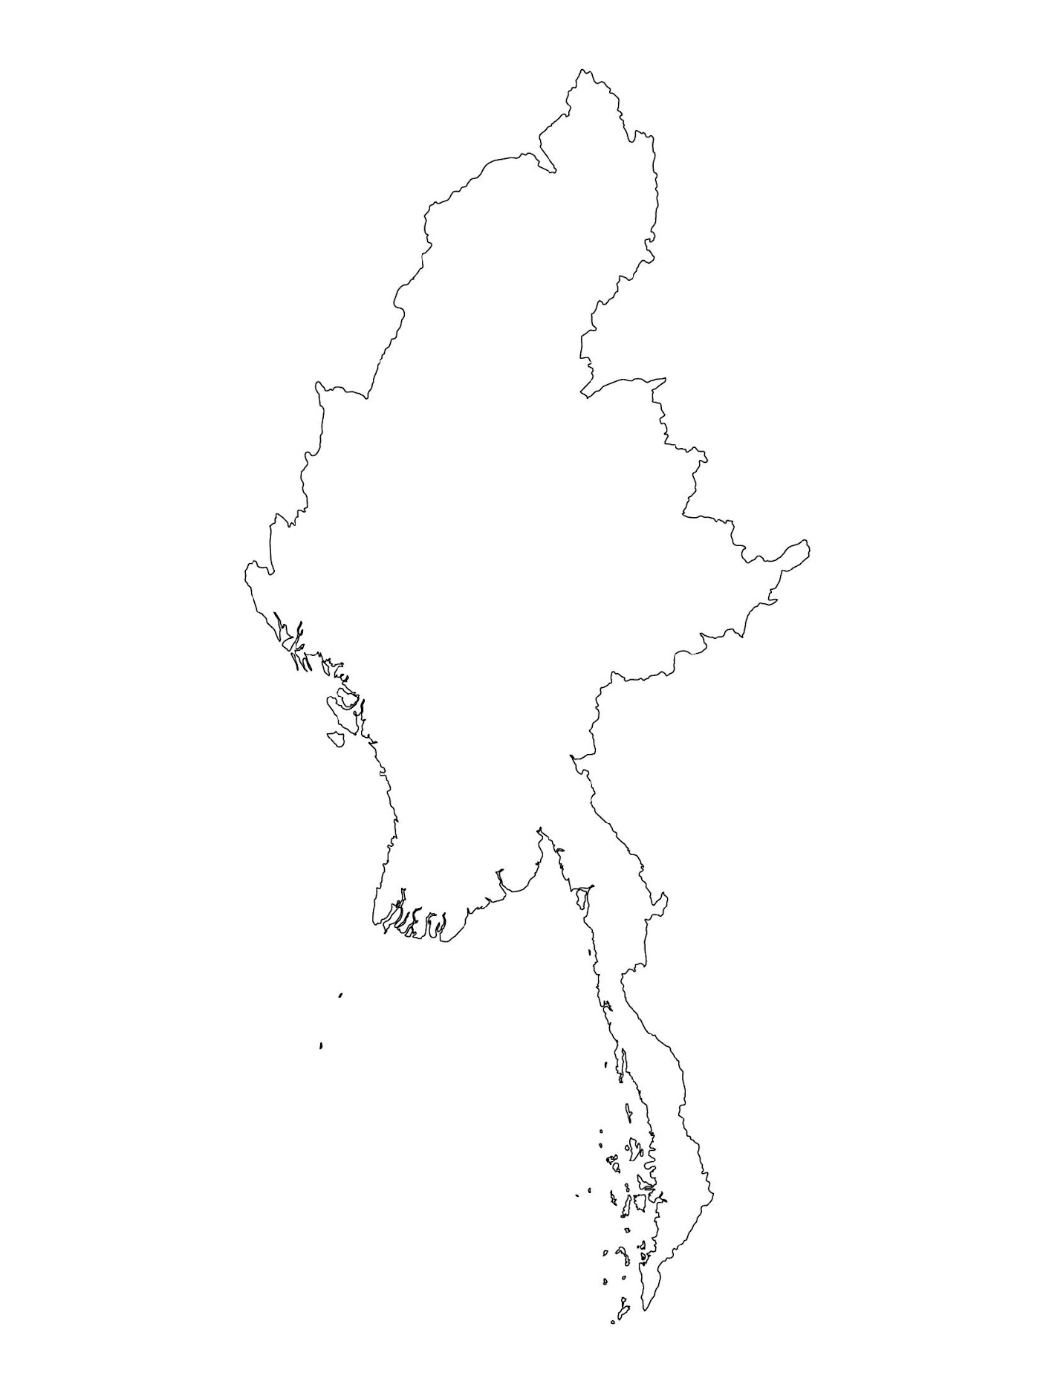
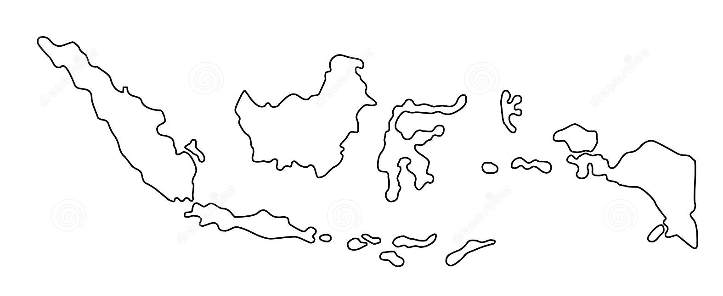
Examples from the Region
[COUNTRY NAME]
Add key presentation sentence about a specific program/project using Standard 18
Add name of organisations
Add key message / numbers
[ COUNTRY NAME]
Add key presentation sentence about a specific program/project using Standard 18
Add name of organisations
Add key message / numbers
[ COUNTRY NAME]
Add key presentation sentence about a specific program/project using Standard 18
Add name of organisations
Add key message / numbers
Notes:
Depending on the time you have for facilitation, consider adding here examples from the Region/ Country/ Response, of programming that meets the standards.
This could be a draft slide that you could update or remove if necessary.
For each example, you could add:
A short, concise, key presentation sentence about the specific program/project using Standard 18
Add the name of organisations and partners involved
Add practical lessons learnt, key actions, message or numbers, that will attract interest of your audience
Another option, if you have a longer facilitation span (and also depending on the audience you have), this slide can be completed in an interactive way during the session.
In that case, you could:
split the groups into 2 or 3 smaller groups,
allow 15 – 20 min for them to prepare a short presentation of an example from the Region/ Country/ Response, of programming that meets the standard
in plenary, have the groups present their examples, and discuss /compare lessons learnt out of them.
If you will be sending this presentation to the participants after the training, you can fill up this slide, to keep records of the presentations.
TIP: you can use https://thenounproject.com/ to get map outlines like those.

Slide 9
Need more than the hard copy?
On the Alliance website
PDF version
Briefing & Implementation Pack
25-page Summary
E-course
YouTube videos
A gallery of illustrated Standards
👉 www.AllianceCPHA.org
On the Humanitarian Standards Partnership website
Online, interactive version
HSP App for mobile phones and tablets
👉 www.HumanitarianStandardsPartnership.org
Notes:
[Facilitators - if you can project from the internet, then we suggest you navigate people there and show them]
HSP:
1. Online handbook
2. The Humanitarian Standards Partnership App
– It is the 2nd most popular app on that site after Sphere
CPMS page:
1. Interactive handbook – our greatest resource
2. A Summary: At just 32 pages, it means that it is very topline but can be used to introduce the idea of minimum standards or start child protection discussions with government colleagues or other humanitarians without overwhelming them with the huge handbook.
Alliance website:
The PDF & all materials available can be downloaded if people want to print just portions of the CPMS, on the Alliance site
The “Introduction to CPMS” Briefing Pack contains this PPT and facilitation notes, plus the 2 page Introduction handout.
A gallery of illustrated Standards
Discover our free CPMS e-course with a range of modules.
Videos on the Alliance Youtube channel
ASK: What should our next steps as a team/agency/individual be?
(i.e. you might schedule a longer meeting to digest the changes and create a plan; or ask colleagues to present certain new/revised standards and their implications for the programme; or set up a training or ask Senior Management for a meeting to discuss accountability to children, etc)
[Facilitators - Printed copies – there is a small stockpile of the Handbook and Summary that the global Alliance has in Geneva; however, countries and regions are encouraged to print & manage their own copies locally. Usually, this would be done through the inter-agency Coordination structure. On request, the Alliance can share a print-ready PDF.]
Thank you so much for coming together and starting to explore the CPMS. I will follow up on the next steps we discussed. And that’s the key – the CPMS is a gift that just keeps on giving every time you open it!

