Slide 1
The Minimum Standards for Child Protection in Humanitarian Action
CPMS
SLIDE DECK
Notes:
Facilitators:
This briefing is for any potential user of the CPMS. It is geared primarily toward child protection staff, so consider broadening some questions or providing more detail, if colleagues from other sectors join you.
It is assumed that the group is about 20 people and that everyone in the room knows each other (perhaps colleagues from your agency or the CP coordination group). if not, add 5 minutes for quick introductions.
PREPARE: a flipchart with the objectives of the session
By the end of the session, participants will be able to:
Describe the content of Standard 20
Explain & Share its key messages
Demonstrate how & why to use the handbook
NOTE: if you have already done a Session on Pillar(s), Principles or other Standard(s), skip slide 2 & 8
TIP: Slides are animated -> for each click you’ll make, some few words, a title or an image will appear on the slide.
Read the corresponding notes from the facilitators notes, before showing the following content, so participants have time to process what you say, and read each point.

Slide 2
Aim of the Standards
Benchmark for CPHA.
Collaborative, inter-agency tool
Links with Core Humanitarian Standard
Contextualisation for local ownership
Purpose:
quality and accountability
impact for children’s protection and well-being
Notes:
Donors, local governments, colleagues in other sectors and our beneficiaries themselves want to know what we are doing and why. The CPMS is our benchmark. They are the key way to operationalise or make real children's rights in the practice of humanitarian response.
They are a collaborative, inter-agency tool, that links with other initiatives, such as the Core Humanitarian Standard and the Humanitarian Inclusion Standards
Wherever relevant, the CPMS align with INSPIRE’s 7 strategies to end violence against children – initiative’s icons are actually scattered through the text. In addition, the Core Humanitarian Standard on Quality and Accountability is highlighted in the Introduction and resonates throughout the handbook.
Contextualisation is encouraged and can create ownership of the standards at every level. It builds a deeper understanding of child protection in the specific context for a wide range of actors. National coordination groups are therefore encouraged to adapt the CPMS. Please raise it with colleagues locally and then seek the guidance of the global CPMS team. For more information, watch the short contextualization video on the Alliance’s youtube channel.
BOX: The CPMS aim at improving the quality and accountability of our programing and increasing impact for children’s protection and well-being in humanitarian action (internal displacement and refugee contexts), by establishing common principles, evidence, prevention and goals to achieve. They provide a synthesis of good practice and learning to date.

Slide 3
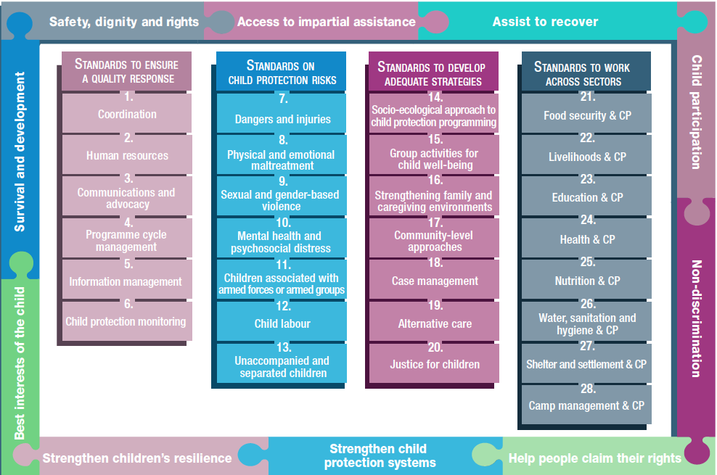
Overview
Notes:
This is an overview of the CPMS structure: there are 28 Standards across 4 pillars and 10 CPHA principles threaded throughout.
You can find this overview on the back of the CPMS handbook or in the online handbook; it’s a practical way of locating quickly a specific topic.
This presentation focuses on Standard 20: Justice for children

Slide 4
An introduction to Standard 20
Key strategies, approaches and interventions
Prevention and response to child protection risks
Contact with formal and informal justice systems w/ child-friendly, non-discriminatory & tailored services
Assess legal and justice systems
Reinforce protection and overcome risks
Protect through formal and customary laws
How may children interact with justice systems ?
Notes:
This Standard is part of the third Pillar of Standards related to developing adequate strategies, approaches and interventions for preventing and responding to the child protection risks outlined in Pillar 2. It is structured around the socio-ecological model and also links with the INSPIRE package, where appropriate, and builds on their evidence-based strategies for preventing violence against children. Hence the ICON in the corner. The INSPIRE package has a similar goal: evidence-based strategies for preventing violence against children. More info about INSPIRE strategies on: http://inspire-strategies.org/
The aim of this Standard is to ensure children in contact with formal and informal justice systems are treated in a child-friendly, non-discriminatory manner and receive services tailored to their needs and best interests.
Using the socio-ecological model, we can collaborate with the full range of actors to (a) assess the ways in which legal and justice systems at all levels either provide protection or present risks, (b) develop interventions to reinforce protection and overcome risks and (c) make efforts to protect children through formal and customary laws
Icons: Link with Inspire strategies on Response and support services + Implementation and enforcement of laws
Discussion Prompt: How may children interact with justice systems ?
-> Children can interact with justice systems as witnesses, victims (survivors), accused, potential wrongdoers, convicted offenders or a combination of these.
You could follow up by asking for how these interactions may change in a humanitarian setting.

Slide 5
Actions
“All children in contact with formal and informal justice systems during a humanitarian crisis are treated in a child-friendly, non-discriminatory manner in line with international norms and standards and receive services tailored to their needs and best interests.”
Monitoring and documentation activities
Advocacy
Capacity-strengthening
Awareness-raising activities
Coordination
Notes:
Standard 20 states: “All children in contact with formal and informal justice systems during a humanitarian crisis are treated in a child-friendly, non-discriminatory manner in line with international norms and standards and receive services tailored to their needs and best interests.”
From the earliest possible stage in the emergency, it is important to document (a) patterns of violations against children in contact with the law and (b) situations that lead to that contact. It provides a basis for evidence-based advocacy in support of an effective national and international response.
Advocacy should focus on (a) enforcing laws that protect children, (b) stopping current violations (beginning with those with the most severe effect on children), and (c) preventing future violations (including through legal reform). Advocacy should be supported by evidence gathered during monitoring and documentation activities.
Capacity-strengthening on appropriate handling of children’s cases (cases of children formerly associated with armed forces or groups and victims of sexual exploitation or trafficking); on child-friendly procedures and processes; on border and reception arrangements (that must be child-sensitive; respect international standards; and use alternatives to detention)…
Awareness-raising activities of community-level reporting mechanisms for child victims and witnesses of crime; on international standards for admission and reception at borders; on alternatives to detention (including immigration detention of all children who are refugees or migrants….)
From the beginning of a crisis, it is important to create or strengthen a coordination platform for professionals and caregivers (such as justice, security, medical, social, community, family) that builds on existing resources and structures.

Slide 6
Strategies to enforce or establish children’s rights
Strategies to overcome risks in formal and informal justice systems
Child protection laws implementation
Criminalise abuse, neglect, exploitation and violence
Customary / national / international laws alignment
Best Interests of the Child & child rights training
Age/Development-appropriate communication training
Juvenile justice approaches
Detention as last resort & Alternatives to detention
Facilities improvements
Notes:
Justice for children can be protective. It may help enforce or establish children’s rights or strengthen legal instruments that do so. Actions in this area include:
Strengthening the implementation and awareness of existing child protection laws;
Advocating for or supporting the development of new laws that criminalise abuse, neglect, exploitation and violence against children.
Facilitating the alignment of and links between customary and national legal systems and international laws
Unfortunately, this contact w/ the law can lead to additional protection risks that are caused by formal and informal justice actors. Humanitarian actors can help mitigate those risks and support children to fulfil their rights when interacting with justice systems. Strategies for overcoming the risks that both formal and informal justice systems may present include:
Training service providers on the rights and best interests of children in contact with the law;
Training justice actors on developmentally and age-appropriate ways of communicating with children;
Supporting juvenile justice approaches that allow children to be accountable to society without being formally processed as a criminal;
Working with States to create practical alternatives that can end the immigration detention of all children who are refugees or migrants;
Detaining children only as a last resort and only for the shortest period possible in age- and gender-segregated facilities; and
Communicating clearly with children in developmentally and age-appropriate ways at all stages of any judicial process.

Slide 7
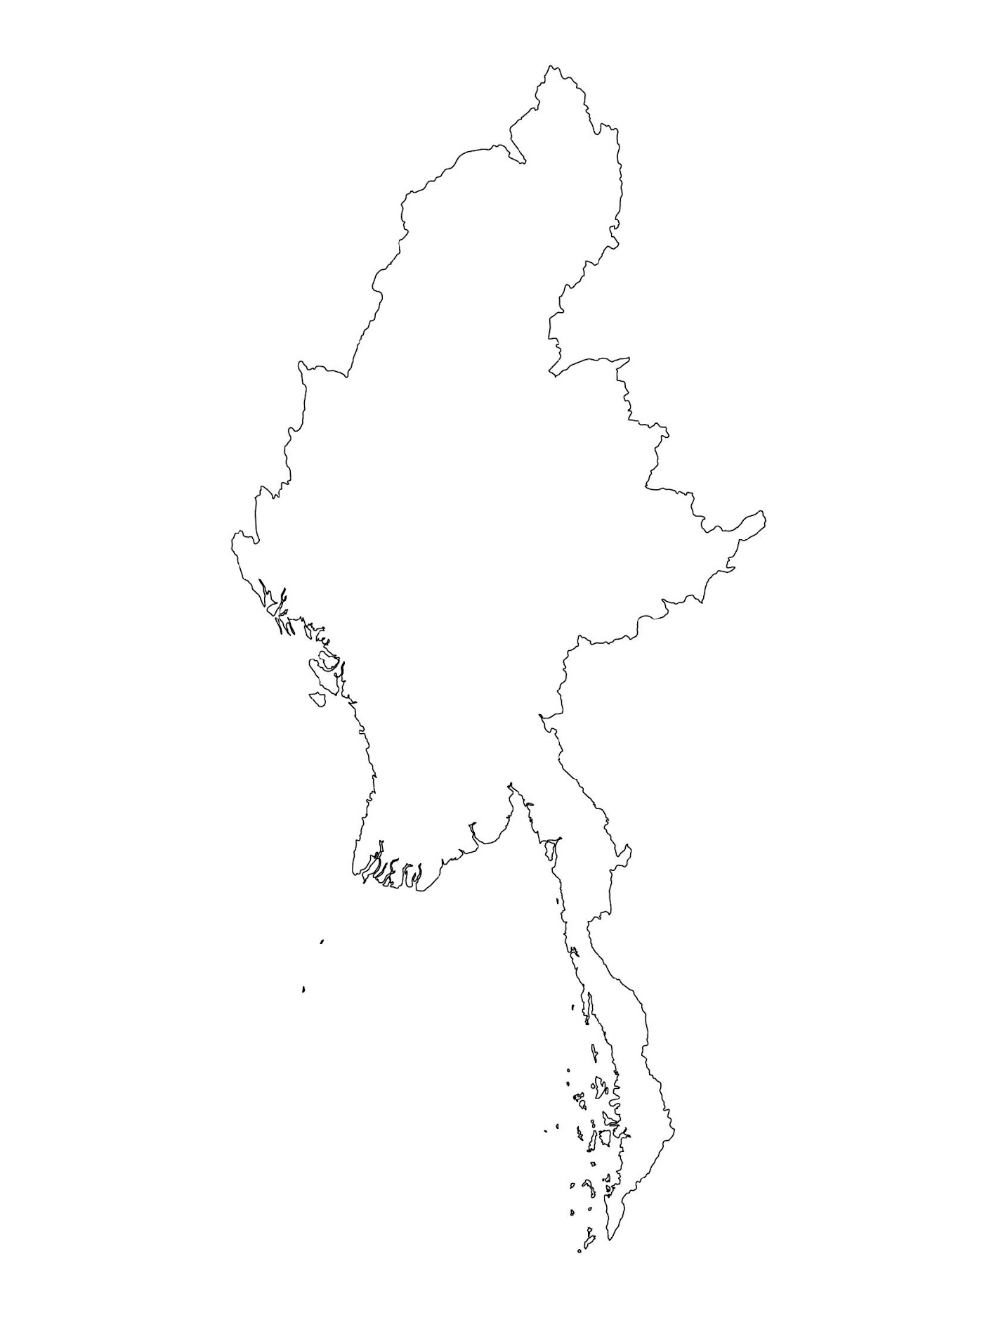
Examples from the Region
[COUNTRY NAME]
Add key presentation sentence about a specific program/project using Standard 20
Add name of organisations
Add key message / numbers
[ COUNTRY NAME]
Add key presentation sentence about a specific program/project using Standard 20
Add name of organisations
Add key message / numbers
[ COUNTRY NAME]
Add key presentation sentence about a specific program/project using Standard 20
Add name of organisations
Add key message / numbers
Notes:
Depending on the time you have for facilitation, consider adding here examples from the Region/ Country/ Response, of programming that meets the standards.
This could be a draft slide that you could update or remove if necessary.
For each example, you could add:
A short, concise, key presentation sentence about the specific program/project using Standard 20
Add the name of organisations and partners involved
Add practical lessons learnt, key actions, message or numbers, that will attract interest of your audience
Another option, if you have a longer facilitation span (and also depending on the audience you have), this slide can be completed in an interactive way during the session.
In that case, you could:
split the groups into 2 or 3 smaller groups,
allow 15 – 20 min for them to prepare a short presentation of an example from the Region/ Country/ Response, of programming that meets the standard
in plenary, have the groups present their examples, and discuss /compare lessons learnt out of them.
If you will be sending this presentation to the participants after the training, you can fill up this slide, to keep records of the presentations.
TIP: you can use https://thenounproject.com/ to get map outlines like those.

Slide 8
Need more than the hard copy?
On the Alliance website
PDF version
Briefing & Implementation Pack
25-page Summary
E-course
YouTube videos
A gallery of illustrated Standards
👉 www.AllianceCPHA.org
On the Humanitarian Standards Partnership website
Online, interactive version
HSP App for mobile phones and tablets
👉 www.HumanitarianStandardsPartnership.org
Notes:
[Facilitators - if you can project from the internet, then we suggest you navigate people there and show them]
HSP:
1. Online handbook
2. The Humanitarian Standards Partnership App
– It is the 2nd most popular app on that site after Sphere
CPMS page:
1. Interactive handbook – our greatest resource
2. A Summary: At just 32 pages, it means that it is very topline but can be used to introduce the idea of minimum standards or start child protection discussions with government colleagues or other humanitarians without overwhelming them with the huge handbook.
Alliance website:
The PDF & all materials available can be downloaded if people want to print just portions of the CPMS, on the Alliance site
The “Introduction to CPMS” Briefing Pack contains this PPT and facilitation notes, plus the 2 page Introduction handout.
A gallery of illustrated Standards
Discover our free CPMS e-course with a range of modules.
Videos on the Alliance Youtube channel
ASK: What should our next steps as a team/agency/individual be?
(i.e. you might schedule a longer meeting to digest the changes and create a plan; or ask colleagues to present certain new/revised standards and their implications for the programme; or set up a training or ask Senior Management for a meeting to discuss accountability to children, etc)
[Facilitators - Printed copies – there is a small stockpile of the Handbook and Summary that the global Alliance has in Geneva; however, countries and regions are encouraged to print & manage their own copies locally. Usually, this would be done through the inter-agency Coordination structure. On request, the Alliance can share a print-ready PDF.]
Thank you so much for coming together and starting to explore the CPMS. I will follow up on the next steps we discussed. And that’s the key – the CPMS is a gift that just keeps on giving every time you open it!

