Slide 1
The Minimum Standards for Child Protection in Humanitarian Action
CPMS
SLIDE DECK
Notes:
Facilitators:
This briefing is for any potential user of the CPMS. It is geared primarily toward child protection staff, so consider broadening some questions or providing more detail, if colleagues from other sectors join you.
It is assumed that the group is about 20 people and that everyone in the room knows each other (perhaps colleagues from your agency or the CP coordination group). if not, add 5 minutes for quick introductions.
PREPARE: a flipchart with the objectives of the session
By the end of the session, participants will be able to:
Describe the content of Standard 23
Explain & Share its key messages
Demonstrate how & why to use the handbook
NOTE: if you have already done a Session on Pillar(s), Principles or other Standard(s), skip slide 2 & 8
TIP: Slides are animated -> for each click you’ll make, some few words, a title or an image will appear on the slide.
Read the corresponding notes from the facilitators notes, before showing the following content, so participants have time to process what you say, and read each point.

Slide 2
Aim of the Standards
Benchmark for CPHA
Collaborative, inter-agency tool
Links with Core Humanitarian Standard / HSP
Contextualisation for local ownership
Purpose:
quality and accountability
impact for children’s protection and well-being
Notes:
Donors, local governments, colleagues in other sectors and our beneficiaries themselves want to know what we are doing and why. The CPMS are our benchmark. They are the key way to operationalise or make real children's rights in the practice of humanitarian response.
They are a collaborative, inter-agency tool, that links with other initiatives, such as the Core Humanitarian Standard and the Humanitarian Inclusion Standards
Wherever relevant, the CPMS align with INSPIRE’s 7 strategies to end violence against children – initiative’s icons are actually scattered through the text. In addition, the Core Humanitarian Standard on Quality and Accountability is highlighted in the Introduction and resonates throughout the handbook.
Contextualisation is encouraged and can create ownership of the standards at every level. It builds a deeper understanding of child protection in the specific context for a wide range of actors. National coordination groups are therefore encouraged to adapt the CPMS. Please raise it with colleagues locally and then seek the guidance of the global CPMS team. For more information, watch the short contextualization video on the Alliance’s youtube channel.
BOX: The CPMS aim at improving the quality and accountability of our programing and increasing impact for children’s protection and well-being in humanitarian action (internal displacement and refugee contexts), by establishing common principles, evidence, prevention and goals to achieve. They provide a synthesis of good practice and learning to date.

Slide 3
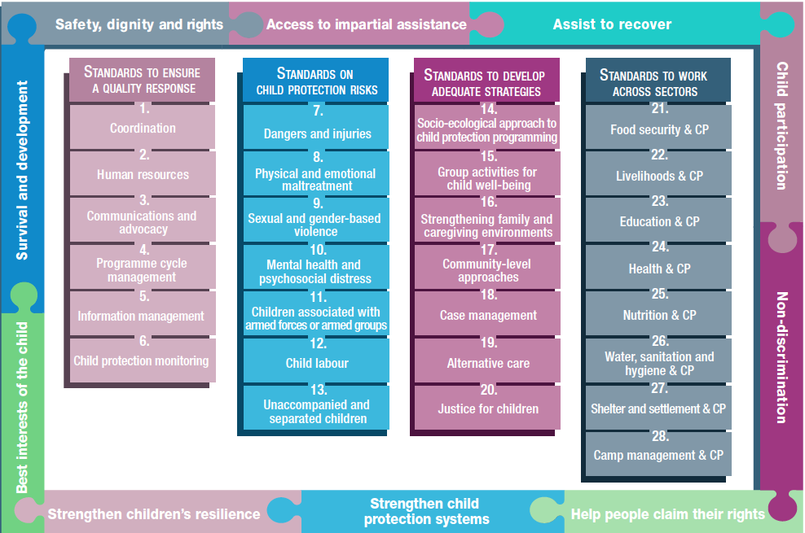
Overview
Notes:
This is an overview of the CPMS structure: there are 28 Standards across 4 pillars and 10 CPHA principles threaded throughout.
You can find this overview on the back of the CPMS handbook or in the online handbook; it’s a practical way of locating quickly a specific topic.
CLICK This presentation introduces Standard 23: Education & Child Protection. Be sure to check out the INEE/Alliance e-module for more learning.

Slide 4
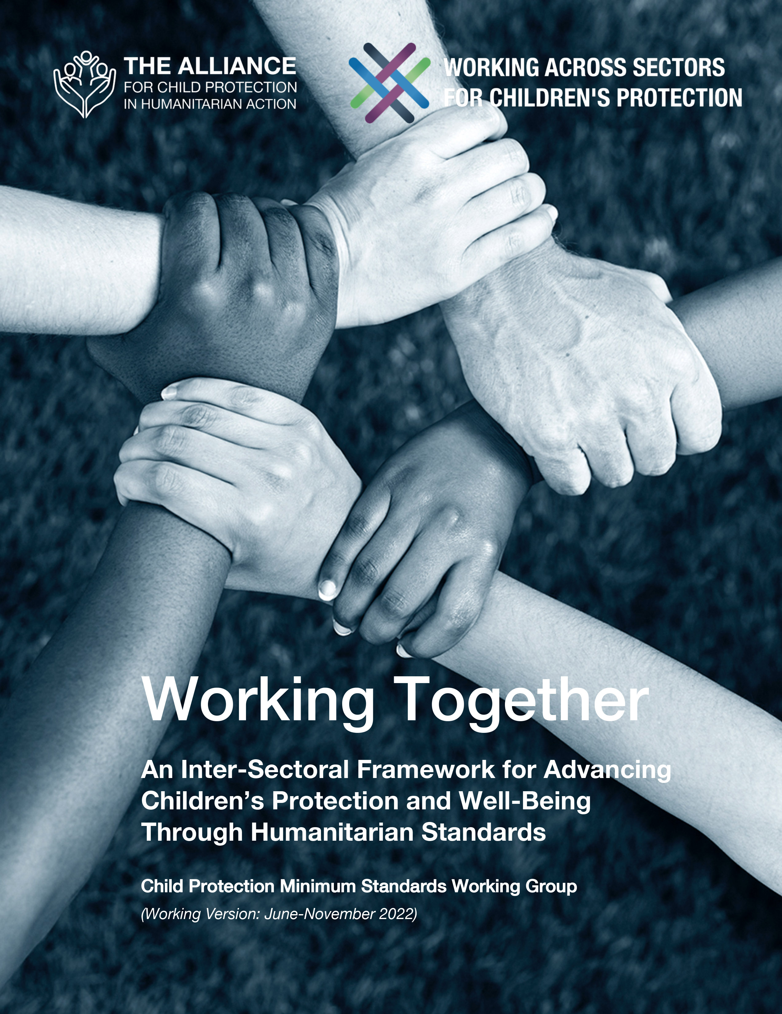
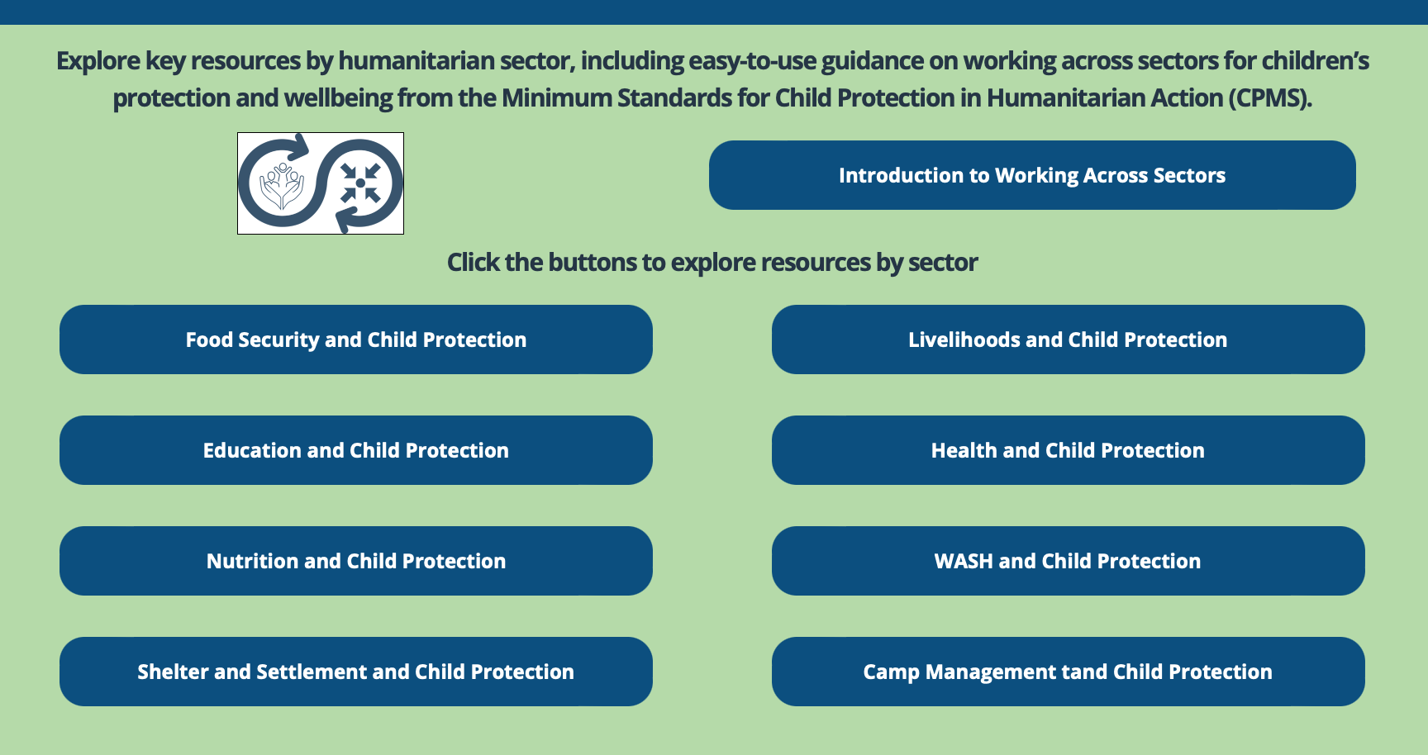
Working Together
Interconnected needs of children
Collective responsibility = Centrality of Protection
Higher-quality impact
Notes:
The CPMS have a complete section devoted to Child Protection personnel working with and learning from other humanitarian actors to improve protection and well-being outcomes for children.
CLICK: Multisectoral approaches reflect the interconnected needs of children and emphasise
CLICK: all humanitarian actors’ collective responsibility to protect children and their families. Children’s protection risks are closely linked with the work of humanitarian actors because they have needs that fall under all sectors.
CLICK: Multisectoral programming - that includes and addresses child protection considerations (such as children’s particular risks, vulnerabilities, developmental stages, etc.) can be an effective way to achieve real, higher quality outcomes for both / all sectors.
CLICK: Working Together is an inter-sectoral framework to promote children’s protection and well-being using humanitarian standards. It was created through a large-scale, consultative process, and is updated every 6 months. Currently, the prioritized sectors are: health, education, Food Security, and Camp Coordination and Camp Management.
CLICK: Check out the microsite for the global Working across Sectors initiative and the sector-specific resource folders.

Slide 5
An introduction to Standard 23
Many natural links & goals: resilience, development, cohesion, life skills, capacities…
Participatory, inclusive, positive discipline and gender-sensitive approaches
Safe & inclusive environments
How could lack of access to education impact a child in a humanitarian setting?
Notes:
This standard outlines how education and child protection actors can work together more systematically, based on complementarity, to support children’s well-being. For in-depth education guidance, refer to the INEE Minimum Standards, and the INEE and the Alliance’s Guidance Notes for CPHA-EiE Integrated Programming
Both education and child protection actors focus on children in and/or out of formal education/schools/non formal education settings. So many activities are conducted jointly, and each sector will have advantages in reaching certain groups of children (in school, out of school, e.g.) and technical capacities in delivering certain activities.
Appropriate approaches (like participatory, inclusive, positive discipline and gender-sensitive approaches) should align with both child protection and education minimum standards and be adapted in-country.
Learning centers should meet ‘Safety criteria’, that are determined in-country. They could include: safe and secure infrastructure, location cleared of explosive ordnance (EO), appropriate facilities, sufficient space, accessibility (both in and around the learning centre), and inclusive environments (in terms of location, gender, language, race, religion, learning environment).
All key actions in this standard apply to both sectors’ actors.
Icons: there are numerous linkages between Education & Prevention / Safeguarding/Adolescence/Refugee & Infectious Disease Outbreaks contexts. For instance, by developing teacher training curricula, you can support more protective learning environments by including training on psychological first aid; social and emotional learning; gender- and disability-sensitive approaches; positive discipline; participatory methods; and child protection principles and concerns (prevention)
You can safeguard children’s rights by prohibiting physical and other degrading forms of punishment (Safeguarding). Joint interventions can be planned for children ages 0–5 & educational options for adolescents (Adolescence & Early Childhood)
It is important to advocate for access to educational opportunities for all children, including girls, children with disabilities and children who are refugees or stateless (refugee contexts)
The role of schools in preventing the spread of infectious diseases is also very important in Infectious Disease Outbreaks contexts
Discussion Prompt: What could be the negative impact of lack of access to education?
Discuss local example of negative impacts and then complete answers
-> A lack of access to education has direct negative impacts on children’s well-being and development. Children who are out of school can face greater child protection risks (labour, engagement into illicit activities & armed groups, into sexual trade etc….). Child protection concerns can prevent children from accessing education or can decrease educational outcomes.

Slide 6
“All children have access to quality education that is protective and inclusive and that promotes dignity and participation throughout all essential activities.”
Resilience
Development
Risk mitigation
Relationships and cohesion
Life skills
Out of school children identification
Identification & Safe referral
Notes:
Standard 23 states the following: “All children have access to quality education that is protective and inclusive and that promotes dignity and participation throughout all essential activities.”
Strengthened collaboration between child protection and education actors can:
Increase children’s resilience;
Support psychosocial, cognitive and physical development;
Mitigate protection risks;
Support positive peer relationships and social cohesion;
Promote essential life skills that support children’s capacities and confidence;
Help identify and refer out of school children into school and to receive the education supports they require
Help identify and refer children in school who are in need of specialized protection services. Multisectoral referral pathways must be developed and education workers trained on how to safely refer children with protection needs
Ideally, school should be an inclusive and protective learning environment that promote safety, participation and respect for all children. Educators must be trained on child-centred, participatory teaching methods, managing gender- and disability-sensitive classrooms and positive discipline.
-> In terms of implementation, collaboration can enhance the effectiveness, coherence, and efficiency of delivering programmes by reducing duplication, maximising efficiency by using joint spaces, human resources, etc. and children receive better quality and comprehensive services.

Slide 7
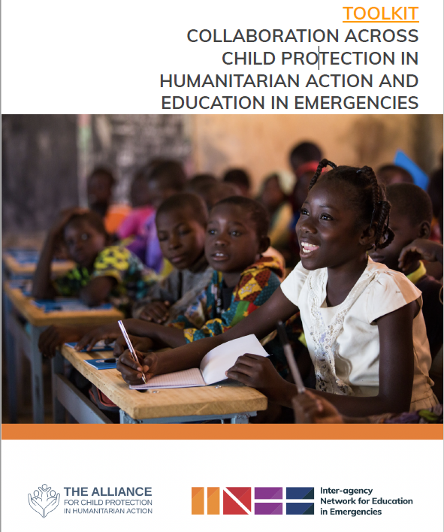
Joint response actions
Child-friendly measures
Feedback and reporting mechanisms
Barriers to accessing education removal, including protection concerns
Caregivers, parent-teacher associations and other educators groups
Education personnel’s training and well-being
Flexibility and adaptation
Notes:
Supporting and ensuring the well-being of teachers and education administrative personnel is important for promoting protective learning environments. Activities may include providing teachers with peer support and continuous professional development; providing mental health and psychosocial support services to teachers who have been affected by traumatic events; limiting class size; and preventing unrealistic expectations of teachers
Flexibility in the way schools are administered can increase enrolment and retention. It may be possible to modify class schedules, yearly timetables and facility design. Decisions regarding location, costs and temporary or permanent educational facilities should be made in collaboration with children, families, communities and relevant authorities. If it is unsafe for children to travel to school or gather in groups, flexible alternatives such as mobile classes may be appropriate.
Response actions:
We should implement child-friendly measures to prevent and respond to any form of maltreatment, exploitation or harassment, including online abuse (Safe, user-friendly reporting and referral pathways; Community training on where and how to report or prevent incidents; Safe, timely and ethical responses to reports of maltreatment committed by education workers, students or others; and Community awareness of relevant codes of conduct)
Develop, monitor and evaluate feedback and reporting mechanisms.
Education and CP staff have to aim at removing barriers to accessing education, including protection concerns in and around learning environments.
Primary caregivers, parent-teacher associations and other educators groups can be supported to learn about positive child caregiving; anti-bullying and anti-discrimination interventions; and other topics related to child protection.
Image: the Alliance and INEE have a joint project on CP-EiE collaboration. A draft toolkit is available. This tool goes further into prioritising response actions/areas, as well digging into capacity building frameworks. Do not hesitate to consult this for further information on EiE/CPiE

Slide 8
Joint response actions /2
Remember
Coordinate with both cluster/sector/working groups to determine how the two sectors can best work together
Educational facilities improvement
CP topics and positive discipline
Joint work on MHPSS
Making schools a safe environment
Promoting equity
In what ways can education be adjusted to promote equity in a humanitarian setting?
Notes:
Joint actions could also include :
Improving children’s safe, dignified access to educational facilities (such as appropriate sanitation facilities) also decrease the risk of school dropout.
teacher trainings on CP topics and positive discipline
Joint work on MHPSS: determining who does what between in school and after school MHPSS services, and ensure coverage at each layer of the MHPSS pyramid (and referrals between layers)
Joint work on making schools a safe environment - including on positive discipline and codes of conduct (internal via teacher training) and safe from external factors including attacks on education and preparedness for natural disasters / security incidents.
Equity in education requires adjustments for children with different personal, economic or social resources that influence their access to education and their ability to learn:
Discussion Prompt: In what ways can education be adjusted to promote equity?
-> Adjustments that promote equity include:
Reviewing curricula for discrimination and/or harmful content;
Providing free learning materials to children;
Providing menstrual hygiene products and awareness;
Supporting teachers to effectively teach children who need additional assistance (such as providing teachers’ assistants or school-based family support workers); and
Collaborating with child protection and gender-based violence specialists to encourage positive social change, particularly related to equality and safe access to education for gilrs; Children of diverse sexual orientation, gender identity and expression, and sex characteristics; Children in conflict with the law; Children accused of witchcraft; Children with disabilities; Children who are refugees, displaced or migrants; and Any other children who may be stigmatised by their communities
Reminder: Joint programming and integrated responses should involve INTER-SECTOR COLLABORATION AND PLANNING AT THE CLUSTER/SECTOR LEVEL for greatest coordination and systematization of joint responses.

Slide 9
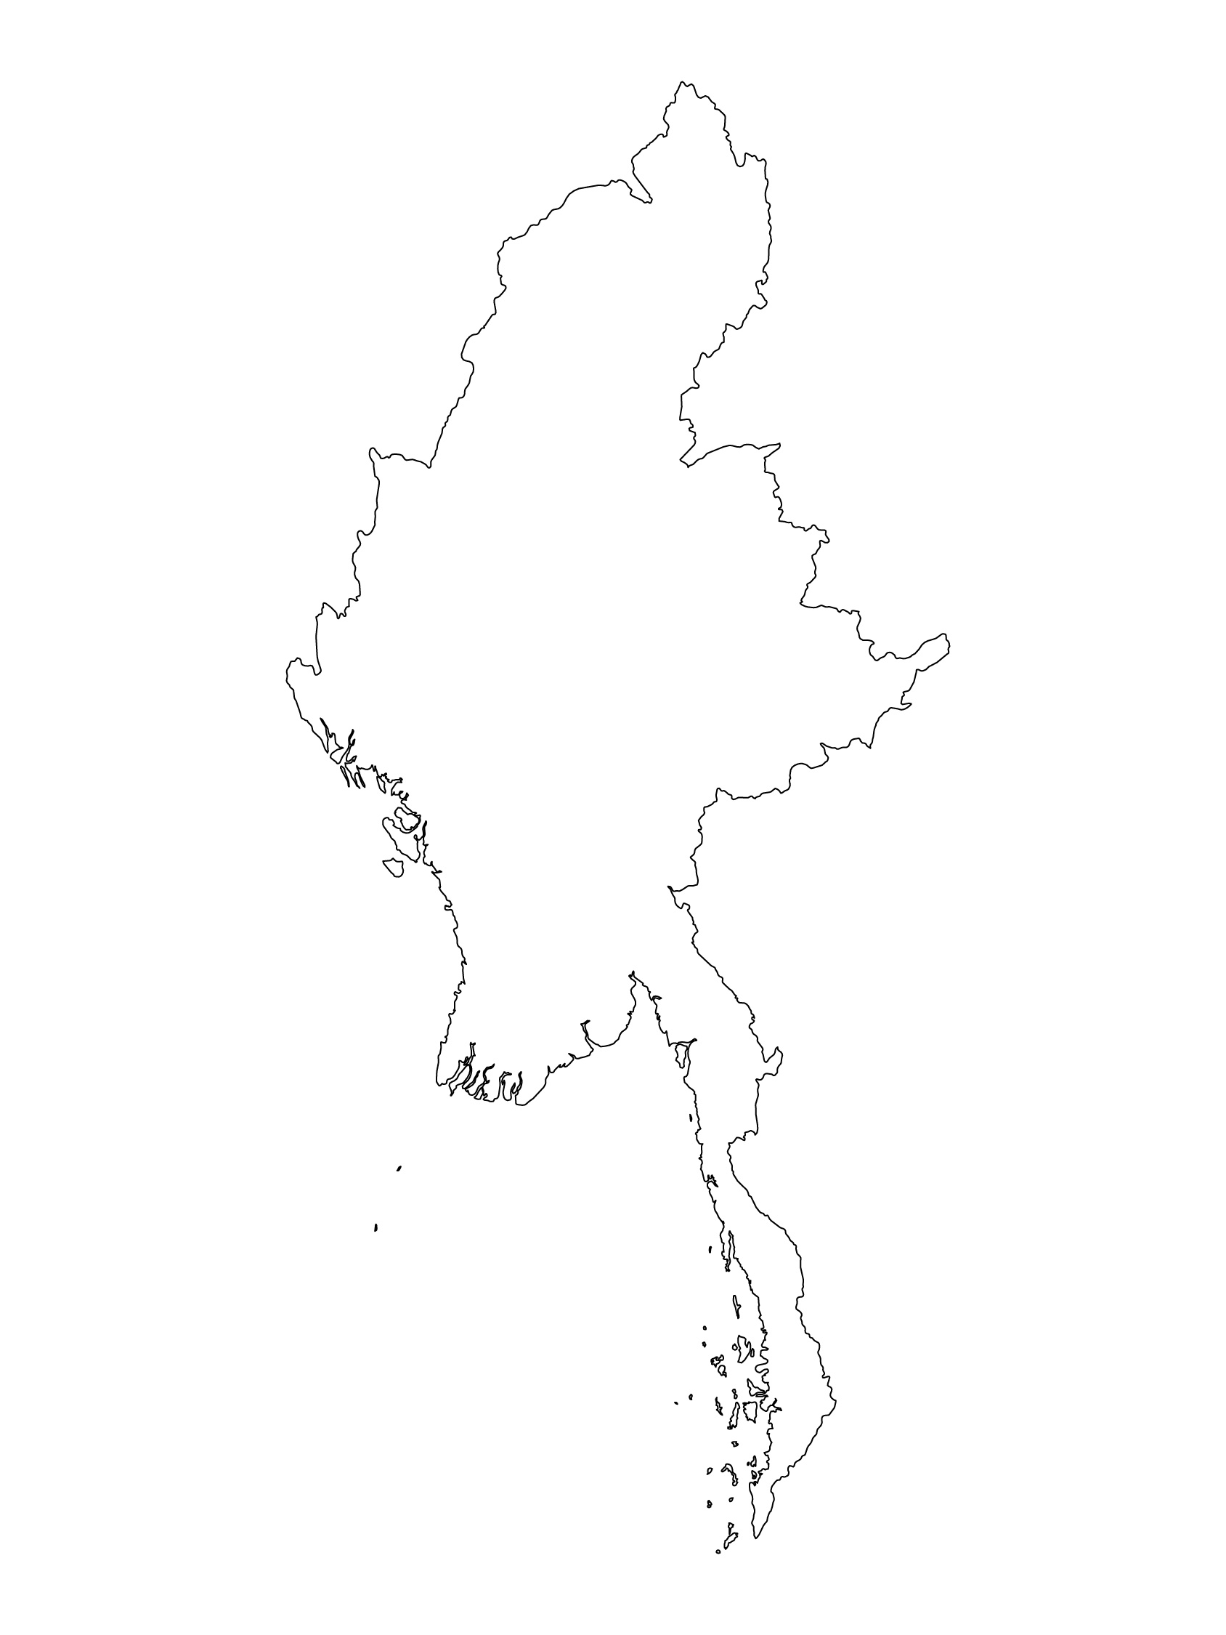
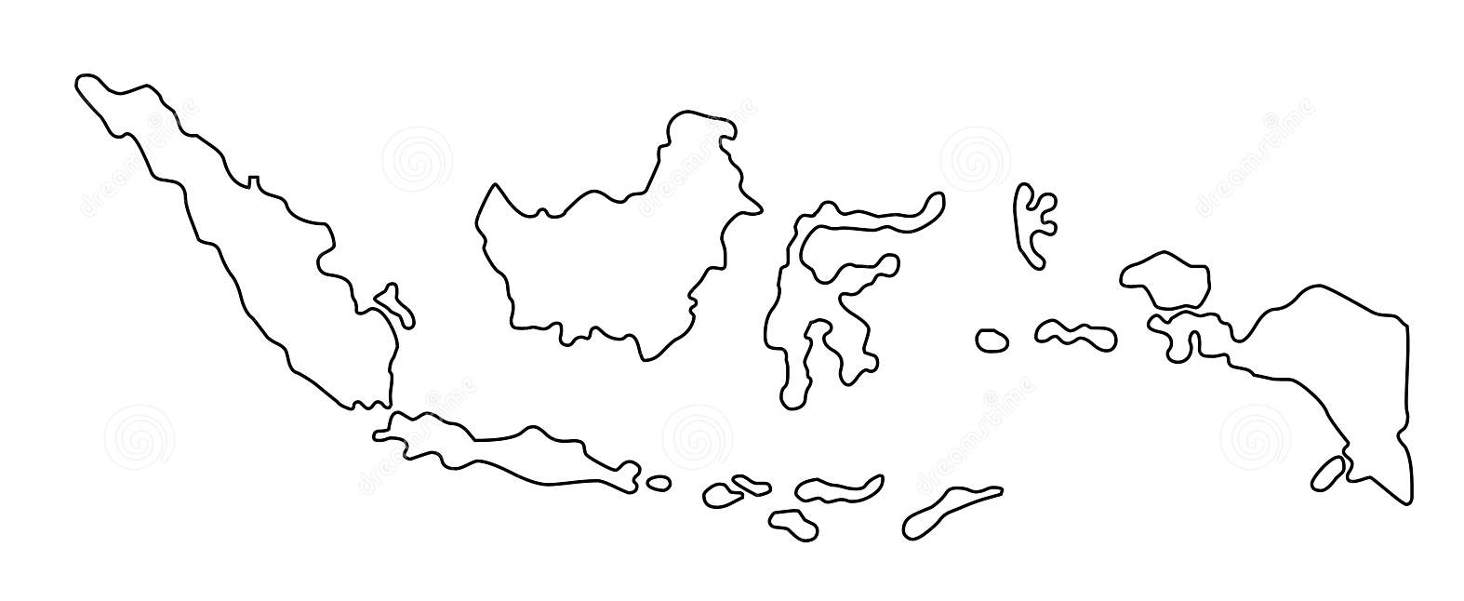
Examples from the Region
[COUNTRY NAME]
Add key presentation sentence about a specific program/project using Standard 23
Add name of organisations
Add key message / numbers
[ COUNTRY NAME]
Add key presentation sentence about a specific program/project using Standard 23
Add name of organisations
Add key message / numbers
[ COUNTRY NAME]
Add key presentation sentence about a specific program/project using Standard 23
Add name of organisations
Add key message / numbers
Notes:
Depending on the time you have for facilitation, consider adding here examples from the Region/ Country/ Response, of programming that meets the standards.
This could be a draft slide that you could update or remove if necessary.
For each example, you could add:
A short, concise, key presentation sentence about the specific program/project using Standard 23
Add the name of organisations and partners involved
Add practical lessons learnt, key actions, message or numbers, that will attract interest of your audience
Another option, if you have longer (and also depending on the audience you have), this slide can be completed in an interactive way during the session.
In that case, you could:
split the groups into 2 or 3 smaller groups,
allow 15 – 20 min for them to prepare a short presentation of an example from the Region/ Country/ Response, of programming that meets the standard
in plenary, have the groups present their examples, and discuss /compare lessons learnt out of them.
If you will be sending this presentation to the participants after the training, you can fill up this slide, to keep records of the presentations.
TIP: you can use https://thenounproject.com/ to get map outlines like those.

Slide 10
Need more than the hard copy?
On the Alliance website
PDF version
Briefing & Implementation Pack
25-page Summary
E-course
YouTube videos
A gallery of illustrated Standards
👉 www.AllianceCPHA.org
On the Humanitarian Standards Partnership website
Online, interactive version
HSP App for mobile phones and tablets
👉 www.HumanitarianStandardsPartnership.org
Notes:
[Facilitators - if you can project from the internet, then we suggest you navigate people there and show them]
HSP:
1. Online handbook
2. The Humanitarian Standards Partnership App
– It is the 2nd most popular app on that site after Sphere
CPMS page:
1. Interactive handbook – our greatest resource
2. A Summary: At just 32 pages, it means that it is topline but can be used to introduce the idea of minimum standards or start child protection discussions with government colleagues or other humanitarians without overwhelming them with the huge handbook.
Alliance website:
The PDF & all materials available can be downloaded if people want to print just portions of the CPMS, on the Alliance site
The “Introduction to CPMS” Briefing Pack contains this PPT and facilitation notes, plus the 2 page Introduction handout.
A gallery of illustrated Standards
Discover our free CPMS e-course with a range of modules
Videos on the Alliance Youtube channel
ASK: What should our next steps as a team/agency/individual be?
(i.e. you might schedule a longer meeting to digest the changes and create a plan; or ask colleagues to present certain new/revised standards and their implications for the programme; or set up a training or ask Senior Management for a meeting to discuss accountability to children, etc)
[Facilitators - Printed copies – there is a small stockpile of the Handbook and Summary that the global Alliance has in Geneva; however, countries and regions are encouraged to print & manage their own copies locally. Usually, this would be done through the inter-agency Coordination structure. On request, the Alliance can share a print-ready PDF.]
Thank you so much for coming together and starting to explore the CPMS. I will follow up on the next steps we discussed. And that’s the key – the CPMS is a gift that just keeps on giving every time you open it!

