Slide 1
The Minimum Standards for Child Protection in Humanitarian Action
CPMS
SLIDE DECK
Notes:
Facilitators:
This briefing is for any potential user of the CPMS. It is geared primarily toward child protection staff, so consider broadening some questions or providing more detail, if colleagues from other sectors join you.
It is assumed that the group is about 20 people and that everyone in the room knows each other (perhaps colleagues from your agency or the CP coordination group). if not, add 5 minutes for quick introductions.
PREPARE: a flipchart with the objectives of the session
By the end of the session, participants will be able to:
Describe the content of Standard 27
Explain & Share its key messages
Demonstrate how & why to use the handbook
NOTE: if you have already done a Session on Pillar(s), Principles or other Standard(s), skip slide 2 & 7
TIP: Slides are animated -> for each click you’ll make, some few words, a title or an image will appear on the slide.
Read the corresponding notes from the facilitators notes, before showing the following content, so participants have time to process what you say, and read each point.

Slide 2
Aim of the Standards
Benchmark for CPHA.
Collaborative, inter-agency tool
Links with Core Humanitarian Standard
Contextualisation for local ownership
Purpose:
quality and accountability
impact for children’s protection and well-being
Notes:
Donors, local governments, colleagues in other sectors and our beneficiaries themselves want to know what we are doing and why. The CPMS is our benchmark. They are the key way to operationalise or make real children's rights in the practice of humanitarian response.
They are a collaborative, inter-agency tool, that links with other initiatives, such as the Core Humanitarian Standard and the Humanitarian Inclusion Standards
Wherever relevant, the CPMS align with INSPIRE’s 7 strategies to end violence against children – initiative’s icons are actually scattered through the text. In addition, the Core Humanitarian Standard on Quality and Accountability is highlighted in the Introduction and resonates throughout the handbook.
Contextualisation is encouraged and can create ownership of the standards at every level. It builds a deeper understanding of child protection in the specific context for a wide range of actors. National coordination groups are therefore encouraged to adapt the CPMS. Please raise it with colleagues locally and then seek the guidance of the global CPMS team. For more information, watch the short contextualization video on the Alliance’s youtube channel.
BOX: The CPMS aim at improving the quality and accountability of our programing and increasing impact for children’s protection and well-being in humanitarian action (internal displacement and refugee contexts), by establishing common principles, evidence, prevention and goals to achieve. They provide a synthesis of good practice and learning to date.

Slide 3
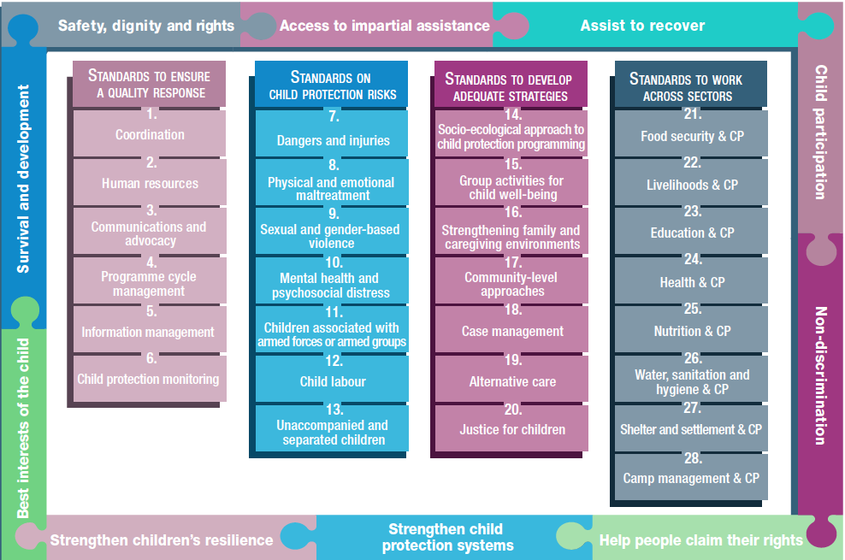
Overview
Notes:
This is an overview of the CPMS structure: there are 28 Standards across 4 pillars and 10 CPHA principles threaded throughout.
You can find this overview on the back of the CPMS handbook or in the online handbook; it’s a practical way of locating quickly a specific topic.
This presentation focuses on Standard 27: Shelter and settlement & Child Protection

Slide 4
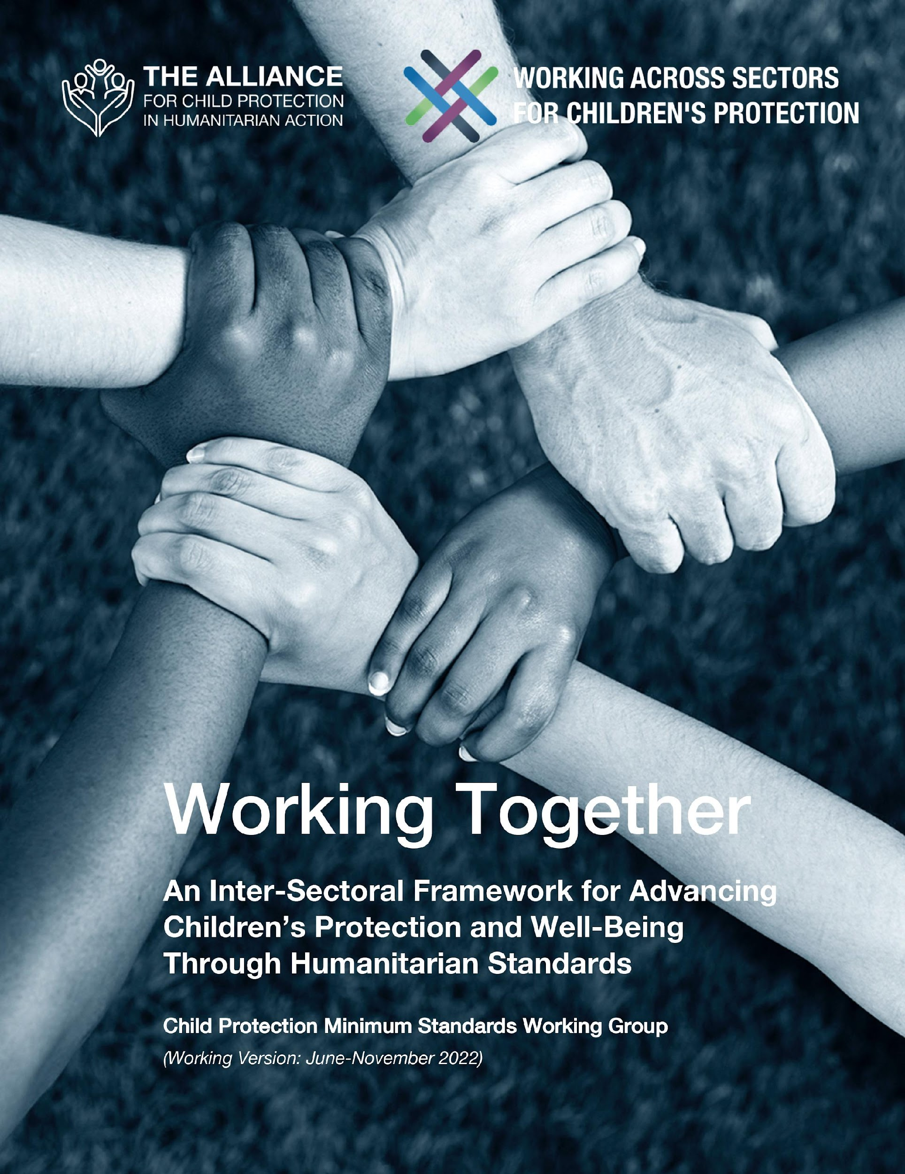
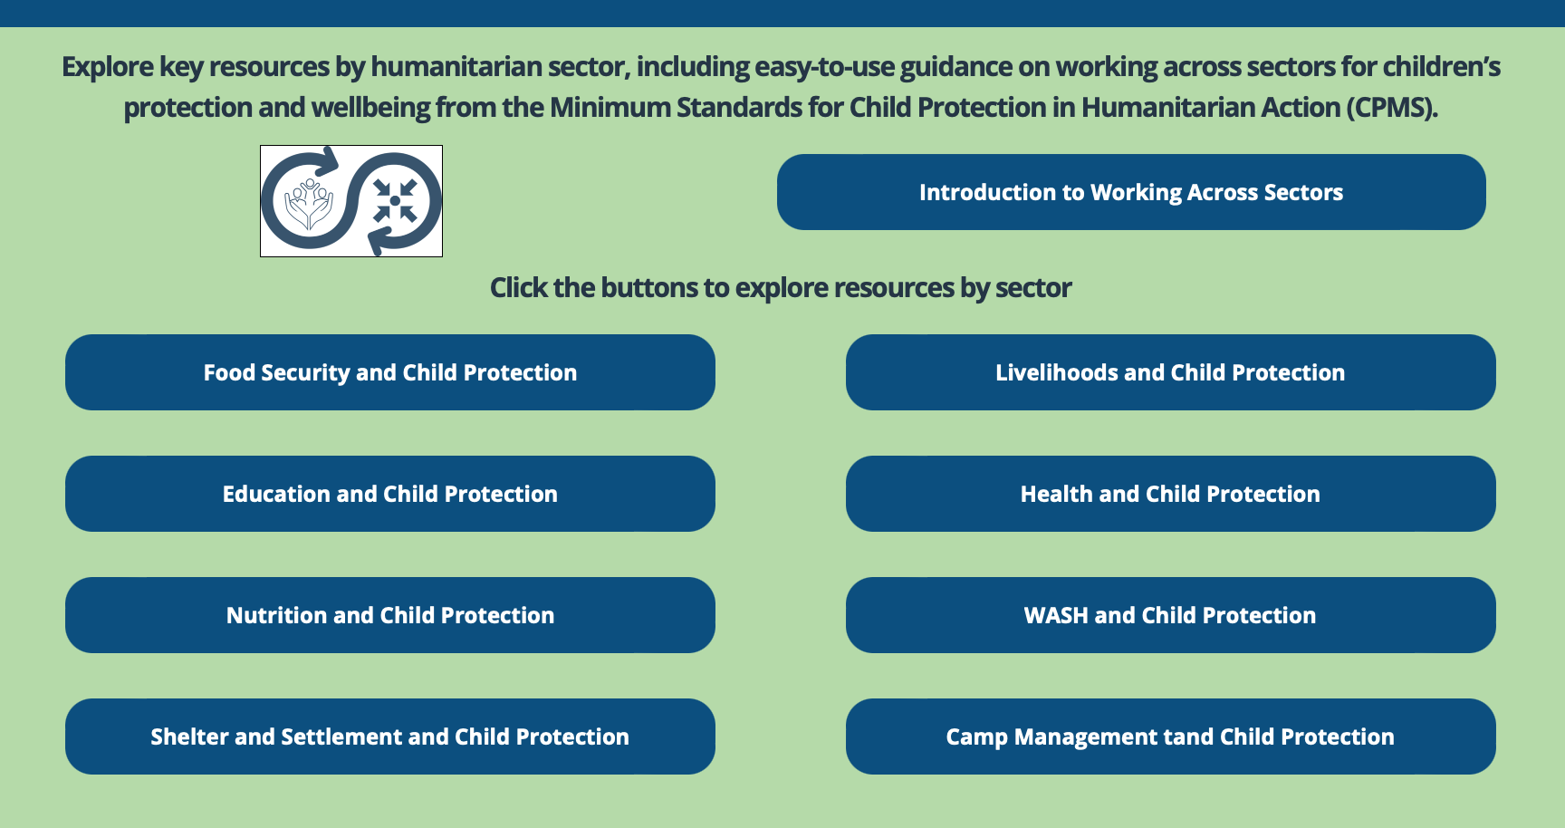
Working Together
Interconnected needs of children
Collective responsibility = Centrality of Protection
Higher-quality impact
Notes:
The CPMS have a complete section devoted to Child Protection personnel working with and learning from other humanitarian actors to improve protection and well-being outcomes for children.
CLICK: Multisectoral approaches reflect the interconnected needs of children and emphasise
CLICK: all humanitarian actors’ collective responsibility to protect children and their families. Children’s protection risks are closely linked with the work of humanitarian actors because they have needs that fall under all sectors.
CLICK: Multisectoral programming - that includes and addresses child protection considerations (such as children’s particular risks, vulnerabilities, developmental stages, etc.) can be an effective way to achieve real, higher quality outcomes for both / all sectors.
CLICK: Working Together is an inter-sectoral framework to promote children’s protection and well-being using humanitarian standards. It was created through a large-scale, consultative process, and is updated every 6 months. Currently, the prioritized sectors are: health, education, Food Security, and Camp Coordination and Camp Management.
CLICK: Check out the microsite for the global Working across Sectors initiative and the sector-specific resource folders.

Slide 5
An introduction to Standard 27
Interconnected needs of children
Collective responsibility = Centrality of Protection
Higher-quality impact
Direct protection outcomes
Key CP considerations to integrate into shelter and settlement interventions
Safe living environments = dignity, security and livelihoods
Appropriate shelter = safety, protection and accessibility
Notes:
This Standard is part of the fourth Pillar of Standards related to Working across Sectors.
Multisectoral approaches reflect the interconnected needs of children and emphasise all humanitarian actors’ collective responsibility to protect children and their families. Child protection risks are closely linked with the work of other sectors because children have needs that fall under all sectors.
One very effective way towards real & higher quality impact is multisectoral programming that includes and addresses child protection considerations (such as children’s particular risks, vulnerabilities, developmental stages, etc.).
DEF: ‘Shelter’ refers to the household living space, including the items necessary for daily activities.
‘Settlement’ refers to the wider locations where people and communities live.
Shelter and settlements programming has direct protection outcomes: they support safe living environments, that allow people to live with dignity, security and livelihoods. They are essential to healthy and safe families and communities.
I.e: privacy for adolescent girls, addressing physical dangers and safe routes for accessing schools [🡪 the adolescent and prevention icons]
Child protection must be integrated into shelter and settlement interventions, from design to monitoring and evaluation, especially take into account :
Family size, unity and composition
Children at risk, like children living alone or in new or altered family units
Accessibility for children with disabilities & barriers to access essential services (impacting the layout of the shelter provided)
Protection risks & social norms
Perceptions of the host community
The available human, financial, physical, environmental and social resources
Local land and property rights to decide on where, how and to whom shelter is provided
Appropriate number of adequate indoor and outdoor play spaces, schools, units for children’s activities, to help reducing CP risks
Safety & privacy criterias, that have to be contextualised and defined locally

Slide 6
Joint Actions
“All children and their caregivers have appropriate shelter that meets their basic needs, including safety, protection and accessibility.”
Shelter for vulnerable groups
Accessible, inclusive and protective environment
Children-specific spaces
Children-specific shelter items
Specific areas for cooking and bathing
On which CP topics should shelter and settlement specialists be trained?
Notes:
Standard 27 states: “All children and their caregivers have appropriate shelter that meets their basic needs, including safety, protection and accessibility.”
Child protection, shelter and settlement actors need to work together to address the short- and long-term shelter needs of the most vulnerable groups. Actions may include:
Mobilising the wider community to help female-headed households, child-headed households, older people and people with disabilities to build their shelter units, and providing adequate shelter to help reduce family separation;
Tailoring shelters to promote an accessible, inclusive and protective environment (such as providing more space for children with disabilities or greater privacy for adolescent girls; addressing physical dangers (holes in the ground, open water, etc.) to prevent injuries to children and caregivers; sufficient lighting at all sites within settlements); safe routes for accessing schools and play spaces
Providing adequate indoor and outdoor play spaces for children;
Providing adequate bedding and blankets for girls and boys to sleep separately;
Designing shelters to support the privacy and dignity of women and children, such as providing specific areas for cooking and bathing;
Providing adequate shelter to help reduce family separation;
Addressing physical dangers (holes in the ground, open water, etc.) to prevent injuries to children and caregivers;
Providing sufficient lighting at all sites (including water, sanitation and hygiene facilities) within settlements;
Providing children with safe routes for accessing schools and play spaces;
Screening and monitoring participants to ensure only children over the minimum working age are involved in decent shelter and settlement-related work (including cash-for-work type programmes).
Shelter and settlement actors should always work with a representative cross-section of the affected population to identify barriers, risks and solutions.
Discussion Prompt: On which CP topics should shelter and settlement specialists be trained?
-> Shelter and settlement specialists’ formal professional training may not include child protection. Child protection actors must support shelter and settlement actors to include child protection in all shelter- and settlement-related actions. At a minimum, shelter and settlement staff should be trained on:
Child safeguarding measures, including implementing codes of conduct and protocols;
Protection from sexual exploitation and abuse;
Identifying and referring child protection concerns; and
Consulting with children on shelter and settlement assessments, planning, monitoring and evaluations.

Slide 7
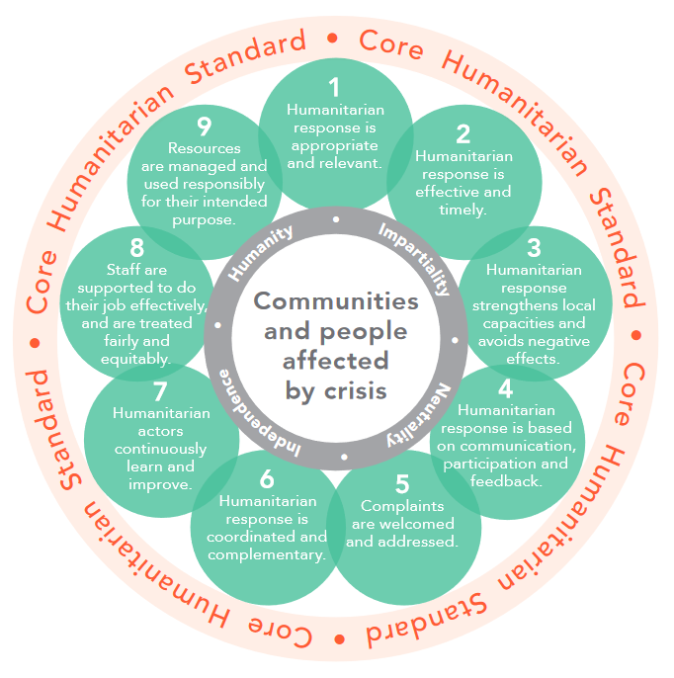
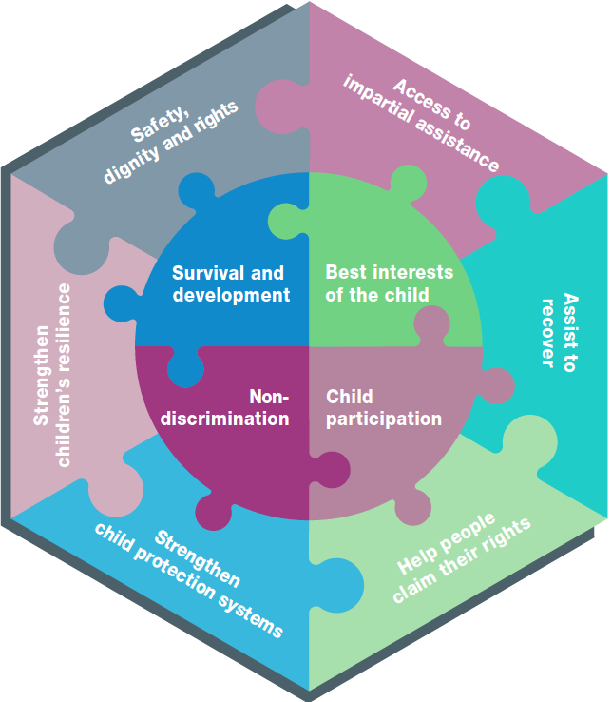
Further linkages
Inter-sectoriality
WASH colleagues should be consulted/involved
CPMS + Sphere Protection Principles
CHS 1
CHS 3
CHS 4
CHS 5
Notes:
WASH colleagues, especially, should be consulted/involved, to design & plan adequately (i.e about how and where to construct latrines, shower sections if they exist, the lighting for these etc), and when addressing physical hazards linked to holes in the ground, open water, insufficient lighting at WASH facilities to prevent injuries to children and caregivers.
All the activities relating to shelter and settlements also related to the four Protection Principles that apply to all humanitarian action and all humanitarian actors:
CPMS Principle 1: Survival and development
CPMS Principle 2: Non-discrimination and inclusion
CPMS Principle 3: Children’s participation
CPMS Principle 4: The best interests of the child
Sphere Principle 1: Enhance the safety, dignity and rights of people, and avoid exposing them to harm (that is also CPMS Principle 5)
Sphere Principle 2: Ensure people’s access to assistance according to need and without discrimination (that is also CPMS Principle 6)
Sphere Principle 3: Assist people to recover from the physical and psychological effects of threatened or actual violence, coercion or deliberate deprivation (that is also CPMS Principle 7)
Sphere Principle 4: Help people claim their rights (that is also CPMS Principle 8)
CPMS Principle 9: Strengthen child protection systems
CPMS Principle 10: Strengthen children’s resilience in humanitarian action
Out of the Core Humanitarian Standard on Quality and Accountability (CHS) Nine Commitments, commitments 1, 3, 4 & 5 especially apply here:
CHS 1 aim at ensuring people affected receive appropriate and relevant assistance
CHS 3 aim at ensuring people affected are not negatively affected and are more prepared, resilient and less at-risk as a result of humanitarian action (local capacities and do no harm)
CHS 4 aim at ensuring people affected know their rights and entitlements, have access to information and participate in decisions that affect them. (communication, participation and feedback)
CHS 5 aim at ensuring people affected have access to safe and responsive mechanisms to handle complaints. -> reminder : organisations and individuals involved in humanitarian response can use the CHS to improve the quality and effectiveness of the assistance they provide. It also facilitates greater accountability to communities and people affected by crisis.

Slide 8
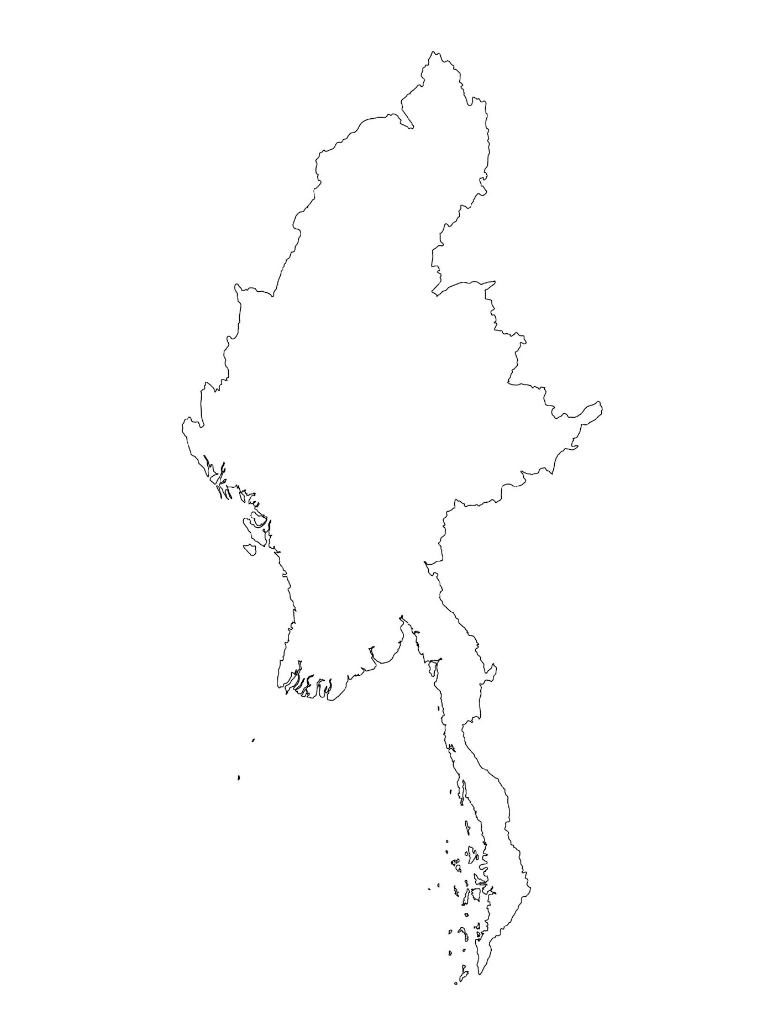
Examples from the Region
[COUNTRY NAME]
Add key presentation sentence about a specific program/project using Standard 27
Add name of organisations
Add key message / numbers
[ COUNTRY NAME]
Add key presentation sentence about a specific program/project using Standard 27
Add name of organisations
Add key message / numbers
[ COUNTRY NAME]
Add key presentation sentence about a specific program/project using Standard 27
Add name of organisations
Add key message / numbers
Notes:
Depending on the time you have for facilitation, consider adding here examples from the Region/ Country/ Response, of programming that meets the standards.
This could be a draft slide that you could update or remove if necessary.
For each example, you could add:
A short, concise, key presentation sentence about the specific program/project using Standard 27
Add the name of organisations and partners involved
Add practical lessons learnt, key actions, message or numbers, that will attract interest of your audience
Another option, if you have a longer facilitation span (and also depending on the audience you have), this slide can be completed in an interactive way during the session.
In that case, you could:
split the groups into 2 or 3 smaller groups,
allow 15 – 20 min for them to prepare a short presentation of an example from the Region/ Country/ Response, of programming that meets the standard
in plenary, have the groups present their examples, and discuss /compare lessons learnt out of them.
If you will be sending this presentation to the participants after the training, you can fill up this slide, to keep records of the presentations.
TIP: you can use https://thenounproject.com/ to get map outlines like those.

Slide 9
Need more than the hard copy?
On the Alliance website
PDF version
Briefing & Implementation Pack
25-page Summary
E-course
YouTube videos
A gallery of illustrated Standards
👉 www.AllianceCPHA.org
On the Humanitarian Standards Partnership website
Online, interactive version
HSP App for mobile phones and tablets
👉 www.HumanitarianStandardsPartnership.org
Notes:
[Facilitators - if you can project from the internet, then we suggest you navigate people there and show them]
HSP:
1. Online handbook
2. The Humanitarian Standards Partnership App
– It is the 2nd most popular app on that site after Sphere
CPMS page:
1. Interactive handbook – our greatest resource
2. A Summary: At just 32 pages, it means that it is topline but can be used to introduce the idea of minimum standards or start child protection discussions with government colleagues or other humanitarians without overwhelming them with the huge handbook.
Alliance website:
The PDF & all materials available can be downloaded if people want to print just portions of the CPMS, on the Alliance site
The “Introduction to CPMS” Briefing Pack contains this PPT and facilitation notes, plus the 2 page Introduction handout.
A gallery of illustrated Standards
Discover our free CPMS e-course with a range of modules
Videos on the Alliance Youtube channel
ASK: What should our next steps as a team/agency/individual be?
(i.e. you might schedule a longer meeting to digest the changes and create a plan; or ask colleagues to present certain new/revised standards and their implications for the programme; or set up a training or ask Senior Management for a meeting to discuss accountability to children, etc)
[Facilitators - Printed copies – there is a small stockpile of the Handbook and Summary that the global Alliance has in Geneva; however, countries and regions are encouraged to print & manage their own copies locally. Usually, this would be done through the inter-agency Coordination structure. On request, the Alliance can share a print-ready PDF.]
Thank you so much for coming together and starting to explore the CPMS. I will follow up on the next steps we discussed. And that’s the key – the CPMS is a gift that just keeps on giving every time you open it!

