Slide 1
The Minimum Standards for Child Protection in Humanitarian Action
CPMS
SLIDE DECK
Notes:
Facilitators:
This briefing is for any potential user of the CPMS. It is geared primarily toward child protection staff, so consider broadening some questions or providing more detail, if colleagues from other sectors join you.
It is assumed that the group is about 20 people and that everyone in the room knows each other (perhaps colleagues from your agency or the CP coordination group). if not, add 5 minutes for quick introductions.
PREPARE: a flipchart with the objectives of the session
By the end of the session, participants will be able to:
Describe the content of Standard 5
Explain & Share its key messages
Demonstrate how & why to use the handbook
NOTE: if you have already done a Session on Pillar(s), Principles or other Standard(s), skip slide 2 & 8
TIP: Slides are animated -> for each click you’ll make, some few words, a title or an image will appear on the slide.
Read the corresponding notes from the facilitators notes, before showing the following content, so participants have time to process what you say, and read each point.

Slide 2
Aim of the Standards
Benchmark for CPHA.
Collaborative, inter-agency tool
Links with Core Humanitarian Standard
Contextualisation for local ownership
Purpose:
quality and accountability
impact for children’s protection and well-being
Notes:
Donors, local governments, colleagues in other sectors and our beneficiaries themselves want to know what we are doing and why. The CPMS is our benchmark. It is the key way to operationalise or make real children's rights in the practice of humanitarian response.
They are a collaborative, inter-agency tool, that links with other initiatives, such as the Core Humanitarian Standard, INSPIRE and the Humanitarian Inclusion Standards.
Wherever relevant, the CPMS align with INSPIRE’s 7 strategies to end violence against children – initiative’s icons are actually scattered through the text. In addition, the Core Humanitarian Standard on Quality and Accountability is highlighted in the Introduction and resonates throughout the handbook.
Contextualisation (adaptation to your specific context) is encouraged and can create ownership of the standards at every level. It builds a deeper understanding of child protection in the specific context for a wide range of actors. National coordination groups are therefore encouraged to adapt the CPMS. Please raise it with colleagues locally and then seek the guidance of the global CPMS team. For more information, watch the contextualization video on the Alliance’s youtube channel.
BOX: The CPMS aim at improving the quality and accountability of our programing and increasing impact for children’s protection and well-being in humanitarian action (across all contexts), by establishing common principles, evidence, prevention and goals to achieve. They provide a synthesis of good practice and learning to date.

Slide 3
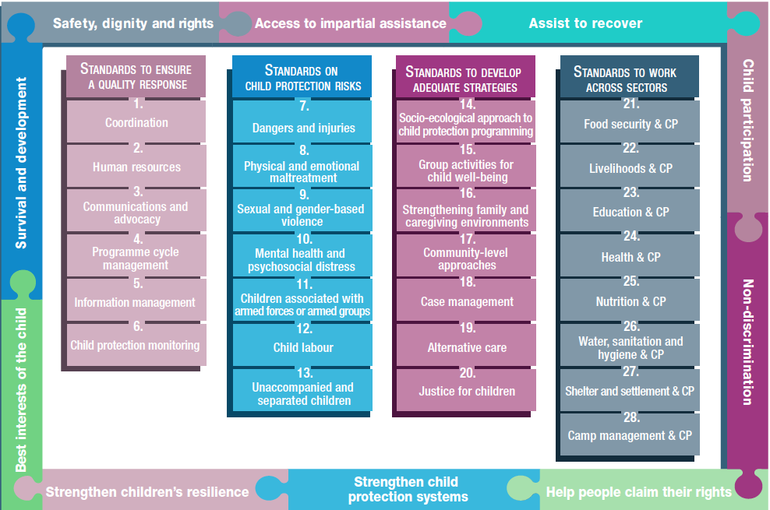
Overview
Notes:
This is an overview of the CPMS structure: there are 28 Standards across 4 pillars and 10 CPHA principles threaded throughout.
You can find this overview on the back of the CPMS handbook or in the online handbook; it’s a practical way of locating quickly a specific topic.
This presentation focuses on Standard 5: Information management

Slide 4
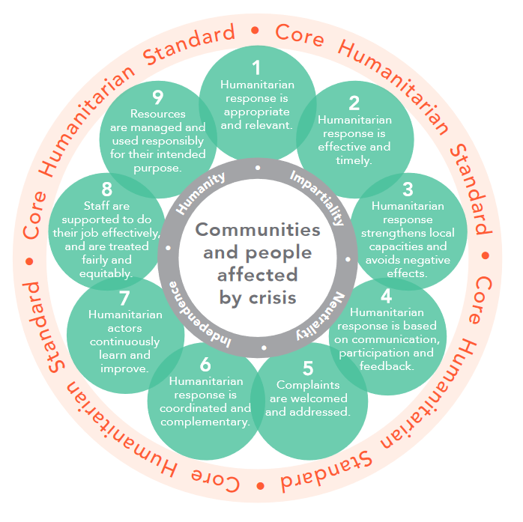
General introduction to Standard 5
Part of Pillar 1 related to quality response
To be used with all Standards & the CPMS principles
CHS
Child protection-focused IM guidance
PIM Framework
What categories of information are covered?
Notes:
This Standard is part of the first Pillar of Standards related to quality response, which are all common across all areas of child protection programming, applicable in all situations and contexts, during preparedness and response phases. They are ALL fundamental to reach the level of quality we are aiming to reach as practionners.
These Quality standards should be used in conjunction with all the rest of the Standards (7–28) & the CPMS principles
This Standard is complementary to the Core Humanitarian Standard on Quality and Accountability (CHS), as a whole, and should be used together with it.
This standard provides child protection-focused information management guidance that is intended to complement existing information management tools and trainings.
Whenever appropriate, information should be shared with relevant actors to strengthen coordination, inform strategic decision-making and support advocacy.
Complements the Protection Information Management (PIM) Framework & Protection Information Management guidance, that is the: principled, systematised and collaborative processes to collect, process, analyse, store, share, and use data and information to enable evidence-informed action for quality protection outcomes” (Protection Information Management Website). PIM helps ensure the efficient and targeted use of resources and strengthens the coordination, design and delivery of protection responses
Discussion Prompt: what categories of information are covered?
->Four broad categories of information need to be managed for child protection in humanitarian action (CPHA):
Information about the emergency situation and supporting coordination mechanisms;
Information about the overall humanitarian response and the child protection response in particular;
Information about the situation of children in a given context (including the well-being of hosting families/caregivers, specific risk factors and patterns of child rights violations); and
Information about specific children who are facing protection concerns (which are typically managed through the case management process).

Slide 5
“Up-to-date information necessary for child protection action is collected, processed/analysed and shared according to international child protection principles and with full respect for confidentiality, data protection and information-sharing protocols.”
Ethical concerns:
Anonymous
Contextualised
Up-to-date
Necessary/meaningful
Confidentiality
CP principles
Technically and ethically sound
Cultural practices and norms
Always with informed consent/assent
Positive language
No labels
No repetition
Notes:
Standard 5 states: “All child protection programmes are designed, planned, managed, monitored and evaluated through structured processes and methodologies that build on existing capacities and resources, address evolving child protection risks and needs, and are continuously adapted based on learning and evidence.”
It details the ethical concerns to keep in mind when processing, analysing and sharing data and information:
it should be made anonymous;
only be shared according to contextualised data protection and information-sharing protocols;
should be up-to-date, and necessary/meaningful (Only gather data that you will use) ;
should respect confidentiality and CP principles ;
collection must be technically and ethically sound; take into account the cultural practices and norms ;
always with informed consent/assent; use positive language and do not label children who are at risk. …
Also avoid repeatedly asking the same population the same questions.

Slide 6
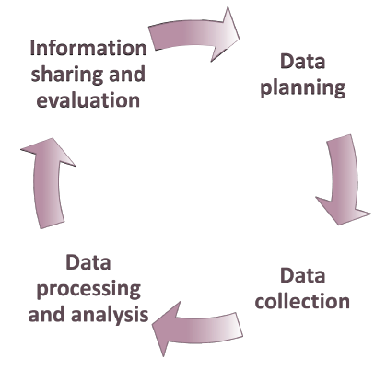
Standard 5 - Information Management cycle
STEP 4: Sharing & Evaluation
population-level information
feedback
= accountability
Do no harm!
advocacy
STEP 1: Data Planning
Mapping
Inter-agency baseline values
IM tools and procedures
Training
STEP 3: Processing & Analysis
Cross-analysis
Gap analysis
Trends analysis
Double counting
STEP 2: Data Collection
Ethics
Principles
Dissagregation
Notes:
The overall information management cycle is described in the Protection Information Management (PIM) Framework. This standard is developed around four main stages that are drawn from the PIM framework:
Data planning;
Data collection;
Data processing and analysis; and
Information sharing and evaluation.
Step 1:
First step will be to map the existing data and systems (used by the government. & CP actors) to inform CP situation and response capacity, and then use it as a baseline to define an IM strategy to improve, standardize and/or develop new tools and procedures with other CP actors
historical and current data on child protection concerns can be used to establish inter-agency baseline values for agreed-upon child protection priorities
with other child protection actors, develop, adapt, share and translate standardised information management tools and procedures for use with national or other existing information management systems, wherever possible.
Appropriate training should be given to staff involved in information management on:
Ethics;
Principles of data collection;
Data protection protocols;
Management of sensitive information; and
Child-friendly interview techniques.
STEP 2:
Ethical data collection protocols and the principles of confidentiality and do no harm must be followed at all times.
Data has to be disaggregated by gender, age and disability, at a minimum. This shows how risks or programmes may affect certain children differently. Other additional factors (such as country of origin, migration or displacement status) may also be important or relevant in your context.
STEP 3:
Interactive online platforms and tools can be used to cross-analyse data (use information after first comparing and triangulating it) and improve the gap analysis function
Trends analysis is also key to better understand and monitor the situation
It is important to avoid ‘double counting’ – that is, counting the same child more than once if they are accessing two different programme interventions. For example, when providing data on the total reach of your child protection programme, a child who receives both case management and psychosocial support should be counted as only one programme participant.
STEP 4:
- Consolidate, analyse and share population-level information and give feedback to:
All relevant stakeholders, including children and communities (as appropriate);
Those who have provided information; and
The affected population.
Feedback will make your information management cycle effective.
We have to remember to consider the risks to children and their families before sharing information (i.e. no individually-identifiable data)
These efforts will strengthen accountability to affected populations and support the advocacy function of the coordination team.

Slide 7
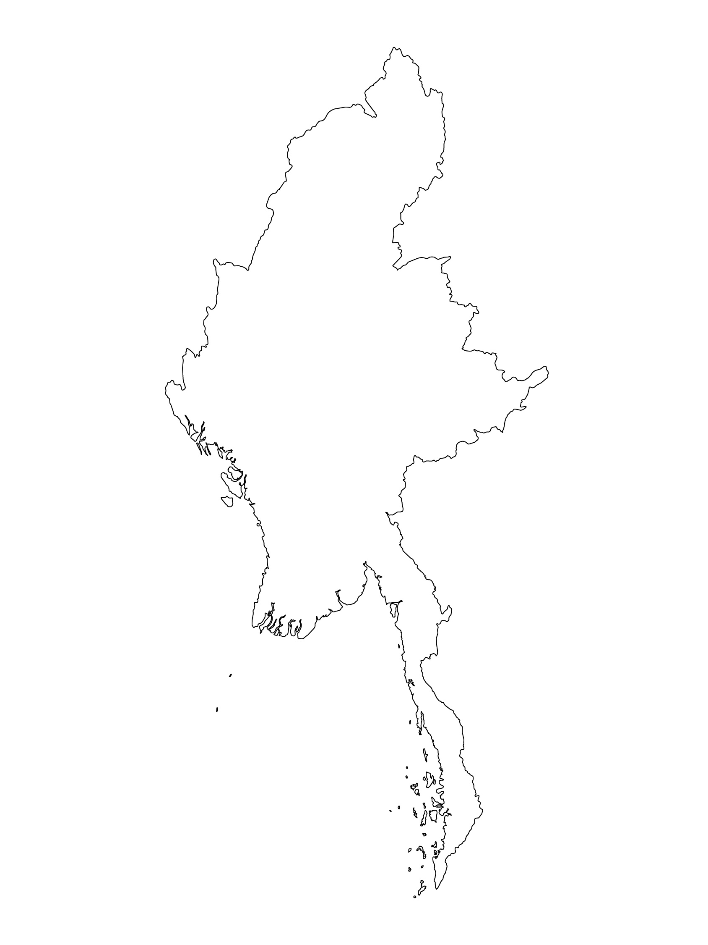
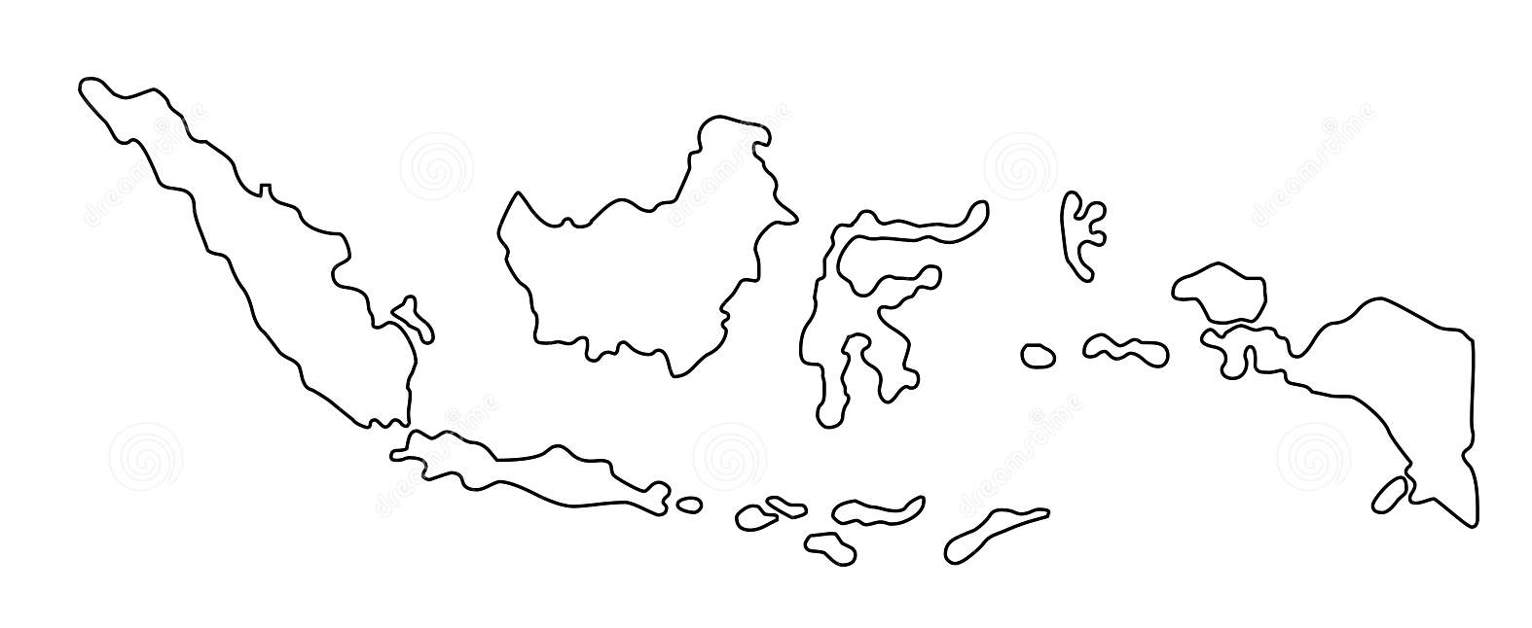
Examples from the Region
[COUNTRY NAME]
Add key presentation sentence about a specific program/project using Standard 5
Add name of organisations
Add key message / numbers
[ COUNTRY NAME]
Add key presentation sentence about a specific program/project using Standard 5
Add name of organisations
Add key message / numbers
[ COUNTRY NAME]
Add key presentation sentence about a specific program/project using Standard 5
Add name of organisations
Add key message / numbers
Notes:
Depending on the time you have for facilitation, consider adding here examples from the Region/ Country/ Response, of programming that meets the standards.
This could be a draft slide that you could update or remove if necessary.
For each example, you could add:
A short, concise, key presentation sentence about the specific program/project using Standard 5
Add the name of organisations and partners involved
Add practical lessons learnt, key actions, message or numbers, that will attract interest of your audience
Another option, if you have longer (and also depending on the audience you have), this slide can be completed in an interactive way during the session.
In that case, you could:
split the groups into 2 or 3 smaller groups,
allow 15 – 20 min for them to prepare a short presentation of an example from the Region/ Country/ Response, of programming that meets the standard
in plenary, have the groups present their examples, and discuss /compare lessons learnt out of them.
If you will be sending this presentation to the participants after the training, you can fill up this slide, to keep records of the presentations.
TIP: you can use https://thenounproject.com/ to get map outlines like those.

Slide 8
Need more than the hard copy?
On the Alliance website
PDF version
Briefing & Implementation Pack
25-page Summary
E-course
YouTube videos
A gallery of illustrated Standards
👉 www.AllianceCPHA.org
On the Humanitarian Standards Partnership website
Online, interactive version
HSP App for mobile phones and tablets
👉 www.HumanitarianStandardsPartnership.org
Notes:
[Facilitators - if you can project from the internet, then we suggest you navigate people there and show them]
HSP:
1. Online handbook
2. The Humanitarian Standards Partnership App
– It is the 2nd most popular app on that site after Sphere
CPMS page:
1. Interactive handbook – our greatest resource
2. A Summary: At just 32 pages, it means that it is very topline but can be used to introduce the idea of minimum standards or start child protection discussions with government colleagues or other humanitarians without overwhelming them with the huge handbook.
Alliance website:
The PDF & all materials available can be downloaded if people want to print just portions of the CPMS, on the Alliance site
The “Introduction to CPMS” Briefing Pack contains this PPT and facilitation notes, plus the 2 page Introduction handout.
A gallery of illustrated Standards
Discover our free CPMS e-course with a range of modules
Videos on the Alliance Youtube channel
ASK: What should our next steps as a team/agency/individual be?
(i.e. you might schedule a longer meeting to digest the changes and create a plan; or ask colleagues to present certain new/revised standards and their implications for the programme; or set up a training or ask Senior Management for a meeting to discuss accountability to children, etc)
[Facilitators - Printed copies – there is a small stockpile of the Handbook and Summary that the global Alliance has in Geneva; however, countries and regions are encouraged to print & manage their own copies locally. Usually, this would be done through the inter-agency Coordination structure. On request, the Alliance can share a print-ready PDF.]
Thank you so much for coming together and starting to explore the CPMS. I will follow up on the next steps we discussed. And that’s the key – the CPMS is a gift that just keeps on giving every time you open it!

