Slide 1
The Minimum Standards for Child Protection in Humanitarian Action
CPMS
SLIDE DECK
Notes:
Facilitators:
This briefing is for any potential user of the CPMS. It is geared primarily toward child protection staff, so consider broadening some questions or providing more detail, if colleagues from other sectors join you.
It is assumed that the group is about 20 people and that everyone in the room knows each other (perhaps colleagues from your agency or the CP coordination group). if not, add 5 minutes for quick introductions.
PREPARE: a flipchart with the objectives of the session
By the end of the session, participants will be able to:
Describe the content of Standard 8
Explain & Share its key messages
Demonstrate how & why to use the handbook
NOTE: if you have already done a Session on Pillar(s), Principles or other Standard(s), skip slide 2 & 8
TIP: Slides are animated -> for each click you’ll make, some few words, a title or an image will appear on the slide.
Read the corresponding notes from the facilitators notes, before showing the following content, so participants have time to process what you say, and read each point.

Slide 2
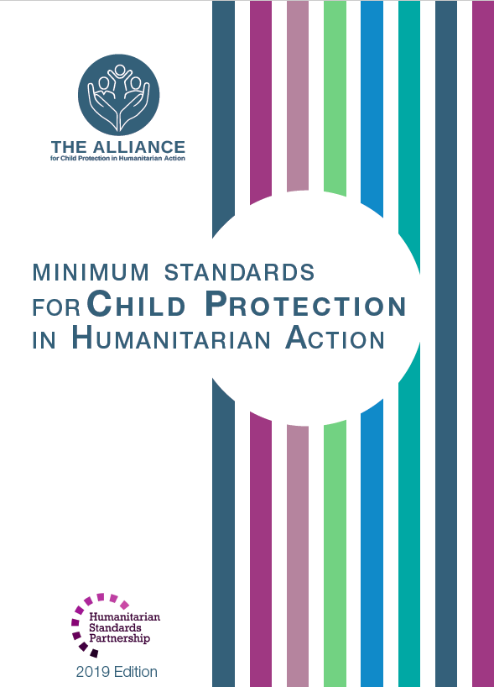
Aim of the Standards
Benchmark for CPHA.
Collaborative, inter-agency tool
Links with Core Humanitarian Standard
Contextualisation for local ownership
Purpose:
quality and accountability
impact for children’s protection and well-being
Notes:
Donors, local governments, colleagues in other sectors and our beneficiaries themselves want to know what we are doing and why. The CPMS are our benchmark. CPMS are the key way to operationalise or make real children's rights in the practice of humanitarian response.
They are a collaborative, inter-agency tool, that links with other initiatives, such as the Core Humanitarian Standard, INSPIRE and the Humanitarian Inclusion Standards
Wherever relevant, the CPMS align with INSPIRE’s 7 strategies to end violence against children – initiative’s icons are actually scattered through the text. In addition, the Core Humanitarian Standard on Quality and Accountability is highlighted in the Introduction and resonates throughout the handbook.
Contextualisation is encouraged and can create ownership of the standards at every level. It builds a deeper understanding of child protection in the specific context for a wide range of actors. National coordination groups are therefore encouraged to adapt the CPMS. Please raise it with colleagues locally and then seek the guidance of the global CPMS team. For more information, watch the short contextualization video on the Alliance’s youtube channel.
BOX: The CPMS aim at improving the quality and accountability of our programing and increasing impact for children’s protection and well-being in humanitarian action (across all contexts), by establishing common principles, evidence, prevention and goals to achieve. They provide a synthesis of good practice and learning to date.

Slide 3
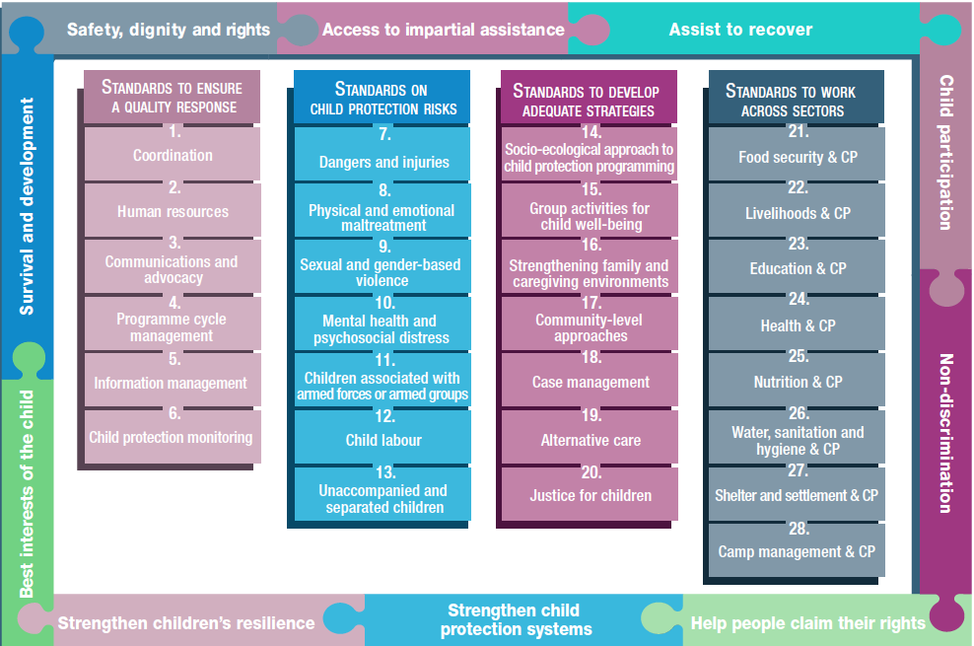
Overview
Notes:
This is an overview of the CPMS structure: there are 28 Standards across 4 pillars and 10 CPHA principles threaded throughout.
You can find this overview on the back of the CPMS handbook or in the online handbook; it’s a practical way of locating quickly a specific topic.
This presentation focuses on Standard 8: Physical and emotional maltreatment

Slide 4
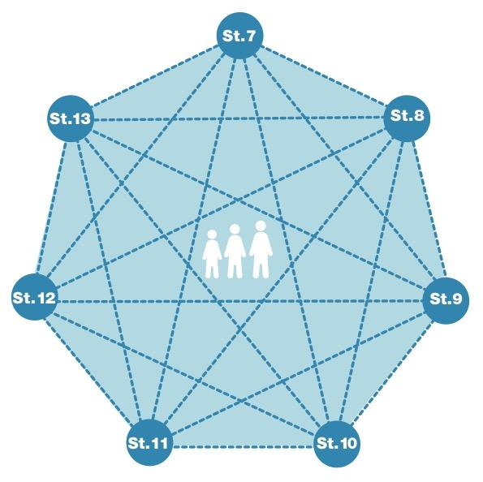
General intro to Standard 8
Part of 2nd Pillar, related to child protection risks
RISK = Nature & Extent of hazard + Vulnerability - Resilience
Physical and emotional neglect/abuse
Importance of the environment
Short- and long-term effects
Comprehensive and coordinated interventions
What types of acts?
Notes:
This Standard is part of the second Pillar related to child protection risks that children may face in humanitarian settings. All the seven different risk standards are linked, as they address overlapping vulnerabilities and risks. The risks cannot be addressed in isolation.
Child protection risks are potential violations and threats to children's rights that will cause harm to children. To understand a child's risk, we need to understand the nature (type of hazard, situation, threat…) & extent of the risk and the individual child’s vulnerability to that risk, but also the family/child coping or survival strategies (meaning their resilience and ability to withstand the risk). Vulnerability is understood as the extent to which a child has characteristics that reduce his ability to withstand adverse impact. We have to record that vulnerability is specific to each person and each situation
However, in humanitarian settings where protective environments are weakened, maltreatment is widespread and may increase. Consider how the environment contributes to violence against children (e.g. children sent unsupervised to fetch water, unlit places, alcohol sales close to areas where children play etc.)
It emphasizes the serious short and long-term, negative impacts on children of physical and emotional maltreatment in a range of settings
All humanitarian actors, including those working on child protection, should engage in comprehensive and coordinated interventions to both prevent and respond to cases of maltreatment
It provides guidance on prevention : strengthen appropriate, local strategies; identification by service providers; positive coping and parenting skills; positive discipline skills for teachers … [→ the prevention icon]
Discussion Prompt: What types of acts are concerned ?
->Emotional and physical abuse and violence include such varied acts as:
Limiting movements;
Ridiculing, threatening and intimidating;
Hitting, beating and torturing;
Abducting; and
Killing.
Different forms of violence may occur together, and overlap (like intimate partner violence). If it is known that a child is experiencing one form of violence, monitor for any other forms of violence they may also be experiencing.
Abuse and violence of a sexual nature – called ‘sexual and gender-based violence’ – is addressed in Standard 9.
Definitions/examples:
Physical abuse - This includes intentionally causing injury or harm to the body by, for example, hitting, kicking or beating, using a hot object, substance or flame to burn the body, pushing, punching and inflicting hurt with an object.
Emotional abuse – this involves failure over time on the part of a parent or caregiver to provide a developmentally appropriate and supportive environment. It can include many types of behaviours such as:
- telling a child that you wished he/she would never have been born or that it was dead
- telling a child that he/she is not loved or does not deserve to be loved
- threatening to hurt or kill the child or adolescent
- telling the child or adolescent that he/she is stupid or useless
Neglect - includes a caregiver’s failure to provide for the development and well-being of the child – where the parent is in a position to do so – in respect of health; education; emotional development; nutrition; shelter and safe living conditions. Neglect is a form of maltreatment and may take many forms (physical, medical, emotional, educational, supervisory or relational)

Slide 5
“Children are protected from physical and emotional maltreatment and have access to contextually appropriate and gender-, age- and disability-specific response services.”
Social norms
Stigma around maltreatment
Consequences
Children’s safety
System thinking
Notes:
Standard 8 states: “Children are protected from physical and emotional maltreatment and have access to contextually appropriate and gender-, age- and disability-specific response services.”
Certain forms of violence may be upheld by social norms, such as the ‘right’ of parents to hit their children. Humanitarian situations can provide opportunities to re-evaluate social norms that encourage violence and maltreatment. Evidence suggests that harmful social norms and attitudes can be changed through longer-term interventions such as those implemented in protracted crises or in transitions from humanitarian to development situations [→ Norms and values icon, from INSPIRE]
It might be useful to work with community actors, including schools, to reduce any stigma around maltreatment [→ Safe environments & Education and life skills icons, from INSPIRE]
The consequences of emotional and physical abuse and violence include:
Physical injury (burns, broken bones, brain injury, etc.);
Decreased psychosocial well-being and mental health;
Permanent physical or cognitive impairment;
Long-term illnesses related to toxic stress; and/or
Death.
To ensure children’s safety and to prevent further harm, social workers, community or health workers dealing with cases of maltreatment, must observe the principles of confidentiality, informed consent/assent and best interests of the child. As far as possible they must take into account the wishes, rights and dignity of the child.
Children’s risk of maltreatment increase in humanitarian crises and affect all levels of the socio-ecological model. Further to the interventions at individual and family-levels, we must work with private, public, educational and institutional structures; laws and policies enforcement institutions, and in different contexts/moments that might be more sensitive (quarantine; migration…) [→ Implementation and enforcement of laws icon, from INSPIRE]

Slide 6
Promoting children’s…
Resilience :
Age-appropriate skills
Discussion forums
Behavioural change
Child-friendly, inclusive awareness
Positive coping skills
Healthy peer relationships
Safety:
Positive coping and parenting skills
Positive discipline skills (teachers, parents, caregivers)
Awareness
Appropriate, comprehensive and confidential case management services
Signs and symptoms of abuse and neglect identification
Child-centred first line support
Notes:
To help reduce and mitigate the risk and incidence of maltreatment, humanitarian actors can strengthen children’s resilience by:
Providing children with age-appropriate skills (problem-solving; seeking help; decision-making; participation…);
Facilitating discussion forums, if they do NOT encourage survivors to share traumatic experiences in a group [→ Education and life skills icon, from INSPIRE]
Re-evaluate social norms that encourage violence and maltreatment [→ Norms and values icon, from INSPIRE]
Create and distribute child-friendly, inclusive awareness messages about definition and forms of maltreatment; effects of maltreatment; and support services available to prevent and respond to maltreatment. [→ Response and support services icon, from INSPIRE]
Provide children at risk with access to gender-, age- and disability-appropriate activities that support positive coping skills and healthy peer relationships, including group activities for child well-being.
Humanitarian actors can strengthen children’s safety by:
Supporting caregivers to develop positive coping and parenting skills and to access livelihood support
Strengthening the protective capacities of teachers, parents, caregivers and others who have direct contact with children [→ Parent and caregiver support icon, from INSPIRE]
Collaborating with community members to raise awareness of the signs and consequences of psychosocial distress in children and caregivers (and/or helping parents to deal with difficult behaviour of their kids, so that they see a benefit, to reframe it as a positive consequence)
Providing children who are experiencing, or have experienced, maltreatment with access to appropriate, comprehensive and confidential case management services, including IGA and economic strengthening interventions [→ Income and economic strengthening icon, from INSPIRE + Case Management icon]
Often access to services is the problem, so we need to train health and social care providers in identifying signs and symptoms of abuse and neglect and offering child-centred first line support.

Slide 7
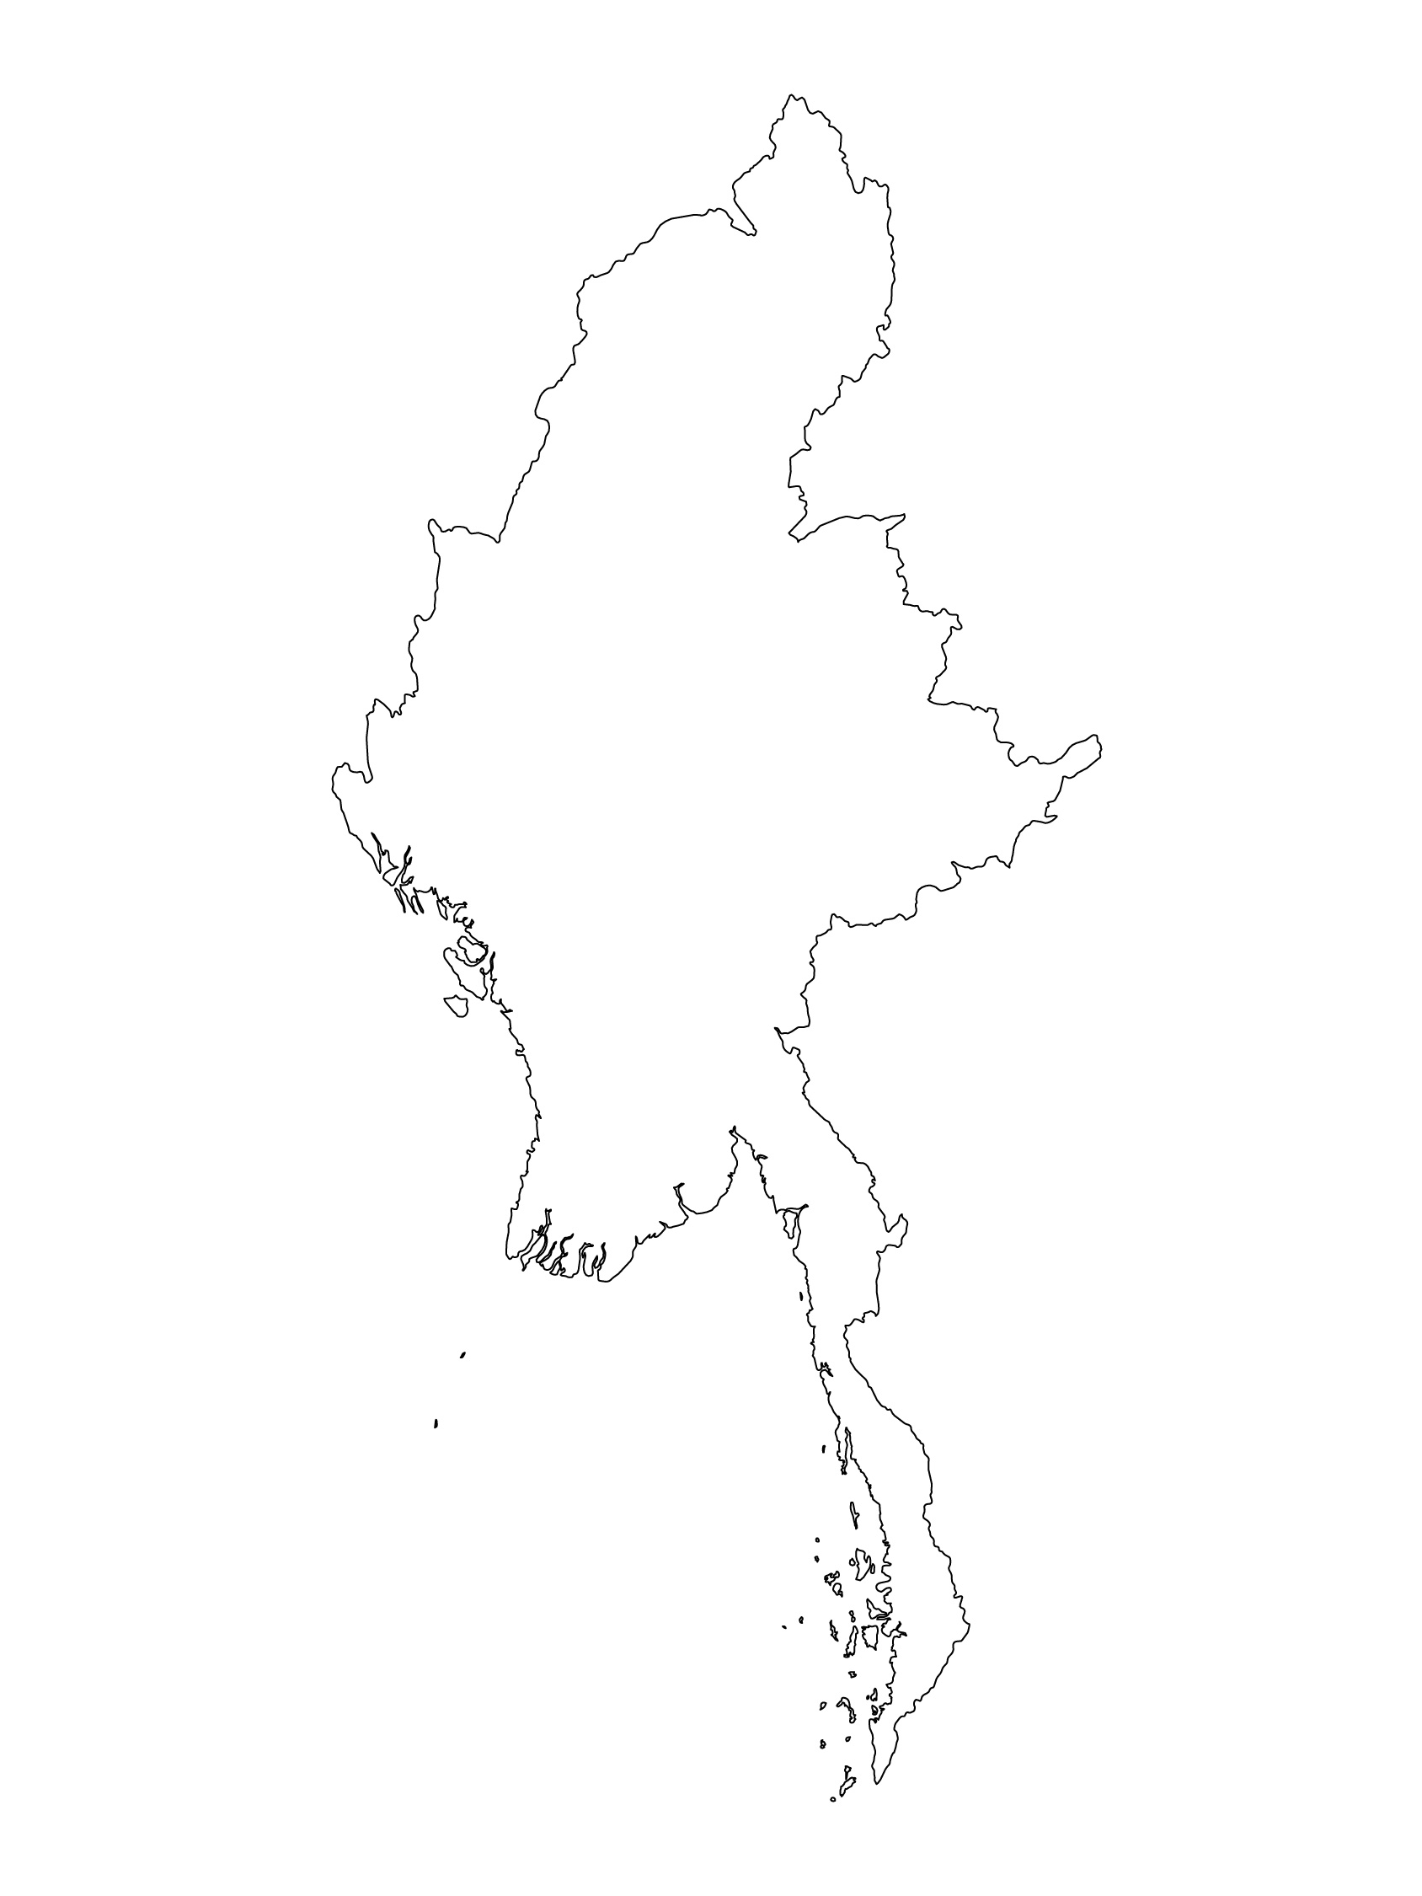
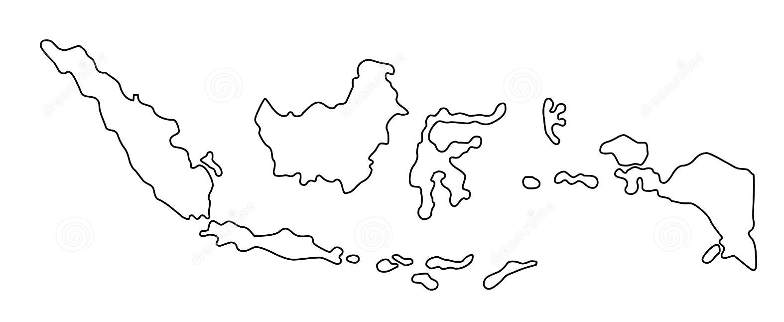
Examples from the Region
[COUNTRY NAME]
Add key presentation sentence about a specific program/project using Standard 8
Add name of organisations
Add key message / numbers
[ COUNTRY NAME]
Add key presentation sentence about a specific program/project using Standard 8
Add name of organisations
Add key message / numbers
[ COUNTRY NAME]
Add key presentation sentence about a specific program/project using Standard 8
Add name of organisations
Add key message / numbers
Notes:
Depending on the time you have for facilitation, consider adding here examples from the Region/ Country/ Response, of programming that meets the standards.
This could be a draft slide that you could update or remove if necessary.
For each example, you could add:
A short, concise, key presentation sentence about the specific program/project using Standard 8
Add the name of organisations and partners involved
Add practical lessons learnt, key actions, message or numbers, that will attract interest of your audience
Another option, if you have longer (and also depending on the audience you have), this slide can be completed in an interactive way during the session.
In that case, you could:
split the groups into 2 or 3 smaller groups,
allow 15 – 20 min for them to prepare a short presentation of an example from the Region/ Country/ Response, of programming that meets the standard
in plenary, have the groups present their examples, and discuss /compare lessons learnt out of them.
If you will be sending this presentation to the participants after the training, you can fill up this slide, to keep records of the presentations.
TIP: you can use https://thenounproject.com/ to get map outlines like those.

Slide 8
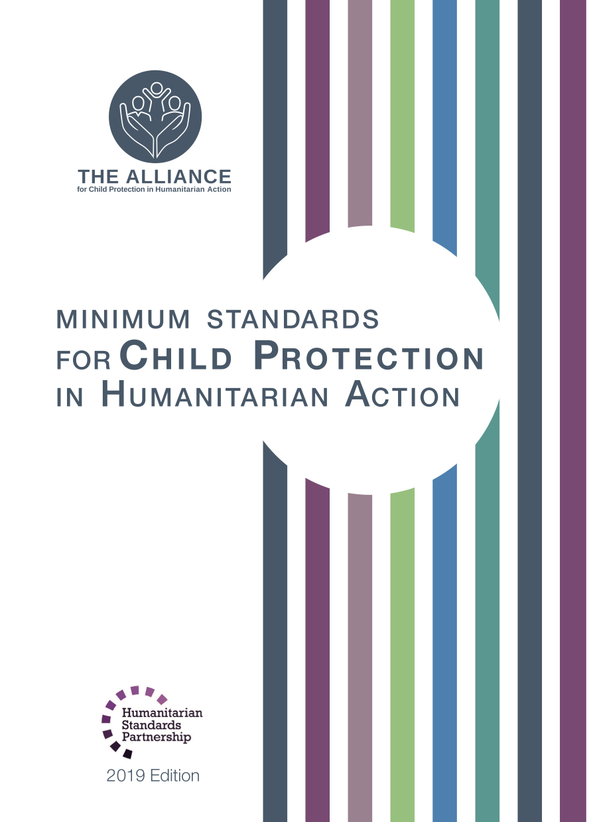
Need more than the hard copy?
On the Alliance website
PDF version
Briefing & Implementation Pack
25-page Summary
E-course
YouTube videos
A gallery of illustrated Standards
👉 www.AllianceCPHA.org
On the Humanitarian Standards Partnership website
Online, interactive version
HSP App for mobile phones and tablets
👉 www.HumanitarianStandardsPartnership.org
Notes:
[Facilitators - if you can project from the internet, then we suggest you navigate people there and show them]
HSP:
1. Online handbook
2. The Humanitarian Standards Partnership App
– It is the 2nd most popular app on that site after Sphere
CPMS page:
1. Interactive handbook – our greatest resource
2. A Summary: At just 32 pages, it means that it I CPHA topline but can be used to introduce the idea of minimum standards or start child protection discussions with government colleagues or other humanitarians without overwhelming them with the huge handbook.
Alliance website:
The PDF & all materials available can be downloaded if people want to print just portions of the CPMS, on the Alliance site
The “Introduction to CPMS” Briefing Pack contains this PPT and facilitation notes, plus the 2 page Introduction handout.
A gallery of illustrated Standards
Discover our free CPMS e-course with a range of modules
Videos on the Alliance Youtube channel
ASK: What should our next steps as a team/agency/individual be?
(i.e. you might schedule a longer meeting to digest the changes and create a plan; or ask colleagues to present certain new/revised standards and their implications for the programme; or set up a training or ask Senior Management for a meeting to discuss accountability to children, etc)
[Facilitators - Printed copies – there is a small stockpile of the Handbook and Summary that the global Alliance has in Geneva; however, countries and regions are encouraged to print & manage their own copies locally. Usually, this would be done through the inter-agency Coordination structure. On request, the Alliance can share a print-ready PDF.]
Thank you so much for coming together and starting to explore the CPMS. I will follow up on the next steps we discussed. And that’s the key – the CPMS is a gift that just keeps on giving every time you open it!

