Slide 1
The Minimum Standards for Child Protection in Humanitarian Action
CPMS
SLIDE DECK
Notes:
Facilitators:
This briefing is for any potential user of the CPMS. It is geared primarily toward child protection staff, so consider broadening some questions or providing more detail, if colleagues from other sectors join you.
It is assumed that the group is about 20 people and that everyone in the room knows each other (perhaps colleagues from your agency or the CP coordination group). if not, add 5 minutes for quick introductions.
PREPARE: a flipchart with the objectives of the session
By the end of the session, participants will be able to:
Describe the content of Standard 9
Explain & Share its key messages
Demonstrate how & why to use the handbook
NOTE: if you have already done a Session on Pillar(s), Principles or other Standard(s), skip slide 2 & 8
TIP: Slides are animated -> for each click you’ll make, some few words, a title or an image will appear on the slide.
Read the corresponding notes from the facilitators notes, before showing the following content, so participants have time to process what you say, and read each point.

Slide 2
Aim of the Standards
Benchmark for CPHA.
Collaborative, inter-agency tool
Links with Core Humanitarian Standard
Contextualisation for local ownership
Purpose:
quality and accountability
impact for children’s protection and well-being
Notes:
Donors, local governments, colleagues in other sectors and our beneficiaries themselves want to know what we are doing and why. The CPMS are our benchmark. CPMS are the key way to operationalise or make real children's rights in the practice of humanitarian response.
They are a collaborative, inter-agency tool, that links with other initiatives, such as the Core Humanitarian Standard, INSPIRE and the Humanitarian Inclusion Standards
Wherever relevant, the CPMS align with INSPIRE’s 7 strategies to end violence against children – initiative’s icons are actually scattered through the text. In addition, the Core Humanitarian Standard on Quality and Accountability is highlighted in the Introduction and resonates throughout the handbook.
Contextualisation is encouraged and can create ownership of the standards at every level. It builds a deeper understanding of child protection in the specific context for a wide range of actors. National coordination groups are therefore encouraged to adapt the CPMS. Please raise it with colleagues locally and then seek the guidance of the global CPMS team. For more information, watch the short contextualization video on the Alliance’s youtube channel.
BOX: The CPMS aim at improving the quality and accountability of our programing and increasing impact for children’s protection and well-being in humanitarian action (internal displacement and refugee contexts), by establishing common principles, evidence, prevention and goals to achieve. They provide a synthesis of good practice and learning to date.

Slide 3
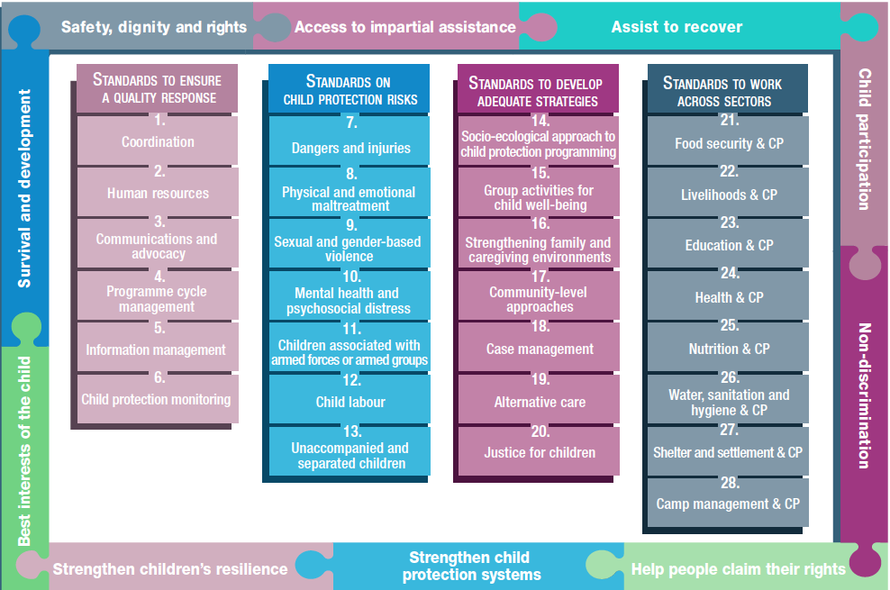
Overview
Notes:
This is an overview of the CPMS structure: there are 28 Standards across 4 pillars and 10 CPHA principles threaded throughout.
You can find this overview on the back of the CPMS handbook or in the online handbook; it’s a practical way of locating quickly a specific topic.
This presentation focuses on Standard 9: Sexual and gender-based violence

Slide 4
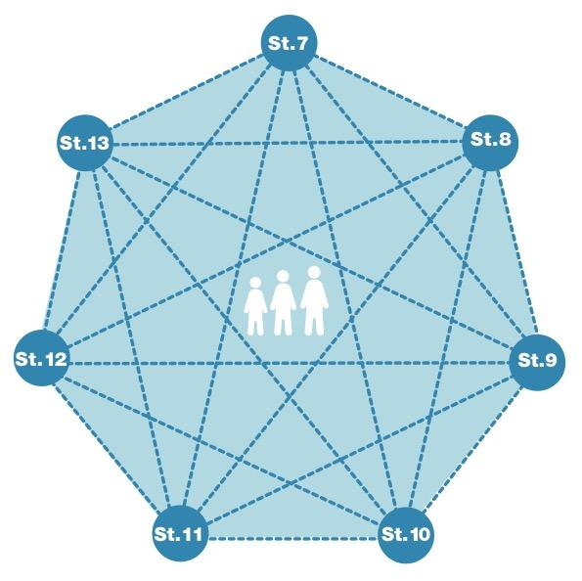
General intro to Standard 9
Part of 2nd Pillar, related to child protection risks
RISK = Nature & Extent of hazard + Vulnerability - Resilience
Widespread, often hidden, underreported
Life-saving interventions
Well-coordinated, sensitive, multisectoral survivor-centered response
What types of acts can we think of?
Notes:
This Standard is part of the second Pillar related to child protection risks that children may face in humanitarian settings. All the seven different risk standards are linked, as they address overlapping vulnerabilities and risks. The risks cannot be addressed in isolation.
Child protection risks are potential violations and threats to children's rights that will cause harm to children. To understand a child's risk, we need to understand the nature (type of hazard, situation, threat…) & extent of the risk and the individual child’s vulnerability to that risk, but also the family/child coping or survival strategies (meaning their resilience and ability to withstand the risk). Vulnerability is understood as the extent to which a child has characteristics that reduce his ability to withstand adverse impact. We have to record that vulnerability is specific to each person and each situation
DEF: ‘Sexual violence’ is defined in this standard as any form of sexual activity with a child by an adult or by another child who has power over the child.
DEF: ‘Gender-based violence’ (GBV) is a general term for any harmful act that is perpetrated against a person’s will and that is based on socially ascribed (gender) differences between males and females.
GBV is rooted in systemic inequality between males and females and therefore girls are most at risk (though boys also experience some forms of sexual violence, including child sexual abuse).
Sexual and gender-based violence is widespread but often hidden and underreported. All humanitarian actors should assume that it is taking place.
It stresses the fact that mitigation, prevention and response to SGBV against children are life-saving interventions that require a multisectoral & coordinated response. [→ prevention and case management icons] It also strengthens guidance on a survivor-centred approach and confidentiality
Discussion Prompt: What types of acts are concerned ?
Any act arising from social norms that promote and/or excuse gender-based discrimination and unequal power
Include sexual violence, harmful practices, denial of resources or opportunities, sexual harassment, sexual exploitation, and intimate partner violence (e.g. for children who are married), child marriage or female genital mutilation/cutting…. (to be contextualized depending on the country)
Gender norms, social barriers, stigma and discrimination – are causes of GBV
-> interventions aiming at promoting gender equality and systemic change to social and gender norms are encouraged, whenever possible.

Slide 5
“All children are informed about and protected from sexual and gender-based violence and have access to survivor-centred response services appropriate to their gender, age, disability, developmental stage and cultural/religious background.”
Social norms
Child survivor-centered approach
Safe management of survivor data
Need-to-know basis
Do no harm
Notes:
Standard 9 states following: “All children are informed about and protected from sexual and gender-based violence and have access to survivor-centred response services appropriate to their gender, age, disability, developmental stage and cultural/religious background.”
The root causes of SGBV relate to the attitudes, beliefs, norms and structures that promote and/or excuse gender-based discrimination and unequal power. Transforming norms and systems that support gender inequality can have an observable impact on survivors’ immediate health, safety and security. However, interventions related to social norms and systemic change should only be implemented (a) in more stable environments and (b) when basic SGBV response services are functional.
A child survivor-centered approach creates a supportive environment in which the survivor’s rights and wishes are respected, their safety is ensured and they are treated with dignity and respect. A survivor-centered approach is based on the following guiding principles:
Safety: The safety and security of the survivor and their family is the primary consideration.
Confidentiality: Survivors have the right to choose to whom they will or will not tell their story, and any information about them should only be shared with their informed consent/assent. However, when working with children there are limits to confidentiality that must be explained clearly to children and their caregivers. These limits include the need to protect a child’s physical and emotional safety and provide immediate assistance when needed.
Respect: All actions should be guided by respect for the choices, wishes, rights and dignity of the survivor. The role of helpers is to facilitate recovery and provide resources to aid the survivor.
Non-discrimination: Survivors should receive equal and fair treatment regardless of their sexual orientation, gender identity, age, disability, religion, nationality, ethnicity or any other diversity factor.
the best interests of the child need to be considered: all decisions and actions affecting children should reflect what is best for the safety, well-being and development of that particular child. It recognises that every child is unique and will be affected differently by SGBV. Children have the right to participate in decisions affecting them, appropriate to their level of maturity. Parents/caregivers should be involved in decision-making in accordance with the best interests of the child.
SGBV data should be managed with survivors’ full informed consent/assent for the purpose of improving service delivery. It should be done in a safe and ethical way to ensure data security and the safety of everyone involved. Incident data collection is the responsibility of specialised service providers who assist child survivors and who are bound by data protection protocols such as those developed by the Gender-Based Violence Information Management System (GBVIMS). There are many types of data related to GBV (qualitative info collected through FGDs, trend analysis, etc.) but what is referenced here, including the GBVIMS, is more specifically about reported incidents/survivor data.
It must be shared only on a need-to-know basis and safeguarded by confidentiality and information-sharing protocols.
Non-compliance with these agreed-upon protocols can expose survivors to risks or increase the chance of discrimination and violence towards individual children, specific families and entire communities.

Slide 6
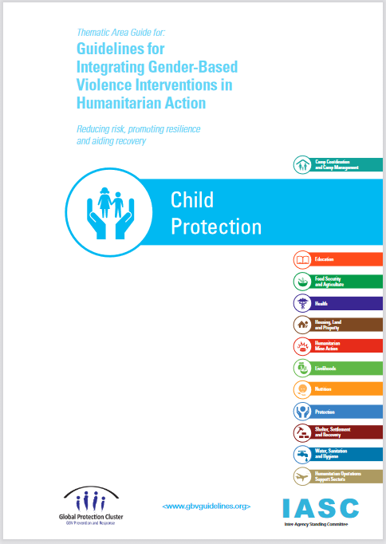
SGBV programming
Prevention:
SOPs
Secondary data review
Referral pathway
Family support
Social and cultural norms
Risk mitigation
Response:
Basic SGBV services
Information
Service providers’ capacity
High-quality case management
Alternative care
Urgent care
SGBV messages
Notes:
To prepare for SGBV programming and prevent its occurrence:
Develop standard operating procedures with GBV coordination groups
Collect and analyse information about existing SGBV risks through secondary data review.
Develop a referral pathway of existing formal and informal service providers
Support families with education, life skills training, parenting programmes and economic empowerment
Shift harmful social norms, by changing social expectations, not just individual attitudes; publicising the change; inspiring new norms and behaviours.
Risk mitigation refers to a process and specific interventions in all phases of humanitarian programming; to mitigating the risk of GBV across other humanitarian sectors (WASH, Nutrition, etc.). It includes actions that are taken in each humanitarian sector and area of work to reduce risks and exposure to GBV and improve safety as part of an agencywide approach. Risk mitigation measures also contribute to reducing the risk of SEA. Operations must anticipate and identify GBV risks and take prompt action to mitigate them, including through intervention/advocacy with national authorities and service providers. I.e. Conducting safety audits and safety planning, distribution of dignity kits and ensuring girls' access to these items, ensuring safe spaces for girls (particularly through women's spaces).
Examples of the key actions that should be implemented in coordination with GBV actors to respond to SGBV against children:
Ensure that basic SGBV services are available
Make information on the referral pathways available to and understood by all service providers, children, caregivers and communities
Strengthen formal and informal service providers’ capacity to provide child-friendly services to all children
Support child survivors’ access to high-quality case management services delivered by service providers with the appropriate expertise.
Identify appropriate alternative care for child survivors where removal from the home is in the best interests of the child
Provide cash and voucher assistance and/or in-kind material support to enable child survivors to rapidly access urgent care.
Consult with children to incorporate SGBV messages into child protection community outreach and awareness-raising activities.
The icon is the Child Protection thematic area guide from the IASC GBV Guidelines. The GBV guidelines is the key resource for more information that is helpful to implementing Standard 9.
(You can open the guidelines by clicking on the image if needed)

Slide 7
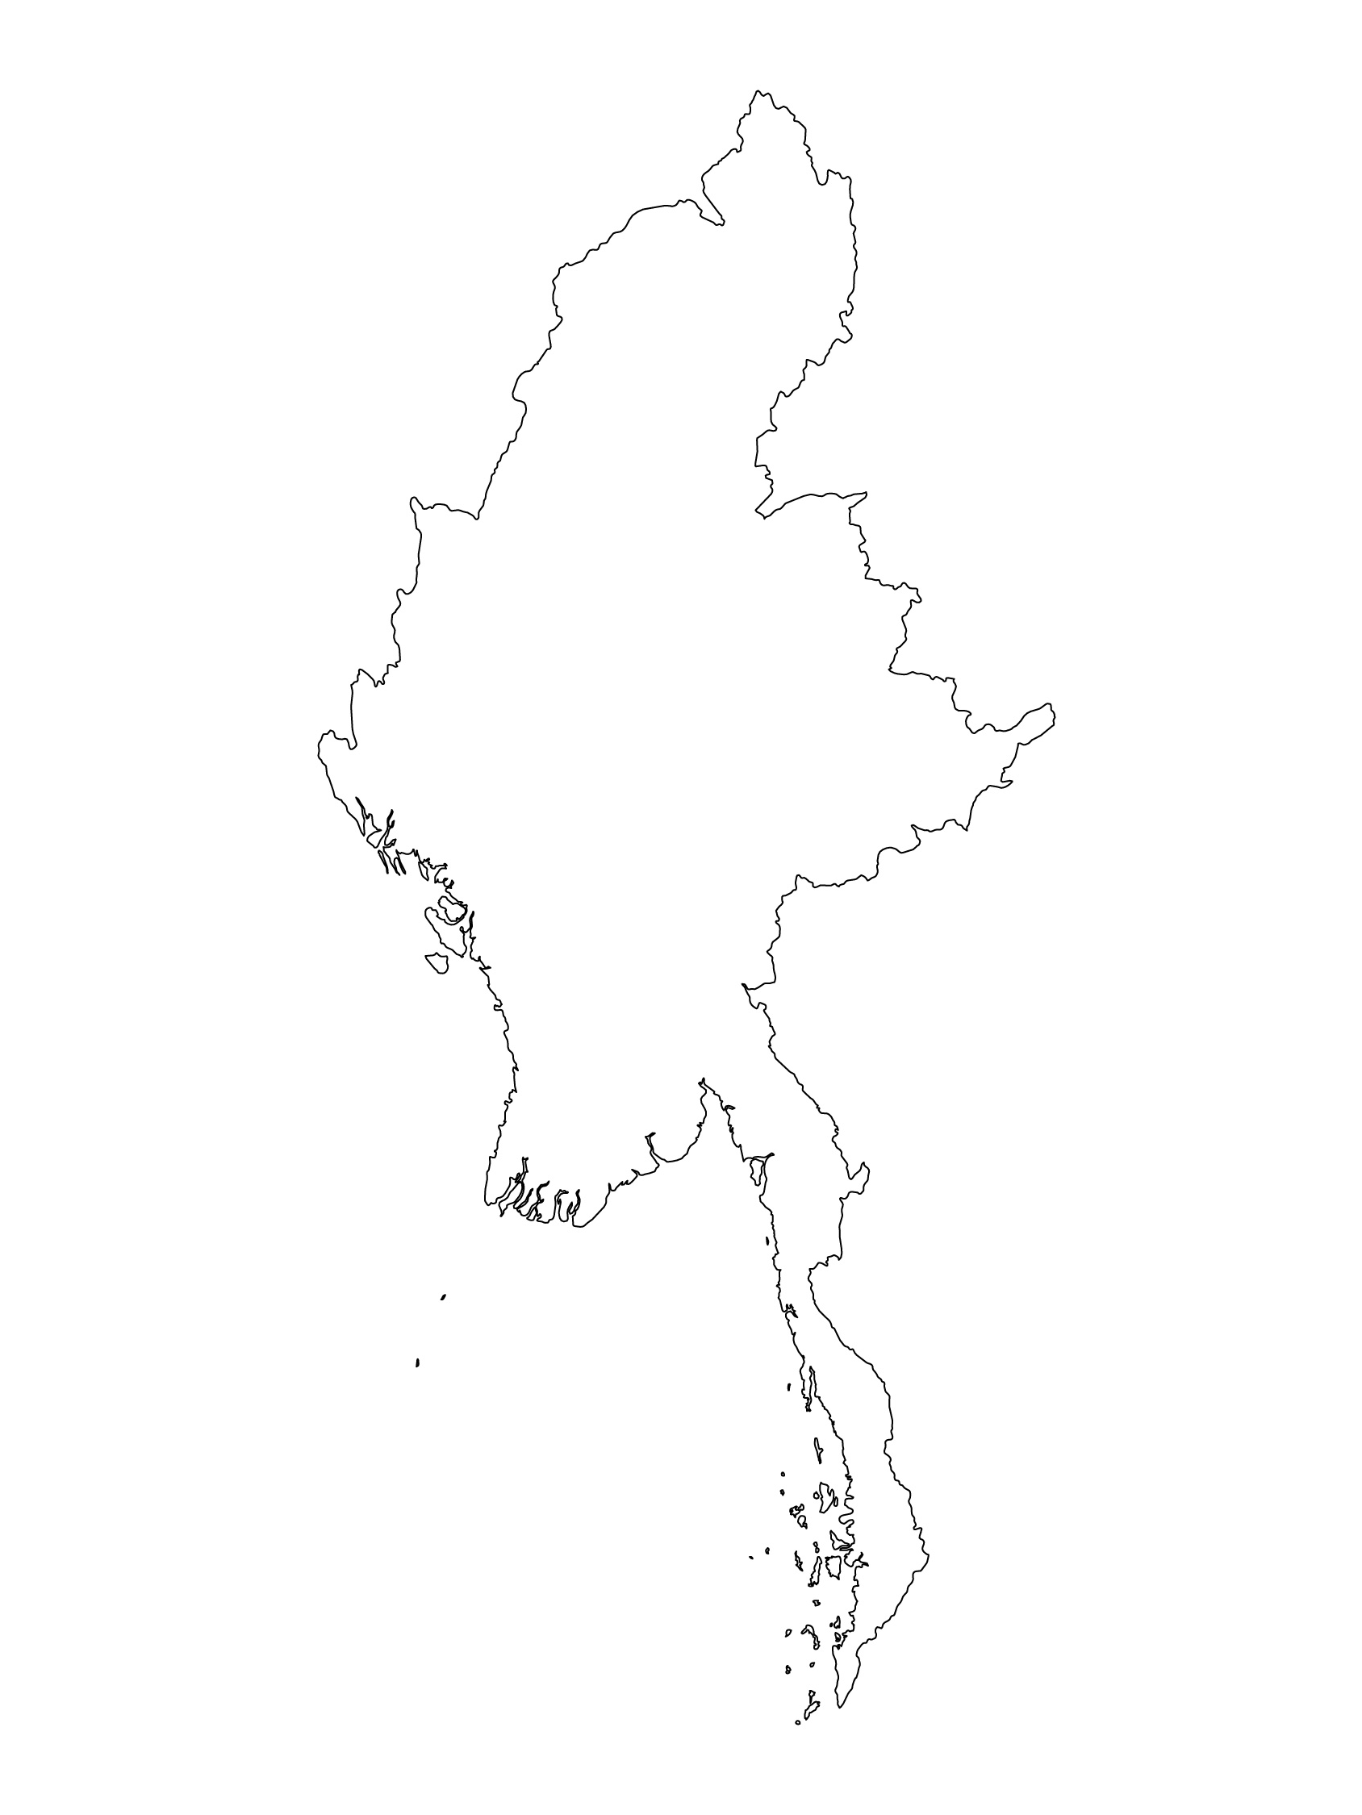
Examples from the Region
[COUNTRY NAME]
Add key presentation sentence about a specific program/project using Standard 9
Add name of organisations
Add key message / numbers
[ COUNTRY NAME]
Add key presentation sentence about a specific program/project using Standard 9
Add name of organisations
Add key message / numbers
[ COUNTRY NAME]
Add key presentation sentence about a specific program/project using Standard 9
Add name of organisations
Add key message / numbers
Notes:
Depending on the time you have for facilitation, consider adding here examples from the Region/ Country/ Response, of programming that meets the standards.
This could be a draft slide that you could update or remove if necessary.
For each example, you could add:
A short, concise, key presentation sentence about the specific program/project using Standard 9
Add the name of organisations and partners involved
Add practical lessons learnt, key actions, message or numbers, that will attract interest of your audience
Another option, if you have longer (and also depending on the audience you have), this slide can be completed in an interactive way during the session.
In that case, you could:
split the groups into 2 or 3 smaller groups,
allow 15 – 20 min for them to prepare a short presentation of an example from the Region/ Country/ Response, of programming that meets the standard
in plenary, have the groups present their examples, and discuss /compare lessons learnt out of them.
If you will be sending this presentation to the participants after the training, you can fill up this slide, to keep records of the presentations.
TIP: you can use https://thenounproject.com/ to get map outlines like those.

Slide 8
Need more than the hard copy?
On the Alliance website
PDF version
Briefing & Implementation Pack
25-page Summary
E-course
YouTube videos
A gallery of illustrated Standards
👉 www.AllianceCPHA.org
On the Humanitarian Standards Partnership website
Online, interactive version
HSP App for mobile phones and tablets
👉 www.HumanitarianStandardsPartnership.org
Notes:
[Facilitators - if you can project from the internet, then we suggest you navigate people there and show them]
HSP:
1. Online handbook
2. The Humanitarian Standards Partnership App
– It is the 2nd most popular app on that site after Sphere
CPMS page:
1. Interactive handbook – our greatest resource
2. A Summary: At just 32 pages, it means that it is topline but can be used to introduce the idea of minimum standards or start child protection discussions with government colleagues or other humanitarians without overwhelming them with the huge handbook.
Alliance website:
The PDF & all materials available can be downloaded if people want to print just portions of the CPMS, on the Alliance site
The “Introduction to CPMS” Briefing Pack contains this PPT and facilitation notes, plus the 2 page Introduction handout.
A gallery of illustrated Standards
Discover our free CPMS e-course with a range of modules
Videos on the Alliance Youtube channel
ASK: What should our next steps as a team/agency/individual be?
(i.e. you might schedule a longer meeting to digest the changes and create a plan; or ask colleagues to present certain new/revised standards and their implications for the programme; or set up a training or ask Senior Management for a meeting to discuss accountability to children, etc)
[Facilitators - Printed copies – there is a small stockpile of the Handbook and Summary that the global Alliance has in Geneva; however, countries and regions are encouraged to print & manage their own copies locally. Usually, this would be done through the inter-agency Coordination structure. On request, the Alliance can share a print-ready PDF.]
Thank you so much for coming together and starting to explore the CPMS. I will follow up on the next steps we discussed. And that’s the key – the CPMS is a gift that just keeps on giving every time you open it!

