Slide 1

Child Safeguarding:
What Education Clusters
Need to Know
Notes:
Photo Credit: CH1745546_The Kindness Circle at a Primary School in Wakiso, where children are taught to be kind to each other, Uganda.

Slide 2
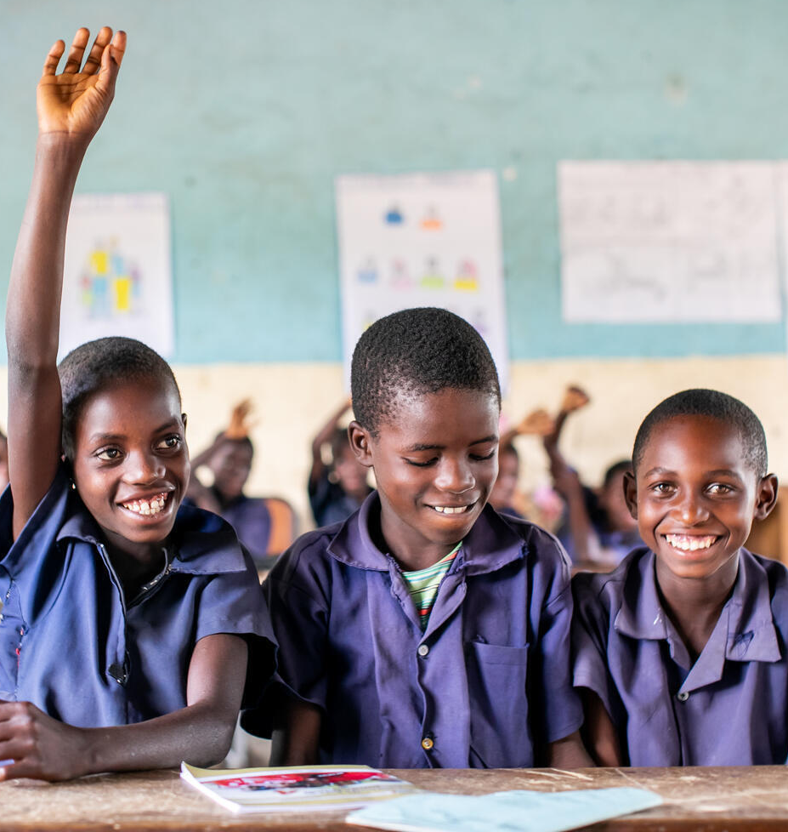
How to Use This Slide Deck
This slide deck is easy to use! There are five sections:
1. Child Safeguarding Basics
This section is a 30-minute PowerPoint presentation that Cluster Coordination Teams can use to introduce child safeguarding to Education Cluster members.
2. Child Safeguarding Across the Humanitarian Program Cycle (HPC)
This section explains how Cluster Coordination Teams can integrate child safeguarding in their coordination work across the HPC. It includes examples from countries that are doing great work!
3. Related Concepts
This section explains how child safeguarding connects to PSEA, GBV, child protection, and child participation.
4. Safe Education Programming
This section explains how Education Cluster members can make sure that EiE programming is safe for children.
Support for child safeguarding is available! Contact the GEC Helpdesk: help.edcluster@humanitarianresponse.info
5. Key Resources
This section includes guidance documents and templates to learn more about child safeguarding and related concepts.
Notes:
Photo Credit: UNICEF/UN0645310/Schermbrucker

Slide 3
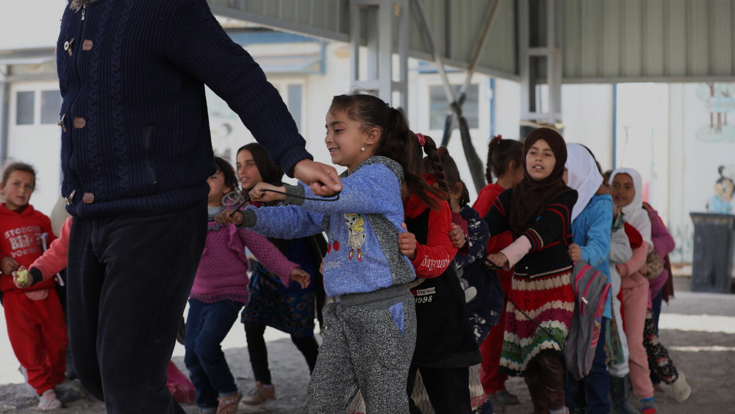
Child Safeguarding Basics
Notes:
PC: Roni Ahmed / Save the Children. CH1805857

Slide 4
What is Child Safeguarding?
Child safeguarding concerns harm (deliberate or unintentional) to children caused by an aid organisation or anyone associated with the organisation.
Child safeguarding applies to all children.
All children means all boys, girls, and adolescents aged 0 to 18, including children and youth with disabilities.
Child Safeguarding is:
A responsibility to ensure that aid organizations’ staff, associates, operations, and programs do not harm children.
Staff: includes employees, trainees, and interns
Associates: includes consultants, contractors, volunteers, and partners – including teachers (including Ministry of Education teachers at schools where partners work)
A set of organizational policies and procedures to prevent and respond to harm to children caused by an aid organization or anyone associated with the organisation.
Includes Codes of Conduct
Includes Child Safeguarding policy and/ or Protection from Sexual Exploitation and Abuse (PSEA) policy
Any person associated with an aid organization is prohibited from harming children, including:
Children who are not beneficiaries of the organization’s programs.
The person’s own children.
Notes:
Whether MoE teachers fall under safeguarding is stated differently in different documents. Dianne to clarify with a safeguarding expert.

Slide 5
Principles of Child Safeguarding
Best interest of the child: All actions taken by organisations should be in the best interest of the child.
Duty of care: Organisations have a duty of care to children with whom they work.
Do No Harm: Organisations have a responsibility to Do No Harm to children.
Zero tolerance: There is a zero tolerance policy for child safeguarding violations. Child safeguarding is fundamental and non-negotiable.
Equal rights: All children have an equal right to be protected from harm.
Everyone’s responsibility: Safeguarding children is everyone’s responsibility.
Organisations that work with partners have a responsibility to support them to meet child safeguarding minimum requirements, including the protection from sexual exploitation and abuse (PSEA).

Slide 6
Connections with Other Key Concepts
Child safeguarding connects to other key concepts that keep girls and boys, including children with disabilities, safe:
Protection from Sexual Exploitation and Abuse (PSEA)
SEA is a is a form of GBV – it is sexual violence, specifically perpetrated by someone who works with an aid organization (see below for more details).
PSEA is a set of organizational policies and procedures to protect children and vulnerable adults from SEA by anyone working with an aid organization.
Child safeguarding includes PSEA, specifically the protection of children from SEA.
Gender-Based Violence (GBV)
Child safeguarding violations include many forms of GBV, which can be perpetrated by anyone working with an aid organization.
Mitigating child safeguarding risks also means mitigating GBV and SEA risks associated with aid organizations.
Child Protection (CP)
Abuse, neglect, exploitation and violence perpetrated against children external to an aid organization falls under CP
Abuse, neglect, exploitation and violence perpetrated against children internal to an aid organization (or caused by an aid organization and anyone associated with it) falls under child safeguarding
Accountability to Affected Populations (AAP)
Child safeguarding is part of AAP, including accountability to children.
Harm caused by an aid organization to children is a failure of accountability – the trust that children place in us is betrayed.
Feedback and complaints mechanisms (FCMs) are important for child safeguarding and for AAP.

Slide 7
Humanitarian Commitments
Child safeguarding is enshrined in international humanitarian commitments.
Child Safeguarding | Accountability to Children | Child Participation
UN Convention on the Rights of the Child (UNCRC) | Grand Bargain workstream 6 Participation Revolution | Grand Bargain workstream 6 Participation Revolution
IASC 6 Principles on PSEA | IASC AAP commitments, especially 3 (feedback and complaints) and 4 (participation) | IASC AAP commitment 4 (participation)
Core Humanitarian Standard (CHS) commitment 3 (do no harm) and 5 (feedback and complaints) | Core Humanitarian Standard (CHS) commitment 3 (do no harm), 4 (information and participation), and 5 (feedback and complaints) | Core Humanitarian Standard (CHS) 4 (information and participation)
Organisations’ safeguarding policies
National laws
Notes:
Add CRC for accountability and child participation?

Slide 8
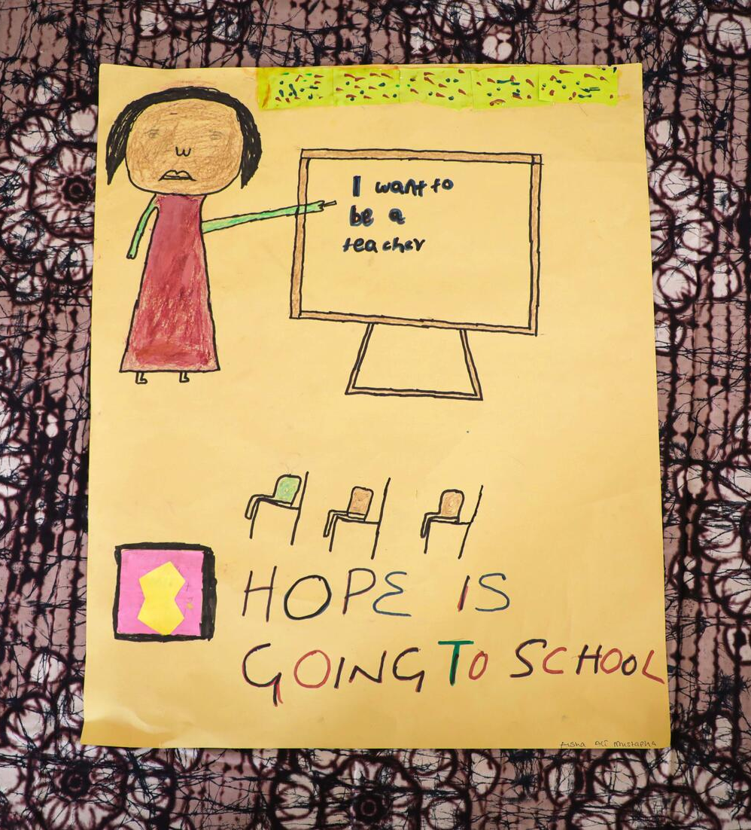
Examples of Harm to Children Falling Under Safeguarding
Note: For the purpose of this slide, NGOs references INGOs, Local and National Organisations and the UN.
Physical abuse: a teacher using corporal punishment on a student
Emotional abuse: an NGO education staff insulting a child during a focus group discussion
Sexual exploitation: a teacher demanding sex in return for grades
Sexual abuse: an NGO contractor touching a child inappropriately in the community (outside of work)
Neglect: an NGO education staff not supervising children during recreational time, and children having accidents and injuring themselves
Discrimination: an NGO consultant treating a child differently because of their ethnicity during an education project evaluation
Exclusion: an NGO volunteer not letting a child join an education activity due to their disability status
Traditional harmful practices: an NGO staff facilitating child marriage of their niece
Economic exploitation: an NGO supplier forcing a child to work for them
Online (sexual) abuse: an NGO staff using WhatsApp to share sexual images with children
Other: abuse of power or misuse of authority in any way!
Notes:
Others: Shoddy construction?
PC: PC: Save the Children. CH1826244

Slide 9
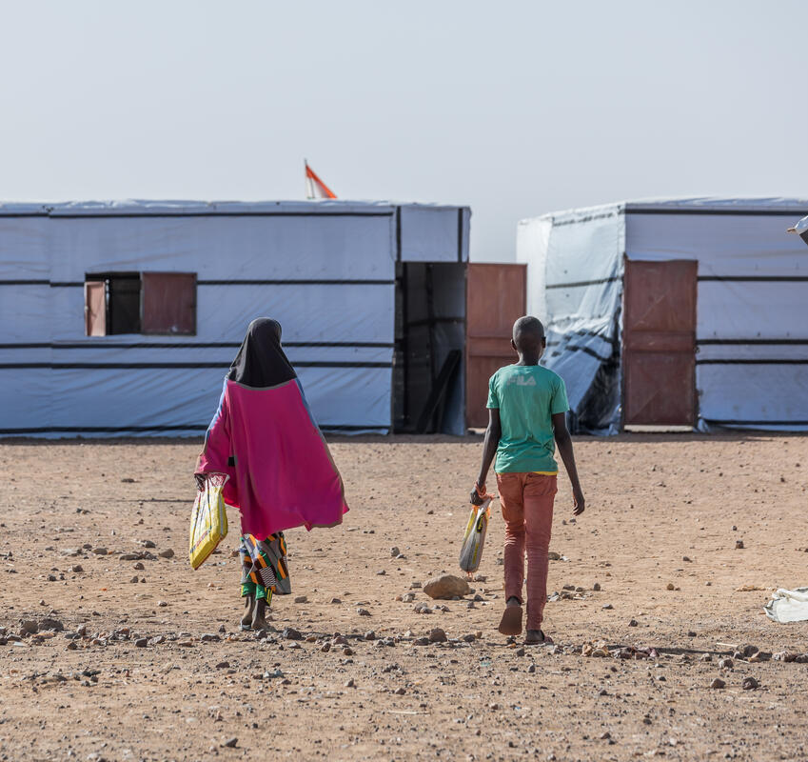
Examples of Safeguarding Risks
Staff behaviour
Teachers have isolated one-on-one time with children
Physical school environment
Isolated, obstructed, or poorly supervised areas in the school
Latrines in unsafe or dark areas, not sex-segregated for girls and boys, and/ or not accessible for children with disabilities
School grounds and buildings not secured to limit entry by people not associated with the school
Unsafe school infrastructure, such as damaged or dilapidated walls and roofs, flimsy structures at risk of falling down, hazards on the school grounds, etc.
School administration/ system
Lack of female teachers
Mix of different ages of children in classes
Lack of training for teachers and other education personnel (including principals, management, and administrative staff) on safeguarding, PSEA, child protection, GBV, and child rights
Lack of participation of girls and boys, including children with disabilities, in key school management structures, project design and/ or implementation
Notes:
PC: Apsatou Bagaya / Save the Children. CH1544227

Slide 10
Examples of Safeguarding Risks
Safeguarding System
Insufficient measures to safeguard particularly vulnerable children
Absence of risk identification, mitigation, and response mechanisms in schools and education programs
Absence of a child safeguarding or protection focal point at the school
Absence of or poorly understood Code of Conduct for teachers and other school staff
Absence of clear and implemented disciplinary sanctions in case of violation of Codes of Conduct
Absence of referral pathways to specialized services (including CP, GBV, and MHPSS) or lack of knowledge of them at the school level
Lack of information shared inclusively and accessibly with children and the community on the behaviour they should expect from teachers, other school staff, and NGO staff
Absence of safe, inclusive, and accessible child-friendly feedback and complaints mechanisms
For SEA specifically, low reporting because of fear of stigma or reprisals; lack of trust/confidence in the safety and confidentiality of the reporting and investigation process; lack of support services for survivors.
Notes:
Particularly vulnerable children - ex: young/adolescent girls, children with disabilities, unaccompanied minors, etc.
Child safeguarding or protection focal point at the school – someone who children know they can come to with safeguarding, protection, and GBV concerns and for psycho-social support
Lack of information shared on what constitutes a violation of the Code of Conduct; how to safely report violations; and potential (positive and negative) consequences of reporting

Slide 11
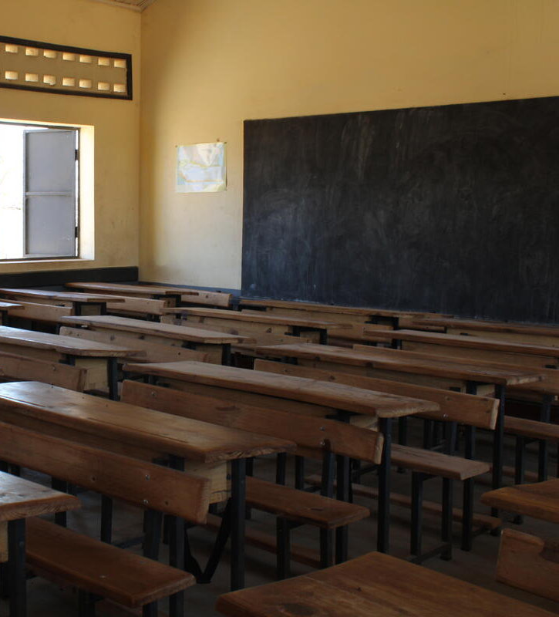
Why is Child Safeguarding Important in Cluster Work?
Child safeguarding violations increase in emergencies – children who were already vulnerable before the crisis (including girls and children with disabilities) become even more vulnerable during an emergency and are more at risk of sexual abuse, gender-based violence, and other safeguarding violations.
The education sector works with large numbers of children every day.
Schools are common locations for abuse of children, perpetrated by NGO staff, school staff, teachers, and other children.
Safeguarding children is key to an accountable education response.
Organisations have a duty of care to children with whom they work.
Clusters can support the Ministry of Education to strengthen child safeguarding in schools.
Notes:
Save the Children 2018 CSG trends show that the vast majority of reports of physical abuse against children in emergency responses occurred in temporary learning spaces, schools or Child Friendly Spaces. For the same period reports of child sexual abuse in emergencies show that the most common perpetrators (by far) were teachers, followed by security guards and Child Friendly Space animators/facilitators (source: Save the Children, personal communication).
PC: Narindra Rakotonanahary/Save the Children. CH1725457

Slide 12
Child Safeguarding is a Collective Interest
Child safeguarding violations, and in particular SEA, are violations of humanitarian principles and of children’s rights.
Working collectively on child safeguarding is more efficient and effective:
Partners can map and share resources for referral of cases at the school level
Partners can share harmonised messaging on child safeguarding to children and communities
Partners can jointly advocate for improved safety and security in schools
Inter-agency approaches (like inter-agency child-friendly feedback and complaints mechanisms) can improve accountability
Developing a community of practice fosters peer exchange and the sharing of best practices
Involving local actors, such as local and national NGOs (LNNGOs), community-based organisations (CBOs), women-led organisations (WLOs), and organisations of persons with disabilities (OPDs) provides benefits including local knowledge on possible safeguarding risks
Child safeguarding incidents can:
Harm the organization’s reputation at the community level and reduce the community’s trust in all humanitarian actors working in the same location, leading to worsening security.
Negatively affect donor funding to the involved organization, its partners and even the whole sector.

Slide 13
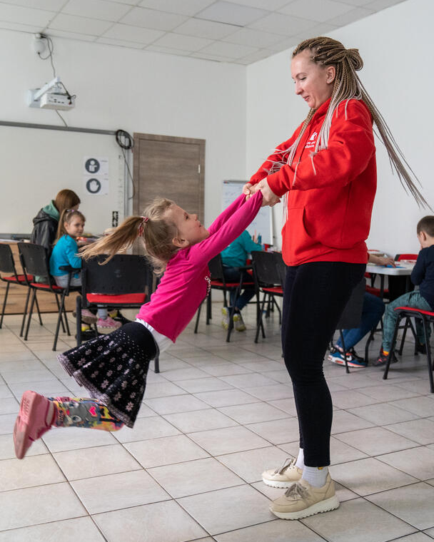
Role of the Education Cluster in Child Safeguarding
Child safeguarding should fit into coordination functions across all phases of the Humanitarian Program Cycle (HPC), led by Education Cluster Coordination Teams supported by Global Education Cluster (GEC).
Each Education Cluster member is responsible for having child safeguarding measures in place, including:
Child Safeguarding Policy that includes PSEA
Code of Conduct
Child Safeguarding Focal Point(s)
Trained staff
Safe education programming approach
Risk identification and mitigation measures (including GBV risk mitigation)
Notes:
PC: Oleksandr Khomenko/Save the Children. CH1818316

Slide 14

Minimum Actions for Education Cluster Coordination Teams
Each bullet point is hyperlinked to the relevant slide in the ‘Child Safeguarding Across the HPC’ section of this PowerPoint, which provides more detail on how to put these steps into action.
Support partners to have a Child Safeguarding Policy and a Code of Conduct in place
Identify partners that do not have a Child Safeguarding policy and a Code of Conduct
Reference the number of partners without these policies as a gap in the HNO and Cluster Strategy
In the HRP, prioritize project sheets from partners that include child safeguarding elements
Support Education Cluster members in strengthening their child safeguarding capacity, particularly to put in place Child Safeguarding Policies (including PSEA) and Codes of Conduct.
Follow up to assess progress annually.
The GEC has put together a short guide outlining suggested minimum actions for Education Cluster Coordination Teams on child safeguarding
GEC Guide

Slide 15
Minimum Actions for Education Cluster Members
2. Jointly identify child safeguarding, CP and GBV (including SEA) risks for children in education programmes
Identify the most likely or frequently reported risks affecting girls and/ or boys in and around schools in your context
Mention identified risks in the HNO and Education Cluster Strategy
3. Coordinate partners to design mitigation measures to prevent and respond to child safeguarding risks in education programmes
Plan measures to adopt in education programmes to mitigate previously identified child safeguarding, CP and GBV (including SEA) risks
Include identified mitigation measures in the HRP and Education Cluster Strategy, and design at least one indicator to monitor mitigation measures
Follow up with partners to assess progress towards implementing safe education programmes

Slide 16
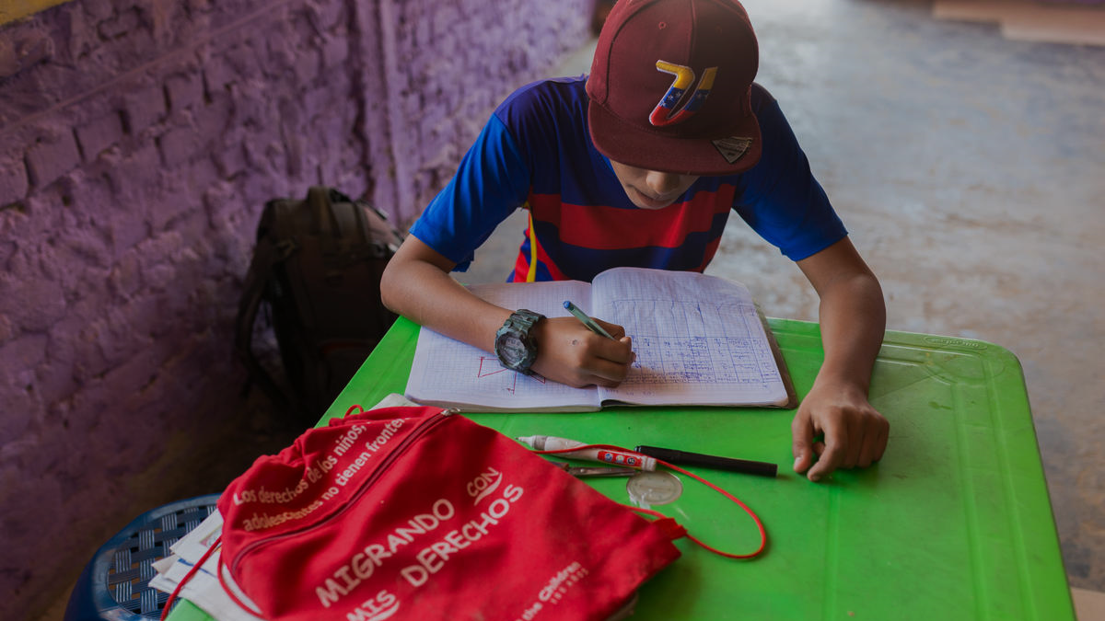
Child Safeguarding Across the Humanitarian Program Cycle (HPC)
Notes:
PC: MIGUEL ARREATEGUI RODRIGUEZ / Save the Children. CH1370166

Slide 17
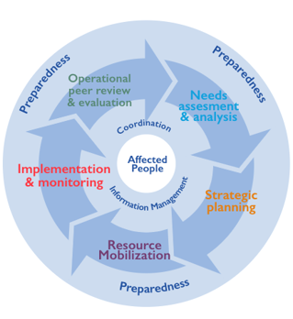
Section Overview
Child Safeguarding Across the Humanitarian Program Cycle (HPC)
Cross-cutting Across the HPC
Train Education Cluster members on child safeguarding
Collaborate on child safeguarding with other clusters, inter-cluster initiatives, and the government
Follow safe and ethical guidelines for taking and sharing images of children
Needs Assessment and Analysis
Survey Education Cluster members’ child safeguarding knowledge and practices
Identify safeguarding risks for children in EiE programming
Reference child safeguarding gaps/ needs and risks in the HNO and the Education Cluster Strategy
Include child safeguarding protocols in all Joint Education Needs Assessments (JENA), particularly child participation components
Strategic Planning
Address child safeguarding gaps/ needs and risks in the HRP and Education Cluster Strategy
Build collective commitment to child safeguarding among partners
Support partners to put Child Safeguarding Policies (including PSEA) in place
Support partners to put Codes of Conduct in place
Resource Mobilisation
Prioritise project sheets that include child safeguarding
Identify funding for Education Cluster member capacity strengthening on child safeguarding
Mobilise human resources to support Education Cluster member capacity strengthening on child safeguarding
Implementation and Monitoring
Support Education Cluster members to implement child-friendly feedback and complaints mechanisms
Maintain an up-to-date list of Safeguarding/ PSEA Focal Points of all Education Cluster members
Appoint an Education Cluster Child Safeguarding/ PSEA Focal Point or create a Child Safeguarding/PSEA Task Team
Create a standing agenda item in Education Cluster coordination meetings on child safeguarding and PSEA
Monitor progress towards child safeguarding commitments
Operational Peer Review and Evaluation
Reflect to improve integration of child safeguarding in Education Cluster coordination

Slide 18
Cross-cutting Across the HPC
1. Train Education Cluster members on child safeguarding
Objective: To strengthen Education Cluster members’ understanding of basic child safeguarding concepts AND to generate interest in working collectively on child safeguarding
How to do it:
Organise a basic information session on Child Safeguarding with Education Cluster members – use this PPT: Child Safeguarding Basics, slides 3-15
The information session can happen during an Education Cluster meeting or at an ad hoc meeting
Disseminate the link to the 50-minute GEC e-learning module on Child Safeguarding with Education Cluster members and encourage them to complete the module
For a more in-depth training, contact the GEC Helpdesk: help.edcluster@humanitarianresponse.info
Resources:
This PPT: Child Safeguarding Basics, slides 3-15
50-minute e-learning module on Child Safeguarding, available on Kaya here
Several other online learning modules are available – see the list here

Slide 19
Cross-cutting Across the HPC
2. Collaborate on child safeguarding with other clusters, inter-cluster initiatives, and with the government
Objective: To link up efforts to keep children safe across sectors and in alignment with Ministry of Education guidelines
How to do it:
Collect, discuss, and disseminate any existing child safeguarding rules, regulations and standards issued by the Ministry of Education
Identify child safeguarding connections with other clusters and inter-cluster initiatives.
  Reach out to: CP AoR, GBV AoR, Disability-inclusion task force or intercluster focal point, Inter-cluster/ inter-agency AAP initiatives or Communication with Communities working group, and/ or PSEA Network or ongoing initiatives
  Set up bilateral introduction meetings. Exchange information about ongoing initiatives related to child safeguarding and look for opportunities to collaborate:
    Consider sharing work plans for inputs, and/ or planning joint trainings
    Assess whether systematising ongoing engagement on child safeguarding would be beneficial, perhaps through regular meetings, or attendance in Education Cluster meetings by CP/ GBV/ AAP/ PSEA Network focal points, or attendance in CP/ GBV/ AAP/ PSEA Network meetings by an Education Cluster focal point, etc.
For collaboration with the PSEA Network, request that PSEA assessments conducted by UN agencies be shared with Education Cluster members, request training on reporting protocols for allegations received by Education Cluster Coordination Teams, and share expertise on improving the child-friendliness of Feedback and Complaints Mechanisms.
Resources:
For collaboration on CP including and beyond safeguarding, see CP-EiE Collaboration Framework
For collaboration on GBV including and beyond safeguarding, see GEC GBV workstream
Notes:
Working collaboratively avoids duplicating efforts and creating parallel systems/pathways that can confuse Partners, schools, children and communities. There are other distinct advantages for the Education, GBV and CP sectors working jointly on Child Safeguarding (and PSEA): maximising mutual cooperation and trust-building; reducing costs via sharing of resources; reinforcing the strength of advocacy; and improving chances of resources mobilisation. Since several Partners are members of both the Education Cluster Team and the CP sub-Cluster, and often also of the GBV sub-Cluster, there is a clear advantage in strengthening partners’ capacity for the benefit of all sectors.
Cooperation with the PSEA Network ensures that Education Cluster Team education work is aligned with and contributes to the PSEA programme (and vice versa), as a paramount best practice identified by the International Organization for Migration (IOM)

Slide 20
Cross-cutting Across the HPC
3. Follow safe and ethical guidelines for taking and sharing images of children
Objective: To support a common understanding of how to take and share images of children safely and ethically in our work.
How to do it:
Review the PPT presentation created for the Education Cluster in DRC, which summarizes guiding principles for taking, using, and sharing images of children in our work.
Deliver the presentation to Education Cluster partners during a regular or ad hoc cluster meeting. Contact the GEC Helpdesk to request support as needed (help.edcluster@humanitarianresponse.info).
Develop contextualized guidelines based on the PPT and discussion with cluster partners. Annex the contextualized guidelines to your Education Cluster Strategy and/ or include them in your orientation package for new cluster members.
Resources:
DRC Guidelines on the ethical use of children’s images and Photo consent form, available in French.
GEC PPT presentation – Sharing images of children: Child safeguarding, developed for DRC. Available in French.

Slide 21
Needs Assessment and Analysis
1. Survey Education Cluster members’ child safeguarding knowledge and practices
Objective: To assess Education Cluster members’ child safeguarding knowledge and practices, identify gaps, and clarify training needs.
How to do it:
Adapt the 30-minute GEC Cluster Partner Safeguarding Survey guidance note and tool to suit your context
Administer the survey to Cluster members via Microsoft Forms, or engage an Information Management Officer (IMO) to put the survey on Kobo, Survey Monkey or another platform.
Extract findings from the hosting platform and analyse the results
Resources:
GEC Cluster Partner Safeguarding Survey guidance note and tool, available in English and French.
GEC online survey in Microsoft Forms (in English and French).
Examples of survey data analysis reports from DRC (French), Kenya (English), and Nigeria (English).
Notes:
Findings from this survey can be used to include an analysis of the Child Safeguarding and PSEA environment in Secondary Data Review.
Group de travail Protection de l’Enfance RDC (in French);
EiE WG Nigeria (in English);

Slide 22
Needs Assessment and Analysis
Country Spotlight: Kenya (2021)
Kenya EiE WG survey of partners – Child Safeguarding results
The objective of the survey was to help the Kenya Education in Emergencies Working Group (EiE WG) understand the kind of support member organizations needed to improve their child safeguarding and child participation practices.
An online questionnaire was developed and shared with members in December 2020. The online system (Microsoft Forms) registers all the responses and produces an Excel database and automatic diagrams that can be used for analysis.
The survey generated the following interesting findings:
23% of partners did not have a Child Safeguarding Policy and 30% did not have a Child Safeguarding Focal Point
30% of partners did not have a staff Code of Conduct in place
30% of partners did not have a policy for PSEA
Partners had an average level of knowledge about child safeguarding
Schools supported by partners were not always safe and protective places, although almost all partners identified risks for children in their EiE programmes
The vast majority of partners had Complaints and Feedback Mechanisms in place
Recommendations:
Encourage partners to put in place Child Safeguarding Policies (including PSEA) and staff Codes of Conduct
Follow-up with individual organisations that lack policies
Notes:
Whether MoE teachers fall under safeguarding is stated differently in different documents. Dianne to clarify with a safeguarding expert.

Slide 23
Needs Assessment and Analysis
2. Identify safeguarding risks for children in EiE programming
Objective: Identify common risks for children in EiE programming (including safeguarding, GBV, SEA and CP risks), and develop mitigation measures to keep children safe.
How to do it:
Use child participatory approaches to identify risks and recommend mitigation measures – children are experts in their own lives!
To complement child participation, organise a workshop for identifying risks and mitigation measures with Education Cluster members, including L/NNGOs and partners from the CP and GBV sectors
  If children were consulted, use findings to inform this workshop. Build on children’s voices to agree on key risk mitigation measures.
  Identify risks specific to girls and children with disabilities, and pay special attention to risks specific to cash and voucher assistance (CVA) and online learning.
Resources:
Follow the Save the Children Guidance on Children’s Consultations in Humanitarian Contexts for consulting children. The GEC child participatory tool Risk and resource mapping can be used when involving children in identifying risks.
Read the GEC Safe and Inclusive Children’s Participation tipsheet to involve girls, boys, and children with disabilities.
GEC Briefing note: Education programming & Gender-based violence risks, and Basic concepts for understanding GBV risks mitigation in humanitarian action, which includes content on the AAAQ Framework.
UNICEF Consulting with women and girls on GBV risks and GBV risk mitigation
Notes:
Later, safety audits can be added to this slide.

Slide 24
Needs Assessment and Analysis
3. Reference child safeguarding gaps/ needs and risks in the HNO and the Education Cluster Strategy
Objective: To include child safeguarding (and PSEA) needs and risks in the HNO Education sector page, and the Education Cluster Strategy needs analysis section
How to do it:
Include findings from the survey of Education Cluster members on child safeguarding (slide 21) and the safeguarding risk and mitigation exercise (slide 23) in the HNO Education sector page, and in the Education Cluster Strategy needs analysis section.
Child safeguarding and PSEA capacity issues/gaps analysed in the HNO should then be followed by a plan to address those issues in the HRP and the Education Cluster Strategy strategic response section.
  This is in line with PSEA best practices as recommended by the IOM.
Resources:
GEC Check-list for inclusion of Child Safeguarding and Child Participation in the education section of HNOs and HRPs (also including AAP, Disability, GBV risk mitigation and Localization)
Notes:
Findings from this survey can be used to include an analysis of the Child Safeguarding and PSEA environment in Secondary Data Review.
Group de travail Protection de l’Enfance RDC (in French);
EiE WG Nigeria (in English);

Slide 25
Needs Assessment and Analysis
4. Include child safeguarding protocols in all Joint Education Needs Assessments (JENA), particularly child participation components
Objective: To ensure that JENA’s adhere to child safeguarding requirements, and to keep children safe in JENA child participation components
How to do it:
Review the Child Participation within Coordinated EiE Needs Assessments: Supplementary Guide, section 3.1.6 for details on the following steps:
  Assess risks to children, conflict sensitivity and gender sensitivity using the Risk, Conflict, and Gender Analysis Tool. Review participating organisations’ Child Safeguarding Policies (including PSEA)
    Ensure organisations have a Child Safeguarding Focal Point, a Code of Conduct and reporting channels and referral protocols.
  Have enumerators sign a specific JENA Code of Conduct that considers children’s participation in the JENA (as relevant)
  Ensure reporting and referral protocols are in place
  Secure informed consent/assent requirements and other ethical approvals for children’s participation
Ensure that all enumerators are trained on Child Safeguarding and PSEA, reporting and referral mechanisms, and how to respond to GBV disclosures.
Resources:
    GEC Training Module on Child Participation and Child Safeguarding in JENAs
    GEC Child Participation within Coordinated EiE Needs Assessments: Supplementary Guide, section 3.1.6
    GEC Considerations for Protection Against Sexual Exploitation and Abuse & Gender-based Violence in Education in Emergencies Needs Assessments Checklist
    Examples: JENAs in Yemen and Burkina Faso included safeguarding considerations in the ToRs and Focus Group discussion/ interview guides with children, enumerator Codes of Conduct, and consent forms.
    Forthcoming: JENA ToR template and child participation FGD guides with safeguarding components embedded
Notes:
Later, safety audits can be added to this slide.

Slide 26
Strategic Planning
1. Address child safeguarding gaps/ needs and risks in the HRP and Education Cluster Strategy
Objective: To mainstream child safeguarding and PSEA activities in the Education Cluster humanitarian response plan
How to do it:
Draw on findings from the survey of Education Cluster members on child safeguarding (slide 21) and the safeguarding risk and mitigation exercise (slide 23).
Include activities (and budget) to mitigate child safeguarding risks in the HRP Education sector page, and in the Education Cluster Strategy strategic response section
  Consider including costed capacity-strengthening actions on child safeguarding for partners
Include at least one indicator to monitor performance against child safeguarding objectives
Resources:
GEC Check-list for inclusion of Child Safeguarding and Child Participation in the education section of HNOs and HRPs
GEC Suggested Child Safeguarding sample sentences for inclusion in HRP Education section
GEC Set of monitoring indicators on Child Safeguarding and participatory education programming
GEC Education Cluster Strategy development package addendum: Tips for inclusion of Child Safeguarding and child participation in EC strategy
Notes:
It is important to remember that needs that are not mentioned in the HRP as priority issues to address in the Education response may not be included in funding requests for Pooled Funds, for example.

Slide 27
Strategic Planning
Country Focus – CAR HNO and HRP 2023
The Central African Republic (CAR) HNO and HRP 2023 integrated child safeguarding concisely in the Education sector page narrative:
HRP: Response strategy:
HNO: Sector needs analysis: Vital needs / Physical and mental well-being
“...The priority needs are access to education in a learning environment that is both physically and psychologically safe and protective, to save children’s lives by reducing their exposure to protection risks outside of school, and to promote their mental well-being. These needs include safe physical spaces and teaching and learning materials, teachers capable of providing psychosocial support and addressing children’s specific learning needs, and a school environment that reinforces child protection and safeguarding, including the prevention and referral of cases of sexual exploitation and abuse [SEA] and GBV."
“...The Education Cluster will ensure that feedback mechanisms are effectively put in place to guarantee beneficiaries access to information on aid and involvement in decision-making, and the implementation of a feedback and complaints mechanism in targeted schools, and that mechanisms to prevent sexual exploitation and abuse (PSEA) are put in place and made operational.
Main activities:
...Improve mechanisms for protecting children in schools by... promoting compliance with the code of conduct on the protection of children in schools.”

Slide 28
Strategic Planning
Country Focus – Ukraine Education Cluster Strategy
Accountability to Affected Populations
Child Safeguarding
The Ukraine Education Cluster included a section on Child Safeguarding in their Education Cluster Strategy. It is short but to-the-point, underscoring the Cluster’s commitment to safeguarding and partners’ responsibilities to develop and implement supportive policies and procedures.
Child Safeguarding is a concept that reaches beyond child protection, a more all-encompassing approach aiming to prevent harm of children’s health and development and to create and proactively maintain an environment that aims to prevent and deter any actions and omissions – whether deliberate or unintended – that place children at the risk of any kind of abuse.
As Education Cluster partners working for and with children, it is crucial we ensure our organizations are child-safe, that we conduct our programs and operations in a manner that is safe for children we are in contact with. To enforce this, all cluster partners are strongly encouraged to develop and employ policies, procedures, and practices that can ensure the safety and wellbeing of all children we interact with, thus making us child safe organizations.
Partners can consult the UEC Coordinator for best practice suggestions. Based upon partner consultations, it is also the intention to appoint a Ukraine Education Cluster Child Safeguarding focal point.
Notes:
For the French translation, we could use DRC

Slide 29
Strategic Planning
2. Build collective commitment to child safeguarding among partners
Objective: To reflect on child safeguarding practices and agree upon child safeguarding minimum requirements for cluster members
How to do it:
Draw on findings from the survey of Education Cluster members on child safeguarding (slide 21) to identify capacities and gaps
Through a workshop or a series of meetings, review, discuss, and adapt the Minimum Actions for Child Safeguarding in Education Coordination with partners.
  Agree on commitments, indicators, and timelines for the implementation of the minimum actions
  Specify whether they will be mandatory (as a condition of Cluster membership) or not
Where additional support is needed for partners to implement the minimum actions – specifically putting in place Child Safeguarding Policies and Codes of Conduct – see slide 32 and slide 33 for ideas
Resources:
  GEC Minimum Actions for Child Safeguarding in Education Coordination
  Example: Nigeria EiE WG Child Safeguarding commitments for Education Partners and working-group monitoring table

Slide 30
Strategic Planning
Country Focus – Nigeria Commitment Workshop
Process: 2-day workshop with Cluster members from 34 organisations. Hybrid, online and face-to-face modality.
Topics Covered:
Objectives
To reflect on the importance of child safeguarding and child participation in EiE along the humanitarian cycle
To identify child safeguarding and child participation practices and collect tools
To jointly define child safeguarding and child participation statements/ commitments for a child-safe and more accountable organization.
Introduction on child safeguarding and child participation in education coordination;
National/States Guidelines and Practices on child safeguarding and child participation
Identification of child safeguarding risks in EiE programming in the NE Nigeria context
Identification of mitigation measures for the identified child safeguarding risks
Taking stock – how are we doing and how can we improve on child participation in EiE?
Defining child safeguarding and child participation commitments

Slide 31
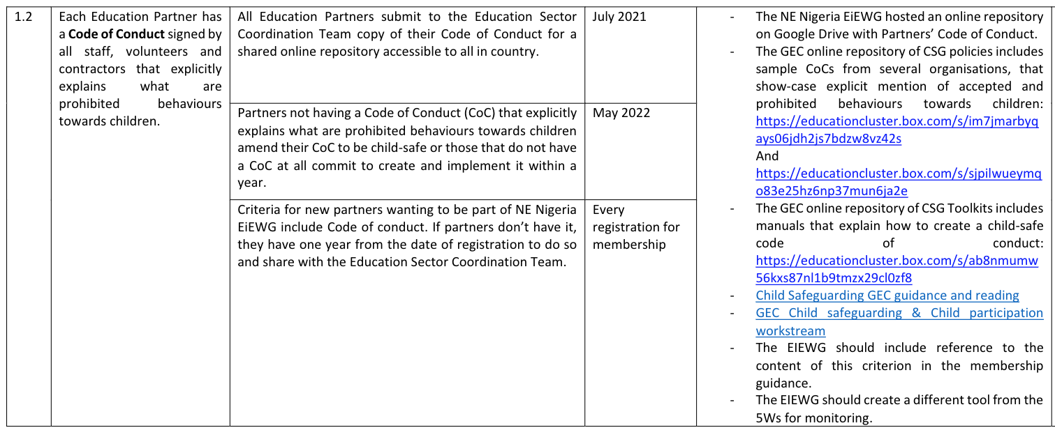
Strategic Planning
Country Focus – Nigeria Commitment Workshop, continued
A document outlining commitments, action points, and indicators was produced:
Results of the Workshop:
The workshop allowed joint reflection on the importance of child safeguarding and child participation in the EiE sector. Partners identified needs so that the principles and actions of child safeguarding and child participation can be harmonised and put into practice by all in the medium term. By working together, partners identified weaknesses and strengths and areas for mutual support.

Slide 32
Strategic Planning
3. Support partners to put Child Safeguarding Policies (including PSEA) in place
Objective: To strengthen Child Safeguarding and PSEA compliance among Education Cluster members
How to do it:
Identify partners who do not have a Child Safeguarding Policy (including PSEA) – draw on results from the survey of Education Cluster members on child safeguarding (slide 18)
Share resources (listed below) with partners to support them to develop their Child Safeguarding Policies (including reporting protocols, referral mechanisms, investigations, and sanctions)
Connect partners with experts from the PSEA Network, CP AoR, GBV AoR, and/ or Cluster partners who are strong on Child Safeguarding for support to create their policies. (see speaker notes for examples)
Follow-up with partners to monitor progress – the goal is for all partners to have a policy in place (and operational) within one year.
Resources:
Resource and Support Hub: Safeguarding Essentials
CHS Alliance: PSEA Implementation Quick Reference Handbook
Child Safeguarding Policy Template (developed for oPT) and Examples of Child Safeguarding Policies
Notes:
Examples for how to connect partners with experts
Ask the PSEA Network what support is available for partners that do not have safeguarding/ policies in place – possibly trainings, expert guidance and advice, review of draft policies, etc.
Smaller NGOs often don’t have the capacity to do their own investigations when incidents are reported. Ask the PSEA Network for guidance on investigations and if joint investigations systems are established.
Connect partners with the CP AoR and GBV AoR for a list of partners to whom they can refer survivors of SEA and abuse for care. Referral protocols should be included in child safeguarding and PSEA policies.

Slide 33
Strategic Planning
4. Support partners to put Codes of Conduct in place.
Objective: To strengthen Child Safeguarding and PSEA compliance among Education Cluster partners.
How to do it:
Identify partners who do not have a Code of Conduct for staff and other personnel associated with the organisation.
Share resources (listed below) with partners to support them to develop their Codes of Conduct
Connect partners with experts from the PSEA Network and/ or Cluster partners who are strong on Child Safeguarding for support to draft their Codes of Conduct.
Follow-up with partners to monitor progress – the goal is for all partners to have a Code of Conduct in place (and operational) within one year.
Resources:
  Resource and Support Hub: Safeguarding Essentials
  CHS Alliance: How to Create an Effective Code of Conduct
  Code of Conduct Template for frontline EiE workers (developed for oPT) and Examples of Codes of Conduct

Slide 34
Resource Mobilisation
1. Prioritise project sheets that include child safeguarding and PSEA
Objective: To incentivize the inclusion of child safeguarding and PSEA in project proposals, and to validate the importance of including activities and budget to support child safeguarding in EiE programming
How to do it:
Link child safeguarding to the section on protection risk analysis (PRA), including the PRA tools/ templates, so that addressing child safeguarding in project sheets is mandatory.
Integrate child safeguarding in Education Cluster project vetting criteria. Look for costed activities like:
  Child-friendly, inclusive, and accessible information campaigns
  Child-friendly and inclusive complaints and feedback mechanisms
  Recruiting a child safeguarding/PSEA focal person within the organisation if needed
Resources:
GEC Tip-sheet for EC/EiE WG Teams and Partners on what to include in Project Sheets regarding child safeguarding in education programmes, including costing.
Notes:
Double check this slide with the Guide, esp. How to do it section

Slide 35
Resource Mobilisation
2. Identify funding for Education Cluster member capacity strengthening on child safeguarding, including PSEA
Objective: To mobilize resources for joint, sector-wide child safeguarding capacity building initiatives and activities
How to do it:
Include a budget for child safeguarding capacity building and/ or activities in the HRP and Education Cluster Strategy.
  Consider budgeting for translation of child safeguarding guidance and/ or the creation of child-friendly versions of safeguarding messages in local languages to support local actors’ and children’s access to safeguarding information
  If needed, advocate for short-term, dedicated, full-time Child Safeguarding/ PSEA Focal Point to be based within the Education Cluster Coordination Team and responsible for developing partners’ child safeguarding capacity.
Use in-country pooled funding mechanisms (such as the Common Emergency Response Funds [CERFs] and Common Humanitarian Funds [CHFs]) to support child safeguarding capacity and activities, for example, through a dedicated project sheet for partners to develop institutional capacity on child safeguarding and PSEA through:
  Peer-to-peer capacity strengthening amongst NGOs (INGOs and LNNGOs) through a dedicated project
  Engaging external trainers specialised in child safeguarding/PSEA to support a group of Education Cluster member organisations
Resources:
Sample project sheet for institutional capacity strengthening of local and national partners of the cluster, developed by the GEC Localisation workstream.

Slide 36
Resource Mobilisation
3. Mobilise human resources to support Education Cluster member capacity strengthening on child safeguarding, including PSEA
Objective: To mobilise Education Cluster members strong on child safeguarding for capacity strengthening of partners requiring extra support.
How to do it:
Ask partners who are strong on child safeguarding and PSEA to voluntarily take on leadership roles within the Education Cluster, such as being a focal point, offering orientation sessions/ trainings, etc.
Include child safeguarding in institutional capacity development initiatives (like those supported by the GEC Localization workstream)
Promote partnerships that include mentoring and coaching on child safeguarding, going beyond sub-grantee compliance
  For example, organisations with expertise could support by sharing tools, guidance, staff, training opportunities, support for investigation of allegations, and time with the Education Cluster and Education Cluster members.
Resources:
None

Slide 37
Implementation and Monitoring
1. Support Education Cluster members to implement child-friendly feedback and complaints mechanisms (FCMs)
Objective: To strengthen accountability to children through child-friendly feedback and complaints mechanisms (FCMs).
How to do it:
Include child-friendly FCMs as a standard within the Education Cluster response plan – clarify that all Education Cluster members should have FCMs in place in their EiE programming.
  Encourage partners to consult children when designing FCMs. Consultation with children can make sure FCMs are age- and gender-appropriate, user-friendly, safe, and accessible for children with disabilities.
  Consider including an indicator in the HRP or Education Cluster Strategy to monitor the implementation of FCMs.
If interagency community-based complaints mechanisms exist, cooperate with the PSEA Network to include child-friendly channels.
Alternatively, support partners to connect their existing child-friendly FCMs to the interagency operating procedures, reporting channels, and referral systems.
Resources:
GEC Cheat-sheet: Why Education Cluster/EiE WG Coordinators should promote that Education Partners implement child-friendly feedback and complaints mechanisms, including at the school level
GEC repository of child-friendly feedback and complaints mechanisms – Forthcoming: Summary document with good practices and practical ‘how to’ guidance
Notes:
, and contribute to the establishment/ strengthening of interagency PSEA community-based complaints mechanisms (*)
To contribute to making the Education sector more accountable to affected populations and children (in line with the Core Humanitarian Standard on Quality and Accountability (CHS) and supported by the guiding principle of the UN Convention on the Rights of the Child (UNCRC) on children’s right to participation) through promoting that Partners establish/strengthen gender- and age-appropriate and child-friendly, inclusive, safe and confidential feedback and complaints mechanisms.

Slide 38
Implementation and Monitoring
2. Maintain an up-to-date list of Safeguarding/ PSEA Focal Points of all Education Cluster members
Objective: To facilitate reporting procedures for allegations brought to the attention of the Education Cluster Coordination Team and Education Cluster members.
How to do it:
Request a list of Education Cluster member organisations’ Child Safeguarding/ PSEA Focal Points from the PSEA Network Coordinator, as they often have this information readily available.
If a list is not available, create the list by collecting the names and contact information of Child Safeguarding/ PSEA Focal Points for every Education Cluster member.
Circulate this list with partners regularly.
Remind partners of the reporting protocol:
  If an allegation is brought to the attention of the Education Cluster Coordination Team or an Education Cluster member, they will report the allegation to the Child Safeguarding/PSEA Focal Point of the organisation of the alleged perpetrator.
  The Education Cluster is not involved in the follow-up and management of the allegation, which remain the responsibility of each organisation.
Resources:
  GEC Sample EC/EiE WG contact list of Partners’ Child Safeguarding and PSEA focal points
Notes:
and when required contact the Safeguarding/ PSEA Focal Point (or other assigned person) of the organisation of the alleged perpetrator to report Child Safeguarding concerns, including SEA, that might become known informed that, witness, or suspect that a staff of another organisation has been involved in wrongdoing against children (or vulnerable adults). All humanitarian staff have an obligation to report allegations of abuse, as stated in the UN Secretary General’s Bulletin on Special Measures for Protection from Sexual Abuse and Sexual Exploitation (2003).28 By understanding how to behave before this challenge, Education Cluster Coordinators and Information Managers will be able to act to prevent or stop potential abuse.
It is to be noted that this approach suggested by the GEC is in line with IOM-identified best practices for PSEA programmes in-country. Regarding this responsibility, cooperation with the PSEA Coordinator is paramount because they should already have lists of organisations’ Safeguarding/PSEA Focal Points and would be able to advise on how best to refer allegations to the right entity.

Slide 39
Implementation and Monitoring
3. Appoint an Education Cluster Child Safeguarding/ PSEA Focal Point or create a Child Safeguarding/PSEA Task Team
Objective: To designate a go-to person or task team for information, resources and support on child safeguarding and PSEA for the Education Cluster.
How to do it:
Select a voluntary Child Safeguarding Focal Point or Task Team for the Education Cluster. Education Cluster members with strong child safeguarding capacity and experience are encouraged to signal their interest in this role.
  The Focal Point/ Task Team will help Education Cluster members follow good practices in the implementation of child safeguarding.
  The final responsibility for institutional child safeguarding still lies with each organisation!
Refer to the Child Safeguarding Focal Point ToR or Task Team ToR for full details on roles and responsibilities
  If a 100% dedicated Education Cluster Child Safeguarding Focal Point is required, mobilise resources to fund a new position as part of the Education Cluster Coordination Team.
  A Child Safeguarding Task Team may be attached to the Strategic Advisory Group (SAG)
Resources:
GEC EC/EiE WG Child Safeguarding focal person ToR
GEC EC/EiE WG Child Safeguarding task team ToR
Notes:
the Education Cluster Child Safeguarding focal person is not in charge of developing an Education Cluster Child Safeguarding policy (creating their own Child Safeguarding policy remains an individual organisational responsibility of Education Partners). The Education Cluster Child Safeguarding focal person is not in charge of managing Partners’ reporting and response/investigation mechanisms, which remain an individual organisational responsibility of Partners. In other words, the presence of the Education Cluster Child Safeguarding focal person does not diminish the individual responsibility of Partners to develop and/or strengthen their own Child Safeguarding institutional system. The Education Cluster Child Safeguarding focal person helps organisations follow good practices in the implementation of Child Safeguarding actions in education toward collective achievements, while the final responsibility for institutional Child Safeguarding lies with Partners.
The Education Cluster Child Safeguarding focal person is therefore a go-to person for Partners and:
• Coordinates the design and implementation of approaches to integrate and scale up Child Safeguarding in Education Coordination;
• Contextualises and adapts the Child Safeguarding guidance locally;
• Facilitates Partners’ improved understanding of Child Safeguarding principles and approaches in their work and behaviours (including, if possible and when required, through delivering training sessions on Child Safeguarding);
• Supports Partners’ plan for Child Safeguarding activities and budget in Project Sheets;
• Ensures Child Safeguarding requirements are met in education needs assessments (with or without inclusion of children’s participation);
• Suggests approaches to mobilise resources for Child Safeguarding;
• Oversees monitoring of Child Safeguarding indicators in the Education Cluster reporting matrix;
• Generates evidence on integration of Child Safeguarding in Education Coordination functions;
• Links with the PSEA Network in-country, and with the CP and GBV sub-Clusters.
It is to be noted that the Education Cluster Coordinator is not necessarily to take on the function of Child Safeguarding focal person. Instead, resources would be needed if the Education Cluster Child Safeguarding focal person was a full-time role within the Education Cluster Team. For this reason, it is not necessarily suggested that a person is hired on purpose – at least in the beginning – but that Partners with substantial Child Safeguarding capacity volunteer to act as the Education Cluster Child Safeguarding focal person, pro bono. It may even be possible to create a lighter version of the Education Cluster Child Safeguarding focal person through identifying a “Child Safeguarding champion”, possibly a Partner’s staff (not necessarily the Education Cluster Coordinator) who could be at a minimum the go-to person for Partners who may need Child Safeguarding support and who could act as the liaison with the GEC to access more support from the GEC Child Safeguarding workstream specialist. Alternatively, a subgroup of the Education Cluster could constitute a dedicated Child Safeguarding task team, for example attached to the EC SAG.

Slide 40
Implementation and Monitoring
4. Create a standing agenda item in Education Cluster coordination meetings on child safeguarding and PSEA
Objective: To dedicate regular time and space for peer exchange on child safeguarding and PSEA, encouraging the sharing of good practices, troubleshooting challenges, and developing a “child safeguarding culture” within the group.
How to do it:
Add child safeguarding and PSEA to the standard Education Cluster meeting agenda. Consider discussing:
  Ongoing initiatives, achievements and challenges, including traditional and customary approaches
  Capacity development needs and internal resources available to address them
  Key advocacy messages or asks for the Inter-Cluster Coordination Group (ICCG) or other audiences
Occasionally, this time can be used to plan and deliver dedicated child safeguarding and PSEA capacity sharing sessions or workshops.
Information sharing about complaints (within the limits of strict confidentiality rules) is also helpful to identify child safeguarding violation trends so that mitigation measures can be strengthened.
Resources:
None

Slide 41
Implementation and Monitoring
5. Monitor progress towards child safeguarding commitments
Objective: To track progress on the implementation of actions supportive of child safeguarding and PSEA within the Education Cluster’s EiE humanitarian response.
How to do it:
Define indicators. Consider monitoring:
  The implementation of activities in the EiE response that support safeguarding (such as child-friendly feedback and complaints mechanisms)
  Partners’ own safeguarding and PSEA compliance (such as the number of partners with Codes of Conducts)
Integrate at least one of these indicators into the Education Cluster Monitoring Tool (ECMT) (such as the 5W matrix)
  If integrating indicators into ECMT is not possible, consider other ways to collect this information (through an ad hoc tool, etc.)
Follow-up with partners so that they report on these indicators in the same way and with the same frequency as they report other data (e.g., quarterly).
Resources:
GEC Set of monitoring indicators on Child Safeguarding and safe and participatory education programming
Example: EiE WG Nigeria Monitoring matrix of the minimum Child Safeguarding (including PSEA) commitments for Education Partners designed and agreed upon with partners in a workshop – see slides 30 and 31

Slide 42
Operational Peer Review and Evaluation
1. Reflect to improve integration of child safeguarding in Education Cluster coordination
Objective: To improve the integration of child safeguarding and PSEA in Education Cluster coordination going forward
How to do it:
During annual reviews or formal evaluations of the Education Cluster’s EiE humanitarian response, include child safeguarding and PSEA issues in the agenda and ToR.
Include an analysis of child safeguarding concerns or trends in any documentation of lessons learned, in order to inform future response planning and strategic processes.
When a Cluster Coordination Performance Monitoring (CCPM) is conducted annually, Education Cluster Coordination Teams may take the opportunity to advocate for child safeguarding and PSEA considerations to be added to the standard questionnaire.
Resources:
None

Slide 43
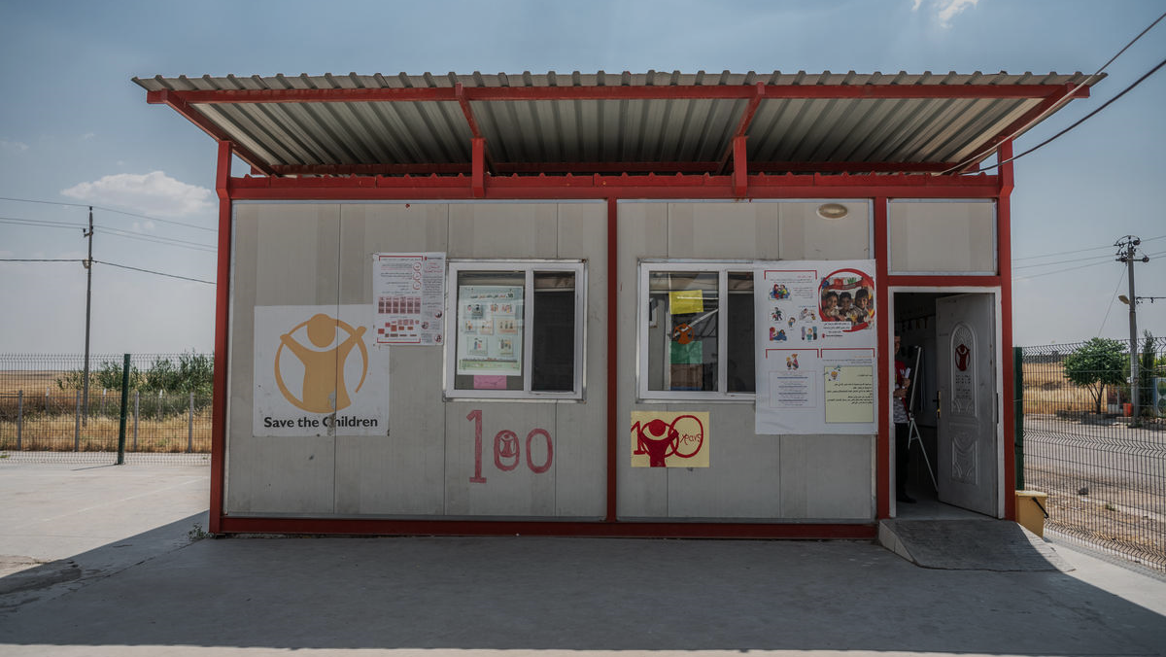
Related Concepts
Notes:
PC: Claire Thomas / Save the Children. CH1350653

Slide 44
Reminder! …Connections with Other Key Concepts
Child safeguarding connects to other key concepts that keep girls and boys, including children with disabilities, safe:
Protection from Sexual Exploitation and Abuse (PSEA)
SEA is a is a form of GBV – it is sexual violence, specifically perpetrated by someone who works with an aid organization (see below for more details).
PSEA is a set of organizational policies and procedures to protect children and vulnerable adults from SEA by anyone working with an aid organization.
Child safeguarding includes PSEA, specifically the protection of children from SEA.
Gender-Based Violence (GBV)
Child safeguarding violations include many forms of GBV, which can be perpetrated by anyone working with an aid organization.
Mitigating child safeguarding risks also means mitigating GBV and SEA risks associated with aid organizations.
Child Protection (CP)
Abuse, neglect, exploitation and violence perpetrated against children external to an aid organization falls under CP
Abuse, neglect, exploitation and violence perpetrated against children internal to an aid organization (or caused by an aid organization and anyone associated with it) falls under child safeguarding
Accountability to Affected Populations (AAP)
Child safeguarding is part of AAP, including accountability to children.
Harm caused by an aid organization to children is a failure of accountability – the trust that children place in us is betrayed.
Feedback and complaints mechanisms (FCMs) are important for child safeguarding and for AAP.

Slide 45
Protection from Sexual Exploitation and Abuse (PSEA)
Sexual Exploitation and Abuse (SEA) is a form of GBV that constitutes an abuse of power by aid workers and associated personnel (anyone affiliated with the provision of aid, including contractors, volunteers, local partners, etc.) against the affected population (including children).
SEA can happen in any setting, against anyone, but the risks of SEA increase in emergencies settings.
Anyone can commit SEA, but those with more power are more likely to perpetrate, while those with less power are vulnerable to becoming victims. Aid workers always have more power over those we are there to serve.
The term Protection from Sexual Exploitation and Abuse (PSEA) is used by the UN and NGO community to refer to measures taken to protect vulnerable people from sexual exploitation and abuse by staff and associated personnel and to ensure an adequate response when abuses occur.
These measures aim to:
Prevent SEA from occurring in the first place
Follow up on the allegation quickly and effectively (including investigating where warranted)
Ensure survivors receive appropriate response services.

Slide 46
Special Measures for PSEA
It is all humanitarian and development actors’ responsibility to protect affected people from SEA and take action when they have knowledge or suspicion of an incident.
The UN Secretary General’s Bulletin on Special Measures for PSEA (SG Bulletin ST/SGB/2013/13):
The Bulletin applies to all UN agencies and their personnel, contractors (both institutional and individual), and implementing partners. It states:
SEA constitutes gross misconduct by staff
Staff must not engage in any sexual activity with anyone under the age of 18, regardless of the age of majority or consent locally. Mistaken belief in the age of a child is not a defense.
Staff must not exchange money, employment, goods or services for sex or sexual favors.
Sexual relationships between staff and beneficiaries are strongly discouraged.
Staff are required to report any concern or suspicion of SEA by any NGO worker.
Staff, especially managers, must create an environment that prevents SEA and promotes our Code of Conduct.
The Inter-Agency Standing Committee (IASC) Statement of Commitment on Eliminating Sexual Exploitation and Abuse by UN and non-UN Personnel (2006) (2) and the subsequent statement in 2015 (3) highlights sexual exploitation and abuse as a serious human rights violation and clearly states that all humanitarian organizations have a fundamental responsibility to take action on SEA, regardless of contractual status with UN agencies.

Slide 47

Measures to Address SEA
There are 8 minimum standards that agencies have committed to put in place:
Developing and implementing effective PSEA policy and procedures.
Implementing PSEA requirements with partners, suppliers and contractors.
Committing and supporting a dedicated department/focal point to PSEA.
Providing clear guidance from HQ to field offices on engaging communities and the affected population to raise awareness on PSEA.
Developing and implementing effective joint community-based complaints mechanisms (CBCM), including victim assistance.
Developing and implementing effective recruitment and performance management.
Establishing effective and comprehensive mechanisms to ensure awareness-raising on SEA amongst personnel.
Establishing internal complaints and investigation procedures.
Many countries have active PSEA Networks with dedicated Coordinators, which can be excellent resources for Education Cluster Coordination Teams.
Notes:
(source: The IASC Minimum Operating Standard for Protection from Sexual exploitation and Abuse for UN and non-UN staff)
PC: Sara Mignogna/Save the Children. CH1574488

Slide 48
PSEA and Child Safeguarding
Both concepts protect children from sexual exploitation and abuse (SEA)
Child Safeguarding
Only children
All forms of abuse:
  Sexual exploitation and abuse (SEA) of children
  Other forms of child abuse
Other safeguarding risks are covered
Protection from Sexual Exploitation and Abuse
Children and vulnerable adults
Only sexual exploitation and abuse (SEA)
Other forms of abuse not covered
Sexual exploitation & abuse (SEA) of children
Perpetrated by staff, partners and volunteers
Must report (mandatory!)
Applies to all humanitarian organisations

Slide 49

Gender-Based Violence (GBV)
Child safeguarding risks include SEA, which is a form of GBV.
  Adolescent girls constitute one of the highest-risk groups for GBV in general, including SEA.
  Children with physical and/ or intellectual disabilities also face increased risk, particularly girls with disabilities.
GBV-related risks can be caused by aid organisations and anyone associated with them (linking to child safeguarding and PSEA), and they can also exist in the general school environment.
  Survivors of GBV incidents should be referred to services for care through GBV referral pathways
Under IASC, GBV incidents that fall under SEA (perpetrated by anyone associated with an aid organization) must be mandatorily reported. Survivors are also to be referred to services for care with their consent.
Notes:
PC: Sara Mignogna/Save the Children. CH1574497

Slide 50
GBV Risk Mitigation
GBV risk mitigation is mandatory
All humanitarian actors have a responsibility to mitigate GBV risks in their work, regardless of mandate or sector, in keeping with the Centrality of Protection and principle of Do No Harm.
GBV risk mitigation comprises a range of activities within the education response to first identify GBV risks and then take specific actions to reduce those risks.
For example, a lack of private and secure latrines in schools is a risk for GBV. A mitigation measure is to build latrines that are in a safe location and can be locked.
GBV risk mitigation means taking actions to:
Identify risks using participatory methods. Consulting women, girls, and boys, including children with disabilities to better understand the risks they face and how to mitigate them is a good practice.
Reduce the risks in programming, in the physical environment (school/ learning space), and through staff behaviour.
Ensuring gender-balanced (or, in some cases, female-only) staff to engage in activities that involve ongoing direct contact with women and child programme participants.
Staff trainings and capacity building on GBV (and child safeguarding and PSEA), including on referrals and safe
and appropriate response to GBV disclosures.
Notes:
The IASC GBV Guidelines have more information on GBV risk mitigation (include link)

Slide 51
GBV Risk Mitigation
Integrating GBV risk mitigation actions across the HPC not only contributes to safer education programming overall but can result in better outcomes for the education sector.
Key Resources
IASC GBV Guidelines for Education
UNICEF & GEC Toolkit for GBVRM across the HPC by Education Clusters
GEC Gender/GBV Tipsheet for HNO/HRPs
For example, an education programme that prioritizes training, placing, and retaining female teachers supports GBV risk mitigation and can also prevent girls from dropping out of school in contexts where a lack of female teachers around adolescence is a barrier to retention for cultural or other reasons.
The GBV AoR is an excellent resource for Education Cluster teams.
The GBV AoR can provide Education Clusters with GBV referral pathways for areas in which partners work, so that Education Cluster members know where to refer survivors of GBV for support and care.
The GBV AoR can provide guidance and trainings to Education Cluster Coordination Teams and members on GBV risk mitigation.

Slide 52





Child Protection (CP) and Child Safeguarding
Child Safeguarding concerns:
Harm (deliberate or unintentional) caused by an aid organisation, one of its staff, partners, volunteers, representatives, casual workers, or contractors, or harm caused by a poorly designed and implemented program.
Child Protection concerns:
Harm caused by the outside world, including family members, community members, peers, armed groups and armed forces, and natural and man-made disasters.
Programmatic sector to prevent and respond to abuse, neglect, exploitation, and violence perpetrated by those external to an organization.
Organisational policy and procedures to prevent and respond to harm to children caused by the organisation’s staff and programmes.
Notes:
Child Protection definition: “The prevention of and response to abuse, neglect, exploitation and violence against children” (source: The Alliance for Child Protection in Humanitarian Action, Minimum Standards for Child Protection in Humanitarian Action, 2019).
Child safeguarding is different from child protection programmes:
Child safeguarding focuses on preventing our own staff harming children (internal).
Child protection focuses on harm to children due to a natural or man-made disasters, or conflict, or community members harming children (external).
Some examples of where CSG and CP systems meet include:
• Designing a hybrid reporting mechanism that exists in communities for reporting child protection incidents that is also used for reporting child safeguarding concerns linked to an organisation’s work.
• Delivering child safeguarding awareness training that is applicable within global, national and community-level child protection legislative frameworks, and including local child protection officials in training.
• Referring a child who has reported a child safeguarding concern to victim support services within the community.
In line with the do no harm principle, organisations should also ensure that their child safeguarding systems do not undermine local child protection. Similarly, if local child protection systems are not robust or child-rights focused it is important they do not undermine an organisations’ own child safeguarding system. Ideally, organisations should aim to strengthen local child protection systems where possible but also learn from them when they prove to be effective.
(Source: Able Child Africa - Save the Children, Disability-inclusive child safeguarding guidelines, March 2021, p.31-32)

Slide 53
Child Protection (CP) and Child Safeguarding
Child Safeguarding
The internal Child Safeguarding Policy applies first Covers beneficiaries and children linked to the organisation and its staff and associates Make referrals to state or non-state service providers Internal focus – internal reporting system Internal system investigates, disciplinary action is taken against staff/associates NGO can control the situation Action is taken to strengthen the internal systems and procedures All staff are responsible Direct risk to NGO programmes and its reputation
Child Protection
Local laws apply Covers all children in the country State is the duty bearer for all children External focus – reporting externally External system investigates NGO cannot control the situation Programmes are designed to prevent and respond to abuse, neglect, exploitation, and violence against children Child Protection team of the NGO is responsible No direct risk to NGO programmes and reputation
Notes:
(Source: Save the Children)
If local laws are less stringent than or contradictory to an organization’s safeguarding policy, the safeguarding policy would apply in safeguarding situations. **Circle back to Adama on this for CP

Slide 54
Child Protection (CP) and Child Safeguarding
What they have in common: children are at the centre!
Measures that keep children safe from harm caused by all those associated with the organisation
Covers staff, programs, and operations.
Obligation for all partners to have child safeguarding measures in place
NGOs are liable if they harm children.
NGOs have control over the way they engage with children
Safeguarding is about creating a culture that prioritizes children’s safety.
Prevention of and response to, abuse, neglect, exploitation, and violence perpetrated by those external to an organisation.
Child protection is a programmatic sector.
NGOs are not liable for what happens in families and communities
NGOs have no control over external environments and external actors.
Protect children from harm (do no harm principle)
Best interests of the child
Types of child abuse
Must report
Referral
Confidentiality
Child Safeguarding
Child Protection (CP)
Notes:
Key principles to follow in all cases:
Do no harm: our guiding principle should always be that the welfare of the child is paramount, and outweighs all other considerations. All actions and interventions taken in response to reports of possible abuse must not expose the child to further harm.
Best interests of the child: All actions must be guided by the best interests principle.
Report: Report all concerns, whether related to Child Protection or Child Safeguarding.
Referral: Children victims of abuse are to be provided with needed assistance as soon as possible through adequate referral mechanisms.
Confidentiality: All actions must adhere to strict confidentiality of information that is considered sensitive, sharing it only with those individuals for whom the information will enable further protection of the child.
Child Safeguarding:
- All organisations must have child safeguarding measures in place because they have a duty of care towards children they work with and for.
- NGOs have control over the way they engage with children: they can ensure they adhere to safeguarding practices and have high standards of staff behaviour – may be higher than local practices.
Child Protection:
- Abuse, neglect, exploitation, and violence can be present in a community independently from the NGOs.
- NGOs are not liable for what happens in families and communities, but they play a crucial role in advocacy, awareness, and supporting communities to protect children

Slide 55
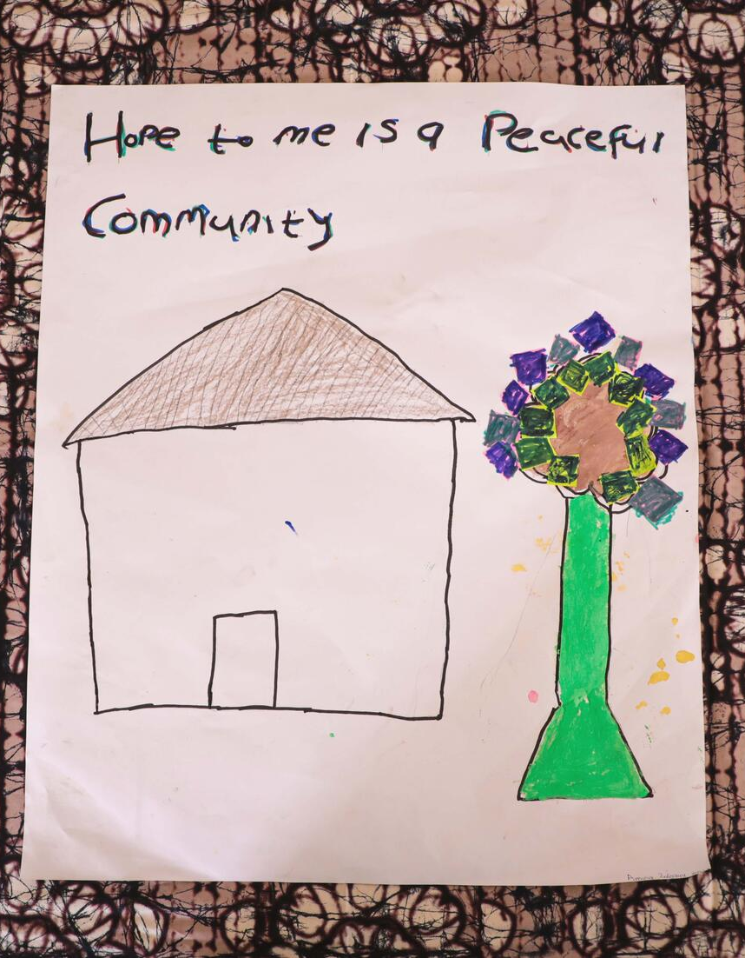
Accountability to Affected Populations (AAP)
Accountability to affected populations (AAP) – including children – is an integral component of a rights-based approach to humanitarianism.
If education staff commit any act of abuse, especially SEA, against the children who are meant to receive quality and protective education, the values and principles of humanitarianism are betrayed, and the trust and the credibility of the entire education sector is undermined.
Abuse is one of the most basic failures of accountability to the children whom the education sector is supposed to serve and protect.
The term PSEA (Protection from Sexual Exploitation and Abuse) is used by the UN and NGO community to refer to measures taken to protect vulnerable people from sexual exploitation and abuse by their staff and associated personnel and to ensure adequate response when abuses occur.
Child safeguarding is part of humanitarian agencies’ AAP responsibilities in ensuring that interventions do not cause harm to children.
Notes:
PC: Save the Children. CH1826141

Slide 56
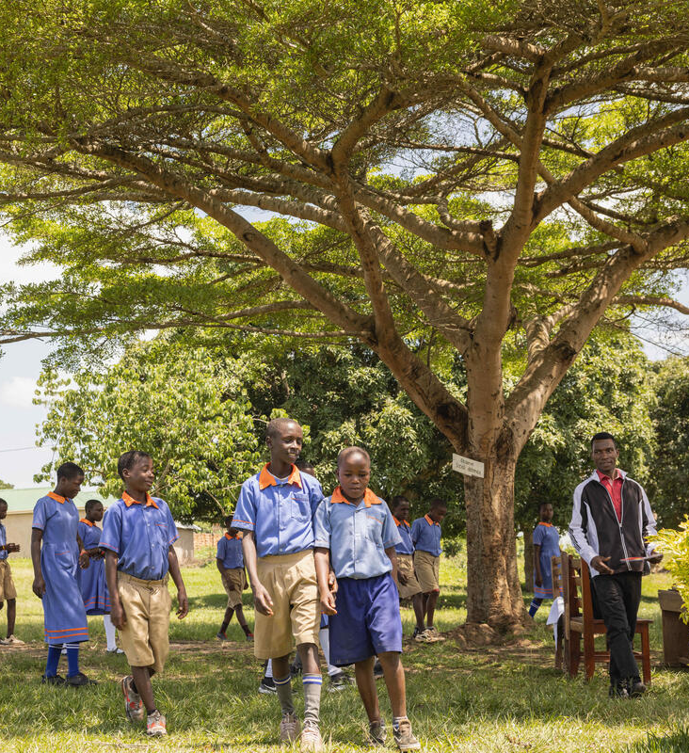
Accountability to Affected Populations (AAP)
A rights-based approach connects AAP and safeguarding principles: Aid providers have a responsibility to promote and respect the rights of affected people, including children, and support them to exercise those rights.
This means…
The right to protection and safe and equal access to assistance, with particular emphasis on PSEA and GBV:
  Organsational child safeguarding and PSEA policies and systems must be in place.
Right to be informed and participate in decisions that affect their lives
  Child participation should be facilitated in all stages of the Humanitarian Programme Cycle (HPC).
Right to hold aid providers accountable for using their power and resources ethically and responsibly, and for taking corrective actions when they have failed to meet their commitments to affected people
  Child-friendly, safe, inclusive and accessible feedback and complaints mechanisms (FCMs) that are able to accommodate reporting of child safeguarding allegations must be in place.
Notes:
PC: Esther Ruth Mbabazi / Save The Children. CH1745558

Slide 57
Linkages Between AAP and PSEA (Applicable to Child Safeguarding)
and
Child Safeguarding
Notes:
(Plan International (2018) Child-Friendly Feedback Mechanisms: Guide and Toolkit, United Kingdom: Plan International, page 13)
Experience shows that when feedback mechanisms are not intentionally designed with and for children, they are often not utilised by them, because:
• Children are not adequately informed about the existence of feedback channels or how to access them;
• Feedback channels are not accessible in locations where children live or access services;
• Feedback channels are not inclusive for children with low literacy levels or disabilities;
• Children think their feedback is not treated confidentially, or that they will not be believed or assisted by those receiving their complaint.

Slide 58
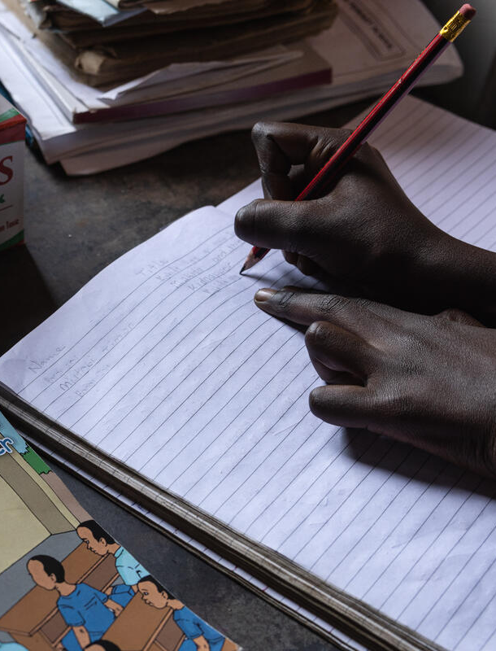
Linkages Between AAP and PSEA: Feedback and Complaints Mechanisms (FCMs)
Child-friendly, safe, accessible, and inclusive feedback and complaint mechanisms
A child-friendly feedback and complaints mechanism (FCM) promotes gender- and age-appropriate, safe, accessible, and inclusive ways for children to provide feedback and report safeguarding, including SEA, violations. It is critical that SEA cases are reported through the appropriate PSEA channels, and that child survivors of SEA access the care, support, and services they need through GBV referral pathways. A survivor-centered, child-friendly approach is key!
While feedback and complaints mechanisms can be confidential (and sometimes anonymous), it is mandatory to report SEA violations. This mandatory reporting might conflict with informed consent/ assent of the child if the child does not want to this information to be reported. It is important that the mandatory reporting of SEA is explained clearly to children as a limit of confidentiality so that they understand that a SEA violation must be reported, how it would be reported, and to whom.
Notes:
PC: Esther Ruth Mbabazi / Save The Children. CH1745545

Slide 59
Child Participation in Child Safeguarding
Children should be actively, meaningfully and ethically involved in the development of safeguarding measures in order to fulfill their potential to actively get involved in their own protection.
If children help design reporting procedures and referral protocols, it helps them understand how they can report safeguarding violations and what support is available to them.
If children help design reporting procedures, it helps ensure that they are child-friendly and accessible to different groups of children, including children with disabilities.
How can organisations involve children in safeguarding?
Involve children in the design of reporting and referral procedures – hold focus group discussions with children to develop these systems
Ensure children from marginalised groups, including boys and girls with disabilities, are included, as they are especially at risk of violence.
Share information about safeguarding policies and procedures with children in child-friendly ways, using child-friendly materials (such as a Code of Conduct illustrated with pictures, information shared using plays and songs, etc.)

Slide 60
Interdependence Between Child Participation and Child Safeguarding
Ensure ethical participation of children by applying the 9 basic requirements for safe and meaningful child participation
Child Safeguarding
Best interests of the child
Do No Harm
Child Participation
Empower children to know and claim their rights to keep themselves safer and more protected
Notes:
The balance between Child Participation and Child Safeguarding
(source: Oxfam Australia, Child safeguarding toolkit, page 74-75)
Children are never responsible for their own safeguarding (protection from abuse and exploitation) however by promoting child participation we give children a voice and send a message that we take them seriously. For children, knowing they can speak up and will be taken seriously by adults is fundamental to child safeguarding. Many children say they do not tell anyone they are being abused because they feel they will not be believed. This is why child participation is so important in safeguarding children.
Effective and sustainable safeguarding of children can therefore only be achieved through listening to children: adopting a child strengths approach where children and youth are asked for solutions, contributes to a child safe organisation. For a child safe organisation, the voice of children is a key child safeguarding measure.
Children are able to provide unique insights into how organisations can make them feel and be safe. Providing opportunities for children to give feedback on programs and activities, developing child/youth friendly complaints mechanisms or seeking their input into the design of a campaign or event strengthens the child safe environment.

Slide 61
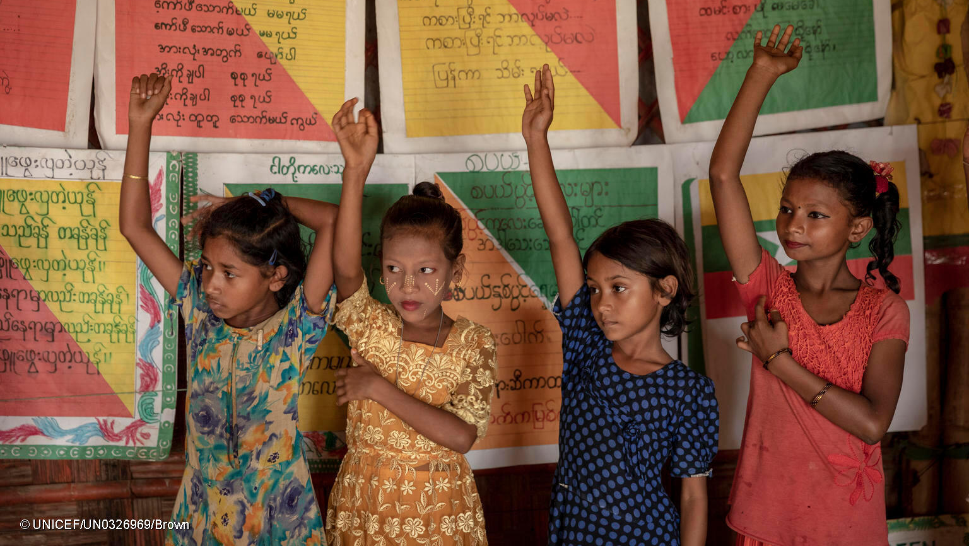
Key Resources
Notes:
PC: Brown / UNICEF. UN0326969

Slide 62
Key Resources
The resources included in this PowerPoint pack can be found on Box here. Notably:
  Survey of Education Cluster members on child safeguarding and participation knowledge and capacities
  Child safeguarding in JENAs
  Safe and Inclusive Child Participation
  Child safeguarding and PSEA resource pack for Education Cluster members (designed for oPT – includes templates)
  Child safeguarding and PSEA online training courses
The following sections of this PowerPoint can be accessed and shared as separate, stand-alone documents through the following links:
  Child Safeguarding Basics
  Child Safeguarding Across the Humanitarian Program Cycle (HPC)
  Child Safeguarding and Connections with Other Key Concepts

