Slide 1
Promoting family unity and preventing family separation in the context of IDOs

Slide 2
Course objectives
By the end of the course, you will be able to:
Describe the increased protection risks for children during COVID-19
Explain child protection mainstreaming best practices during COVID-19 and other IDOs
List key actions for health actors to preventing family separation and preserving family unity
Recall safe referral processes for children identified as at risk

Slide 3
Course structure
[Insert relevant course agenda]

Slide 4
Socio-ecological model
Society
Community
Socio-cultural norms
Family
Child
Notes:
Session: Increased risks to children

Slide 5
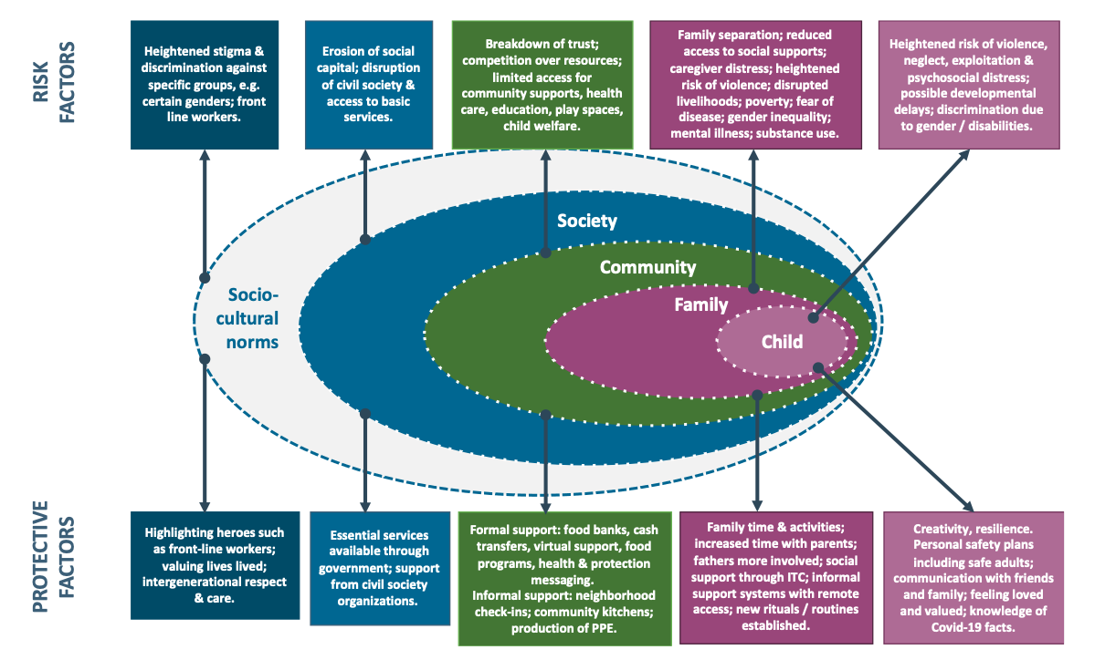
Notes:
Session: Increased risks to children

Slide 6
Quarantine
The separation of persons who are not ill but who may have been exposed to an infectious disease, to monitor their symptoms and promote early detection of cases.
Notes:
Session: Preventing family separation part 1: quarantine, isolation and treatment

Slide 7
Isolation
The separation of ill or infected people to prevent the spread.
Notes:
Session: Preventing family separation part 1: quarantine, isolation and treatment

Slide 8
Types of quarantine and isolation
Home-based
Facility-based
Community level
Zone or area-based
Notes:
Session: Preventing family separation part 1: quarantine, isolation and treatment

Slide 9
Separation linked to isolation, quarantine and treatment measures applied to children and or caregivers can result in increased child protection risks.
Notes:
Session: Preventing family separation part 1: quarantine, isolation and treatment

Slide 10
Measures must always be taken to prevent family separation
Systematically consider home-based isolation and quarantine first for both children and caregivers
Notes:
Session: Preventing family separation part 1: quarantine, isolation and treatment

Slide 11
Child / caregiver needs to isolate or quarantine
Prioritise the best interests of the child
Consider the child’s views
Do no harm
Admit children and caregivers together
Family based over facility based care
Alternate healthy family member
Last resort: Adequate, temporary alternative care
Notes:
Session: Preventing family separation part 1: quarantine, isolation and treatment

Slide 12
Group exercise
Column 1
Column 2
What measures should be taken by health actors to prevent family separation for quarantine, isolation or treatment?
What are the key considerations when determining where a child/caregiver should quarantine/isolate?
Notes:
Session: Preventing family separation part 1: quarantine, isolation and treatment

Slide 13
When a child is admitted
Allow a primary caregiver to accompany
If not possible:
Contact Child Protection actors
Document child and caregiver details
Facilitate regular contact
Provide regular, frequent updates
Consider temporary accommodation for caregivers
Be disability inclusive
Notes:
Session: preventing family separation 2: preserving family unity when a child or caregiver is admitted to a facility

Slide 14
When a caregiver is admitted
Gather information about children
Inquire about children at home
Transfer children to care of a trusted adult
Facilitate regular contact

Slide 15
Preparatory actions
Assign facility focal point for child protection
Establish SOPs, covering:
roles and responsibilities
referral pathways
minimum care package
child safeguarding measures
nurturing care arrangements
Train health personnel on SOPs
Develop and disseminate referral pathways
Establish SOPs for registration and confidential data collection
Notes:
Session: Preventing family separation part 3: SOPs and other preparatory actions

Slide 16
PFA
Look
Check for safety.
Look for children with obvious basic needs.
Look for children and parents or caregivers who have serious distress reactions.

Slide 17
PFA
Listen
Approach children caregivers who may need support
Ask about their needs and concerns
Listen and help them feel calm by:
Staying close (in line with restrictions)
Listening
Not pressuring anyone to talk if they don’t want to.

Slide 18
PFA
Link
Help children and families identify their needs
Provide information
Link to services to meet identified needs.

