Slide 1
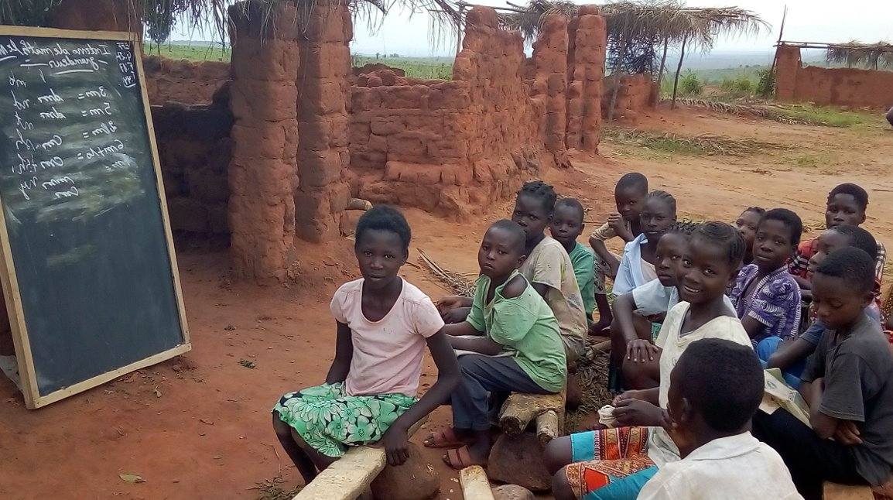

Children's participation and safeguarding in Joint Education and Protection Needs Assessments (JNAs)
Notes:
Add a photo credit

Slide 2
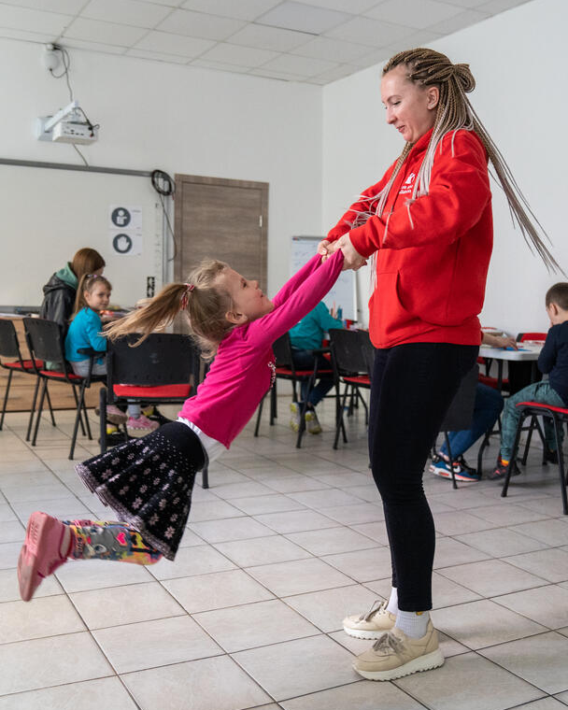
What is child participation?
The UN Committee on the Rights of the Child (CRC) defines child participation as follows:
"... [a] continuous process, which includes information sharing and dialogue between children and adults on the basis of mutual respect, and in which children can learn how their views and those of adults are taken into account and influence the outcome of these processes".
In humanitarian action, children's participation is a key element of accountability to affected populations (AAP).
The right to participate extends to all children, i.e. boys, girls and young people aged 0-18, including children and young people with disabilities and the most marginalized children.
Notes:
Add a photo credit

Slide 3





Accountability includes Child Participation
In humanitarian action, children’s participation is key to Accountability to Affected Populations (AAP).
As the Education Cluster serves children, we are ultimately accountable to all girls and boys, including children with disabilities.
Humanitarian actors have committed to children’s participation through many global conventions and frameworks.
Notes:
Add details for talking points

Slide 4
Benefits of Child Participation
Foundational reasons:
It is a human right that everyone who works with children has a responsibility and obligation to fulfill under the CRC.
It is a core value of any organization working for and with children.
It is a fun and feasible thing to do!
Benefits for children | Benefits for the Education Cluster
Promotes children’s agency and can help them build confidence | Contributes to accountable humanitarian responses
Helps boys and girls develop life skills | Boys and girls can clarify the impact of the crisis on their education
Contributes to a culture of respect and understanding of others | Children can explain their expectations and hopes after a crisis
Supports better-designed programs, tailored to the needs of girls and boys, including children with disabilities | The perspectives of children can inform the response and ensure relevance and quality
 | Children’s voices are the strongest advocacy tool that we have in the sector

Slide 5
Meaningful child participation
Closing the feedback loop with children
Children have the opportunity to express their opinions freely
Consulting children on Education Cluster initiatives
Children see the results of their participation
Children are informed by the Education Cluster of the results of the study and how their contribution has informed the Education Cluster's decisions.
Children's opinions are respected and taken seriously
The results of the consultations with the children are analyzed and integrated into the Education Cluster report, and inform the HNO, the HRP and the strategy.
Decision-making processes are informed by children
The Education Cluster makes decisions based on the children's contributions.

Slide 6
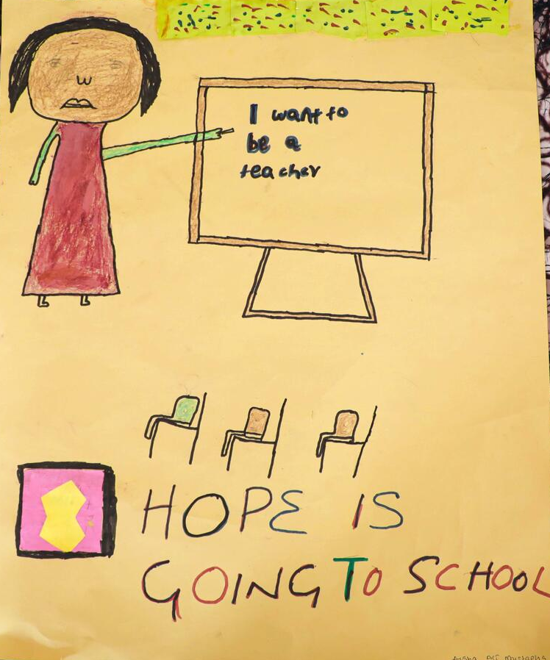
Children's participation in Needs Assessments :
Children are in the best position to share information on education and protection needs and issues that concern them.
They can tell us about... :
  Factors favoring and limiting learning for boys and girls affected by a crisis
  Protection risks faced by boys and girls in and around schools/learning environments and in communities
  Barriers to accessing learning opportunities for out-of-school boys and girls
  The resources available within communities to support children's learning, protection and well-being.

Slide 7
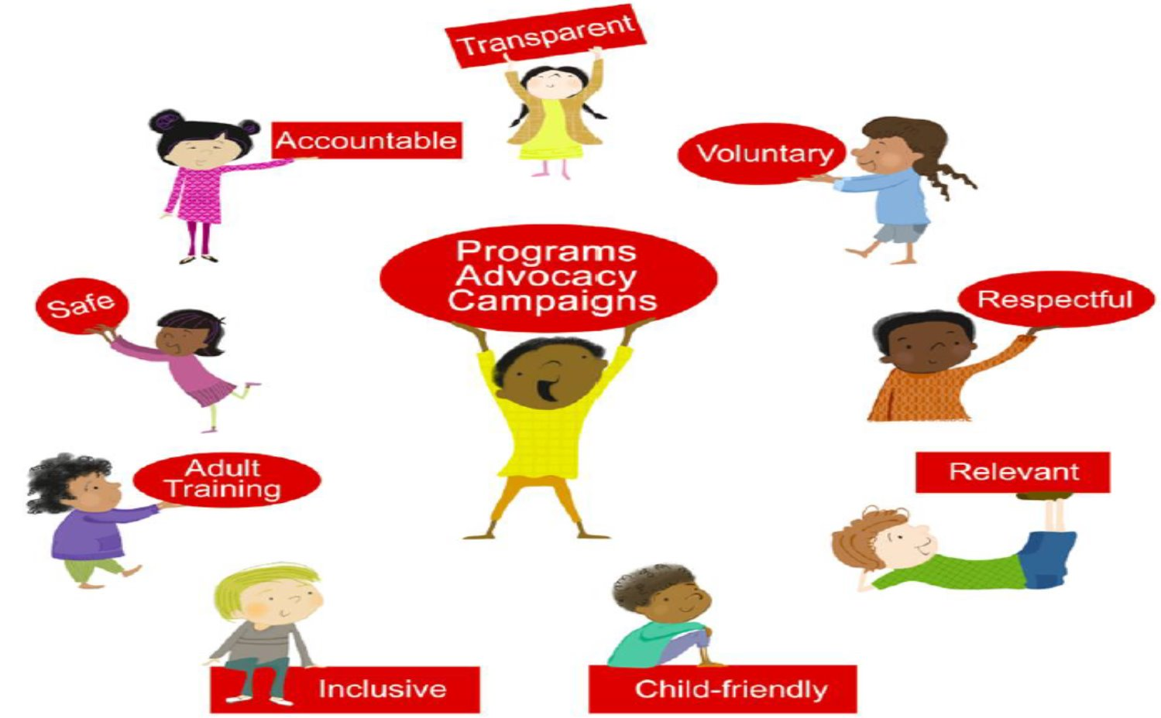
The 9 basic requirements for meaningful and ethical child participation
9 Basic Requirements
Notes:
Add details for discussion points

Slide 8
What is Child Safeguarding?
Child Safeguarding is a responsibility that aid organizations have to make sure that they do not harm children through their:
  Programs
  Operations
  Staff: employees, trainees, and interns
  Associates: consultants, contractors, volunteers, and partners – including teachers contracted by partners (and sometimes MoE teachers at schools where partners work)
This includes all kinds of harm, whether deliberate or unintentional, direct or indirect.
All safeguarding violations must be reported (mandatory reporting).
Child safeguarding applies to all children.
All children means all boys, girls, and adolescents aged 0 to 18, including children and youth with disabilities.
Any person associated with an aid organization is prohibited from harming children, including:
Children who are not beneficiaries of the organization’s programs.
The person’s own children.
Notes:
Our work is intended to help vulnerable and at-risk people. However, sometimes our staff and programmes can actually cause harm. This could be deliberate harm or unintentional harm, and it could be direct or indirect harm.
Most NGO/UN workers would never want to harm a child or adult, but there are some who do. Our organisations could even attract people who want to perpetrate abuse because, as NGO/UN workers, they have access and power over vulnerable communities.
Child safeguarding is an accountability system that your organisation can use to formalise your commitment to keeping children safe.
Child safeguarding means:
ensuring that everyone associated with the organisation is aware of and responds appropriately to issues of child abuse and the sexual exploitation of children.
ensuring that anyone who represents our organisation behaves appropriately towards children and never abuses the position of trust that comes with being a member of the organisation.
assessing and reducing the risks to children that are associated with our activities.
CPMS 2019 DEFINITIONS:
Child safeguarding: The responsibility that organisations have to make sure their staff, operations, and programmes do no harm to children. It includes policy, procedures and practices to prevent children from being harmed by humanitarian organisations as well as steps to respond and investigate when harm occurs.
Best interests of the child: The right of the child to have his or her best interests assessed and taken as a primary consideration in reaching a decision. It refers to the well-being of a child and is determined by a variety of individual circumstances (age, level of maturity, the presence or absence of parents, the child’s environment and experiences).
Do no harm: The concept of humanitarian agencies avoiding unintended negative consequences for affected persons and not undermining communities’ capacities for peace building and reconstruction.

Slide 9
Examples of harm caused to children that fall within the scope of safeguarding issues
Note: For the purposes of this slide, the term "NGO" refers to INGOs, local and national organizations and the United Nations.
Physical abuse: a teacher inflicts corporal punishment on a pupil
Psychological abuse: a member of the educational staff of an NGO insults a child during a group discussion
Sexual exploitation: a teacher demands sex in exchange for good grades
Sexual abuse: an NGO subcontractor touches a child in the community (outside work)
Negligence: the educational staff of an NGO fail to supervise children during playtime, leading to accidents and injuries among the children.
Discrimination: during the evaluation of an educational project, an NGO consultant treats a child differently because of his ethnicity.
Exclusion: an NGO volunteer does not allow a child to take part in an educational activity because of his disability
Harmful traditional practices: an NGO staff member facilitates his niece's marriage
Economic exploitation: an NGO supplier forces a child to work for him
Online (sexual) abuse: NGO staff member uses WhatsApp to share child pornography images
Other: any abuse of power or authority whatsoever.
Notes:
Other: Sloppy construction PC: PC: Save the Children. CH1826244

Slide 10






Child Safeguarding (CSG) vs Child Protection (CP):
Differences and Commonalities
Child Safeguarding concerns: harm (deliberate or unintentional) caused by an organisation, one of its workers (including NGO teachers/NGO school staff), partners, volunteers, representatives, casual workers, contractors or poor practice within education programs.
Child Protection concerns: harm caused by the outside world: family members, community members, peers, armed groups and armed forces, natural and man-made disasters.
Organisational policy and procedures to prevent and respond to harm to children caused by the organisation’s staff and programmes
Programmatic sector to prevent and respond to abuse, neglect, exploitation, and violence perpetrated by those external to an organisation
Notes:
Child Protection definition: “The prevention of and response to abuse, neglect, exploitation and violence against children” (source: The Alliance for Child Protection in Humanitarian Action, Minimum Standards for Child Protection in Humanitarian Action, 2019).
Child safeguarding is different from child protection programmes:
Child safeguarding focuses on preventing our own staff harming children (internal).
Child protection focuses on harm to children due to a natural or man-made disasters, or conflict, or community members harming children (external).

Slide 11
Connections with Other Key Concepts
Child safeguarding connects to other key concepts that keep girls and boys, including children with disabilities, safe:
Child Protection (CP)
Abuse, neglect, exploitation and violence perpetrated against children external to an aid organization falls under CP
Abuse, neglect, exploitation and violence perpetrated against children internal to an aid organization (or caused by an aid organization and anyone associated with it) falls under child safeguarding
Gender-Based Violence (GBV)
Child safeguarding violations include many forms of GBV, which can be perpetrated by anyone working with an aid organization.
Mitigating child safeguarding risks also means mitigating GBV and SEA risks associated with aid organizations.
Protection from Sexual Exploitation and Abuse (PSEA) – mandatory reporting
SEA is a is a form of GBV – it is sexual violence, specifically perpetrated by someone who works with an aid organization (see below for more details).
PSEA is a set of organizational policies and procedures to protect children and vulnerable adults from SEA by anyone working with an aid organization.
Child safeguarding includes PSEA, specifically the protection of children from SEA.

Slide 12
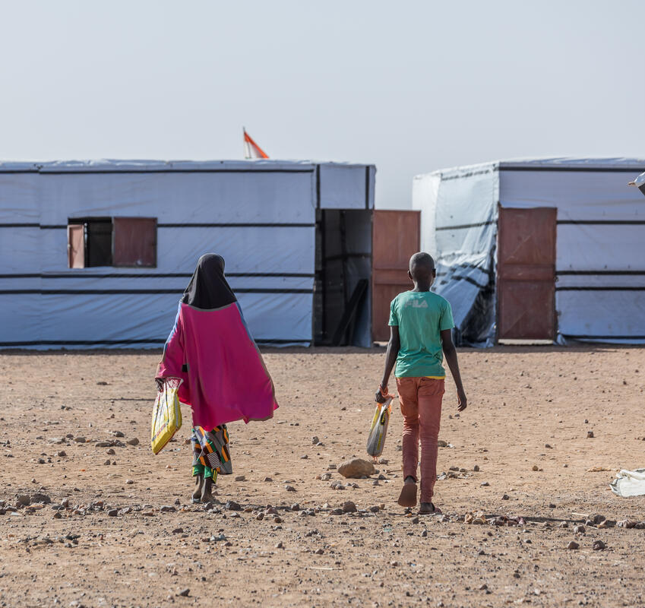
Safe and Ethical Child Participation
For consultations with children/ child participation processes to be safe and ethical, child safeguarding policies and procedures must be in place and followed by everyone involved.
This includes safeguarding policies that cover Protection from Sexual Exploitation and Abuse (PSEA).
Guiding principles:
Do No Harm: Organizations have a responsibility to Do No Harm to children.
Best interest of the child: All actions taken by organizations should be in the best interest of the child.
Zero tolerance: There is a zero-tolerance policy for child safeguarding violations. Child safeguarding is fundamental and non-negotiable.
Notes:
Add photo credit

Slide 13
Responding to safeguarding, protection, GBV, and PSEA incidents or disclosures
If a child shares a concern related to violence, including GBV, abuse, exploitation, or mistreatment, you must:
  Listen to the child and support them in a safe, ethical and non-judgmental way:
    Do not ask for details
    Do not investigate or assess
    Reassure the child: “You're not alone.” “You were brave to speak up.”
  Provide accurate information on available support services:
    Ask if the child wants to hear about support services
    Only refer the child with their consent/ assent.
  Use: LOOK – LISTEN – LINK
Notes:
Children and adolescents seek help in different ways than adults, and rarely make direct disclosures. Children may find it difficult to trust or talk to adults, especially adults they do not know well; experience fear, embarrassment or shame; or be afraid of expressing their emotions.
Adolescents aged 15 and over are generally mature enough to make their own decisions and understand what's happening to them.
Young children 6 to 9 years and young adolescents 10 to 14 years may or may not be able to self-report experiences of violence. They may or may not be able to make decisions on their own. So it's often necessary to identify a trusted adult who can help them with next steps.
Infants and toddlers 0 to 5 years will not self-report experiences of violence given their lack of or limited communication skills. Another individual –a friend, caregiver, family member, community member etc. – will likely seek help on the child’s behalf.

Slide 14
Survivor-centered approach to supporting children
RESPECT
Every action you take is guided by respect for the child's choices, wishes, rights and dignity.
SAFETY
Child safety is the number one priority.
Always consider whether your response might increase the child’s risk before acting.
Do not engage if your involvement may place the child or yourself in danger.
CONFIDENTIALITY
Do not share any information with anyone without the child's consent / assent*
*Except for cases of safeguarding and SEA, which must be reported. You must tell the child that you need to report these cases. You can say:
I will keep what you say private, but if you’re not safe or someone has hurt you, I may need to tell someone who can help.”
NON-DISCRIMINATION
Ensuring equal and fair treatment for everyone who needs support
Notes:
A survivor-centered approach aims to create a supportive environment in which a survivor feels treated with dignity and respect. To do this, we have 4 guiding principles.
Survivors have the right to choose what happens to them. The survivor-centered approach means doing what the survivor wants and needs, rather than basing it on our own opinion of what she wants and needs. This is an essential principle for ensuring a survivor’s safety, making them feel in control of their life, trusting you, and avoiding causing her further suffering. – Even for children???
Limits to confidentiality:
For safeguarding and SEA incidents, there is a mandatory reporting policy, disciplinary sanctions in the Code of Conduct including termination, prosecution and imprisonment. Mandatory reporting emphasizes the importance of justice - there may be an investigation, disciplinary sanctions, etc.
Mandatory reporting does go against the guiding principle of respect for the survivor's choices. Even if the child does not want you to report the incident, you have to. It is your responsibility to explain to the child why you have an obligation to report this incident and to whom/ through which channels. Emphasize that the report will be kept strictly confidential. However, if there is an investigation, some members of the community may find out who it is, so there are risks for the survivor. If the child doesn't want to tell you more for fear of reprisals, the child has the right to stop telling you what happened and not to give any more details. It will also be important to accompany, reassure and comfort the child, and to ensure that the child has access to adequate care and support services.

Slide 15
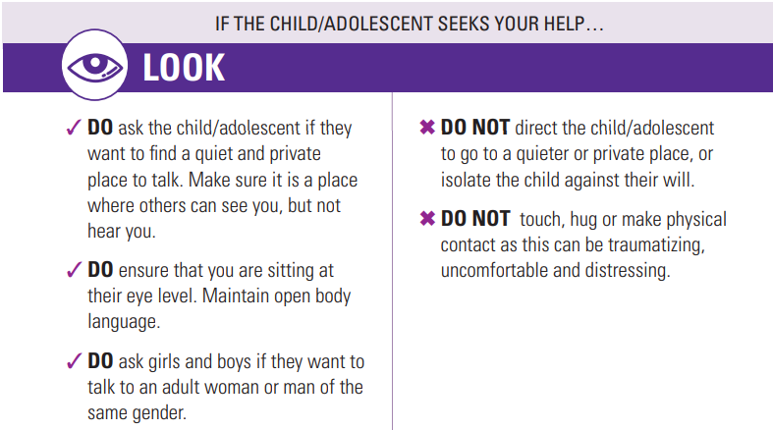
Notes:
Physical contact or holding a child is OK if she approaches you or if you ask her if you can hold her to comfort her and she says YES.

Slide 16
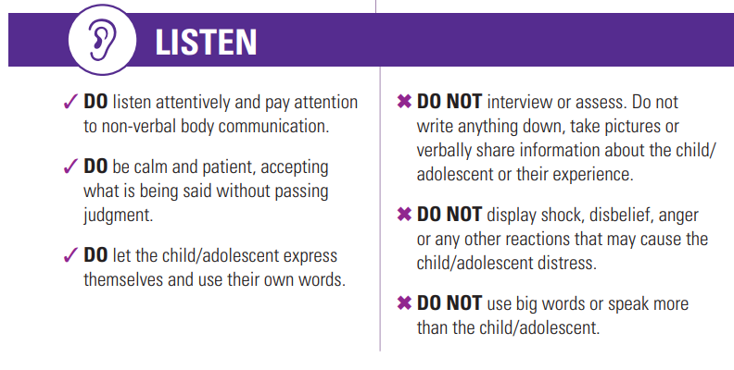
Notes:
Allow the child/adolescent to lead the conversation, even if this means providing company in silence. Be at eye level with open body language to show the child/adolescent that they can open up to you if s/he wants to. Refrain from asking questions about what happened, by who and why – instead use comforting statements and speak in a manner that they can understand.

Slide 17
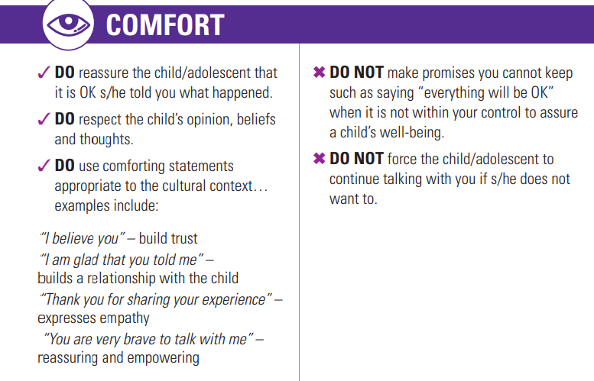

Slide 18
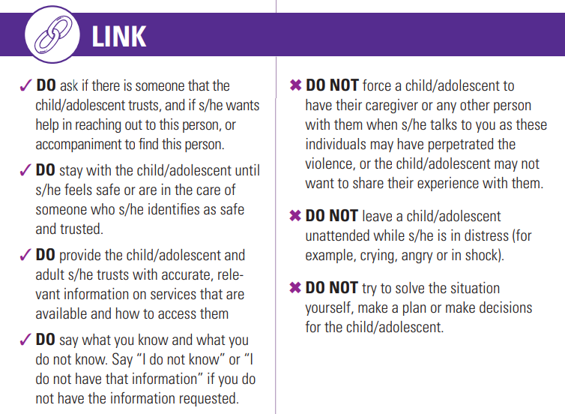
Notes:
Do not force the child or adolescent’s caregiver or any other person to be with them when s/he talks to you. They could be the perpetrator of the violence - it's up to the child or teenager to choose.

Slide 19
Protection and GBV referral pathways
**Include context-specific referral pathways here**
If no pathways are available, see next slide

Slide 20
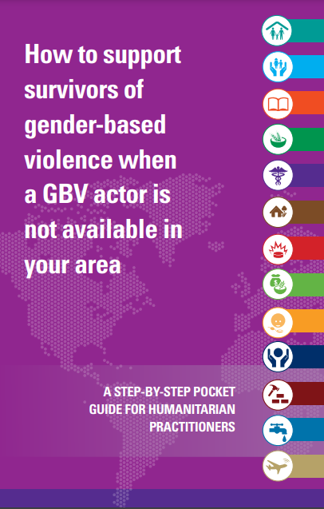
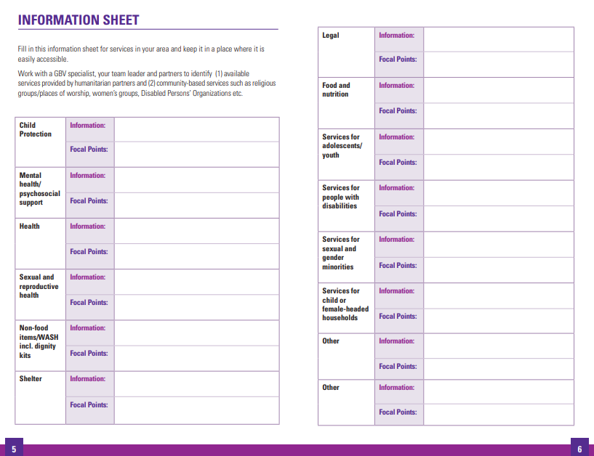
If there are no referral pathways available
Use the Pocket Guide fact sheet (pages 5-6) to gather information on available humanitarian and community services

Slide 21
Summary: Key Messages
"Hello, my name is [XX]. I work for organization [XX] and I'm part of the assessment team that wants to understand education and child protection needs in this area. I am not a counselor / social worker, but I’m here to listen to your concerns.”
"How can I help you?”
"Is there anything you need right now?"
“I know some people/organizations that may be able to provide some support to you and/or your family. Would you like to know about them?”
“You don't have to tell me about your experience in detail if you don't want to. I can give you information about services that exist here for incidents of violence like the one you experienced.”
"Is there someone you trust who can help you, like a family member or friend? Do you want to use my phone to call her and see if s/he can come over now?"
“When it comes to next steps, the most important thing is to focus on what you want to do and what makes you most comfortable. Do not feel pressure to make a decision now. You can take time to think it over and change your mind later. However, there are some medical services for certain incidents that must be received within 72 hours (3 days) to be effective."
Notes:
Reminders:
DO NOT proactively identify or seek out GBV survivors. Be available if a child or adolescent asks for your help.
In line with the "do no harm" principle, you must not actively seek to identify survivors of GBV during an assessment or consultation, or ask direct questions such as "have you ever been subjected to violence" or "do you know of anyone in your circle who has been subjected to violence?" Your job is not to research and assess whether a child/adolescent has experienced violence, including sexual violence, in their life, but to be available and willing to listen if someone chooses to disclose to you that they have suffered GBV.
If you are concerned about a survivor's well-being or whether she has received appropriate support, follow up directly with the service provider. Do NOT contact the survivor directly.
Cinical management of sexual violence, particularly rape, must be carried out within 72 hours to be effective! Clinical management of sexual violence includes PEP, emergency contraception and even the forensic examination for evidence collection, meaning collecting specimens and documenting injuries of the survivor, all of which could be used as forensic evidence in court, should she wish to take the perpetrator to court.

Slide 22
Your Role in Child Protection – Do’s and Don’ts
🟢 You ARE:
  A safe adult children can talk to
  A listener, not a judge
  A connector – someone who refers concerns to the right people
  Accountable to child safeguarding protocols
🔴 You are NOT:
  A counselor or therapist
  An investigator
  A case manager
  Someone who promises secret (safeguarding cases must be reported)
If you’re unsure what to do:
Pause and contact your Child Protection Focal Point or safeguarding lead.

Slide 23
What to Do If a Child Shares a Concern – Quick Decision Tree
1️⃣ Is there a child protection or safeguarding concern?
✔ Yes → continue
✖ No → thank the child, continue session respectfully
2️⃣ Is there a referral pathway available?
✔ Yes → Contact your Child Protection Focal Point
✖ No → Link the child to a trusted adult or available support service
3️⃣ Follow the PLLL approach:
Prepare: Know the CP focal point/referral process
Look: Watch for signs and signals
Listen: Let the child speak, don’t ask for details
Link: Refer to appropriate support
🚫 Do NOT investigate
🚫 Do NOT promise full confidentiality (what the child tells you is “private” but not “secret”)
✅ Do get consent before referring (unless it’s a mandatory safeguarding concern)

Slide 24
Reporting child safeguarding (including PSEA) concerns
* REMEMBER * What a child tells you should be kept confidential (between you and the child) except if it is a safeguarding or SEA concern/ incident. Those must be reported. In this case, you must:
  Tell the child that you need to report the incident
  Explain the channels through which you will report the incident
  Reassure the child that the report will remain confidential : “The report is confidential/ private, but not secret. I will only share it with someone who can help.”
Internal reporting protocol:
If the alleged perpetrator and person reporting are contracted by the same organisation:
  Report according to the organisation’s internal protocols
  If you do not know how to report child safeguarding concerns within your organisation, ask your safeguarding focal point or team lead/ manager for help.
External reporting protocol:
If the alleged perpetrator and the person reporting are contracted by different organisations:
  The person reporting should contact the child safeguarding point of the organisation of the alleged perpetrator immediately.
  The Education Cluster should have a list of child safeguarding focal points of all organisations taking part in the assessment. This should be shared with all enumerators.
Notes:
It is 100% mandatory to report any child safeguarding and PSEA concerns. Reporting child safeguarding allegations is a moral and legal obligation for all staff!

Slide 25
Enumerator Code of Conduct (CoC)
Signing a Code of Conduct (CoC) is one way of mitigating safeguarding and SEA risks
Remember that you are representing the Education Cluster and all EiE actors – not just yourself – when you are collecting data. Your conduct matters!
Everyone who facilitates consultations with children (or collects other data for an assessment) needs to sign
You can electronically sign the CoC here:
Electronic CoC

Slide 26
Principles of ethical conduct for enumerators / facilitators
Maintain personal and professional standards at all times:
  Respect the principles of child protection: Do No Harm and do not expose a child to the risk of violence, abuse, or insecurity
  Never try to create relationships with children (of any kind).
Informed consent must be obtained from parents and children (see next section)
Always create a supportive environment in all interactions, ensuring confidentiality and sensitivity.
"The two-adult rule": An adult interviewer must never be alone with one or more children, including when communicating online or remotely.
Never film or take selfies/videos/pictures or record children.
Never obtain children's contact numbers
Be identifiable - wear your organization's uniform and photo ID to avoid anonymity.
Remind children that they don't have to divulge their personal history or anything they don't want to reveal.

Slide 27

What is informed consent? Add your understanding to the chatbox

Slide 28
Informed consent/ assent for all children
Caregivers need to give consent for their children to participate, AND children need to give assent for their own participation
‘Informed consent’ means that children and caregivers need to fully understand:
    the purpose of the consultation
    what their own involvement would entail
    what the potential impact on their lives might be
    how the information they share will be used
    confidentiality and anonymity
    that consent is negotiable, and they can withdraw at any point with no consequences
    how they can reach your organisation if they need to later on
    that participation does not have implications on receiving humanitarian aid or assistance.
Children can only participate on a VOLUNTARY basis. No child can be forced to participate!

Slide 29
Obtaining informed consent/ assent
Caregiver consent:
  Caregivers need to provide written consent and sign the consent form (print these ahead of time)
    If a caregiver is unable to sign in person, consent can be given over the phone with another responsible adult present (such as a school leaders, teacher, etc.)
    For caregivers with low literacy levels, read them the form for sign off - they can use their fingerprint if they cannot write their name (if there in person)
  If it is impossible to get caregivers’ consent, written consent may be obtained from the school principal where the consultation is taking place. The principal needs to sign a consent form listing the names of all of the children participating.
Child assent:
  Before the consultation begins, children must give verbal assent to after you have explained the assessment, purpose, etc.
    There is a script which tells you exactly what to say – follow that
** If consent from both the child and the caregivers cannot be obtained, the child
cannot participate in the consultation.**
Notes:
An agreement has been reached on the best method (written/oral) to obtain and document informed consent from participants.
Explicit, verbal, informed consent is obtained from all children participating in consultations.
If consent from both the child and the parents cannot be obtained, the child cannot participate in the consultation.

Slide 30
How to plan a consultation with children
Location:
Safe
Accessible
Comfortable
Children know the place
Time:
Sessions are scheduled at a time and place convenient for all your children.
No conflict with school hours!
Duration: 1 hour and 15 minutes
Group size:
Small groups of 6 – 10 children
For younger children, up to 10 year-old, it is best to work with small groups of children.
Gender and age of children:
Girls and boys can be mixed or separated, based on local needs and culture.
If the groups are mixed, be sure to record the gender and age of the participant answering the question.
Groups by age: 3-5 years, 6-8 years, 9-11 years, 12-14 years, 15-17 years.

Slide 31
Do’s and Don’ts for Speaking with Children
DO | DON’T
Listen to children's opinions with respect, and value their contributions | Expose children to harm
Be polite, supporting, caring, and considerate to children | Humiliate, embarrass, or laugh at children, raise your voice or shout at children
Be culturally appropriate and sensitive, honest and open-minded | Discriminate against any child, direct or manipulate children
Listen actively. Give verbal cues to let the child know you're listening ("Ah" or "I see"). | Talk a lot
Be tolerant of diverse opinions | Expressing disagreement with what children say
Ensure confidentiality | Tell anyone what the children said during the consultations
Ask only one question at a time (it can be confusing to ask several questions at once) | Use complex or inappropriate language
Write down exactly what the children say | Interpret/ paraphrase what children say
Be prepared for things to go differently than planned | Panic
Know how to refer a child if they tell you they need assistance | Ask personal questions to investigate if a child is a victim of violence
Know how to report any safeguarding/ SEA issues that arise during the assessment | Ignore or minimize safeguarding/ SEA concerns: you have a moral and legal obligation to report, even if concerns seem minor.
Notes:
SEE ATTACHED SUMMARY DESCRIPTION OF “HOW TO BE A GOOD FACILITATOR OF CHILD-FRIENDLY ACTIVITIES” FOR EACH OF THE 9 PRINCIPLES OF MEANINGFUL AND SAFE CHILD PARTICIPATION. Tips in this document go beyond speaking with children and also provide some guidance on how to be a good facilitator of a focus group discussion for example.
Also, see attached document “Tool 23 - Best Practices in Communicating with Children” by Plan International.
Also, see attached document “Effective Facilitation in a nut-shell”.

Slide 32
Reminders when speaking with children
Be warm, friendly, and open
Give time after asking a question
Encourage those to speak less to speak
  If they still don’t want to speak, don’t pressure them
Do not physically touch children – in case misinterpreted
Notify the safeguarding focal point if an issue arises or if children share a safeguarding issue
Keep what children tell you confidential – especially if you personally know the children or their caregivers
Do not talk too much!! Let children speak.
Be neutral
Use non-verbal body language to show children that you are listening and that you care (head nod, eye contact, etc.)
Set ground rules for the session and intervene if children bully each other, ex:
  We don’t laugh at what anyone says
  We respect the opinions of others
  We are kind, etc.
Notes:
"2-ADULTS" RULE: an adult interviewer should NEVER be alone with a child(ren), including when communicating online/remotely.
All facilitators understand that they need to remind children that they don't have to divulge their personal stories or anything they don't want to.
Facilitators know that they should wear their organization's uniform and photo ID to avoid anonymity
Protocols are in place to ensure that no photograph, video or image or recording of a child is taken/shared without their consent.

Slide 33
DEMO: Consultations with Children
We will model the consultation together!
Link to Canva: https://www.canva.com/design/DAGqQA2So_I/jHy3HsH50bUHQ3IyWjluIQ/edit?utm_content=DAGqQA2So_I&utm_campaign=designshare&utm_medium=link2&utm_source=sharebutton

Slide 34
Quality Note-taking
Role of the note-taker is very important, quality note-taking is the difference between high quality or poor quality data for the assessment - and usable data for advocacy purposes!
There must be dedicated note-taker during the assessment
This person should not require translation and should understand the language the children are speaking
Notes should carefully follow the template, you can add more than what is requested but not less
Notes must be submitted in English to the Assessment team (you can make your own copy originally in another language, but you must submit English version to us)
Be sure to collect some DIRECT QUOTES from children, this means copying exactly what they say, not a summary!
Be sure your notes are legible (easy for someone else to read), as the assessment leads need to be able to read it easily - keep this in mind!
Once finalized, a scanned copy of the notes must be emailed/ sent (use one of the free scanning app to do this, do NOT just send a picture) - to Ameha/ Assessment leads
Notes should NOT include names of anyone EXCEPT facilitator and note-taker - no names of children should be included / it is fully anonymous

Slide 35
Digitizing Notes
To conduct analysis on the data, the hand-written notes must be digitized
Will be using KOBO to digitize the notes
it allows for offline Data collection - mobile and web forms
How to use
  Download the Kobocollect app or use the web link below
    https://ee.kobotoolbox.org/x/Zi9e8hJe
  Fill out the data based on the shared data collection tool
  Save and Finalize in the end
Role as data collect
  Accurately record responses
  Ensure forms are finalized and uploaded promptly
  Protect respondent privacy - no names of children included in any forms / notes
Digitizing Notes - send notes on awoldeamanuel@unicef.org in jpg, pdf or doc format AFTER scanning using apps (e.g. scan genius)

Slide 36
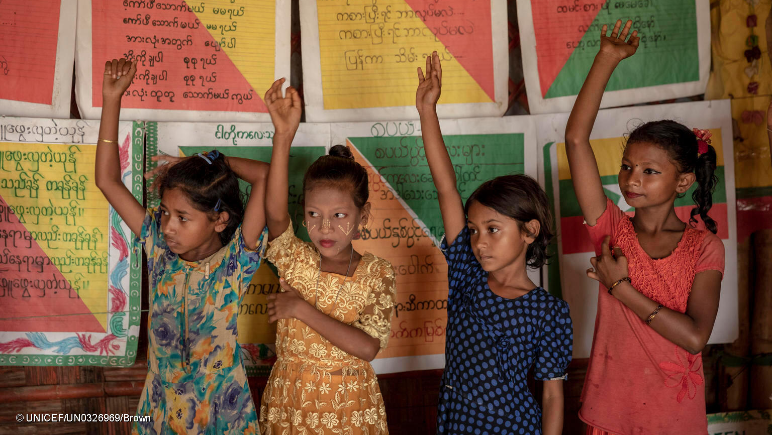
Key resources
Children's participation in joint needs assessments
Child protection in joint needs assessments
Save the Children guide: Consulting children in humanitarian contexts
Checklist for safe and inclusive child participation

Slide 37
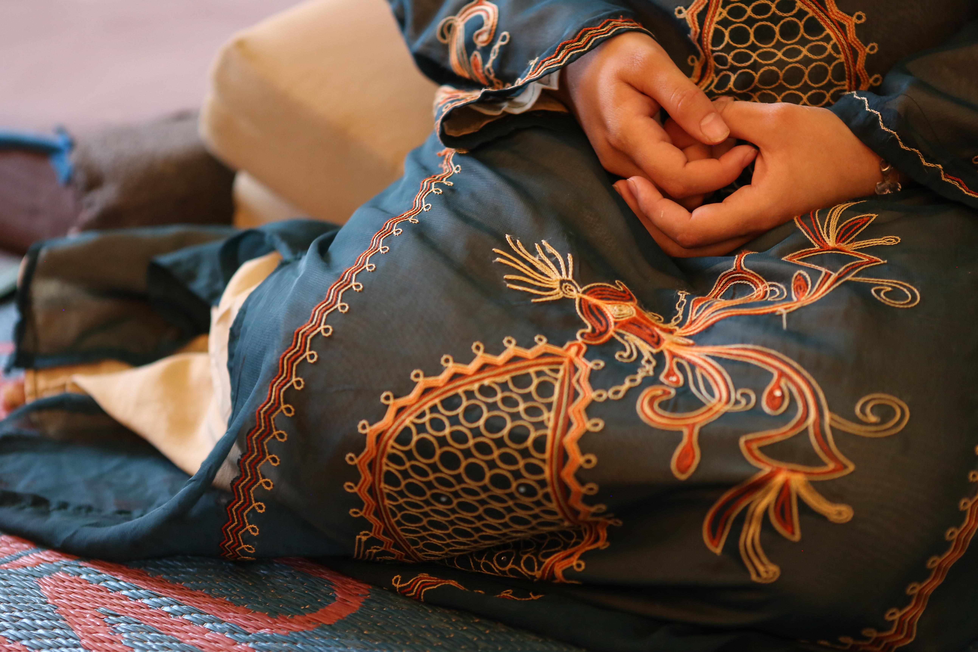

How to respond to a GBV disclosure during a needs assessment?

Slide 38
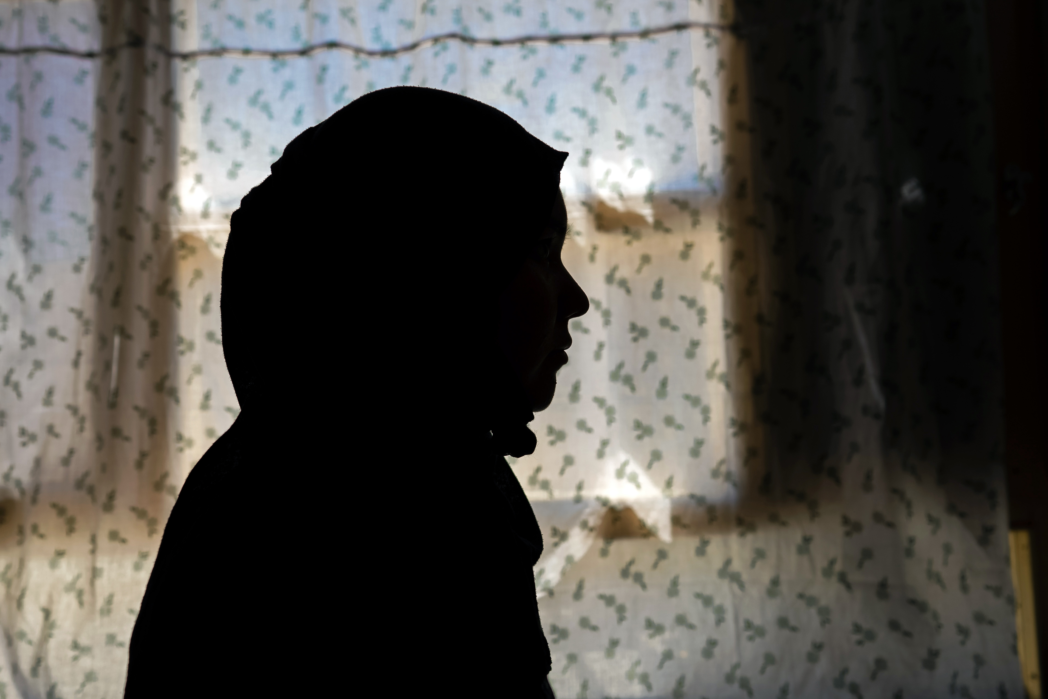
What is GBV?
Any harmful act perpetrated against a person's will, which inflicts physical, sexual, socio-economic and psychological suffering, and which is based on socially ascribed (gender) differences between women and men.
Violence against women and girls because they are women and girls
Examples of GBV incidents
Rape
Sexual harassment
Female Genital Mutilation
Sexual Exploitation and Abuse (SEA)
Examples of GBV incidents
Child marriage
Intimate Partner Violence
Denial of girls' right to education
Trafficking or forced prostitution
Notes:
Gender-based violence (GBV) is one of the most frequent human rights violations in the world, but also one of the least visible. It can take many forms: from domestic and intimate partner violence to child marriage, female genital mutilation and the denial of the right to education.

Slide 39


The role of assessment teams in the event of a GBV disclosure
If a survivor discloses an incident of sexual violence or other GBV to you:
Know how to support and listen to survivors in a safe, ethical and non-judgmental way
Provide accurate information on available services, if any, and know how to safely refer survivors with their informed consent / assent
Referral pathway to GBV response services

Slide 40
Survivor-centered approach
RESPECT
Every action you take is guided by respect for the survivor's choices, wishes, rights and dignity.
SAFETY
Survivor safety is
priority number one
CONFIDENTIALITY
Do not share any information with anyone without the survivor's consent / assent
NON-DISCRIMINATION
Ensuring equal and fair treatment for everyone who needs support
Notes:
A survivor-centered approach aims to create a supportive environment in which a survivor feels treated with dignity and respect.
To implement a survivor-centered approach, we have 4 guiding principles to respect: RESPECT SECURITY CONFIDENTIALITY AND NON-DISCRIMINATION
Survivors have the right to choose what happens to them. Don't think you know better than they do what's right for them. The survivor-centered approach means doing what the survivor wants and needs, rather than basing it on our own opinion of what she wants and needs. This is an essential principle for ensuring her safety, making her feel in control of her life, trusting you, and avoiding causing her further suffering.
People have the right to choose who they do or don't want to tell their story to.

Slide 41
PREPARE
LOOK
LISTEN
LINK

Slide 42

TO PREPARE
Consult women and girls to identify common links and risks of GBV specific to the education sector
Use the Pocket Guide fact sheet (pages 5-6) to gather information on available humanitarian and community services.
Notes:
In many contexts, link between early and forced marriages and pregnancies and girls dropping out of school. Cases of SEA by teaching staff. Etc

Slide 43
Notes:
You can print out this information sheet before going out into the field and fill it in with your colleagues, who will surely know what services are available in their area. It is very important to meet with the GBV AoR and with others such as the child protection AoR and the health cluster, in order to have a complete list of available services. The GBV AoR may have an existing and updated GBV service mapping and referral pathway with all the relevant service providers' contacts, and the contact of the "entry point" person whom the assessment team should contact first in the event of a GBV disclosure during the assessment. Even in the absence of a GBV actor and/or a GBV referral pathway) in your area, there may be other services that could be useful to a survivor, for example, primary health services, mental health services, child protection, general protection, etc.

Slide 44







    IN THE EVENT OF A DISCLOSURE
Introduce yourself
Address urgent basic needs
Provide comfort and information
Recognize what you can and cannot manage

Slide 45
Key messages
"Hello, my name is [Marie]. I work for organization X and I'm part of the assessment team that wants to understand education and child protection needs in this area. I am not a counselor / social worker, but I’m here to listen to your concerns, and I know some people/organizations that may be able to provide some support to you and/or your family. Would you like to know about them?
"Do you feel comfortable here? Is there anywhere else you'd feel better?"
"Would you like a glass of water? You can sit here if you like."
"How can I help you?"
"Is there anything you need immediately?"
"Everything we talk about will remain between us. I won't repeat anything to anyone without your permission."
"You can tell me anything you want. You don't have to tell me about your experience in detail if you don't want to. I can give you information about the help services that exist here for incidents of violence like the one you experienced."

Slide 46
Key messages
“Here are the details of the service including the location, times that the service is open, the cost (if applicable), transport options and the person’s name for who you can talk to [or the trusted adult he or she has chosen to accompany them]."
"Is there someone you trust who can help you, like a family member or friend? Do you want to use my phone to call her and see if s/he can come over now?"
« When it comes to next steps, the most important thing is to focus on what you want to do and what makes you most comfortable. Do not feel pressure to make a decision now. You can take time to think it over and change your mind later. However, there are some medical services for certain incidents that must be received within 72 hours (3 days) to be effective."
Notes:
Think that clinical management of sexual violence, particularly rape, must be carried out within 72 hours to be effective! Clinical management of sexual violence includes PEP, emergency contraception and even the forensic examination for evidence collection, meaning collecting specimens and documenting injuries of the survivor, all of which could be used as forensic evidence in court, should she wish to take the perpetrator to court.

Slide 47
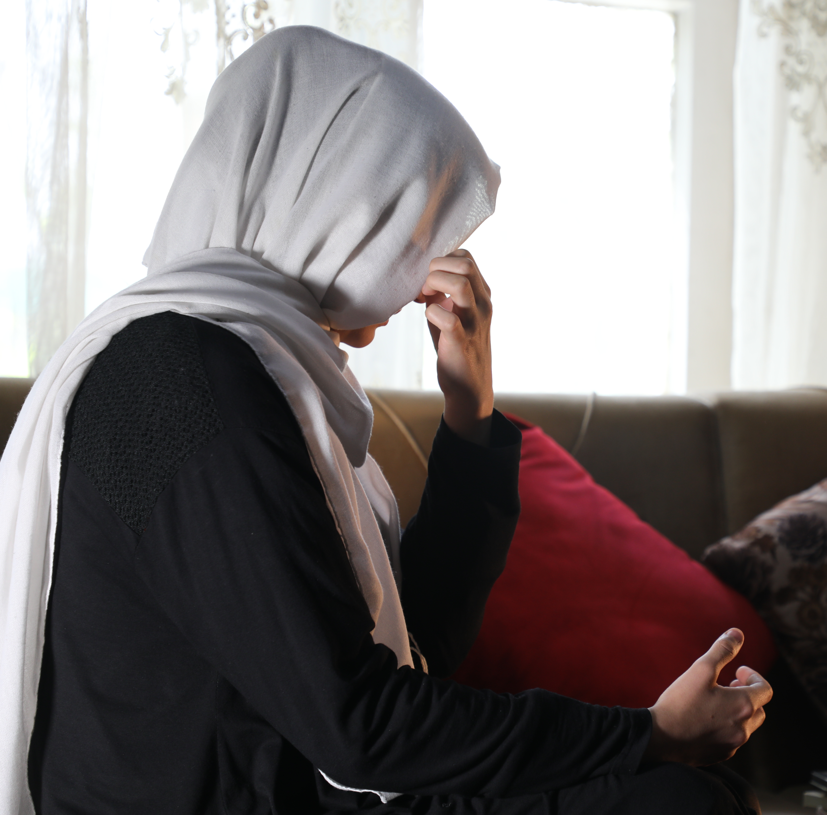
Key messages
"I'm sorry about what happened to you."
"You're very brave to talk with me."
"What happened
wasn't your fault."
"You're not alone."

Slide 48
Notes:
Physical contact or holding a child is OK if she approaches you or if you ask her if you can hold her to comfort her and she says YES.

Slide 52
The role of assessment teams in the event of a GBV disclosure
As a non-specialist in GBV, your role is to
listen to and comfort the child or adolescent
link them to someone that they trust
share information on available services.
Your main role is to provide information on how to access to available services. If no services are available, it's important to be honest with the survivor.

Slide 53

IN BRIEF - KEY ACTIONS FOR YOU
Always talk to a GBV and/or CP specialist first to understand 1) what GBV services are available in your area and 2) referral pathways and standard operating procedures/protocols for referrals of child and adolescent survivors.

Slide 54
IN BRIEF - KEY ACTIONS FOR YOU
DO NOT proactively identify or seek out GBV survivors. Be available if a child or adolescent asks for your help.
Support the child or adolescent who asks for your help:
  Offer attentive, non-judgmental listening.
  Provide comfort.
  Provide information on available services.
  Support the child or adolescent to find an adult they trust to support them with next steps Don't make any decisions for him or her.
Notes:
In line with the "do no harm" principle, you must not actively seek to identify survivors of GBV during the survey or the FGD, or ask direct questions such as "have you ever been subjected to violence" or "do you know of anyone in your circle who has been subjected to violence?" Your job is not to research and assess whether a child/adolescent has experienced violence, including sexual violence, in their life, but to be available and willing to listen if someone chooses to disclose to you that they have suffered GBV.
Allow the child/adolescent to lead the conversation, even if this means providing company in silence. Be at eye level with open body language to show the child/adolescent that they can open up to you if s/he wants to. Refrain from asking questions about what happened, by who and why – instead use
comforting statements and speak in a manner that they can understand. Do not force the child or adolescent’s caregiver or any other person to be with them
when s/he talks to you. They could be the perpetrator of the violence - it's up to the child or teenager to choose.

Slide 55
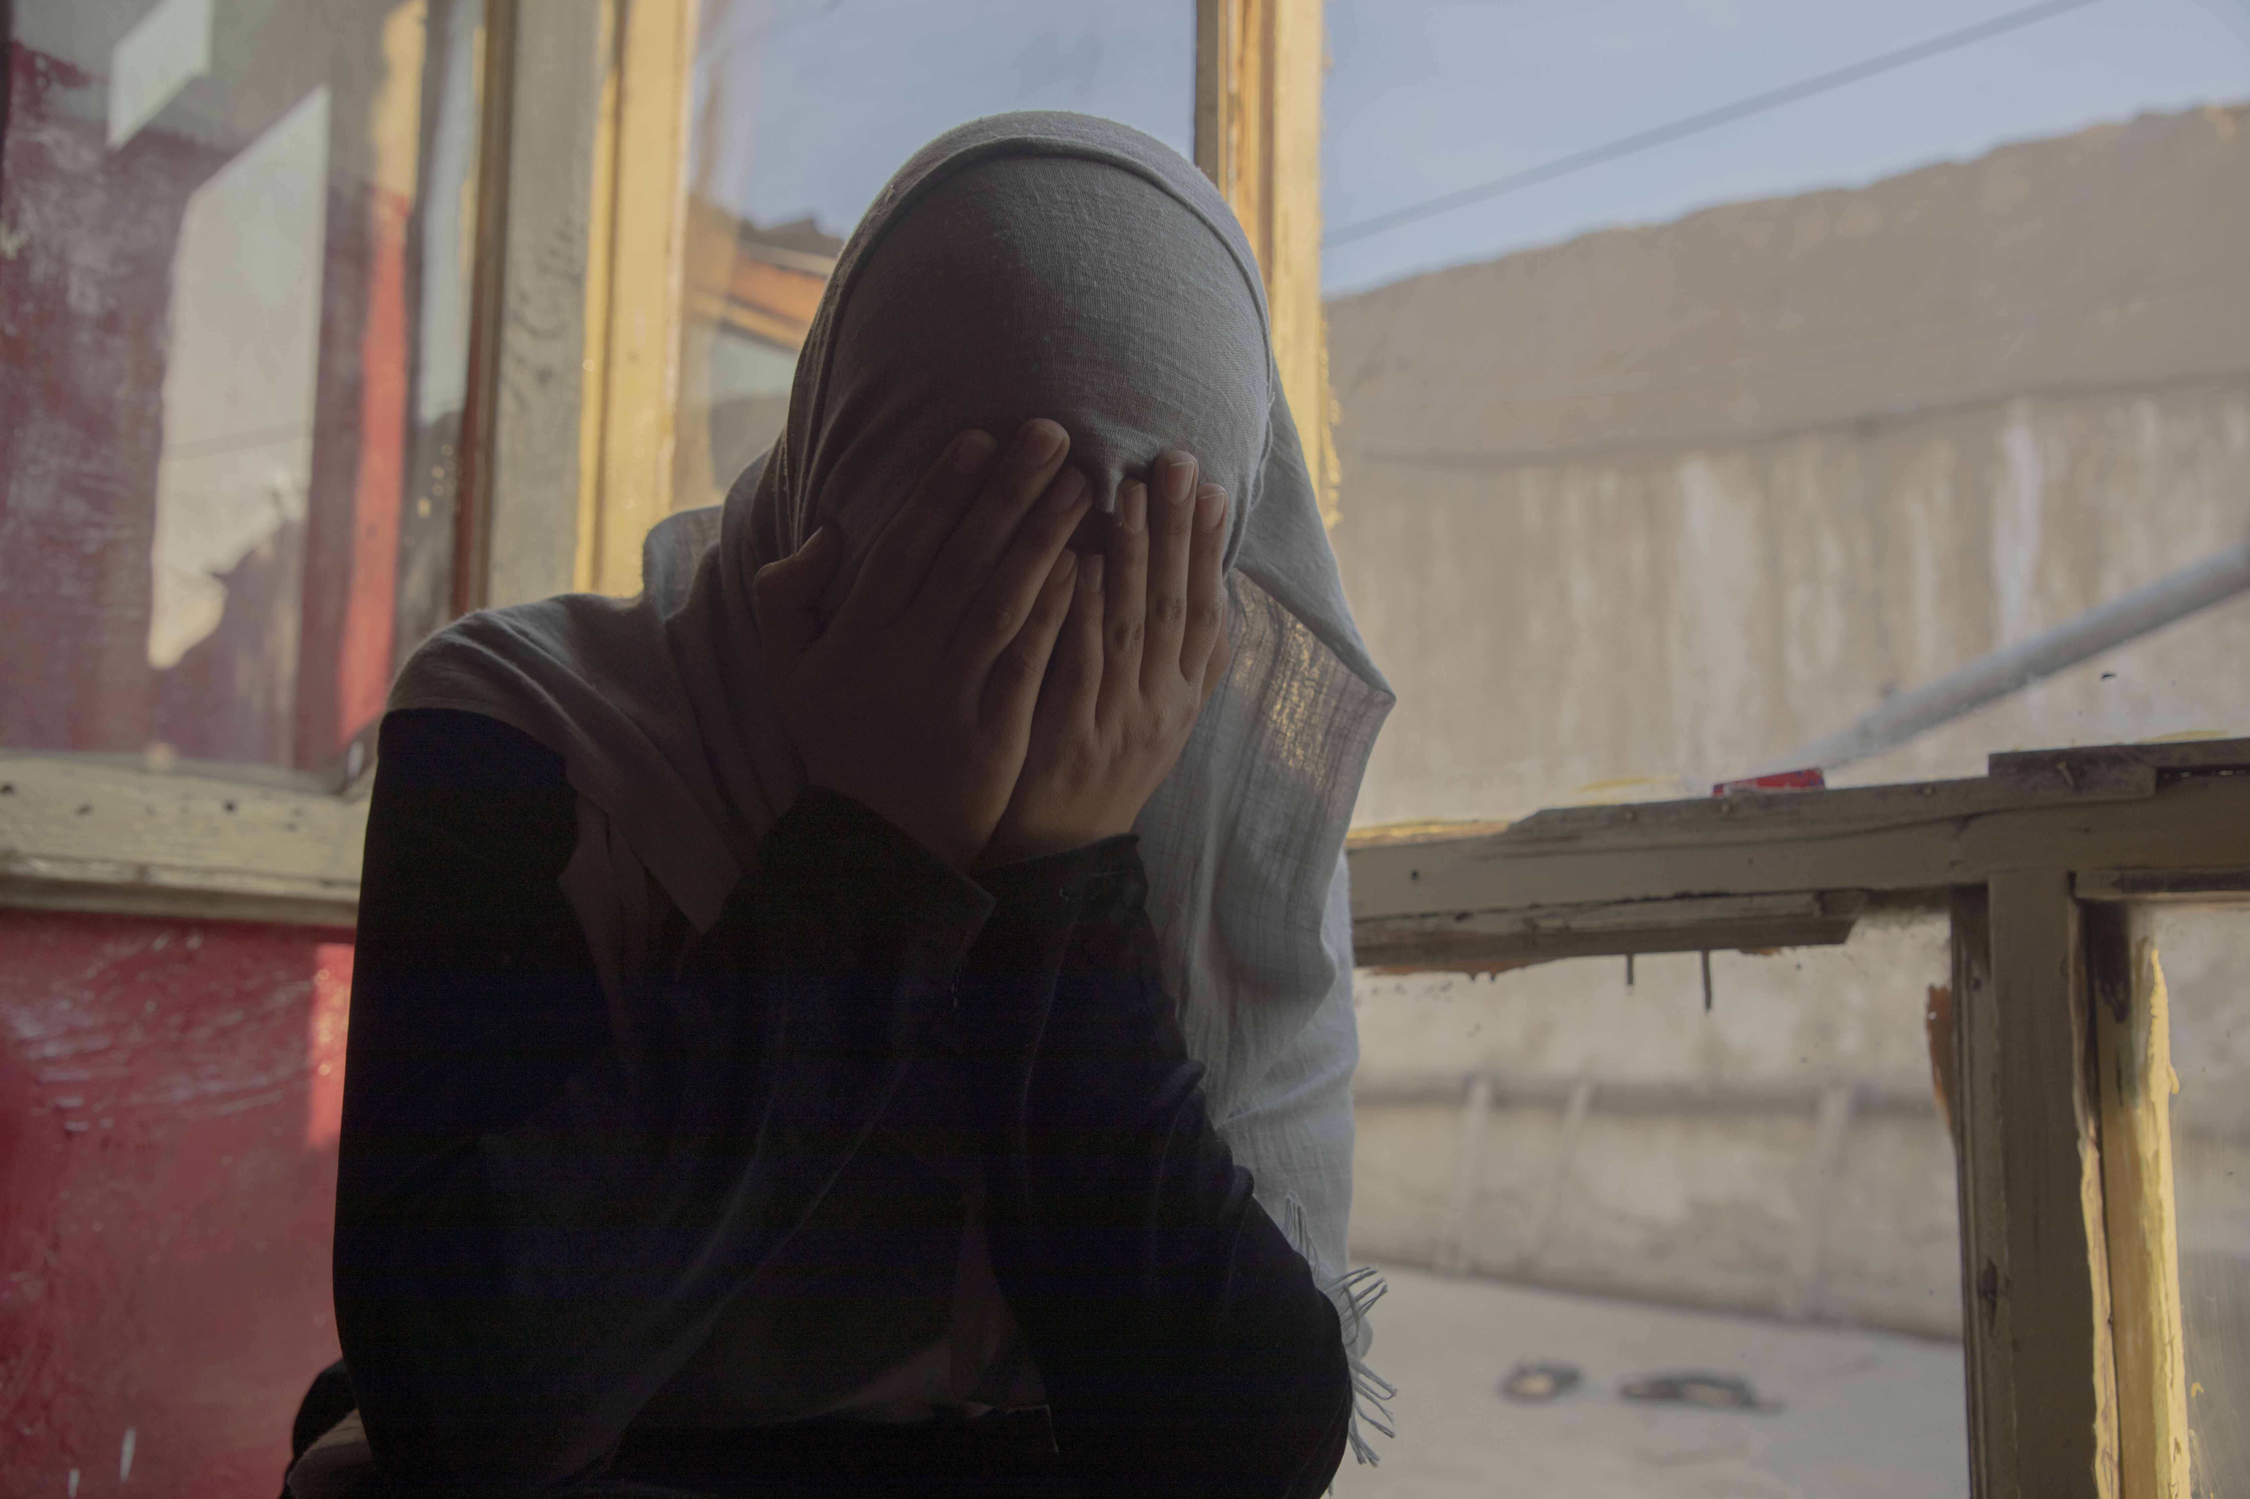
Be aware of how a child or adolescent or their caregiver may seek support.
An adult key informant may tell you about rumors, suspicions based on signs or behaviors from the child or reports they have received from someone else.
Notes:
Children and adolescents seek help in different ways than adults, and rarely make direct disclosures. Children may find it difficult to trust or talk to adults, especially adults they do not know well; experience fear, embarrassment or shame; or be afraid of expressing their emotions.
Adolescents aged 15 and over are generally mature enough to make their own decisions and understand what's happening to them.
Young children 6 to 9 years and young adolescents 10 to 14 years may or may not be able to self-report experiences of violence. They may or may not be able to make decisions on their own. So it's often necessary to identify a trusted adult who can help them with next steps.
Infants and toddlers 0 to 5 years will not self-report experiences of violence given their lack of or limited communication skills. Another individual –a friend, caregiver, family member, community member etc. – will likely seek help on the child’s behalf.

Slide 56
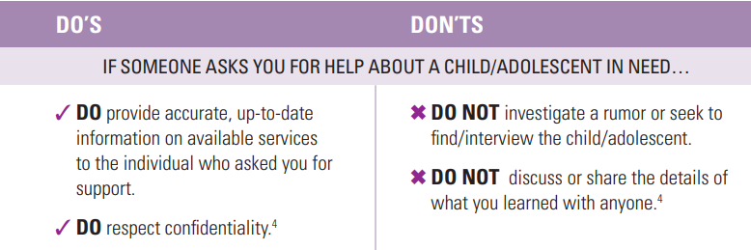
Notes:
During the assessment, you may (1) hear rumors of child abuse, (2) be approached by adults seeking help for a child, or (3) suspect child abuse based on signs or behavior observed in a child. Here are some do's and don'ts.

Slide 57
Reminder: SEA is GBV
Forced sexual intercourse is rape. Rape by a teacher in exchange for an educational favor is a form of Sexual Exploitation and Abuse (SEA), and therefore GBV.
There is a mandatory reporting policy, disciplinary sanctions in the Code of Conduct including termination, prosecution and imprisonment. The child or adolescent survivor is under the legal age of consent and/or felt coerced or manipulated by an adult male who had authority over her and whom she may have trusted, and was unable to refuse.
Notes:
You must understand the laws and policies regarding mandatory reporting for SEA - to be looked into in detail in the Child safeguarding module.
I just want to mention that mandatory reporting emphasizes the importance of justice - there may be an investigation, disciplinary sanctions, etc. But mandatory reporting also goes against the guiding principle of respect for the survivor's choices - she is being forced to disclose the incident of GBV she suffered without being asked her opinion, and above all without her having chosen to reveal it, or when, and to whom. It will therefore be important to accompany, reassure and comfort her, and to ensure that she has access to adequate care and support services after you have reported the incident. It will also be your responsibility to explain to her why you have an obligation to report this incident through the interagency or your own organization’s PSEA reporting channels, but that the report will be kept strictly confidential. However, if there is an investigation, some members of the community may find out who it is, so there are risks for the survivor. If she doesn't want to tell you more for fear of reprisals, she has the right to stop telling you what happened and not to give any more details.
For additional responsibilities that arise when the perpetrator is an aid worker or associated with humanitarian aid, contact your PSEA Focal Point or in-country PSEA network.

Slide 58
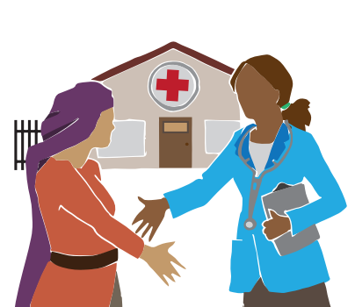
Taking care of the survivor and yourself
It's important to remember that you can do whatever it takes, but you're not going to fix that person's experience or make their pain go away.
If you are concerned about a survivor's well-being or whether she has received appropriate support, follow up directly with the service provider. Do NOT contact the survivor directly.
Notes:
Remember that the service provider also has a confidentiality policy and won't be able to tell you anything about the case in question, but may be able to reassure you that the person has been taken care of and is receiving the support they need.

Slide 59
A few tips for taking care of yourself...
Reach out to your own support system and network, including your colleagues, team leader or a GBV specialist, to debrief on the exchange
Think about how to take care of yourself when these feelings come up.
Recognize the limits of your role
Notes:
Some situations require more specialized support beyond your role, such as situations involving children, mandatory reporting,3 imminent danger of a survivor, or where the survivor may be of harm to themselves or to others. There may be other focal points with the capacity to better support in this scenario.
Listening to other people's experiences can expose you to their pain, suffering or trauma. There are some things that can help you deal with the feelings that arise after hearing a traumatic and painful story.
Remember that you should only communicate general, non-identifiable information about the situation and nothing about the survivor.

