Slide 1
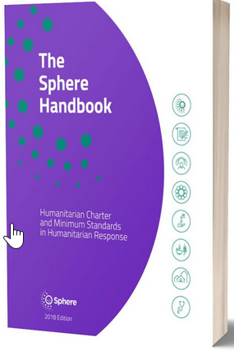
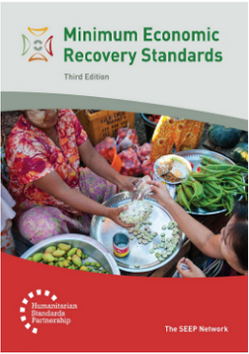
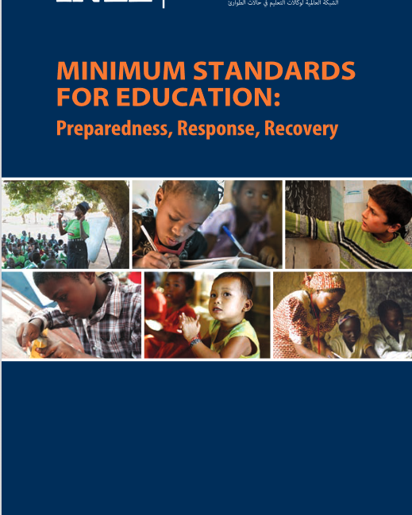
Pillar 4 – to work across sectors
Interconnected needs of children
Collective responsibility to protect
= Centrality of Protection
Higher-quality impacts
Key actions for:
child protection workers
other sectoral workers
Notes:
[FACILITATORS: This might be very familiar for your audience or something quite new, so please prepare your comments accordingly.]
Child protection risks are closely linked with the work of other sectors because children have needs that fall under all sectors. Multisectoral approaches reflect the interconnected needs of children and emphasise all humanitarian actors’ collective responsibility to protect children and their families.
Increasingly complex emergencies pose new risks to the well-being of affected children. These risks emphasise the need to place protection at the centre of all humanitarian response = protection is the purpose and intended outcome of humanitarian action and must be at the centre of all preparedness and response actions
Multisectoral programming that includes and addresses child protection considerations (such as children’s particular risks, vulnerabilities, developmental stages, etc.) contributes to higher-quality impacts. This improves the outcomes of other sectors, promotes positive outcomes for children and ensures their well-being.
These standards provide:
Suggested key actions for child protection and other sectoral workers related to mainstreaming and integration
They do not, however, provide sector-specific guidance for each humanitarian sector. This can be found in the relevant standards for each sector such as the Minimum Economic Recovery Standards (MERS), the Minimum Standards for Education (INEE) and the Sphere Standards. The two (or more) sets of standards should always be used in conjunction.
Discussion prompt: Can anyone name standards under Pillar 4?

Slide 2
Pillar 4 - Approaches
Approach | Implications | Aim | Considerations
Mainstreaming | Sector-specific: actions taken within a specific sector | To promote a safe, dignified and protective environment and to improve the impact the whole response by applying do no harm and proactively reducing risks and harm. | * Apply and contextualise key actions in the CPMS
Integrated Programming | Favouring collective over sector-specific planning, implementation, monitoring and evaluation. A holistic understanding of child well-being is the starting point for action, with sectoral specialties being used to meet that goal. | To achieve collective outcomes for children through deliberate, joint assessment, goal setting, planning, implementation and monitoring across sectors. | * Similar to joint-programming, but greater levels of coordination and collaboration required
Joint Programming | Sectors maintain their own sector’s objectives while jointly planning and implementing certain aspects of their programmes. | To achieve a protection outcome alongside outcomes for other sectors while optimising resources, access, operational capacity, etc. | * Some Joint planning needed + predictable coordination between CP/ other sector + training + SOPs
Notes:
Three approaches:
Protection mainstreaming
Integrated approaches
Joint programming
‘Protection mainstreaming’ is the process of:
Incorporating core humanitarian protection principles by promoting safety, dignity and access for all affected persons; and
Ensuring accountability to, and the participation and empowerment of, affected populations.
When using child protection considerations to inform all aspects of humanitarian action, it maximises the protective impact of all humanitarian assistance without contributing to or perpetuating risks to children. Protection mainstreaming is critical and is part of following the do no harm principle that applies to all humanitarian action.
Protection mainstreaming is applicable and essential to all programmes regardless of the intended outcome.
An ‘integrated approach’ allows two or more sectors to work together to achieve a shared programme outcome(s). It is based on existing capacities and joint needs identification and analysis. It involves deliberately designing and implementing programmes with child protection and one or more other sectors to:
Prevent abuse, neglect, exploitation and violence against children;
Ensure quality services;
Promote children’s development, rights and well-being; and
Build on the cooperation, outcomes and impacts of other sectors.
It promotes beneficial processes and outcomes for all sectors involved. When child protection is included in the integrated approach, it increases opportunities for better child protection outcomes.
Joint programming and integrated programming take place on a continuum of varied levels of integration for situation analysis, programme design and implementation.

Slide 3
Pillar 4: Common Actions for All Sectors
Integrate child protection questions into sectoral and multi-sectoral assessments
Strengthen capacities of sectoral actors to
identify and refer children at risk,
support children in distress, and
prevent harm to children in their programming
Strengthen joint information-sharing and monitoring mechanisms
Coordinate opportunities for community dialogue and messaging
Strengthen child participation throughout the programme cycle
Notes:
This slide is a summary of key actions that are included across all sectors. These are the minimum baseline.

Slide 4
Pillar 4 – description of the Standards
St. 21: Food Sec & CP
Integrated approach to promote well-being and protection
Coordination and complementarity
St. 22: Livelihood & CP
Reduction in the use of risky or harmful coping mechanisms
St. 23: Education & CP
Participatory, inclusive, positive discipline and gender-sensitive approaches
Safe & inclusive environnements
Notes:
READ OUT
[Below the key points of each standard. Depending on your public, their specific area of interest, your programming priorities, your context or the time you have to facilitate, you may want select only one or two keys standard under each pillar]
Standard 21: Food security & Child Protection
Food insecurity increases child protection risks and the possibility of choosing negative coping strategies such as neglect, child marriage and child labour. Child protection can be integrated within each of the four food security pillars – availability, accessibility, stability and utilisation – in order to support children’s well-being and protection.
This standard outlines a systematic, integrated approach between the food security and child protection sectors that is based on coordination and complementarity.
Icon: Many linkages w/ Safeguarding: safeguarding principles to all forms of assistance; training on safeguarding procedures, codes of conducts and protection from sexual exploitation and abuse (PSEA) policies; joint, child-friendly, accessible and confidential feedback and reporting mechanisms for child protection concerns as part of Accountability to Affected Populations (AAP). [→ the safeguarding icon]
Standard 22: Livelihoods & Child Protection
‘livelihood’ = capabilities, assets, opportunities and activities to be able to make a living
When a family’s capacity to provide adequate food, shelter, education and care is reduced, children can be at risk of all forms of child protection concerns. Economic recovery and livelihoods interventions can have then a significant protective impact on children: the likelihood that the household will make choices that are harmful to children when trying to meet their food needs is reduced when incomes are stable.
Icon: focus on targeting economic recovery and livelihoods interventions appropriately at caregivers and older children of working age [→ the Adolescent icon] . We have to think about the traditional stereotypes, obstacles related to gender or cultural norms around appropriate work for genders or groups (and their links with economic dependence on others, exclusion from formal jobs, exploitative, informal work environments & abusive relationships…)
Standard 23: Education & & Child Protection
A lack of access to education has direct negative impacts on children’s well-being and development. Children who are out of school can face greater child protection risks. Child protection concerns can prevent children from accessing education or can decrease educational outcomes. Both education and child protection actors target children in and/or out of formal education/schools, so most activities are conducted jointly
This standard outlines how education and child protection actors can work together more systematically, based on complementarity, to support children’s well-being. Appropriate approaches (like participatory, inclusive, positive discipline and gender-sensitive approaches) should align with both child protection and education minimum standards and be adapted in-country.
Learning centers should aim at meeting ‘Safety criteria’, that should be determined in-country and could include: safe and secure infrastructure, location cleared of explosive ordnance (EO), appropriate facilities, sufficient space, accessibility (both in and around the learning centre), and inclusive environments (in terms of location, gender, language, race, religion, learning environment).
For in-depth education guidance, refer to the INEE Minimum Standards.
All key actions in this standard apply to both sectors’ actors.
[Facilitators – if you have a few minutes, try to inject some fun into the session! It helps the participants feel more comfortable with the handbook itself. You may not have time for all of the activities suggested into this presentation]
Discussion Prompt: → Discuss the linkages between Education & Prevention / Safeguarding/Adolescence/Refugee & Infectious Disease Outbreaks contexts, by seeking the icons in St 23 in the handbook

Slide 5
Pillar 4 – description of the Standards
St. 24: Health & CP
Characteristic of integrated approach
Identification
Child Friendly services
St. 25: Nutrition & CP
Population & vulnerability
Opportunities:
Referrals
CP focal points
Multi-use spaces …
Notes:
READ OUT
[Below, key points from each standard. Depending on your public, their specific area of interest, your programming priorities, your context or the time you have to facilitate, you may want select only one or two keys standard under each pillar]
Standard 24: Health & Child Protection
Supporting children’s health increases children’s protective factors, while supporting children’s protection can, and should, improve children’s physical health and well-being. An integrated approach to health and child protection should be : Safe; Protective; Inclusive; Systematic; Complementary; Valid for all sectors; and Participatory
Healthcare workers should be trained on identification of children affected by abuse, neglect, exploitation or violence (including physical, psychological and emotional signs of them).
It is important to implement accessible, trauma-sensitive and child-friendly procedures, services and communication when admitting, treating and discharging children
Icons:
An integrated approach to health and child protection should include a coordination systems to allow referral mechanisms, safe and confidential protocols and information sharing between the two sectors [→ the case management icon]
Many linkages w/prevention, by including concerns, principles and approaches so actors can correctly prevent, identify, and/or mitigate child protection cases, and avoid family separation during referrals and admissions.
This standard is also especially relevant in Infectious Disease Outbreaks!
Standard 25: Nutrition & Child Protection
Nutritional imbalances often worsen in times of crisis when caregivers struggle to provide food, income and health care for their families. Family separation may become more likely. Children or caregivers may leave to find paid work, including hazardous labour, may drop out of school and lose peer support. Families may place their children in residential care so that their children can access food.
Nutrition and CP target similar groups that are especially vulnerable: Child-headed households; Children without parental care or separated from their families; Pregnant and lactating mothers under the age of 18 year; s Children with disabilities; Children showing signs of physical, sexual abuse; Children showing signs of mental distress; Children under the care of a parent/guardian experiencing mental distress; Children under the care of a parent/guardian unable to care for them etc
[→ the Adolescent / Infant icon] show linkage in programming, i.e: infant and young child feeding (IYCF) support; breastfeeding classes and peer support groups for pregnant adolescents
There are many opportunities to integrate approaches, including:
Joint case management;
Referrals of children in need of services to health facilities and nutritional feeding centres
Holistic support for accessible services;
Encouragement for appropriate care and nurturing;
CP Focal points in supplementary or therapeutic feeding centres
Joint programmes with therapeutic, supplementary or blanket feeding and positive parenting; and
Multi-use spaces that meet both sectors’ needs.

Slide 6
Pillar 4 – description of the Standards
St. 26: WASH & CP
WASH practices, services, facilities & interventions, adapted to the needs of children
St. 27 : Shelter & CP
Safety, well-being & privacy criterias into shelter and settlement interventions
St. 28 : CCCM & CP
Access to life-saving assistance and protection services
Child participation
Safety and security incident monitoring & referrals
Safe living environments = dignity, security and livelihoods
Appropriate shelter = safety, protection and accessibility
Notes:
READ OUT
[Below, key points from each standard. Depending on your public, their specific area of interest, your programming priorities, your context or the time you have to facilitate, you may want select only one or two keys standard under each pillar]
Standard 26: WASH & Child Protection
Child protection staff should guide and advise water, sanitation and hygiene (WASH) staff so they are able to deliver safe and appropriate WASH practices, services, that are adapted to the needs of children. I.e: accessible and child-friendly WASH facilities. For this, child safety and well-being has to be reflected in the initial risk analysis, design, and monitoring and evaluation framework.
Icons: all WASH workers (including subcontractors’ staff) and child protection staff should be trained on and sign safeguarding policies and procedures. Samewise, the way WASH programmes are designed, planed and implemented have a great prevention potential, i.e: prioritisation criteria, support & refer households/children at risk, safe, accessible, inclusive facilities…
Standard 27: Shelter and settlement & Child Protection
Child protection must be integrated into shelter and settlement interventions, from design to monitoring and evaluation, especially to take into account :
Family size, unity and composition
Children at risk, like children living alone or in new or altered family units
Accessibility for children with disabilities & barriers to access essential services
Protection risks & social norms
Local land and property rights to decide on where, how and to whom shelter is provided
Need for adequate indoor and outdoor play spaces, materials and shelter units to help reducing CP risks
Safety & privacy criterias
Shelter programming has direct direct protection outcomes :
- Providing safe living environments (wider locations where people and communities live) allow people to live with dignity, security and livelihoods
- Providing appropriate shelter (household living space) promote safety, protection and accessibility. I.e: privacy for adolescent girls, addressing physical dangers and safe routes for accessing schools [→ the adolescent and prevention icons]
Standard 28: CCCM & Child Protection
Main goal of camp management is to support equitable and dignified access of refugee, internally displaced and migrant populations living in temporary settlements (including camps, collective/evacuation centres and spontaneous settlements) to life-saving assistance and protection services. All children have the right to access educational facilities, health care, psychosocial services, recreational opportunities and religious activities that meet their individual needs.
Child protection and camp management actors need to collaborate to ensure children’s meaningful participation, in the design, monitoring and adjustment of programmes and in representation mechanisms in the camp management structures
Camp management should monitor & refer security concerns and safety incidents (sexual and gender-based violence, abductions, physical attacks, child labour and other dangers - explosive ordnance, drowning or fire, poor
lighting or secluded wáter points/latrines that result in incidents of
sexual violence), and organize risk mitigation activities accordingly (i.e appropriate lighting, patrolling firewood collection routes, monitoring school routes, marking areas contaminated by explosive ordnance or fencing off areas with open water) [→ the prevention icon]

