Slide 1
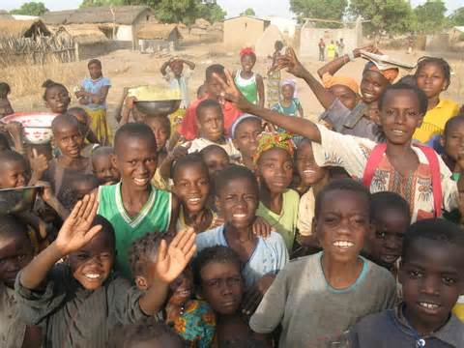
Exploring Beliefs and Values about Girl and Boy Children

Slide 2
Write the first thing that comes to your mind. No over thinking – it is not a test and there are no right answers!
Individually complete the sentences on the handout.

Slide 3
FRAGMENTATION
Definition: Fragmentation
“Simultaneously living with contradictory or conflicting beliefs between an organisation and/or culture and the potential effects to mental health and program delivery.
When a person must adhere to the rules and guiding legislation of the organization that employs them (or at least present as if they believe in those rules), while simultaneously holding beliefs generated by the culture, religion or norms of the society in which they were raised that may be in contradiction to the organization’s beliefs.”

Slide 4
Helpful and Challenging Beliefs
What beliefs are helpful to Child Protection practices (and CPMS)?
What beliefs are challenging to Child Protection practices (and CPMS)?

Slide 5


